Slide 1







Technology for Data Analytics
Haizhen Huang
5/26/2022

Slide 2



OUTLINE
Executive Summary
Introduction
Methodology
Results
Visualization – Charts
Dashboard
Discussion
Findings & Implications
Conclusion
Appendix

Slide 3

EXECUTIVE SUMMARY
Research on currently popularly technology for developers
Top 10 Programming Language
Top 10 Database
Top 10 Platform
Top 10 Web Frame
Research on next year popularly technology for developers
Top 10 desire Programming Language
Top 10 desire Database
Top 10 desire Platform
Top 10 desire Web Frame
Demographics of developers

Slide 4

INTRODUCTION
Analyze the current technology usage in
Programming Language
Databases
Computer Platforms
Web Frames
Identify the trend of the most desired learning technology for next year
Provide a recommendation on technology learning to be more competitive in the job market

Slide 5

METHODOLOGY
Stack Overflow Developer Survey 2019 data
Survey data technologies normalized
Survey data demographics
Use different plots to illustrate the insight from data
Bar charts, Columns charts, Word cloud Charts, bubble charts, tree maps and heat maps to list the technologies and compare their popularity.
Pie charts, World map, line charts, stacked column charts to demonstrate the demographics for the developers

Slide 6
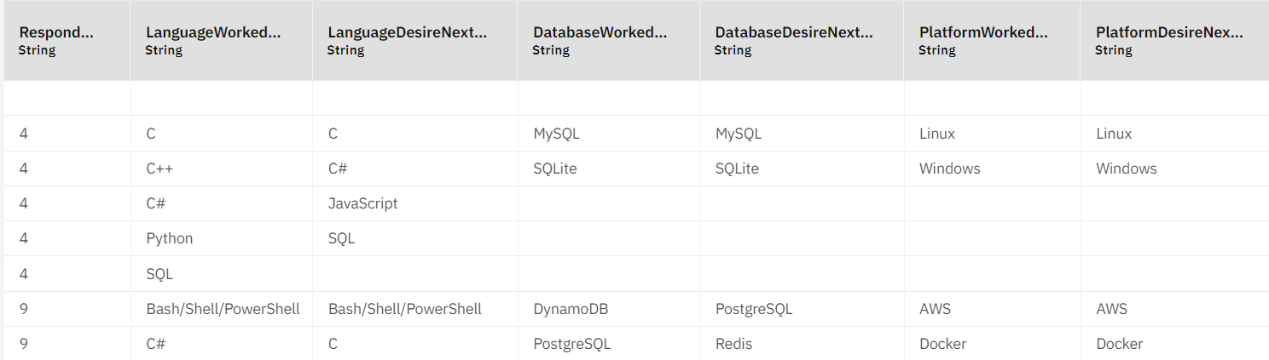
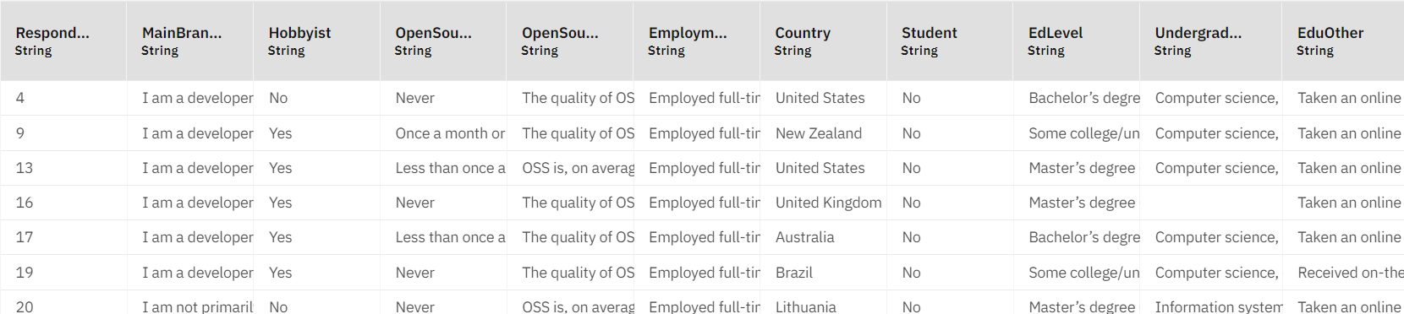
RESULTS
Both datasets organized by Respondent columns as primary key
Other columns are represented each survey questions and survey answers
Blank cells are indicated the survey questions didn’t answer.
Plots will exclude blank values

Slide 7
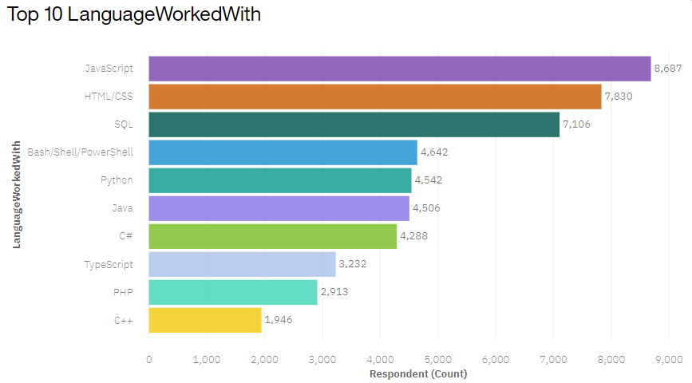
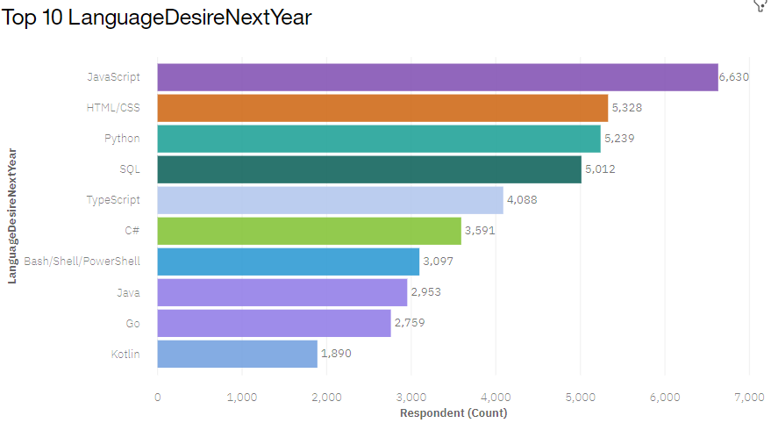
PROGRAMMING LANGUAGE TRENDS
Current Year
Next Year

Slide 8
PROGRAMMING LANGUAGE TRENDS - FINDINGS & IMPLICATIONS
Findings
JavaScript is the top 1 on both currently and next year Language bar charts
HTML/CSS is the 2nd place on both charts
SQL is ranked as 3rd on currently Language, and 4th on next year Language bar chart
Implications
The top 3 most recommended programming languages to learn are:
JavaScript
HTML/CSS
SQL

Slide 9
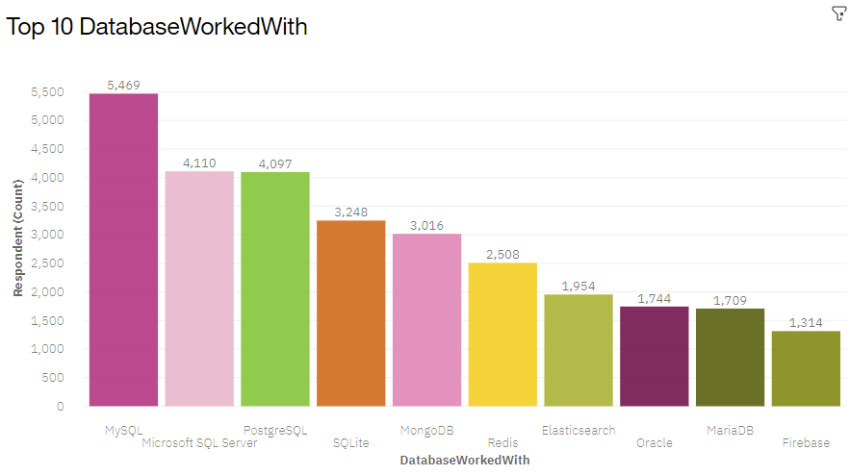
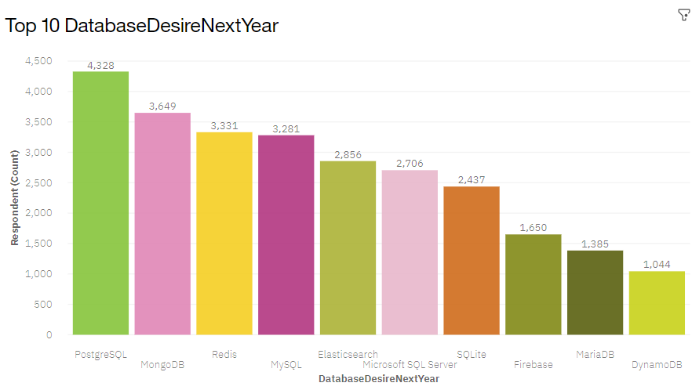
DATABASE TRENDS
Current Year
Next Year

Slide 10
DATABASE TRENDS - FINDINGS & IMPLICATIONS
Findings
MySQL is the 1st place on current Database Work With column chart
PostgreSQL is the 1st place on Database Desire Next Year column chart
MongoDB is the 5th place on current Database Work With, and 2nd place on Database Desire Next Year
Implications
The top 3 most recommended Database to learn are:
MySQL
PostgreSQL
MongoDB

Slide 11

DASHBOARD
The link of dashboard:
https://dataplatform.cloud.ibm.com/dashboards/60533bf9-a1ff-48e3-952e-fb1e2ee6ec8f/view/197be40e028235c267f1e6e4079d78022c65225fbbbbd75283877b4909337897f0601795c826490fdd445065a2b8105ace

Slide 12
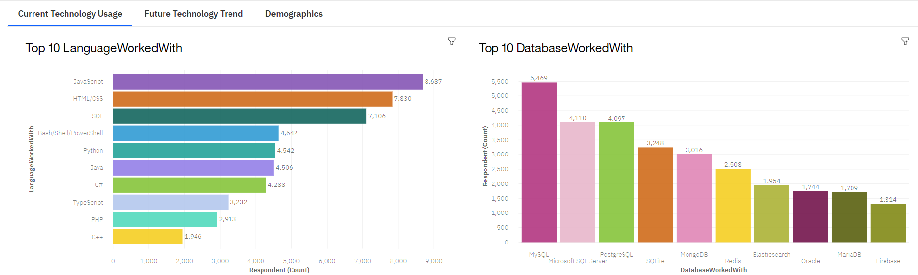
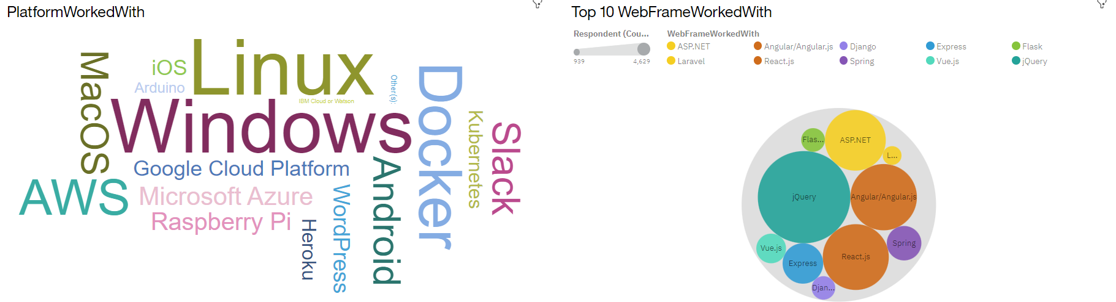
DASHBOARD TAB 1

Slide 13
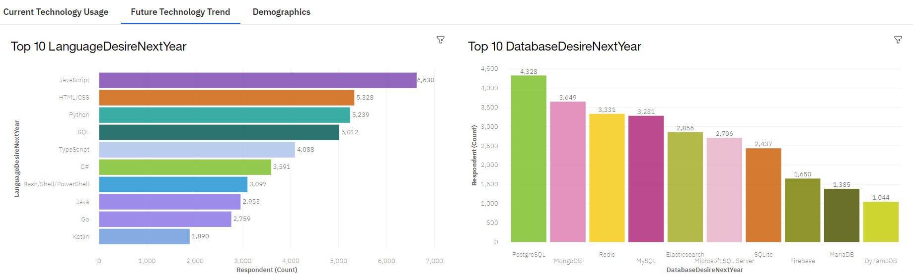
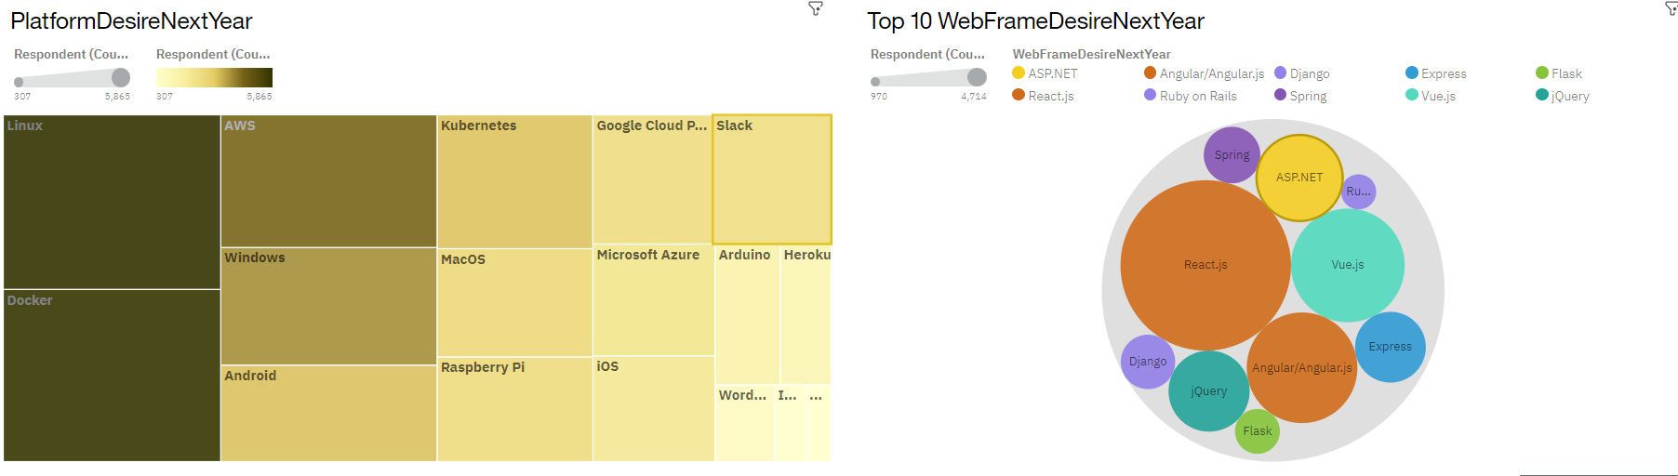
DASHBOARD TAB 2

Slide 14
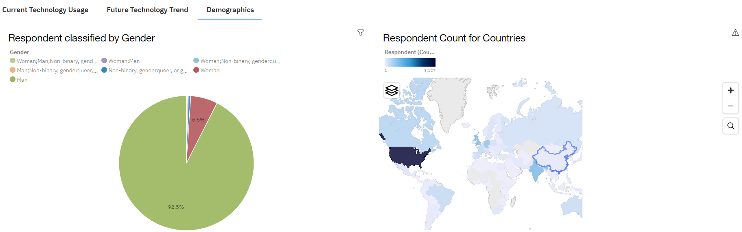
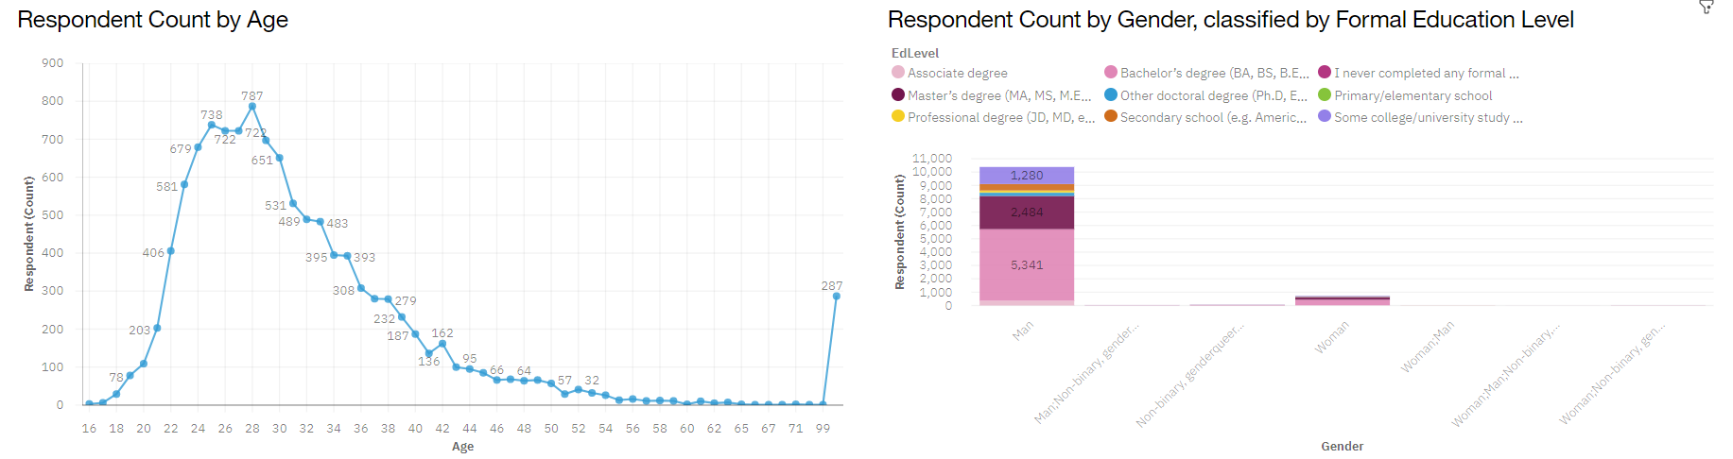
DASHBOARD TAB 3

Slide 15
DISCUSSION
The graphs display top 10 popularly Programming Languages and Database
The popularity trends between Current Technology Usage and Future Technology Trend did not have that much changes.
The rankings are similar.

Slide 16
OVERALL FINDINGS & IMPLICATIONS
Findings
JavaScript, HTML/CSS, Python and SQL are the most popular Programming Languages for developers
MySQL, PostgreSQL, MongoDB, and Microsoft SQL Server are the most popular Database for developers
Implications
Recommended to learn at least one of the programming languages from the list
Recommended to learn at least one of the databases from the list

Slide 17

CONCLUSION
Identified the most recommended Programing Language for developers to learn:
JavaScript, HTML/CSS, Python and SQL
Identified the most recommended Databases for developers to learn:
MySQL, PostgreSQL, MongoDB, and Microsoft SQL

Slide 18

APPENDIX
Demographics of developers

Slide 19
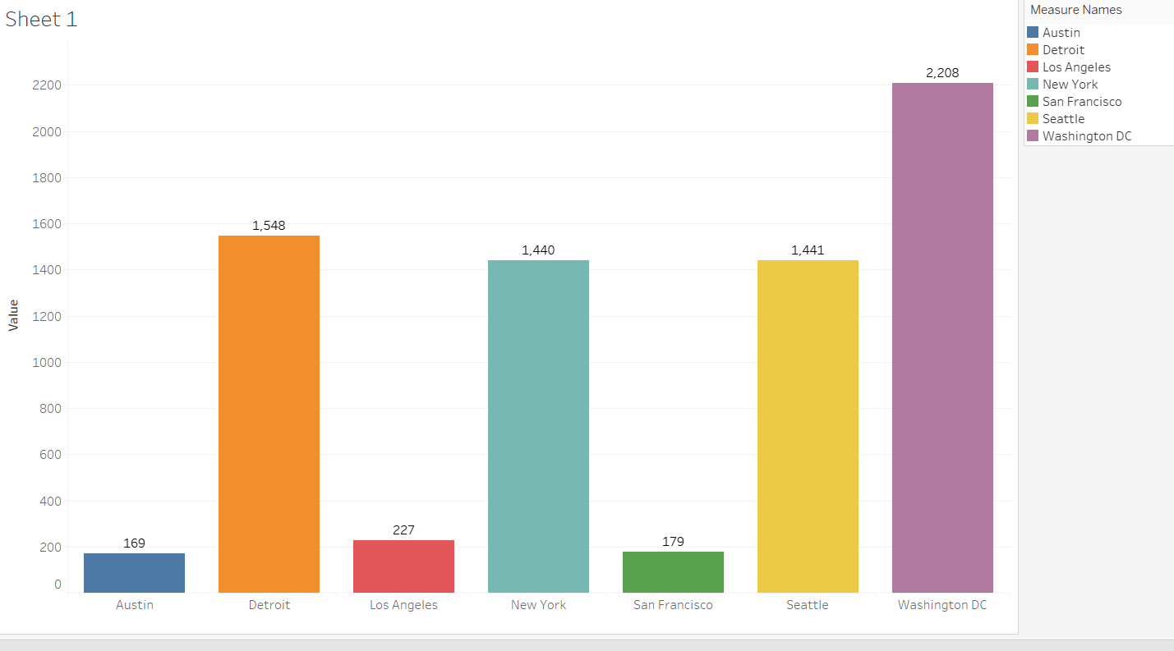
GITHUB JOB POSTINGS

Slide 20
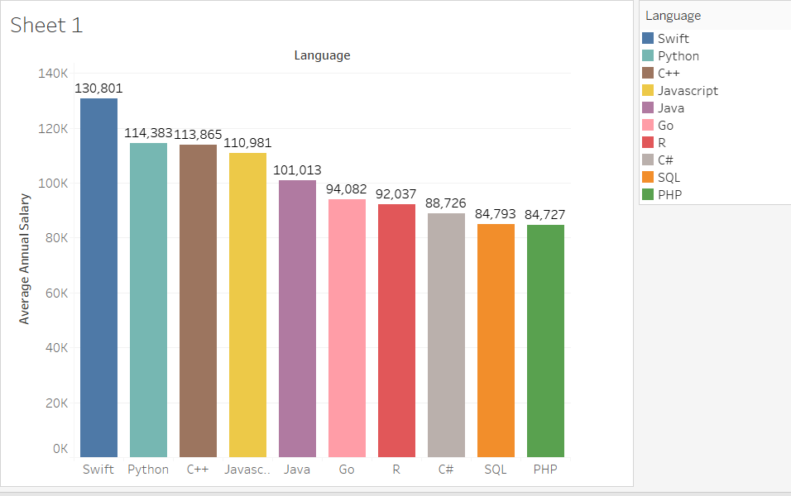
POPULAR LANGUAGES

