Slide 1

Bear Rides
Andrew Scouten
Asher Snavely
Xiangan Wan (Roy)
Yunzhe Liu (Josh)

Slide 2
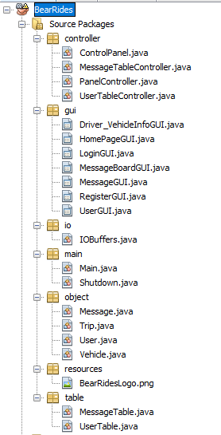
Implementation
GUI – Controller – Panel Manager - Database

Slide 3


Testing

Slide 4
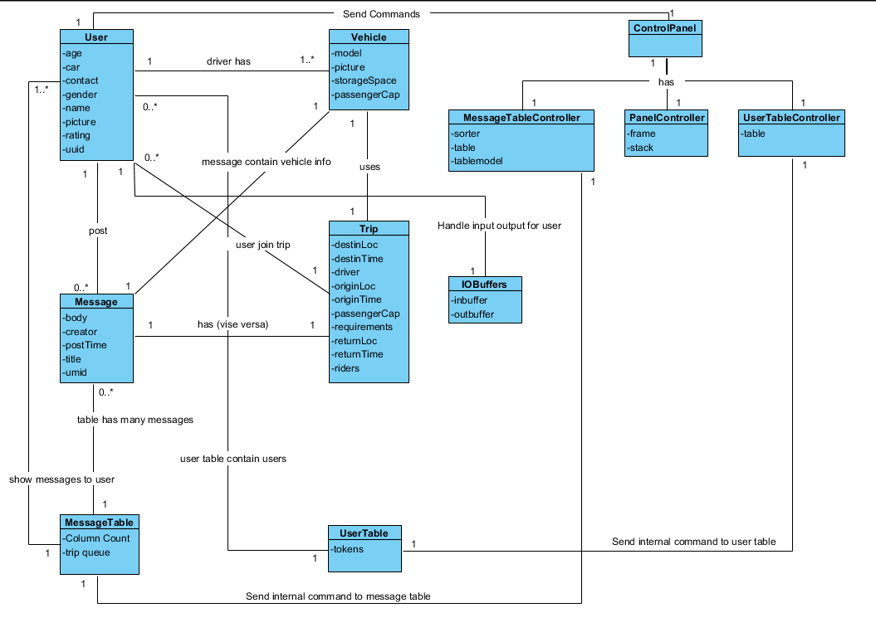
Domain Model V2.0

Slide 5
Class Diagram V2.0

Slide 6
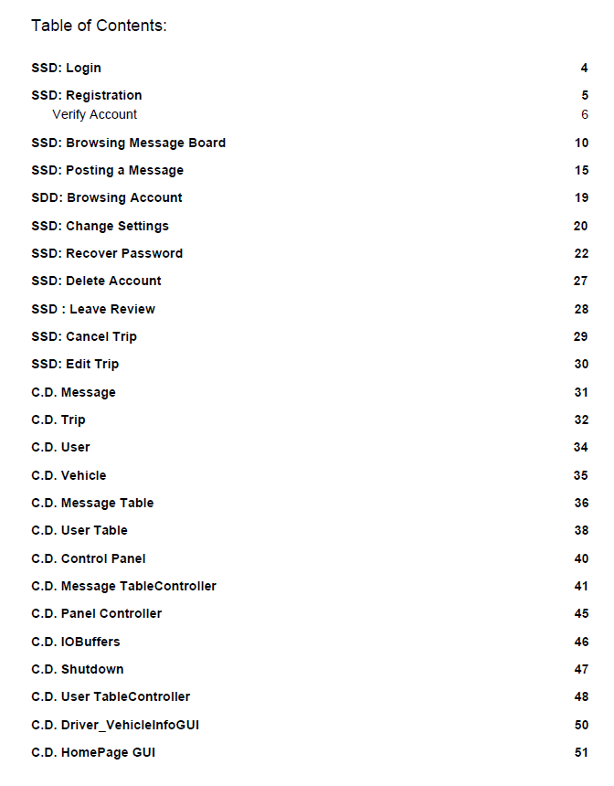
Operations V2.0

Slide 7
Use Cases, Use Case Diagrams, Requirements, and SSD
Nothing really changed…

Slide 8
BearRides

Slide 9
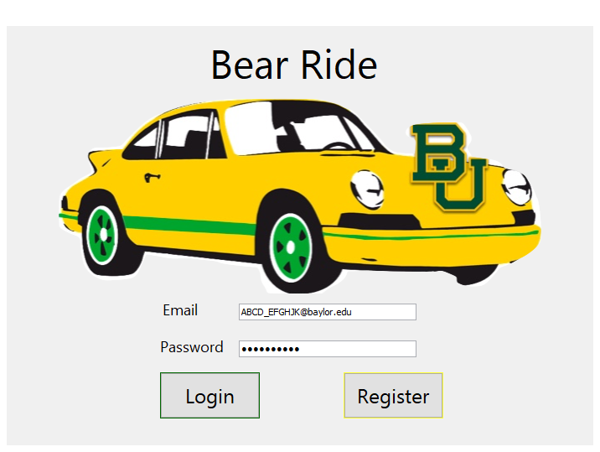
Login Page Demo

Slide 10
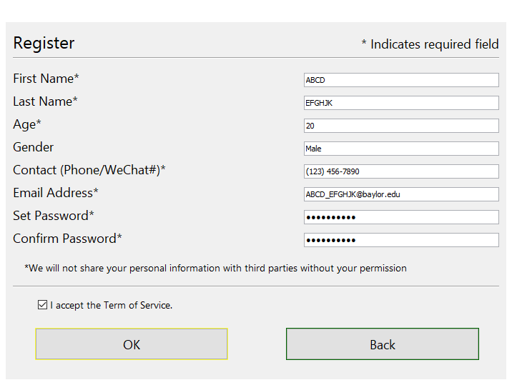
Register Page Demo

Slide 11
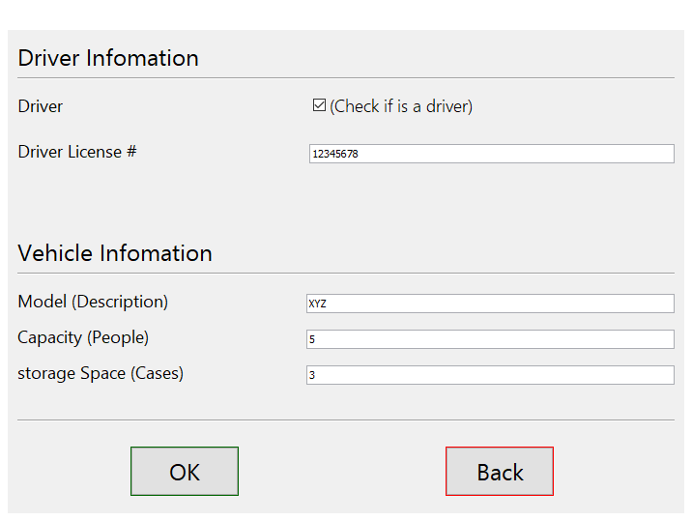
Driver/Vehicle Info Page Demo

Slide 12
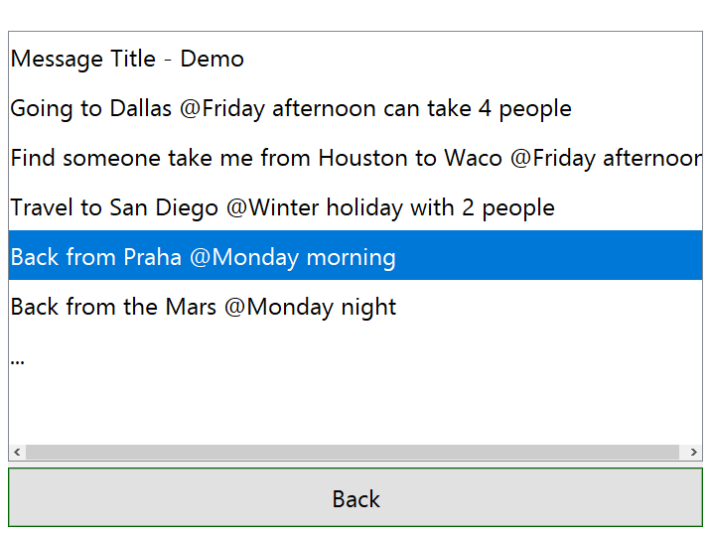
Message Board Demo

Slide 13
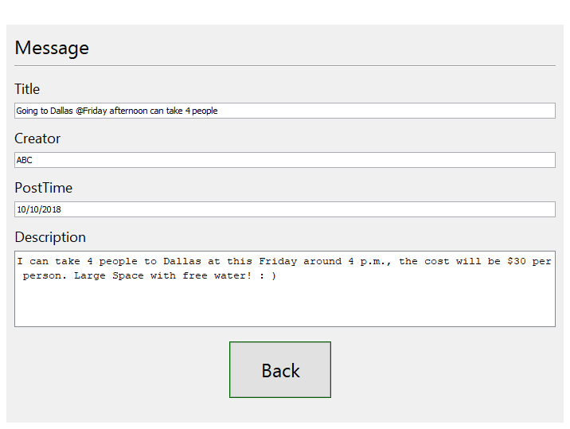
Message Page Demo

Slide 14
Thank you //End of PowerPoint
Our website:
http://cs.baylor.edu/~snavely/

