Slide 1

Bear Rides
Andrew Scouten
Asher Snavely
Xiangan Wan (Roy)
Yunzhe Liu (Josh)

Slide 2
Implementation
GUI – Controller – Panel Manager - Database

Slide 3
Testing

Slide 4
maven

Slide 5
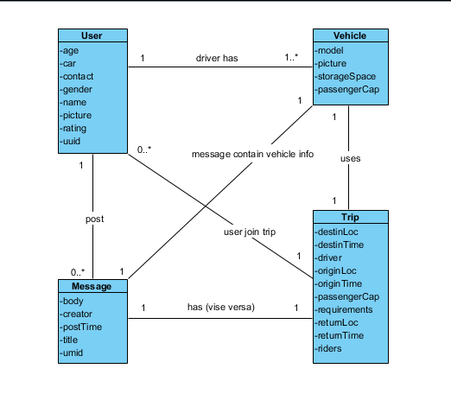
Domain Model V2.0

Slide 6
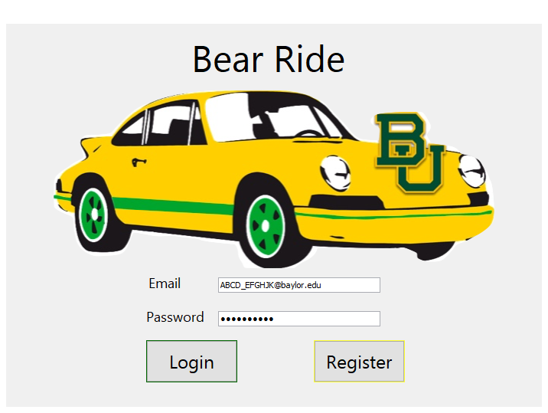
Login Page Demo

Slide 7
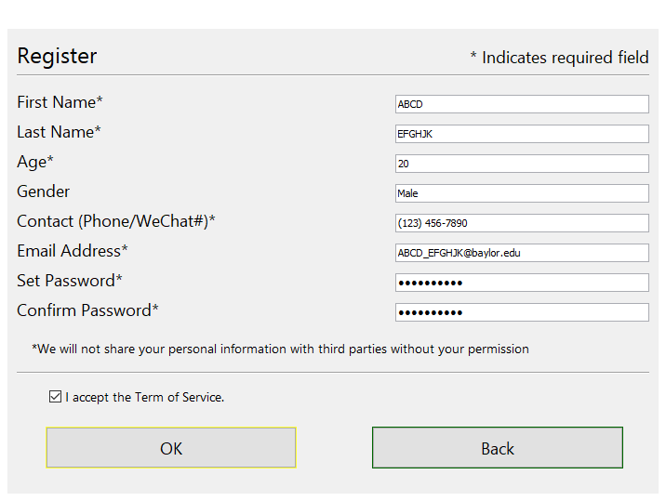
Register Page Demo

Slide 8
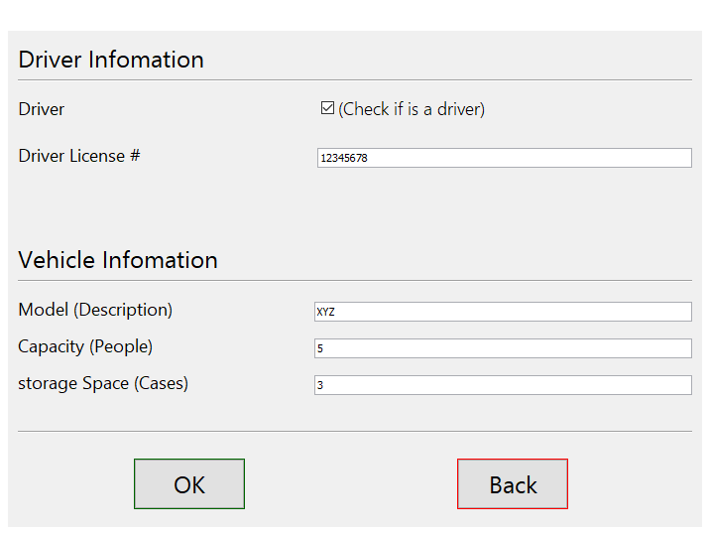
Driver/Vehicle Info Page Demo

Slide 9
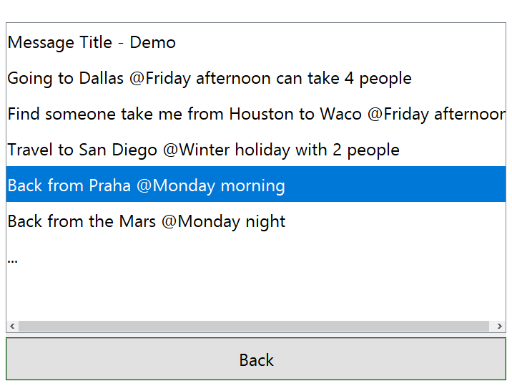
Message Board Demo

Slide 10
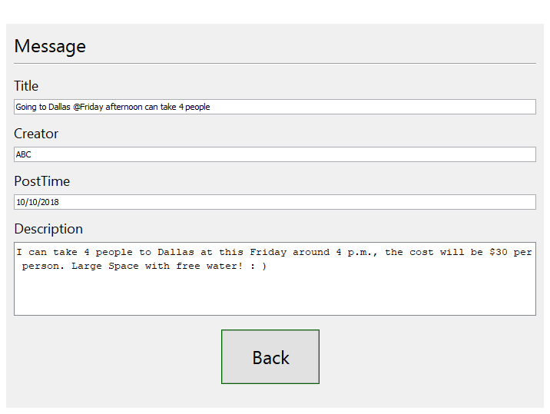
Message Page Demo

Slide 11
Thank you //End of PowerPoint
Our website:
http://cs.baylor.edu/~snavely/

