Slide 1

Bear Rides
Team TBD 2 :
Asher Snavely
Xiangan Wan (Roy)
Yunzhe Liu (Josh)

Slide 2
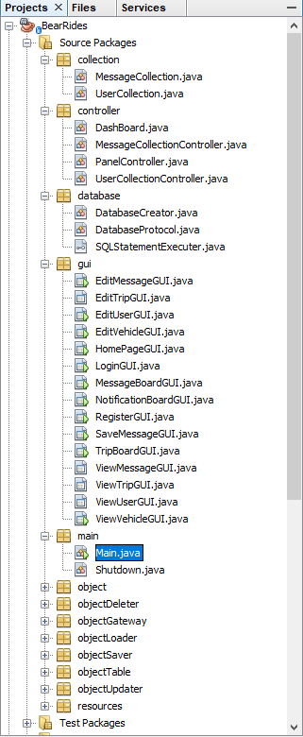
Implementation
GUI – Controller – Panel Manager - Database
We build our base objects first, so we can have a frame of our software,
at the same time we are building a graphical user interface with Swing.
After its frame finished, we consider how to link its internal data altogether.
We used Model Controller View (MVC) structure, with complicated database.
This software add user input to its database and other user can view its data.

Slide 3

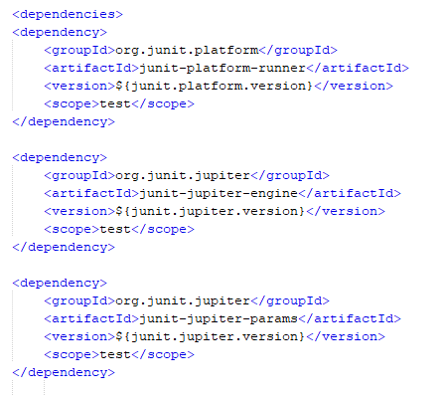
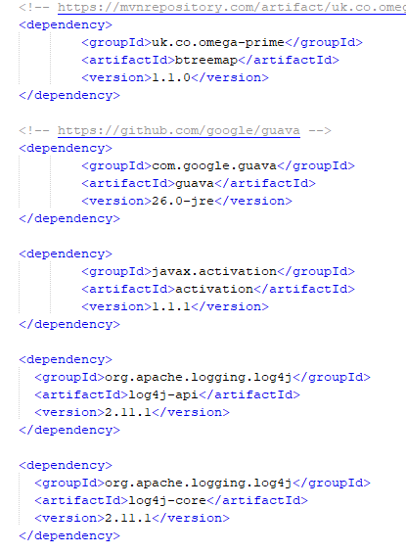
Maven POM
Junit 5 and log4j and other dependencies for its proper running

Slide 4
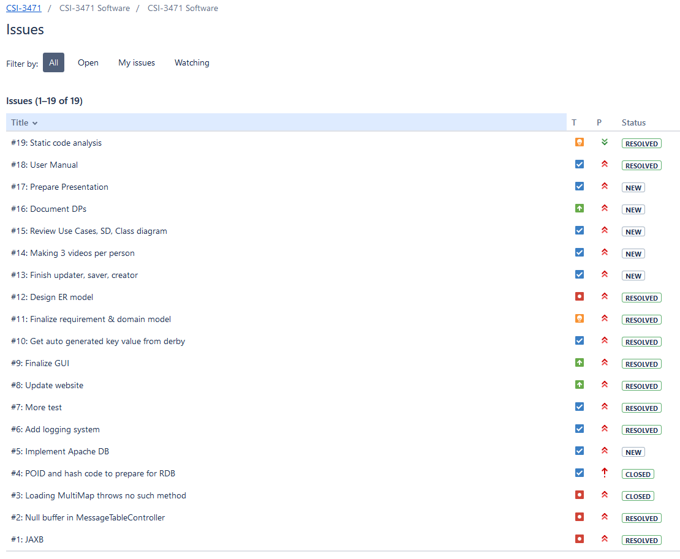
Git – Issues Handle

Slide 5
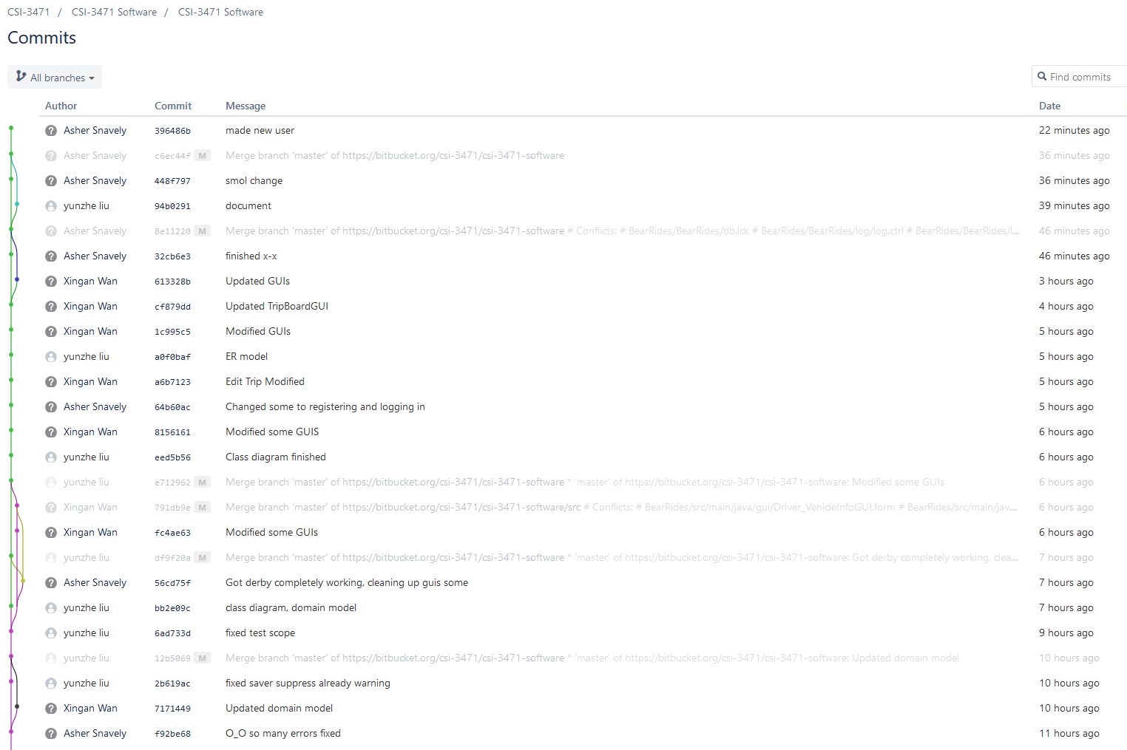
Git – Commits
And there are so much more… Check our Repository at
https://bitbucket.org/csi-3471/csi-3471-software/src/master/

Slide 6
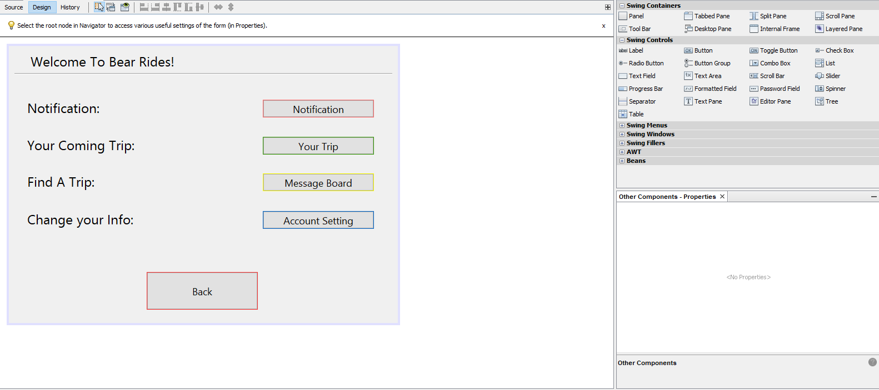
GUI Design
The User Interface is first thing user will see when using our software, so a beautiful UI will make our customer very happy and glad to pay us (credits). We use NetBeans IDE for GUI development, it has a unique GUI builder function, which help developer organize different GUI easily, and also design preview makes product more predictable. All this will for sure give our customer a best using experience.

Slide 7

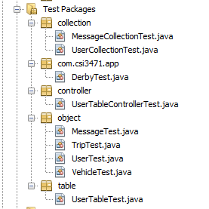
Testing
We thoroughly test the model’s API, the collection of objects, the controller and the access of database, creating, inserting, updating and delete data from database.

Slide 8
UML Diagrams
For demonstration, here we have Domain Model Diagram and Class Diagram, they can show our software structure better…

Slide 9
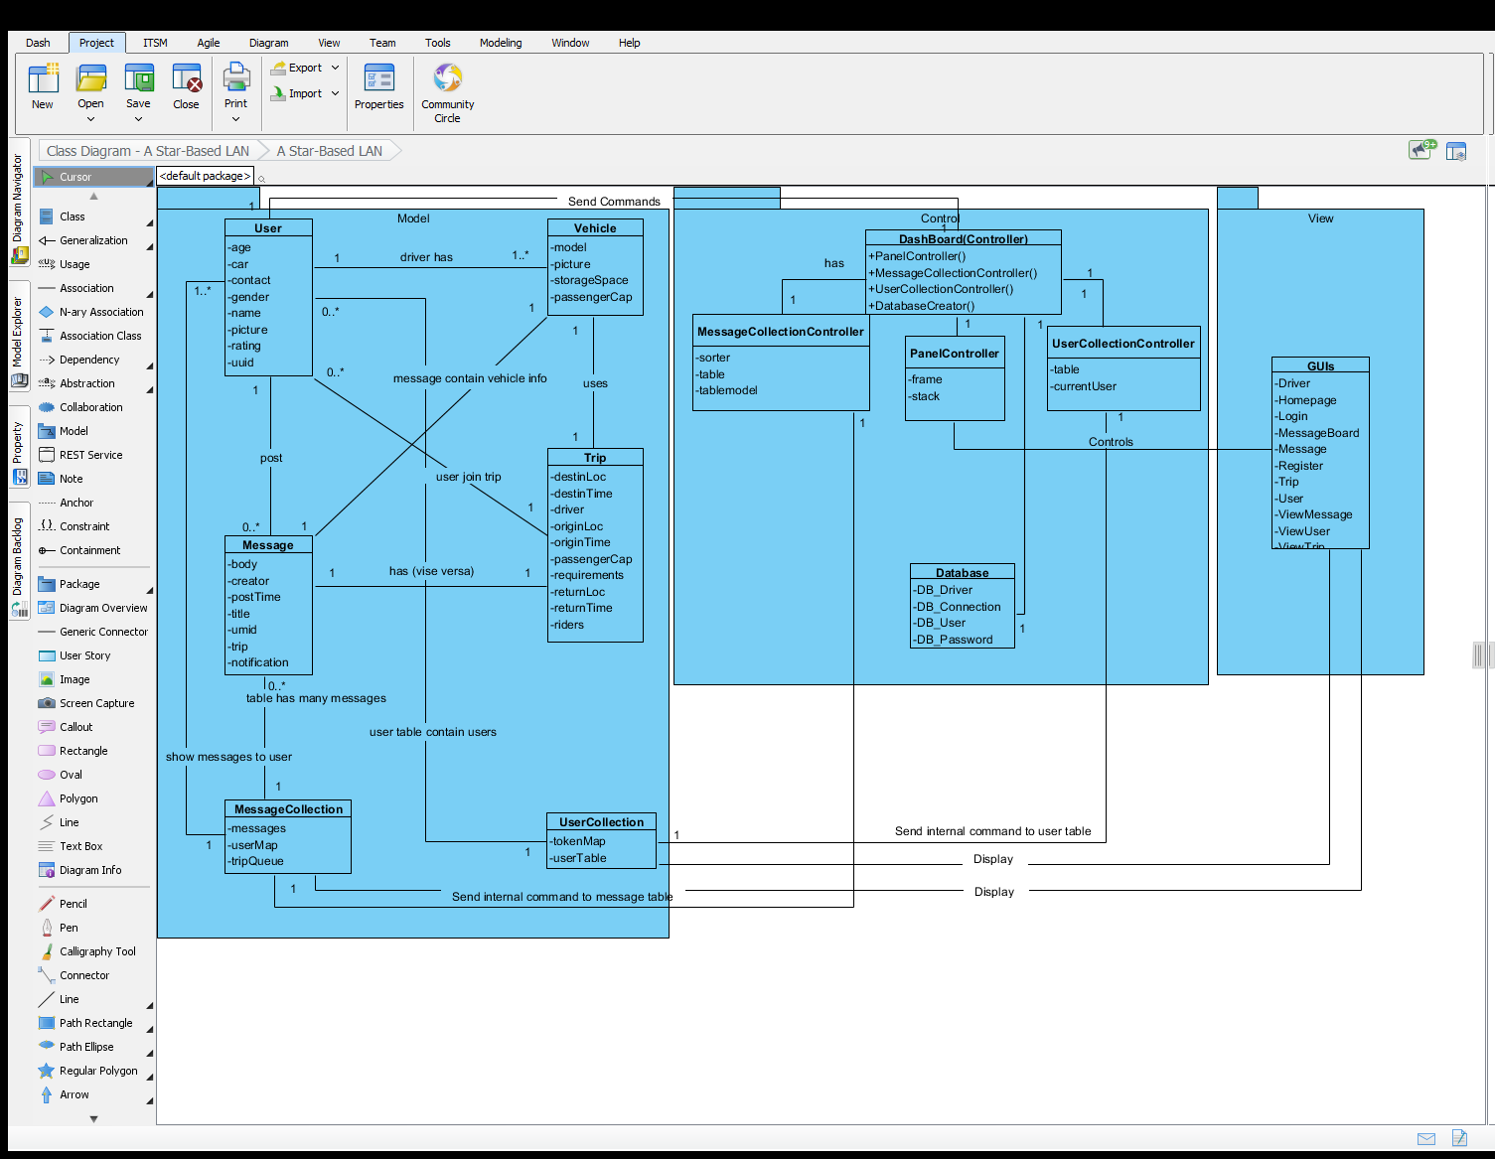
Domain Model Diagram

Slide 10
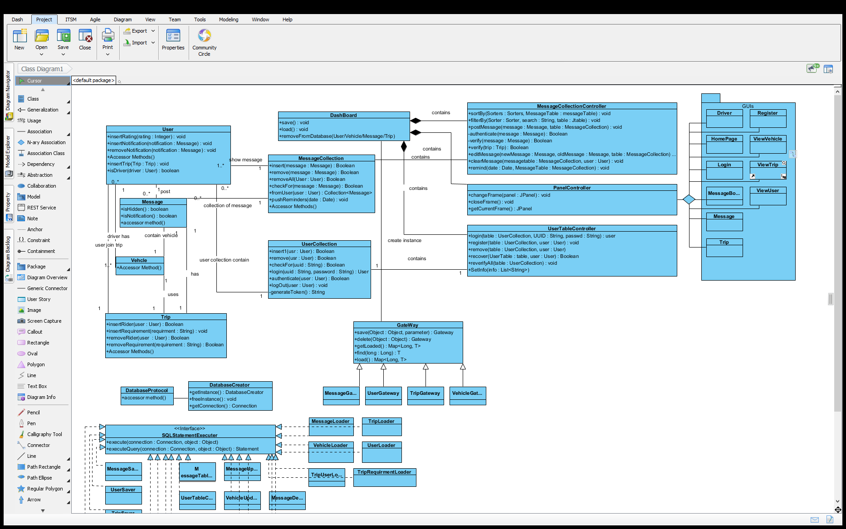
Class Diagram

Slide 11
Bear Rides Application live demonstration

Slide 12
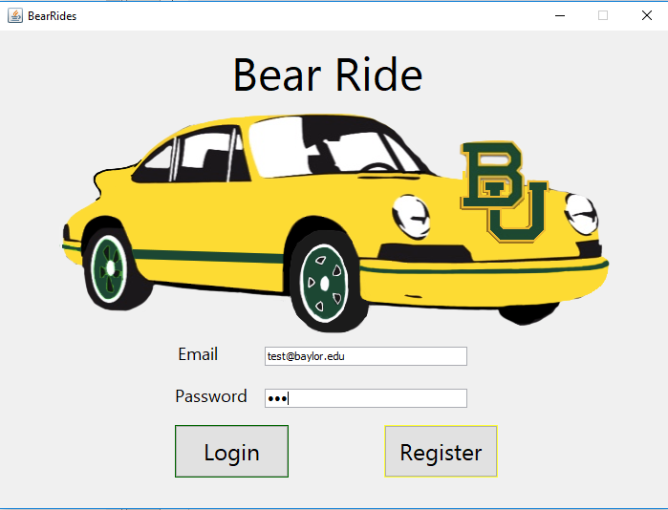
Login Page

Slide 13
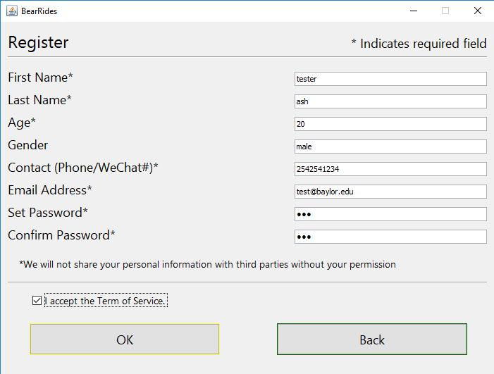
Register

Slide 14
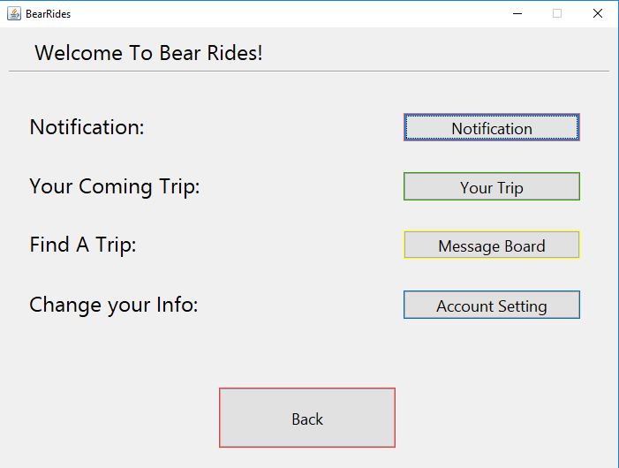
Home Page

Slide 15
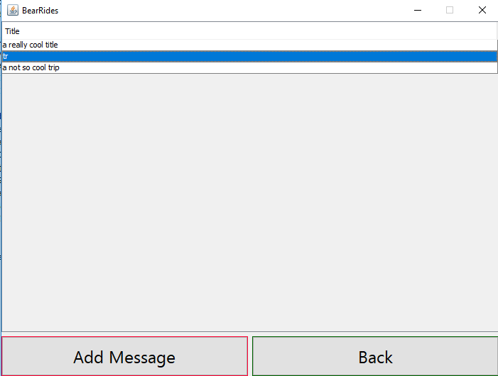
Message Board

Slide 16
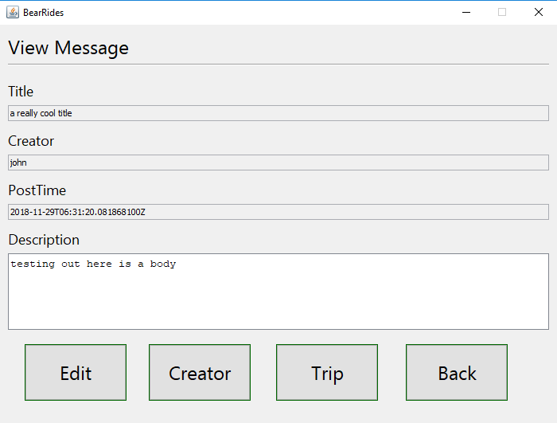
Message Page

Slide 17
Thank you
Our website: http://cs.baylor.edu/~snavely/

