Slide 1



Topic :
« Rhythmic Revelations: Analyzing Spotify's Songs Patterns »
Module : Big Data and NoSql DataBases
Major : Computer Engineering
Realized by :
AIT ABDIELMOMIN Hajar
Supervised by :
Mrs. KARIM Lamia
Academic Year 2023-2024

Slide 2

Plan
BigQuery Overview
Use case
Architecture
Load limitation
Accessing BigQuery
Demonstartion of the project

Slide 3


Overview

Slide 4
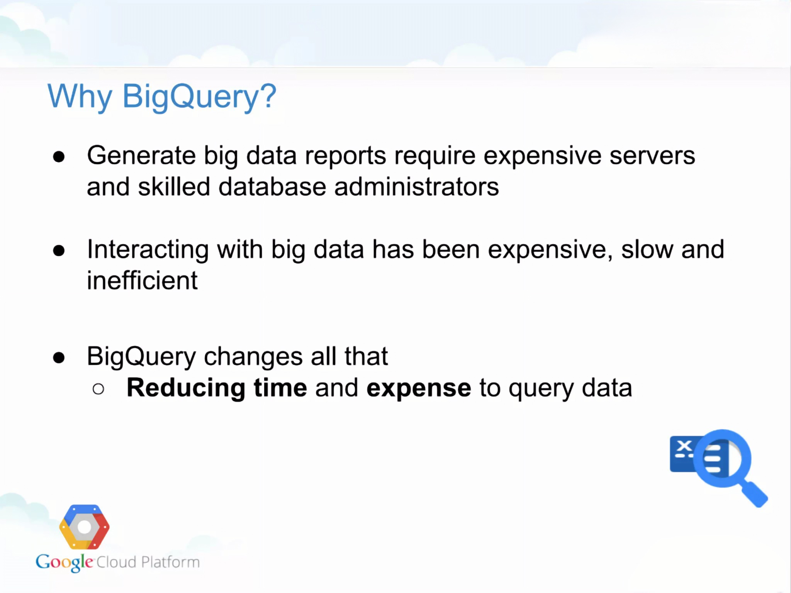

Slide 5
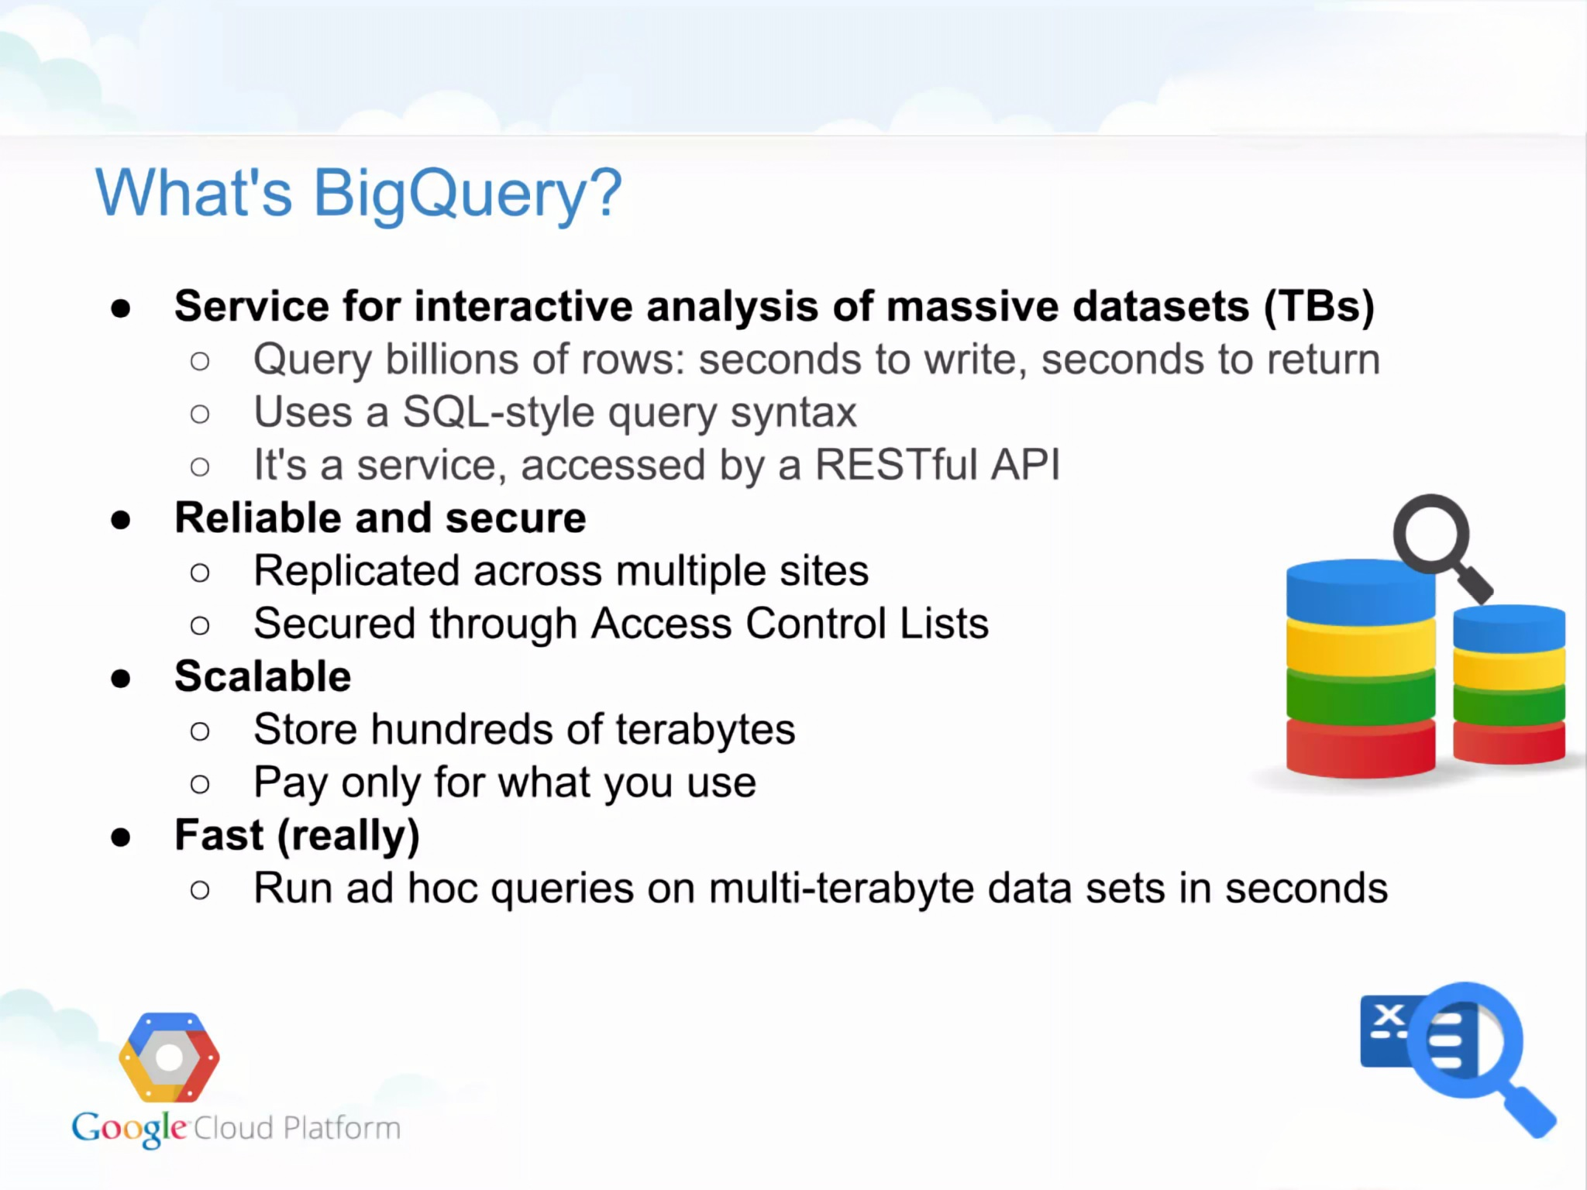

Slide 6
Use case

Slide 7
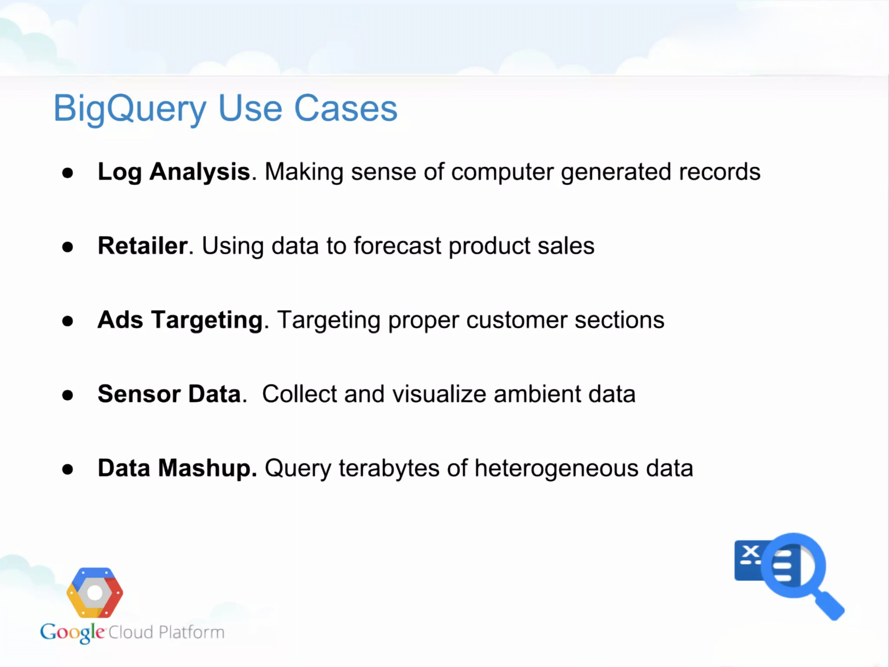

Slide 8
Architecture

Slide 9
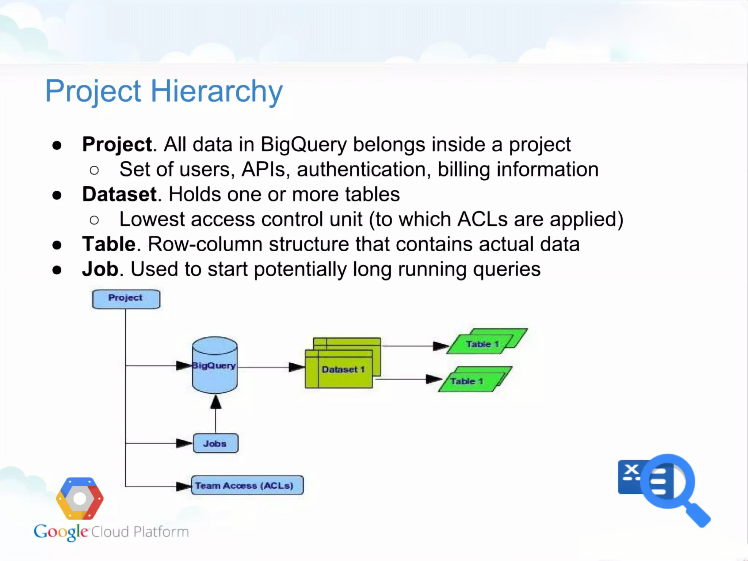

Slide 10
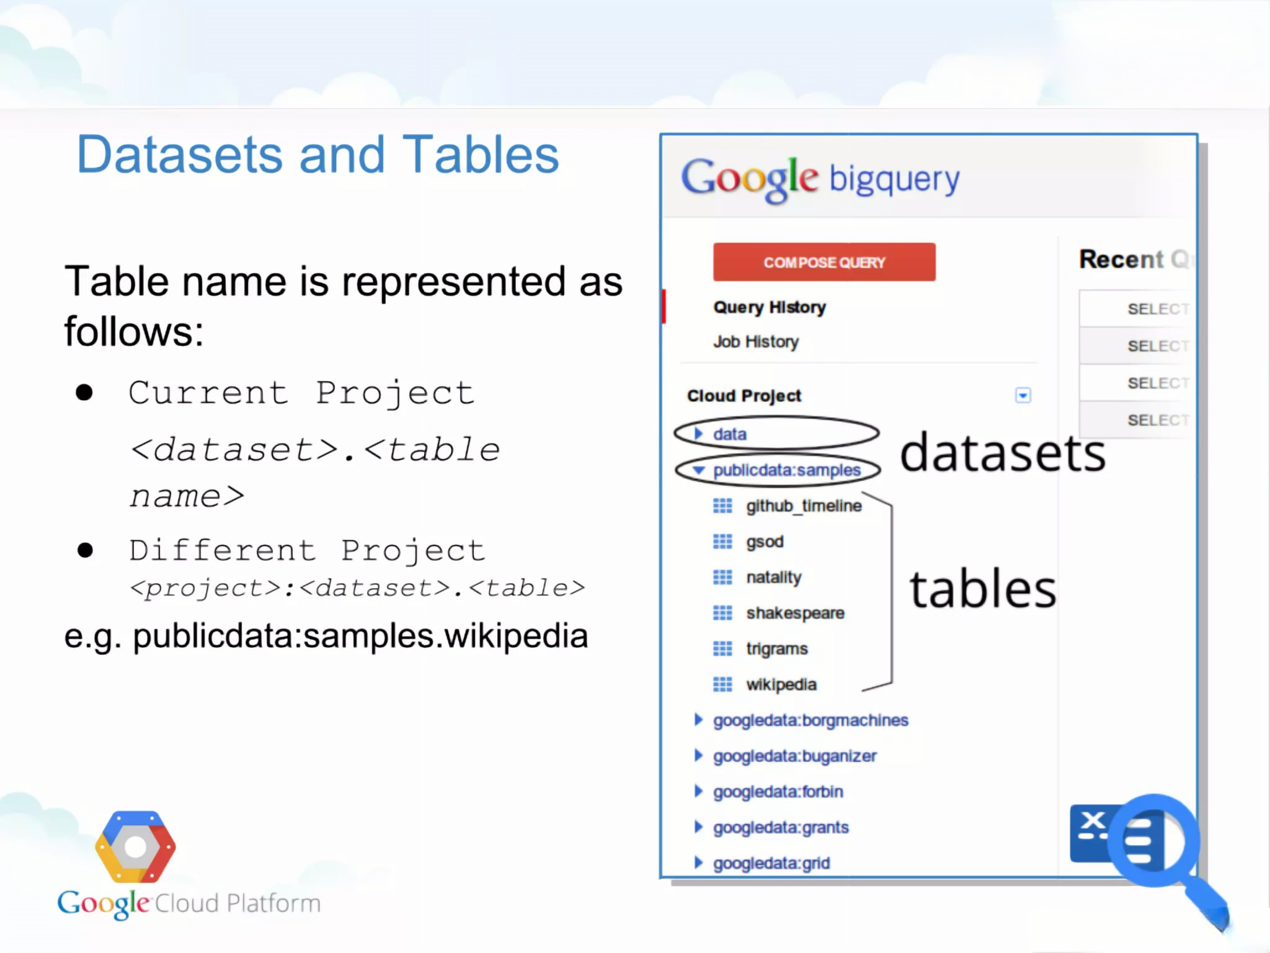

Slide 11
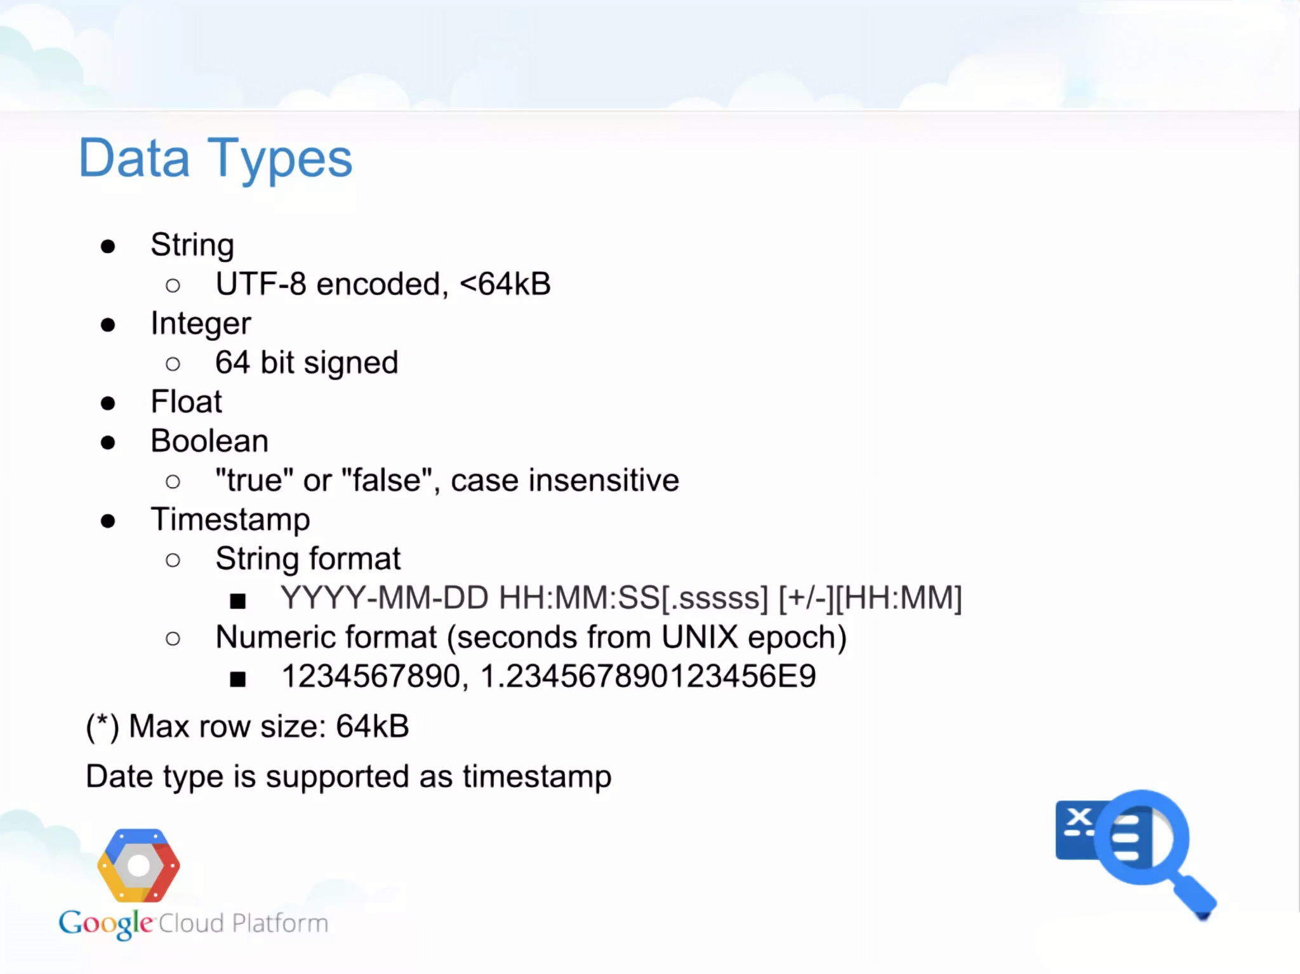

Slide 12
Load Limitation

Slide 13
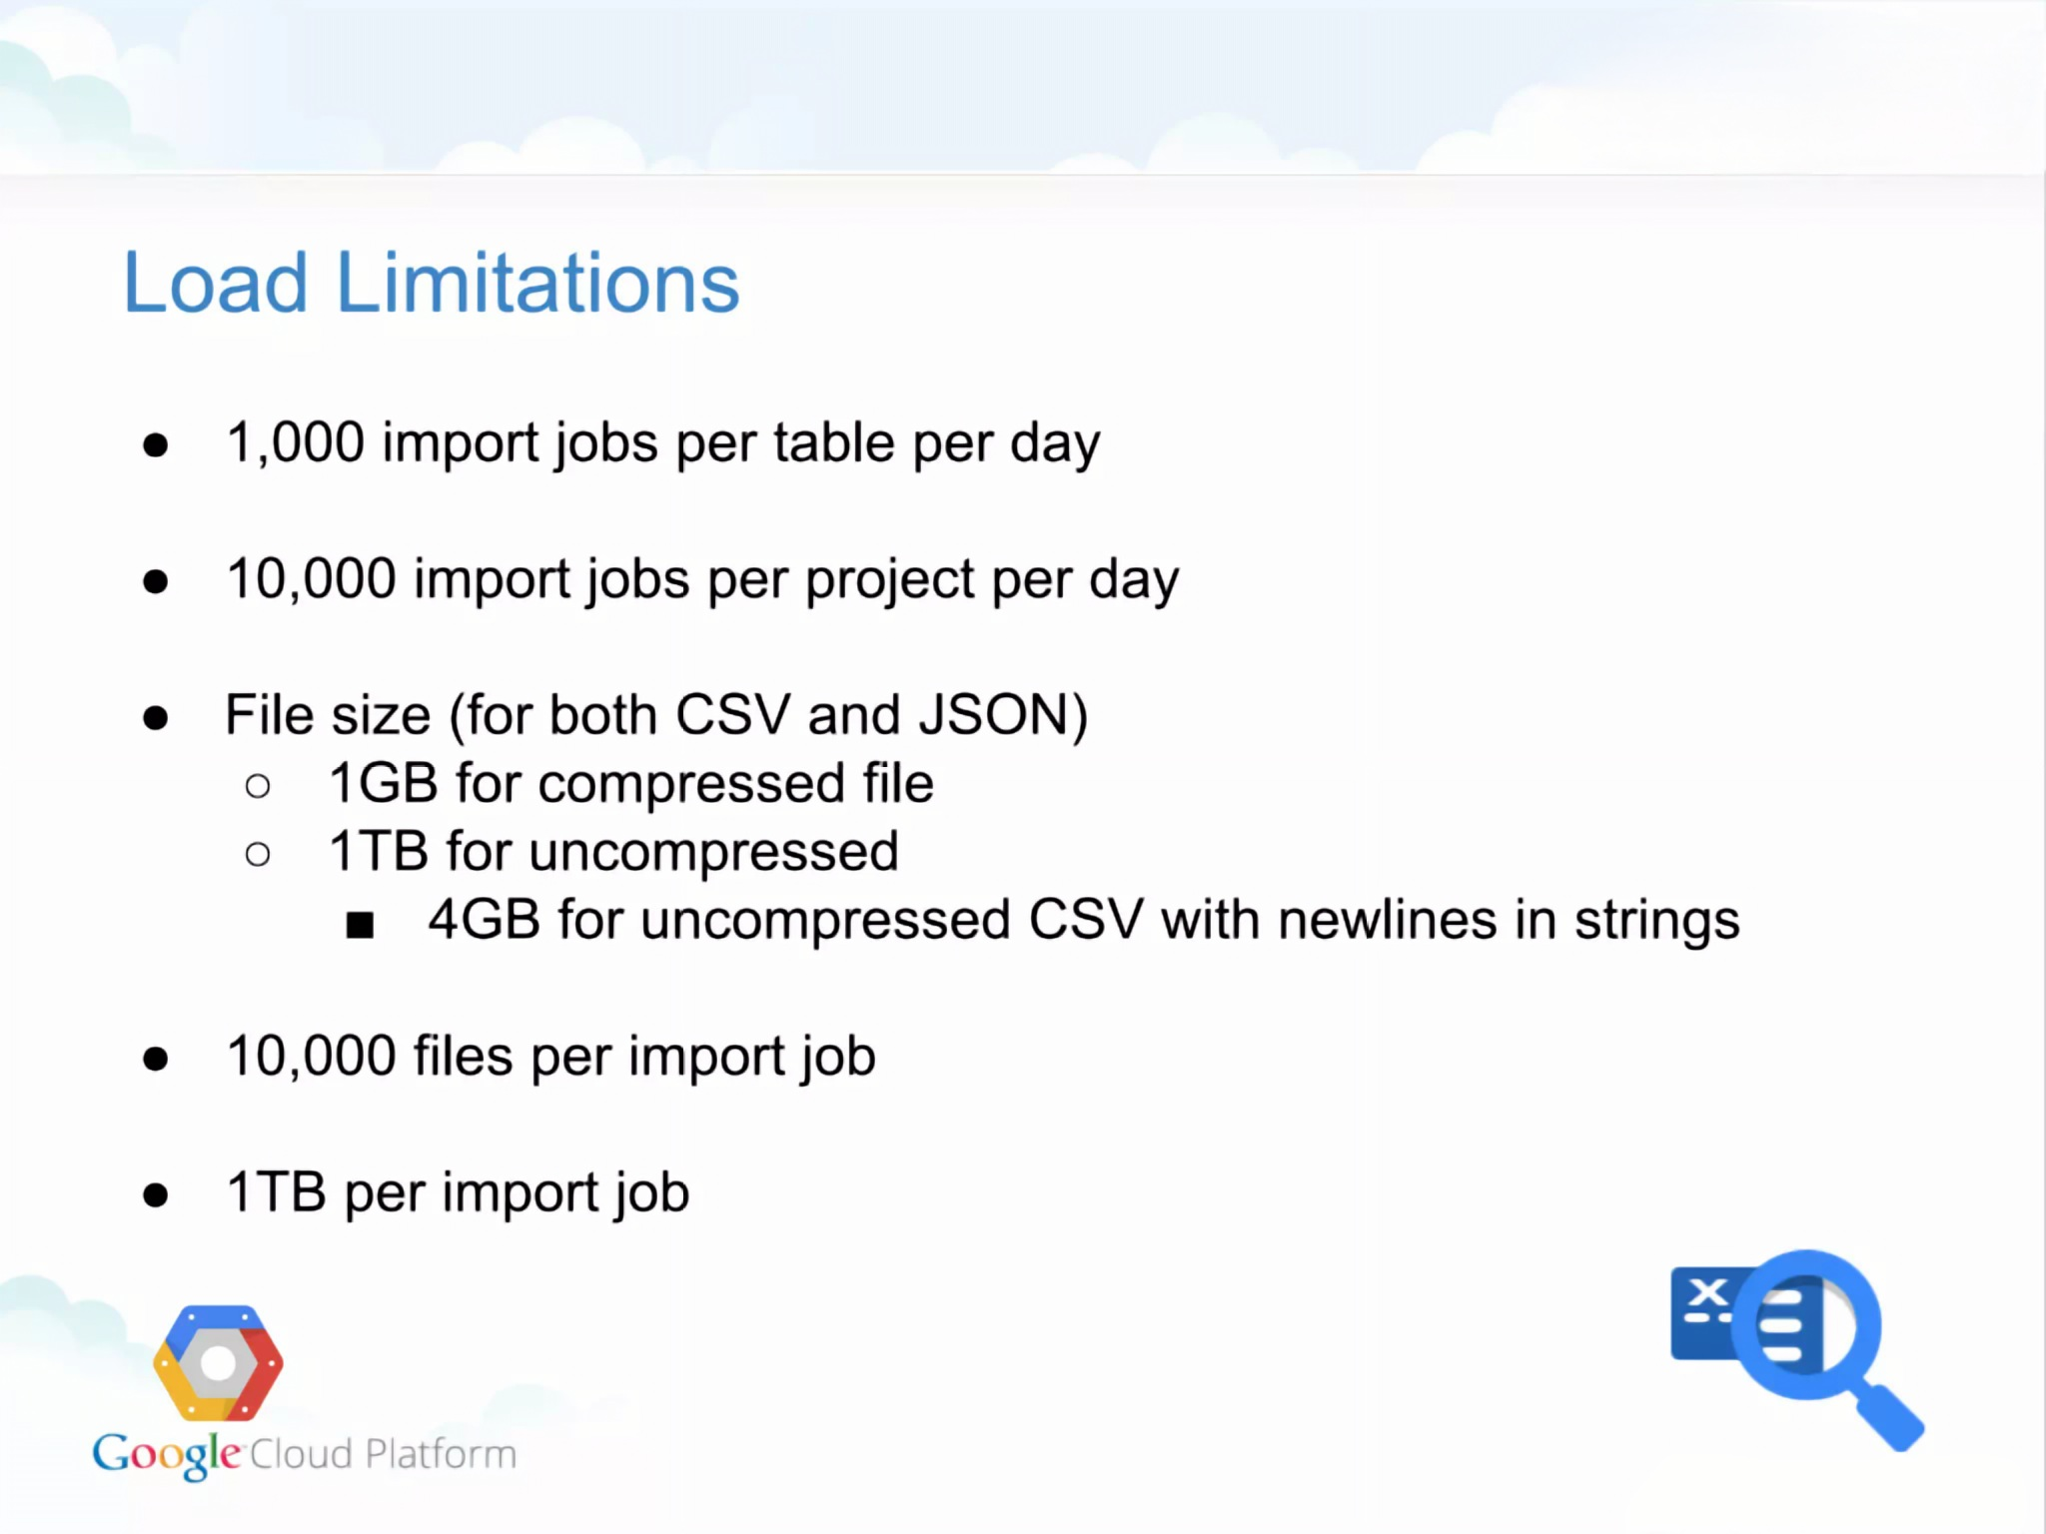

Slide 14
Accessing Bigquery

Slide 15
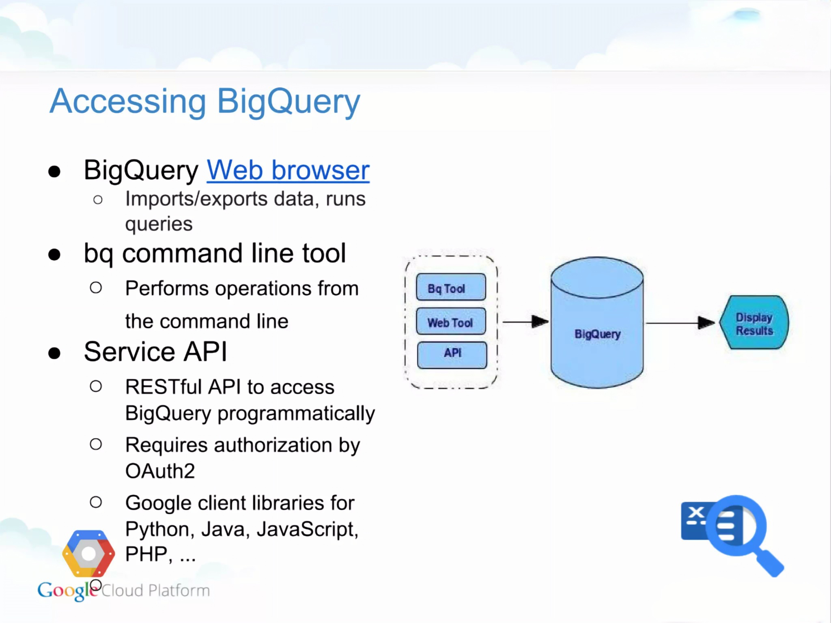

Slide 16
Demonstartion of the project

Slide 17
Link to the demo : https://drive.google.com/file/d/1HIzZs_BwoedIA3vnrFW4T42JQuy3WI0m/view?usp=sharing

Slide 18
