Slide 1
Address Book
Java
OOP – List – Files Handling – Exceptions Handling - RegEx
Comparator ( Sort ) - UML Modeling

Slide 2
Project Overall Goal
This project, creates an address book that can store information about people, entered by a user.
Present the user with a list of options to interact with the database and take in their input.
Allow the user to perform the following actions:
Add an entry
Remove and entry Search for a specific entry
Print the contents of the address book
Delete the contents of the address book
Quit the program

Slide 3
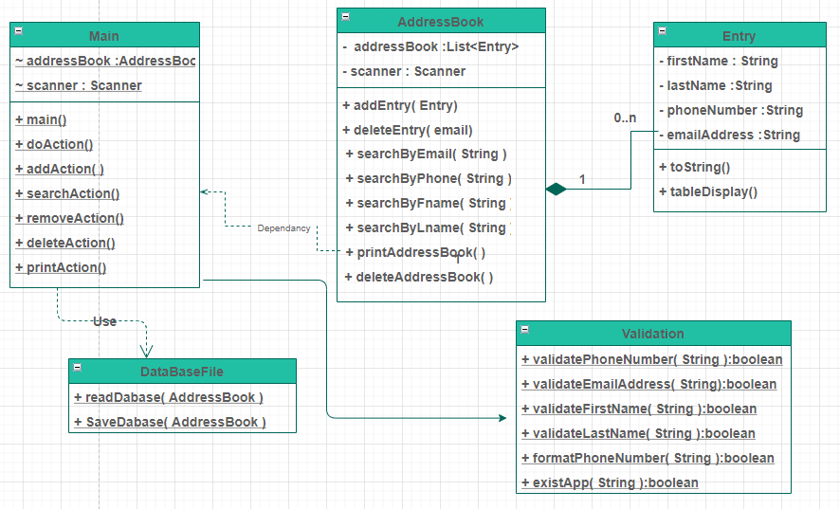
Application Structure
The address book application contains Five Classes

Slide 4
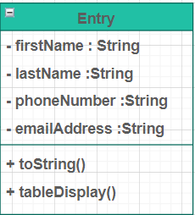
Entry Structure
Entries are contained in a class named Entry
Each entry contains the following properties:
First name
Last name
Phone number
Email address
All variables are private and only accessible via getter and setter methods

Slide 5
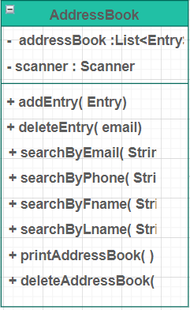
Address Book Structure
The address book contains an ArrayList of Entry instances. This ArrayList is accessed and modified using methods that accomplish the following:
Adding entries .
Remove an entry .
Search for an entry Users can search by (first name, last name, phone number, or email address).
Printing All the entries of the address book.
Deleting the address book.
Quit The program.

Slide 6
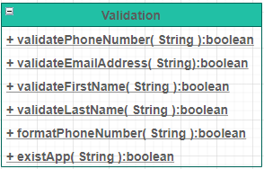
Validating user Input:
Every time the user enter an input the App will validate it using the validation methods of the Validation class.
It will keep asking the user for a valid input until it gets one.
For validation RegEx patterns where used.

Slide 7
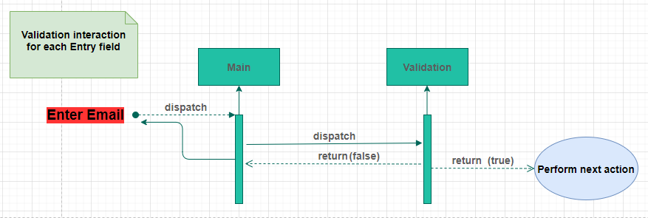
Validating user Input:

Slide 8
Connect to a database File: Read
Every time the application runs it will try to connect to the database text file to read the saved entries using the readDataBase() method of the DatabaseFile class.
The first time the application runs , the database file is not existed so it will retrieve an empty arrayList of entries.
Everytime after it will retrieve the saved address book entries.

Slide 9
Connect to a database File: Save
Every time the user wants to exit the App using the Quit option or by forcing the App to exit by hitting the (Q/q) or (Quit/quit) the address book entries will be saved to the (addressBook.txt).
using the saveDataBase() method of the DatabaseFile class.
The first time the application runs it will check if that file is already exist ?
No ----> Create a new file and stamp it with the following:
Date: The date the file was created.
Time: The time the file was created.
User: The Operation System user who created the file.
Then save the address book entries into it.
Created on [Date] [Time] By [User]

Slide 10
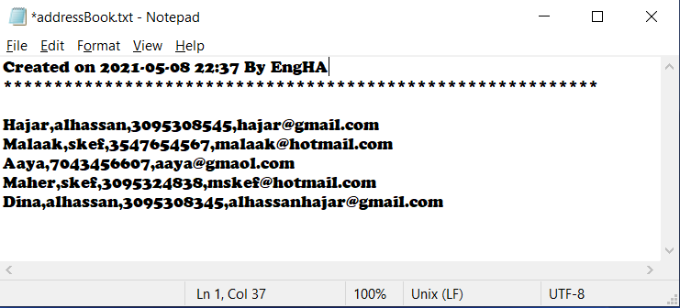
Connect to a database File: Save

Slide 11
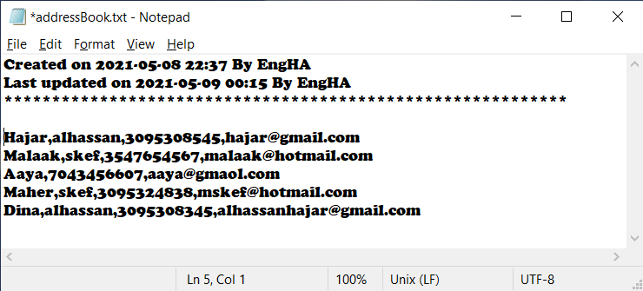
Connect to a database File:
Yes ----> It will save the address book entries and stamp the file with another line contains the updating information.
Last updated on [Date] [Time] By [User]

Slide 12
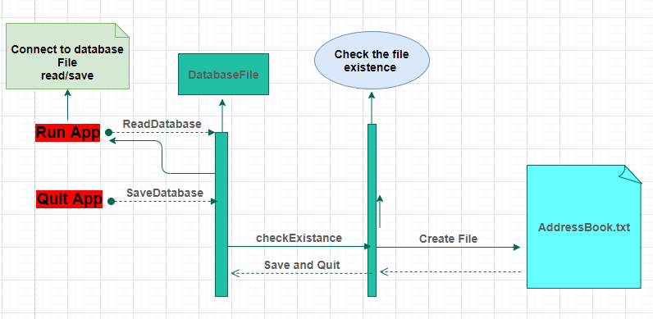
Connect to a database File:

Slide 13
Add an Entry:
When user chooses to add an entry , he will be asked to enter the fields, then the App will check if there is an already existed entry associated with entered email :
Yes ----> The user will be asked if he wants to update the existed entry with entered one:
Yes -> Update the existed Entry.
No -> Thank you!
No ----> Proceed to add the entered Entry.
Validation is always performed on the entered inputs.

Slide 14
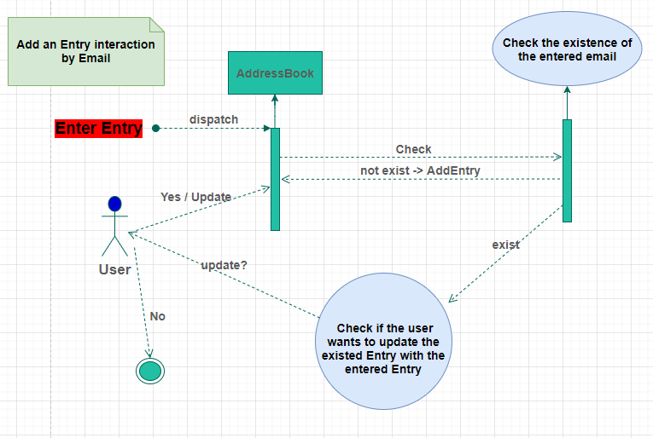
Add an Entry:

Slide 15
Search for an Entry:
User can pick which methods they will search by (first name, last name, phone number, or email address).
The program will take in a search query and search the address book for entry/entries that contains the search as a substring (e.g. if a first-name/last-name search is conducted with 'a,' All entries that have a first-name/last-name starting with 'a' will be returned).

Slide 16
Remove an Entry:
Delete the Address Book:
s.
An entry can be removed by searching the database for an email address and then removing the entry with that unique email address.
The address book will be cleared.
Before proceeding in removing or deleting the user will be asked to confirm the action.

