Slide 1
Secure Programming Project – Hospital Application
Group members:
Hajar El Boutahiri
Pham Vu Van Thanh

Slide 2
Introduction
Secure Hospital Application for Booking, Viewing and Managing Appointments and Users
Support 5 Roles: Default Admin, Admin, Doctor, Patient and User
Aim of the Program: By Building an Application From Scratch, we aimed to:
Enhance Software Engineering Skills
Learn Security Practices
Security Testing

Slide 3
Structure of program
Backend:
FastAPI (Python)
Frontend:
Angular (TypeScript, HTML, CSS)
Database:
SQLite
Docker:
Docker compose

Slide 4

Security practices
Oauth2 + JWT for Authentication
Short Lived Access Tokens: 30 mins
Log Out with Token Blacklist Implementation
Invalid Token, even though it still didn't expire
Revoke Token Whenever it is Needed
Password Encryption on Database Using Bcrypt
Bcrypt a Password Hashing Function
One Way Hashing
Sensitive Data Encryption Using Fernet
Fernet a Symmetric Encryption and Data Authentication Algorithm
Provides Confidentiality, Integrity and Authentication
HTTPS Implementation
Used mkcert Tool to Generate a Self-Signed Certificate and Private Key
Notes:
Oauth2 + JWT (JSON Web Token) for authentication
To authenticate the user, the authorization server issues a JWT access token to the app; which is then stored by the app
Log Out with Token Blacklist Implementation:
=> Advantages:
JWT are stateless => token remains valid until it expires. By blacklisting the token, once logged out, token is no more valid even though it still didn't expire
Revoke token whenever it is needed; hence it is possible to immediately Interrupt Suspicious User Behavior
Encrypted password on database Using Bcrypt
Bcrypt is a password hashing function
one-way hash — you cannot decrypt the hash back to the original password.
Sensitive Data Encryption Using Fernet:
Fernet is a Symmetric Encryption Algorithm
Provides Confidentiality (Only authorized parties can read the encrypted data thanks to symmetric encryprtion) + Integrity (data cannot be modified without detection) + authentication (origin of the data can be verified)
Details: (Uses AES in CBC mode with 128-bit keys, includes random intialization vectors (IV) and HMAC-based authentication "ciphertext cannot be tampered with" )
HTTPS (Hypertext Transfer Protocol Secure) Implementation:
HTTPs is the secure variant of HTTP where data is transfered in an encrypted format and not as plaintext

Slide 5
Security practices
Role Based Access Control
Default Admin, Admin, Doctor, Patient and User
Separate Views and Allowed Actions
Scheduled Data and Access Validity Check
Deactivate Expired Users and their Related Records: Every Day at Midnight
Update Appointments Status: Every 30 mins
Input Validation
Ensure User Input is Correct and Valid
Error Handling
Handle Expected Errors
Exception Handling
Handle Unexpected Errors
Notes:
Role Based Access Control:
Default Admin, Admin, Doctor, Patient and User Role ( Separate Roles, Views and Allowed Actions)
Scheduled Data and Access Validity Check
Daily Check to Deactivate Expired Users and Deactivate their Records ( Stop System Access, Deactivate Related Fields "ex: appointments")
Appointment Status Check each 30 mins (Appointment and Status Validity)
Input Validation
System checks the validity of input ( ex: phone number is unique and includes only a certain number of digits and 1 possible "+" character to define the country code)
Error Handling
System throws an error if a user didn't enter a required field (ex: username in registration form)
Exception Handling
In case of unusual code behavior, system raises an error not to crash

Slide 6
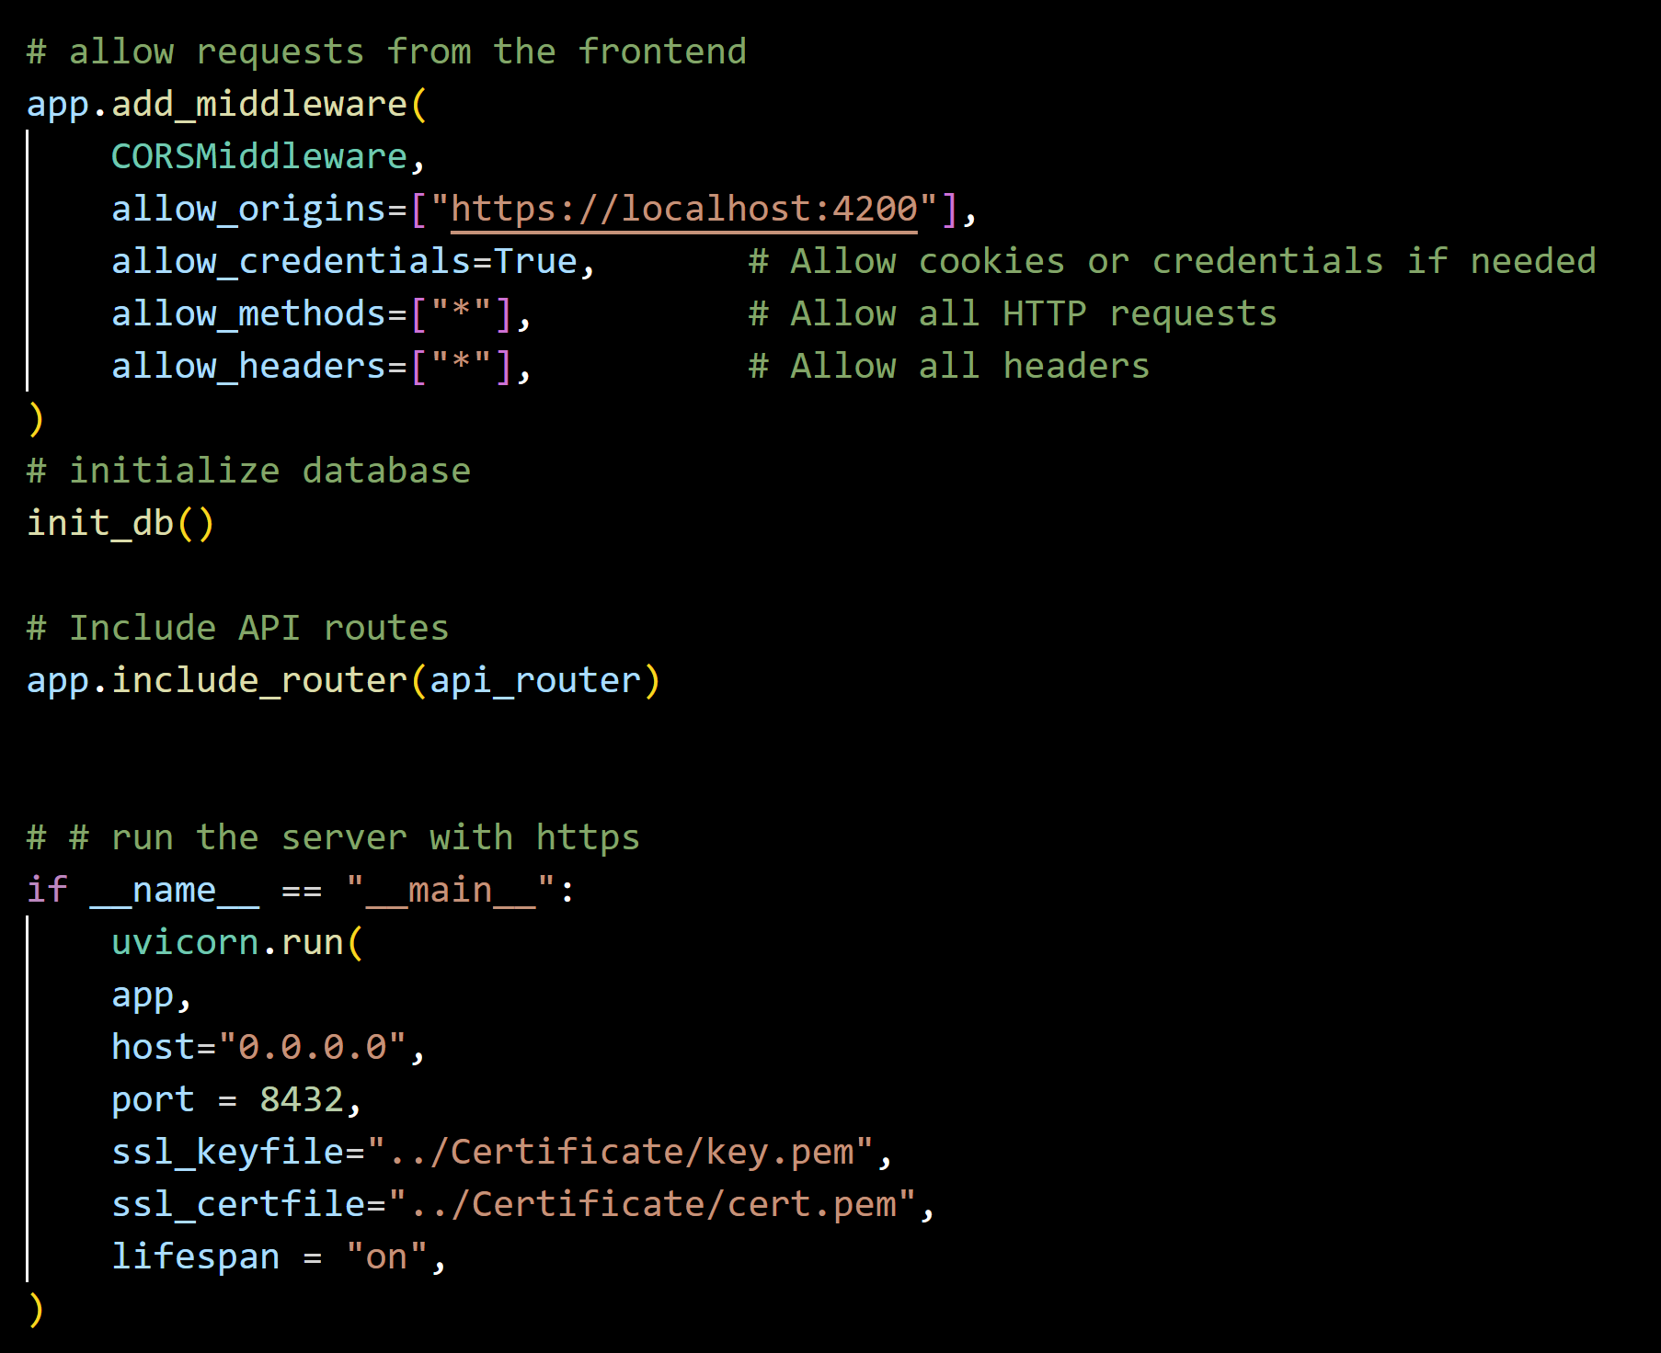
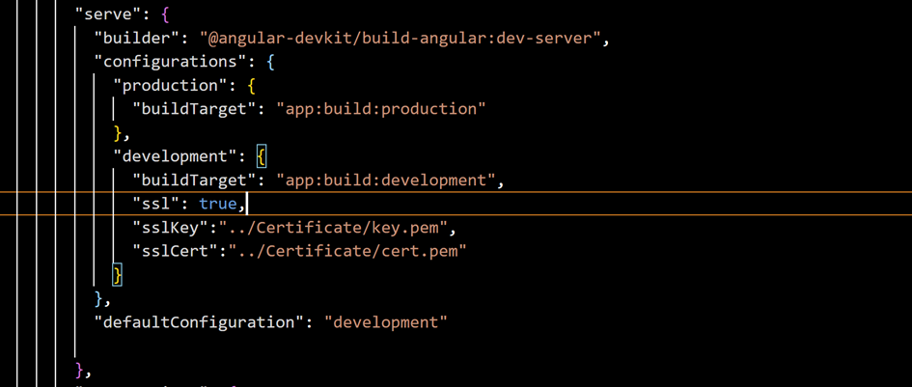
HTTPS Implementation
Backend: "main.py"
Frontend: "angular.json"
Notes:
Uvicorn => server that runs fast api
host 0.0.0.0 => listen on all available network
8432 => arbitrary port
Used mkcert Tool to Generate a Self-Signed Certificate and Private Key
Lifespan we have used it for the scheduler to manage startup and shutdown events

Slide 7
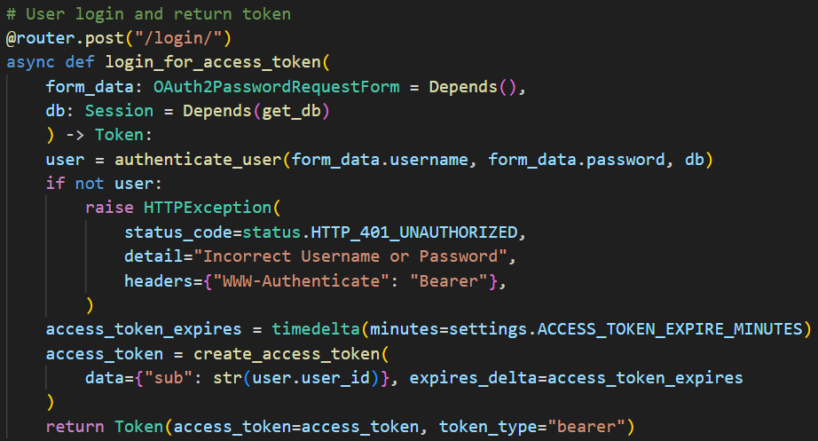
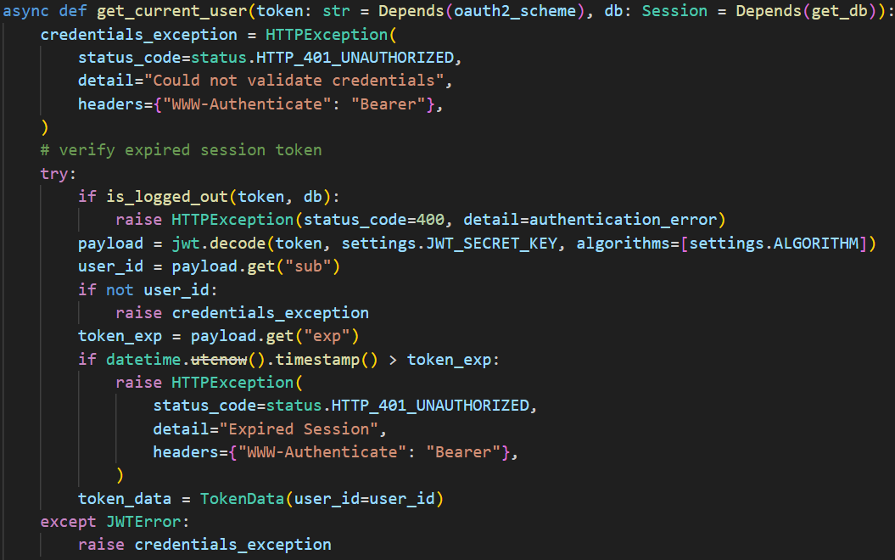
Oauth2 + JWT Implementation
Notes:
We used Oauth2 and jwt to implement our login function.
As you can see in the first picture, we used Oauth2PasswordRequestForm to get username and password from users, then checking them in db. If there is no user has the same username and password function will raise a HTTPException for incorrect username and password. On the other hand, create a token with expire time in 30 mins. This function will return a token and token_type bearer if it is requested.
Then we created a variable oauth2_scheme to get the token from the login function above and used it as a dependency for other functions, for example in picture 3

Slide 8
Security tests
Notes:
We used jenkins CI/CD pipeline to automatically test our application
_ For static code testing, we used sonarQube and semgrep
_ Snyk to scan for vulnerabilities in third-party libraries, dependencies and also create SBOM files
_ and a general static code scan by trivy

Slide 9
Security tests
Notes:
_ then we used docker to build and push images onto dockerhub and use trivy to scan container
_ finally we used ZAP to test vulnerabilities in our dynamic code

Slide 10
Security tests

Slide 11
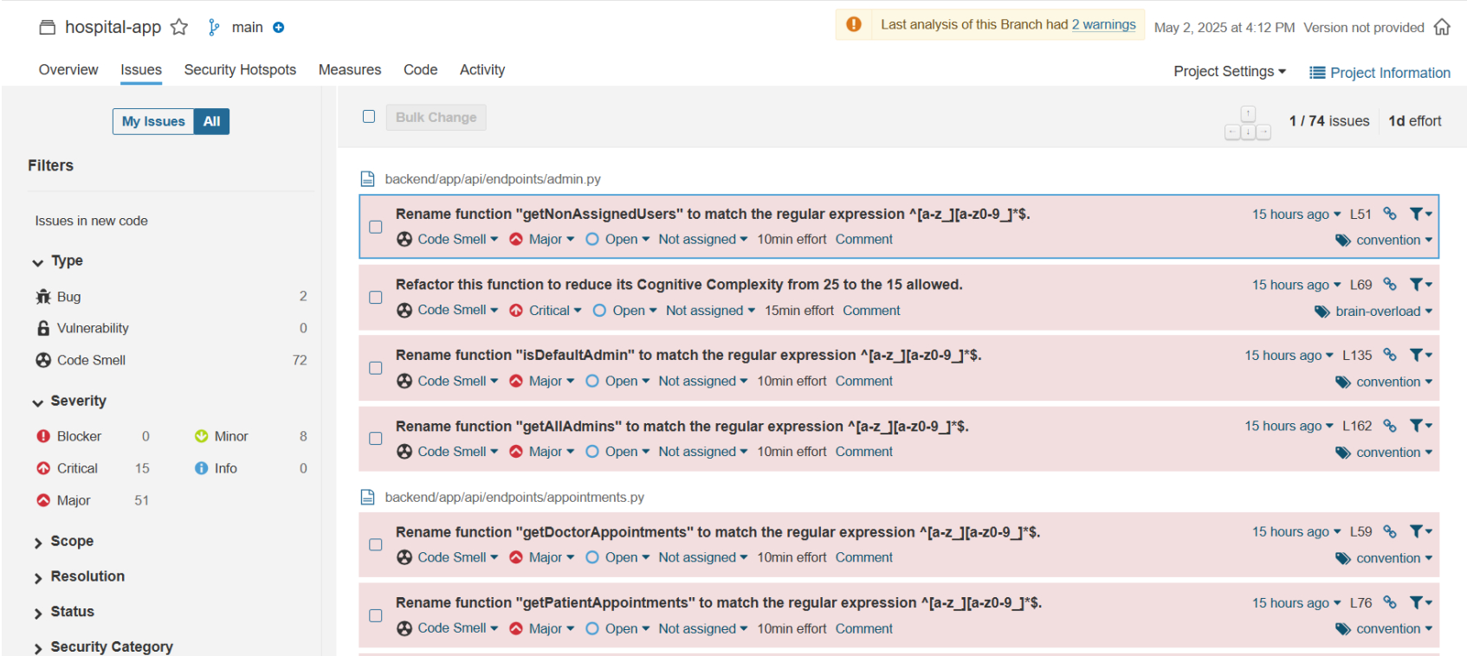
Security tests - Result
Notes:
For static code, we had 74 issues including: funtion’s name did not meet regular expression, high cognitive complexity code, blank files, lack of exception, etc.

Slide 12
Name | Risk Level | Number of Instances
CSP: Failure to Define Directive with No Fallback | Medium | 2
Content Security Policy (CSP) Header Not Set | Medium | 3
Missing Anti-clickjacking Header | Medium | 3
Sub Resource Integrity Attribute Missing | Medium | 7
Dangerous JS Functions | Low | 1
Insufficient Site Isolation Against Spectre Vulnerability | Low | 12
Permissions Policy Header Not Set | Low | 10
Server Leaks Information via "X-Powered-By" HTTP Response Header Field(s) | Low | 6
X-Content-Type-Options Header Missing | Low | 9
Authentication Request Identified | Informational | 1
Information Disclosure - Sensitive Information in URL | Informational | 4
Information Disclosure - Suspicious Comments | Informational | 8
Modern Web Application | Informational | 1
Non-Storable Content | Informational | 2
Storable and Cacheable Content | Informational | 5
Storable but Non-Cacheable Content | Informational | 5
OWASP ZAP report
Notes:
For dynamic code, base on ZAP report, we had vulnerabilities as lacking security headers, information disclosure

Slide 13
Enhanced Security
Set Security Headers to Sensitive Files (" Dynamic Files")
Anti-clickjacking Header
Permissions Policy Header
X-Content-Type-Options Header
Site Isolation Against Spectre Vulnerability
Content Security Policy (CSP) Header
Caching
"X-Powered-By" ( Removed Header)
Added Error Handling Statements
Sensitive Data Exposure Through Headers
Switch GET to POST Requests
Code Refactoring & Function Renaming
Notes:
Anti-clickjacking Header => protecting against clickjacking attacks
Permissions Policy Header => Controls access to browser features (e.g., camera, geolocation)
X-Content-Type-Options Header => Stops browsers from MIME-sniffing content types (and prevent some xss attacks)
Site Isolation Against Spectre Vulnerability => limiting data leakage across sites
Content Security Policy (CSP) Header => detect and mitigate certain types of attacks (ex: Cross Site Scripting (XSS), data injection attacks)
Caching => Controls how responses are cached
"X-Powered-By" ( Removed Header) => prevent server from leaking information via "X-Powered-By" HTTP response headers

Slide 14
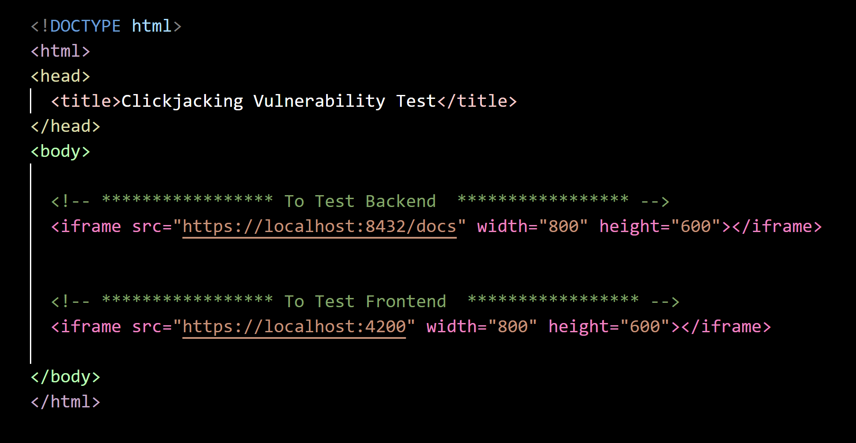
Missing Anti-clickjacking Header Exploit
Notes:
clickjacking attack: is an attack that tricks a user into clicking a webpage element which is invisible or disguised as another element causing them to unknowingly perform harmful actions like sharing data, downloading malware, or making transactions
This is a code to test the clickjacking vulnerability in both backend and frontend

Slide 15
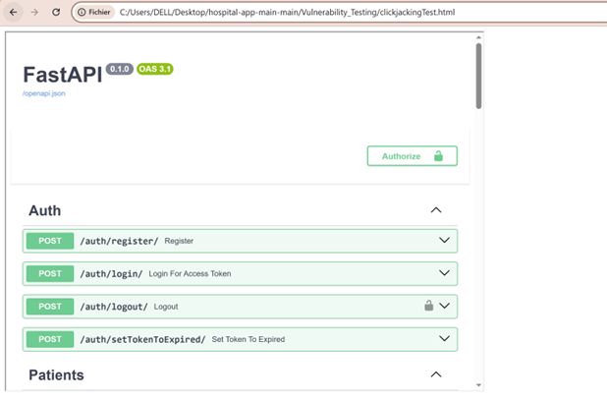
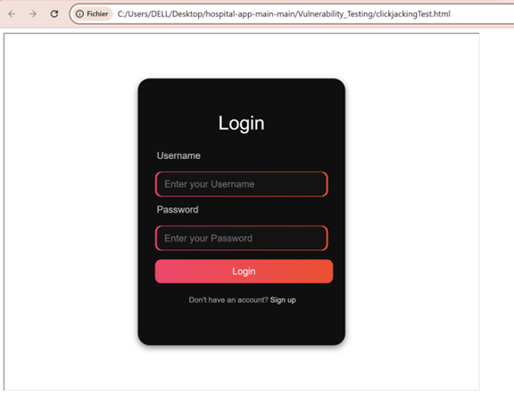
Missing Anti-clickjacking Header Exploit
Notes:
As you can see both backend and frontend code can be called within the iframe
=> In this example, we are just showing how can our website be embeded inside an iframe; but to conduct an actual clickjaking attack, the attacker still needs to make the iframe invisible and place disguised or misleading UI elements over it

Slide 16
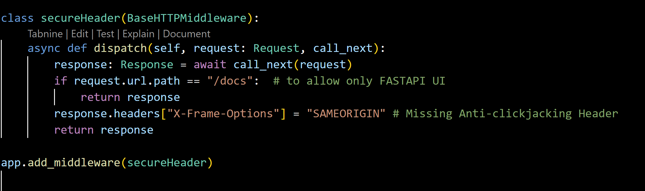
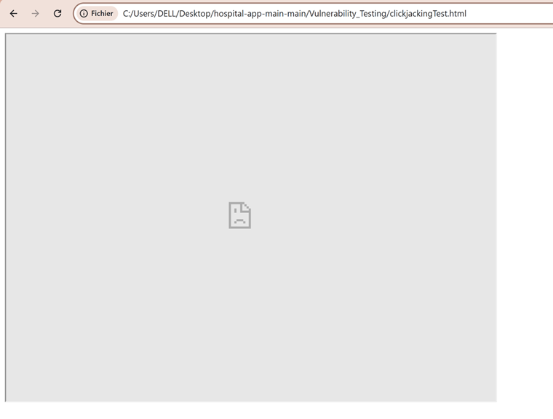
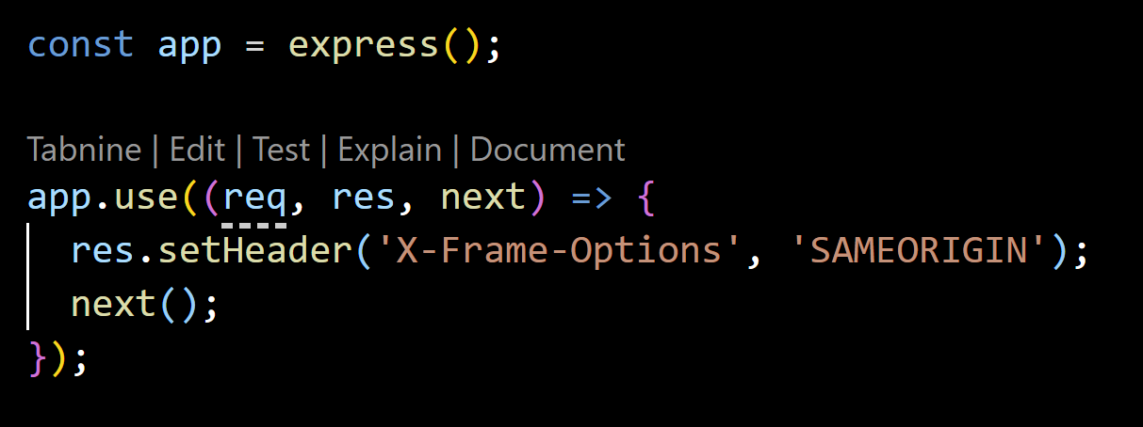
Solution Implementation
Notes:
As a solution, we have implemented X-Frame Options security header in both backend (in main.py file) and in frontend (server.py file), and we have set it to same origin meaning we are telling the browser that Only pages from my own website (same origin) can embed my pages in an iframe.
And As a result, in the right page, you can see can see that the specified endpoints are no more accessible.

Slide 17
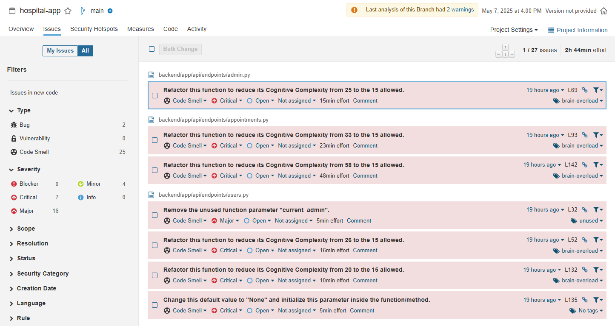
Security tests (Second time) - Result
Notes:
After improving our code, we tested for the second time and saw that issues has decreased to 27 in sonarQube

Slide 18
Name | Risk Level | Number of Instances
CSP: Failure to Define Directive with No Fallback | Medium | 2 -> 1
Content Security Policy (CSP) Header Not Set | Medium | 3
Missing Anti-clickjacking Header | Medium | 3
Sub Resource Integrity Attribute Missing | Medium | 7 -> 1
Dangerous JS Functions | Low | 1
Insufficient Site Isolation Against Spectre Vulnerability | Low | 12 -> 8
Permissions Policy Header Not Set | Low | 10 -> 8
Server Leaks Information via "X-Powered-By" HTTP Response Header Field(s) | Low | 6
X-Content-Type-Options Header Missing | Low | 9 -> 8
Authentication Request Identified | Informational | 1
Information Disclosure - Sensitive Information in URL | Informational | 4
Information Disclosure - Suspicious Comments | Informational | 8 -> 7
Modern Web Application | Informational | 1
Non-Storable Content | Informational | 2
Storable and Cacheable Content | Informational | 5
Storable but Non-Cacheable Content | Informational | 5
OWASP ZAP report
Notes:
In ZAP, the number of instances for each vulnerability has been lower, and there are 3 vulnerabilities that we had fixed completely

Slide 19
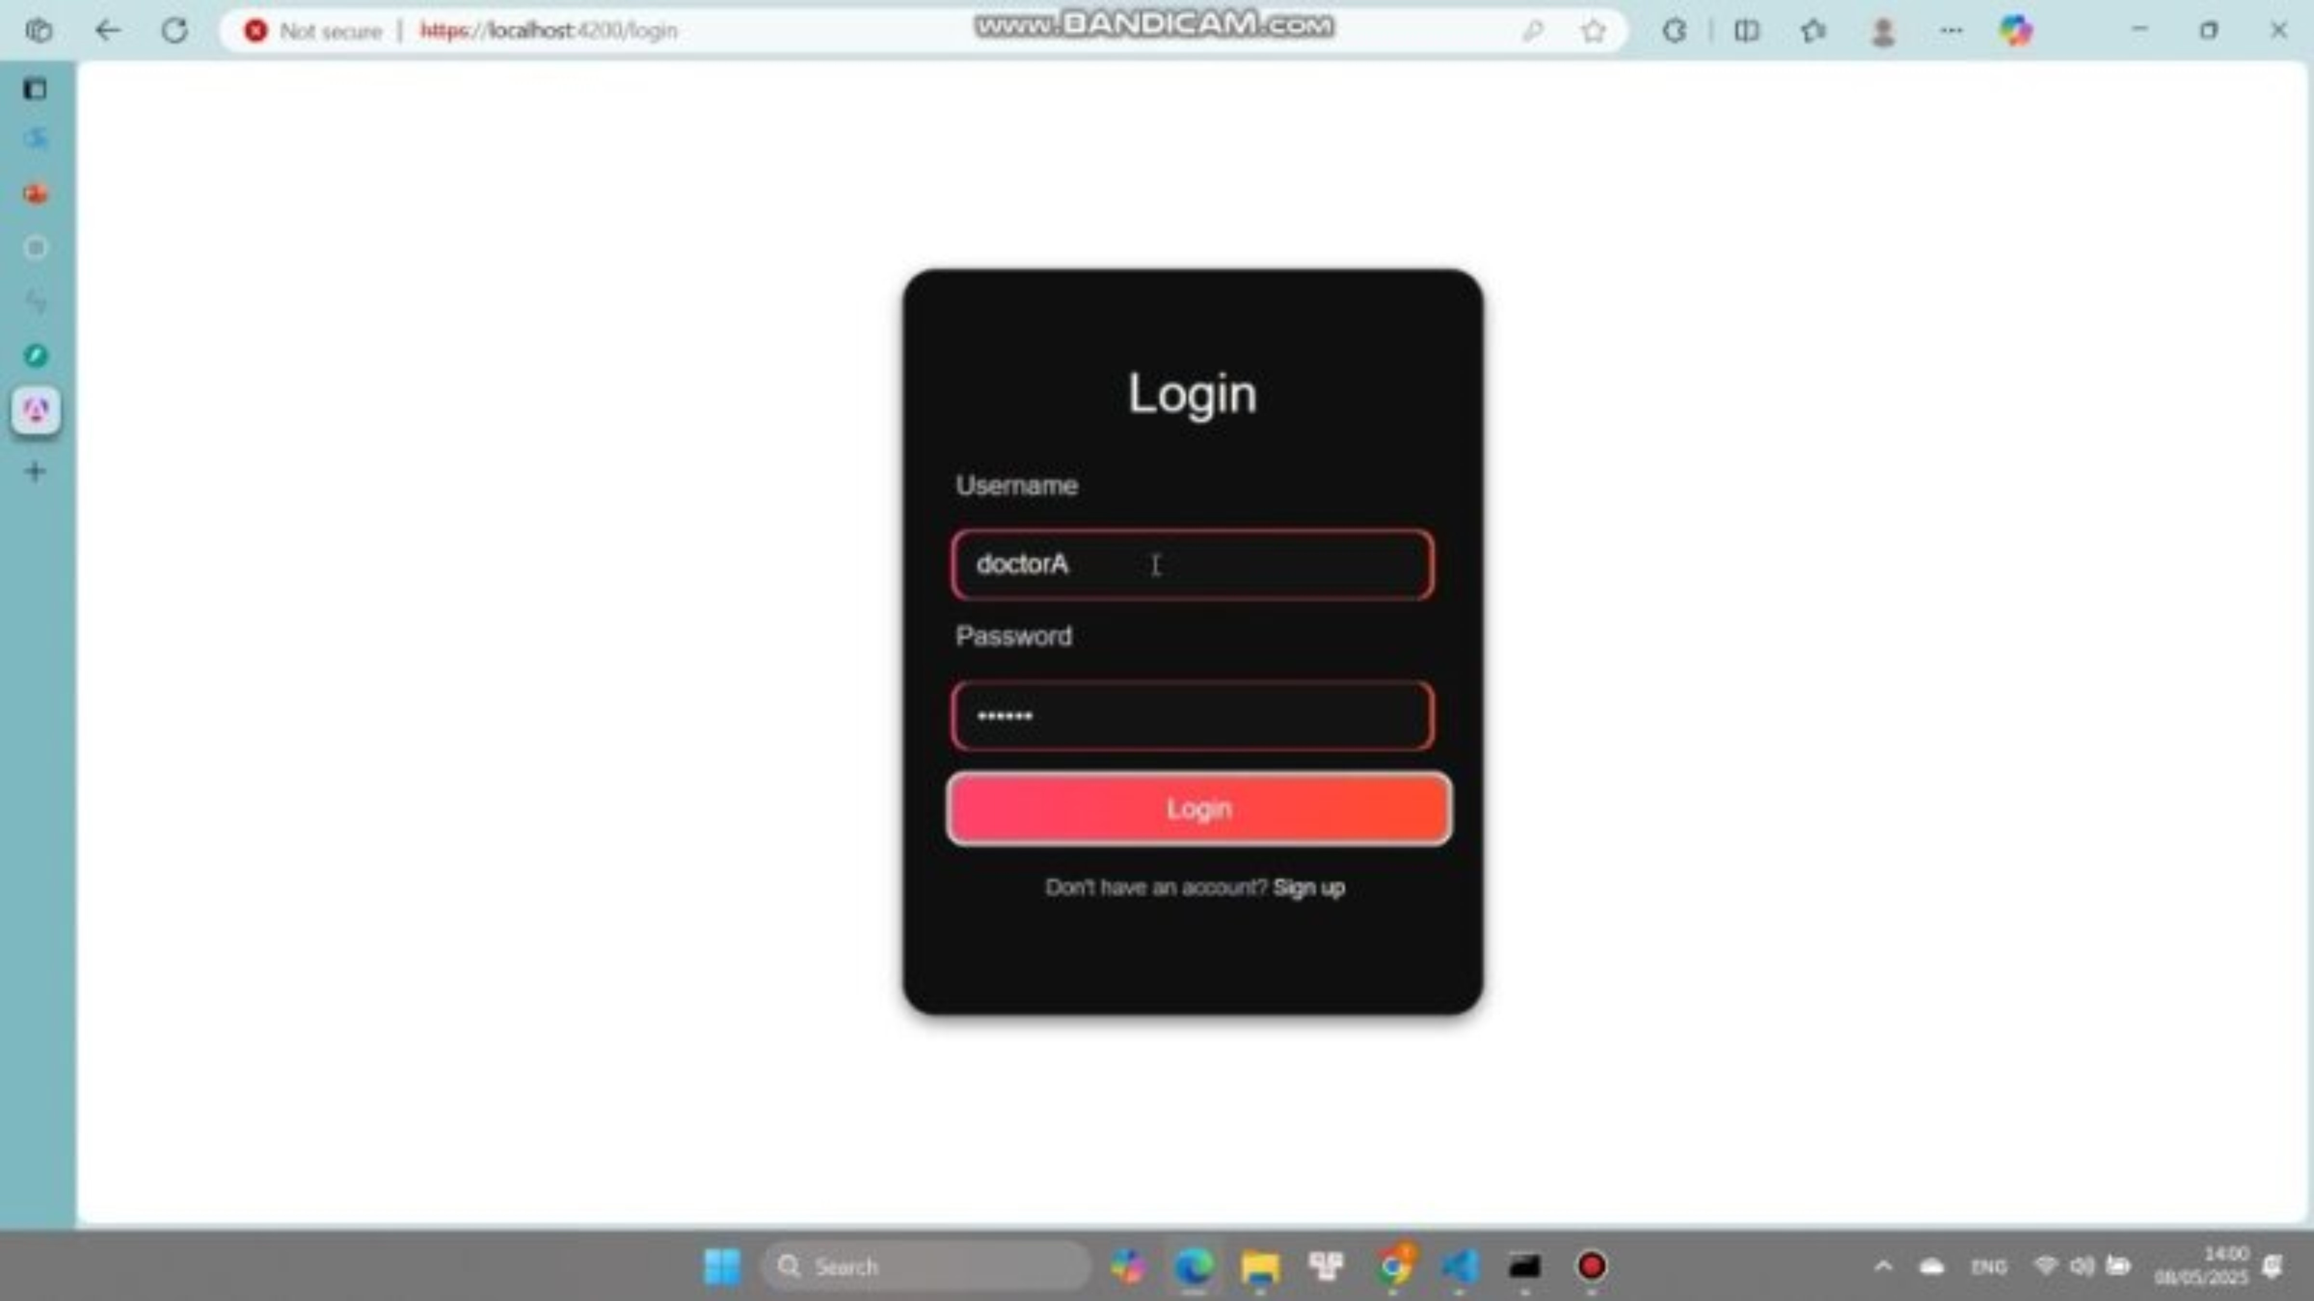
Demo

Slide 20
Further improvement
Encrypt the Entire Database
Resolve All Vulnerabilities in The Scanning Report
Add Logs Auditing
Implement Refresh Token
Rate Limiting Feature
Implement Change Password Functionality

Slide 21
AI Usage
ChatGPT
Find information: framework, security practices, vulnerabilities, etc.
Assist coding and debugging
Provide best-practice to avoid vulnerabilities

Slide 22
Thank you

Slide 23
Questions ?

