Slide 1
SWIFTLOG LOGISTICS ANALYTICS PROJECT
Business performance analysis
and recommendations
A review of customer, product, inventory, warehouse, shipment and returns data.
Prepared as part of the Logistics Analytics & Business Intelligence project

Slide 2
1. What I wanted to understand
The analysis focuses on operational performance and areas where the business could improve.
• How well is SwiftLog delivering orders?
• Are delays concentrated in particular warehouses or locations?
• What are the main reasons customers return orders?
• Which customers, products and categories contribute most to revenue?
• What can the available inventory and warehouse data tell us?
Data used
The project combines 11 datasets covering orders, customers, order items, products, warehouses, inventory, shipments, delivery performance, suppliers, employees and returns.
Scope note
The supplied order data covers 2026. Revenue currency is not specified, and some operational measures are unavailable.
2

Slide 3
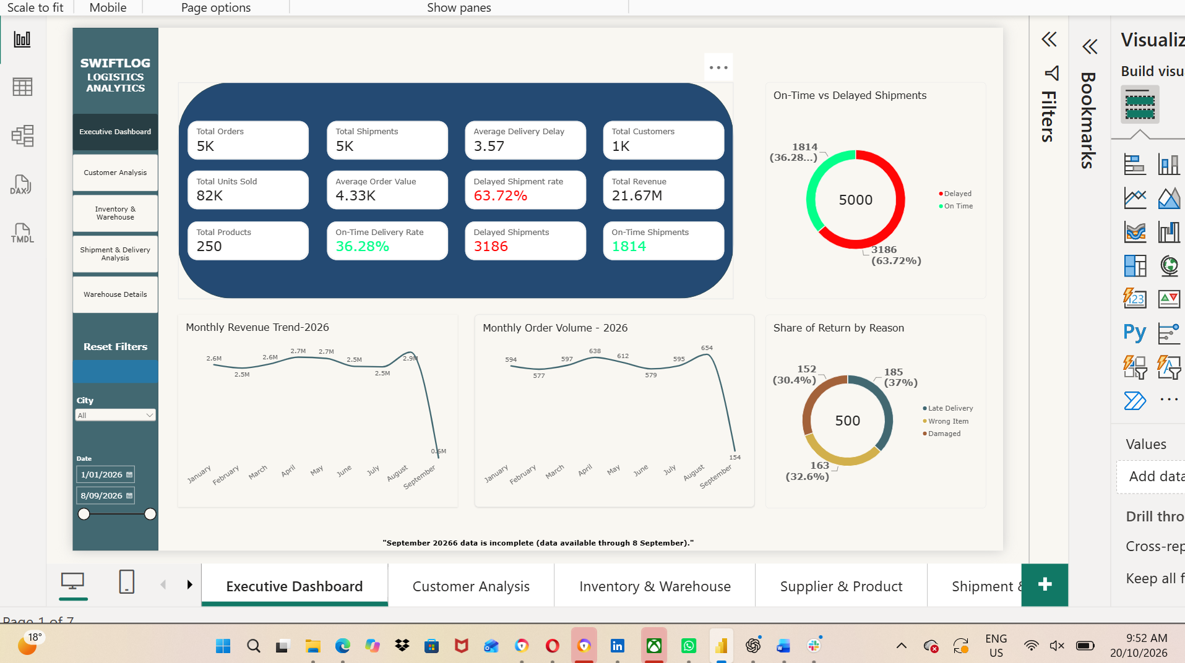
2. Overall business picture
The executive dashboard brings the main performance measures together in one view.
Overall summary
The dataset covers 5,000 orders and shipments, 1,000 customers and 250 products, with recorded revenue of about 21.67M. The executive dashboard brings these measures together with delivery outcomes to provide a high-level view of performance.
Insert your Executive Dashboard screenshot here
Initial finding
Delivery performance stands out as an area requiring further investigation. The next slides examine where delays occur and how they relate to returns.
3

Slide 4
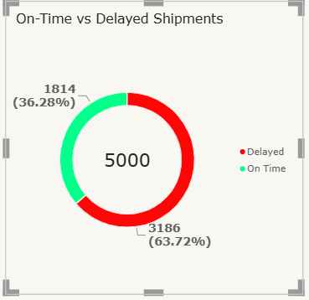
3. Delivery performance is the main concern
The status field classifies almost two-thirds of shipments as delayed.
Delayed shipments
3,186 (63.72%)
On-time shipments
1,814 (36.28%)
Average recorded delay
3.57 days
Interpretation: Nearly two-thirds of shipments (63.72%) were classified as delayed, making delivery reliability the most significant operational issue identified. Improving delivery performance should be management’s highest immediate priority.
4

Slide 5
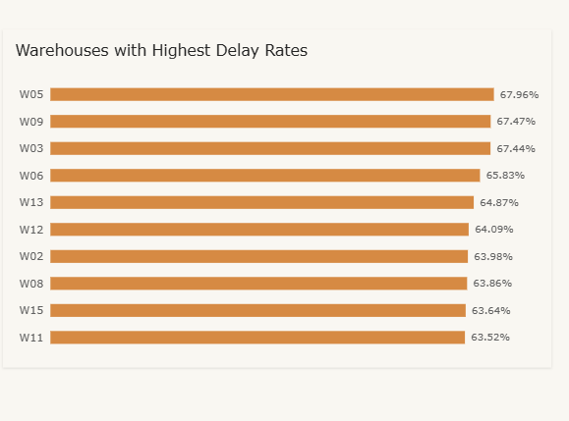
4. Warehouse performance is not uniform
W05, W09 and W03 have the highest recorded delayed-shipment rates in the comparison.
W05
67.96%
W09
67.47%
W03
67.44%
What this suggests
These warehouses are priority locations for investigation, not necessarily the least efficient. Review dispatch stages, carrier handovers, shipment volume and destination mix to identify possible causes.
W07 recorded the highest shipment volume (371), but capacity and processing-time data are needed to assess overall warehouse efficiency.
5

Slide 6
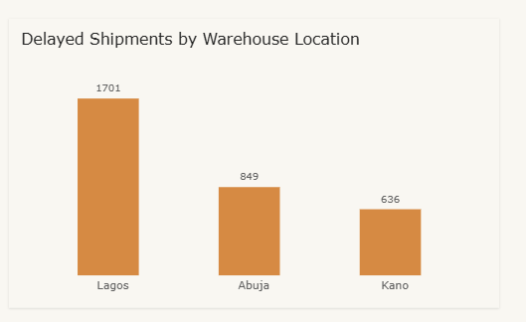
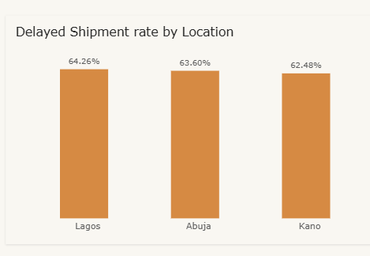
5. Location analysis adds context
Lagos has the largest number of delayed shipments, while the delay rates across the three locations are relatively close.
Lagos
1,701 delayed shipments
64.26% delay rate
Abuja
849 delayed shipments
63.60% delay rate
Kano
636 delayed shipments
62.48% delay rate
Executive takeaway: Lagos should be prioritised because it recorded both the highest delayed-shipment volume and the highest delayed-shipment rate among the locations analysed
6

Slide 7
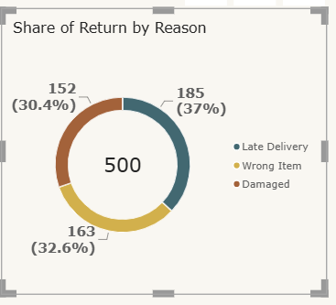
6. Late delivery is the leading return reason
Returns also point to fulfilment quality issues beyond delivery speed.
Returns recorded
500 total
• Late delivery: 185 (37%)
• Wrong item: 163 (32.6%)
• Damaged item: 152 (30.4%)
Recommendation: review late-delivery cases alongside dispatch records; address wrong-item and damage returns through separate fulfilment checks.
7

Slide 8
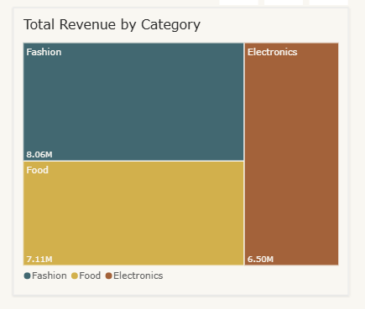
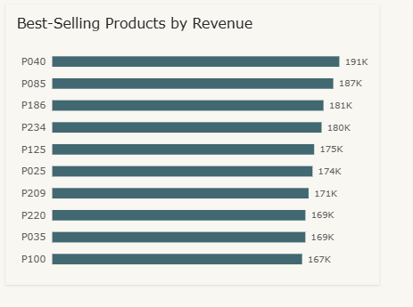
7. Customer and product analysis shows where revenue sits
Revenue patterns can guide further investigation, but they do not establish profitability.
Findings
• Total recorded revenue is about 21.67M.
• Fashion is the leading category at about 8.06M.
• P040 generated about 191K, the highest among the top products reviewed.
• The top 10 customers each generated about 57K–74K.
Business opportunity: evaluate Fashion category expansion, maintain availability of high-revenue products and strengthen retention of high-value customers. Validate profitability and demand before investing.
8

Slide 9
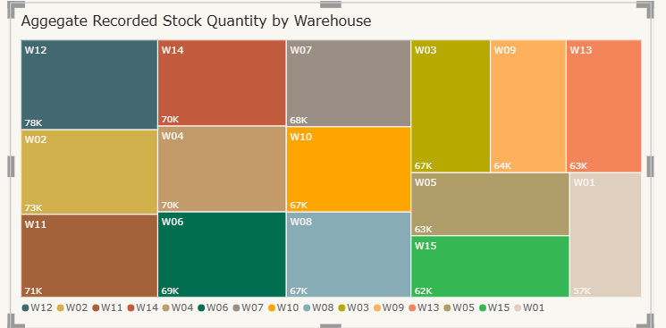
8. Inventory findings need to be interpreted carefully
The inventory table is useful for comparing recorded quantities, but it does not confirm current stock on hand.
What the data supports
• Compare recorded stock quantities by warehouse.
• Compare distinct products represented at each warehouse.
• Use shipment volume and staffing as context.
Add your recorded stock by warehouse visual
What is missing
• Current stock balances
• Warehouse capacity
• Stockout information
Recommendation: improve stock-movement records and capture current balances and warehouse capacity. Recorded quantities support comparison, but current stock balances and warehouse utilisation cannot be reliably assessed from this dataset.
9

Slide 10
9. Business recommendations
Three priorities connect operational improvement, commercial growth and better data.
Delivery & Operations
• Reduce the 63.72% delayed-shipment rate; investigate W05, W09 and W03.
• Prioritise Lagos, with 1,701 delayed shipments and a 64.26% delay rate.
• Reduce wrong-item and damage returns; improve inventory accuracy.
2. Review late-delivery returns
Trace late-delivery cases through order and shipment events to identify where time is being lost.
Revenue & Customer Growth
• Evaluate expansion of Fashion, the leading category at about 8.06M.
• Protect availability of P040, P085 and P186.
• Introduce targeted loyalty initiatives for high-value customers.
4. Improve inventory visibility
Capture current balances, stock movements and warehouse capacity.
Data & Analytics
• Explore predictive delivery monitoring.
• Link supplier data to purchasing and receiving records.
• Capture product-level returns, current stock, warehouse capacity and processing times; monitor KPIs through Power BI.
10

Slide 11
10. How improvement should be measured
Agree definitions and baselines before setting numeric targets.
AREA
MEASURE
BASELINE
DESIRED DIRECTION
Delivery
Delayed-shipment rate
63.72%
Decrease
Delivery
On-time shipment rate
36.28%
Increase
Speed
Average recorded delay
3.57 days
Decrease
Returns
Late-delivery returns
185
Decrease
Fulfilment
Wrong-item / damaged returns
163 / 152
Decrease
Inventory
Stock accuracy / stockout rate
Not available
Establish baseline
Add repeat purchase rate and Fashion revenue to monitor customer retention and category growth. Review measures regularly and compare like-for-like periods as more time-series data becomes available.
11

Slide 12
11. Assumptions and data limitations
These limitations affect which conclusions can be made from the current data.
• Supplier data is standalone, so supplier performance cannot be reliably ranked against deliveries or products.
• Warehouse capacity is not supplied; stock and staffing comparisons are not capacity-utilisation measures.
• Returns have OrderID but no ProductID, so item-level return attribution is not reliable for multi-item orders.
• Currency, product costs and margins are absent; revenue should not be described as profit.
• The status-based delayed-shipment rate differs from the proportion of shipments with positive DelayDays.
These gaps should guide future data collection and the next version of the analysis.
12

Slide 13
12. Conclusion
The analysis provides a starting point for operational improvement.
The analysis indicates that delivery reliability is SwiftLog’s most urgent operational issue, while customer retention and category expansion represent the strongest commercial opportunities.
The next steps are to:
• Improve delivery reliability.
• Grow revenue and retain customers.
• Strengthen operational visibility.
These are expected benefits rather than guaranteed outcomes.
SwiftLog Logistics Analytics & Business Intelligence Project
13

