Slide 1
Final project 2022. Software engineering lab – Group 14
Bence Szabó, Gábor Máté Hajas

Slide 2



Architecture and technologies
Database – SQLite
Client side – Angular
Server side – Express.js

Slide 3
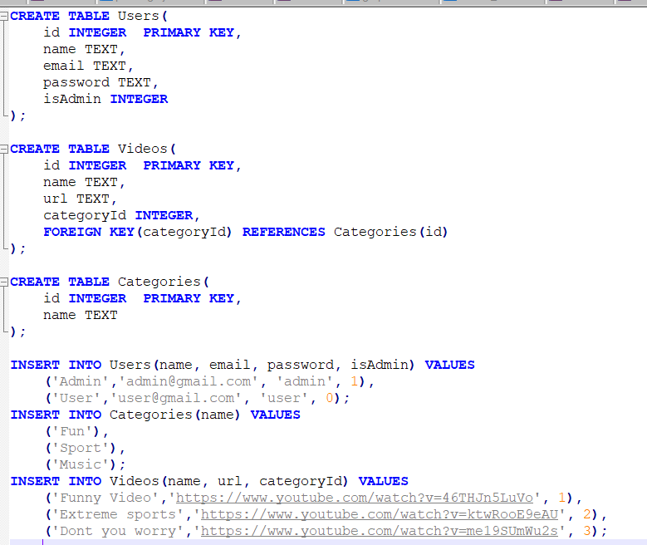
Database

Slide 4
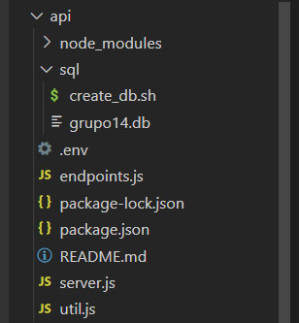
Backend design
Server.js – represents server with Express for this Node.js SQLite project
Util.js – utility functions for multiple use
Endpoints.js – logic of each endpoint is defined in that file

Slide 5
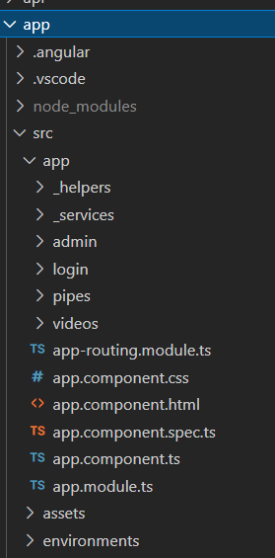
Frontend design
Divided into three components – login, admin, videos
Each component – typescript, html and css file
Services – utility methods for authentification and token storage and api calls

Slide 6
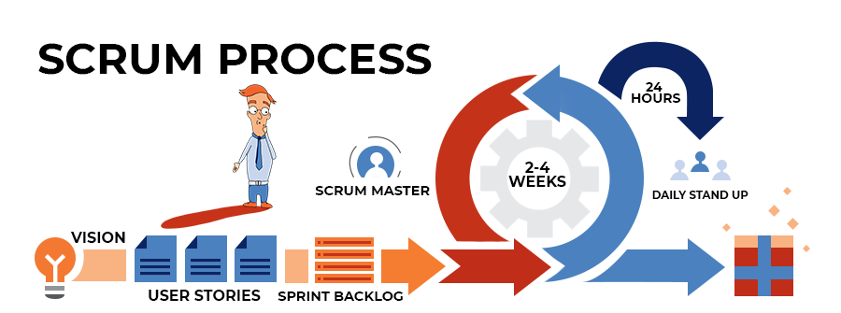
Development
Scrum- a framework for project management that emphasizes teamwork, accountability and iterative progress toward a well-defined goal

Slide 7
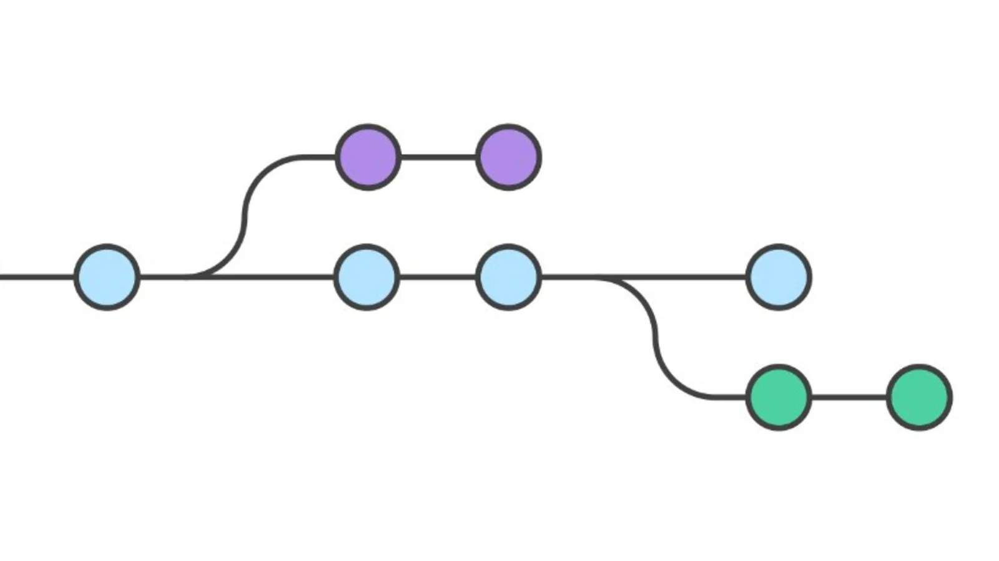
Git
free and open-source distributed version control system designed to handle everything from small to very large projects with speed and efficiency
Branches – main, features

Slide 8
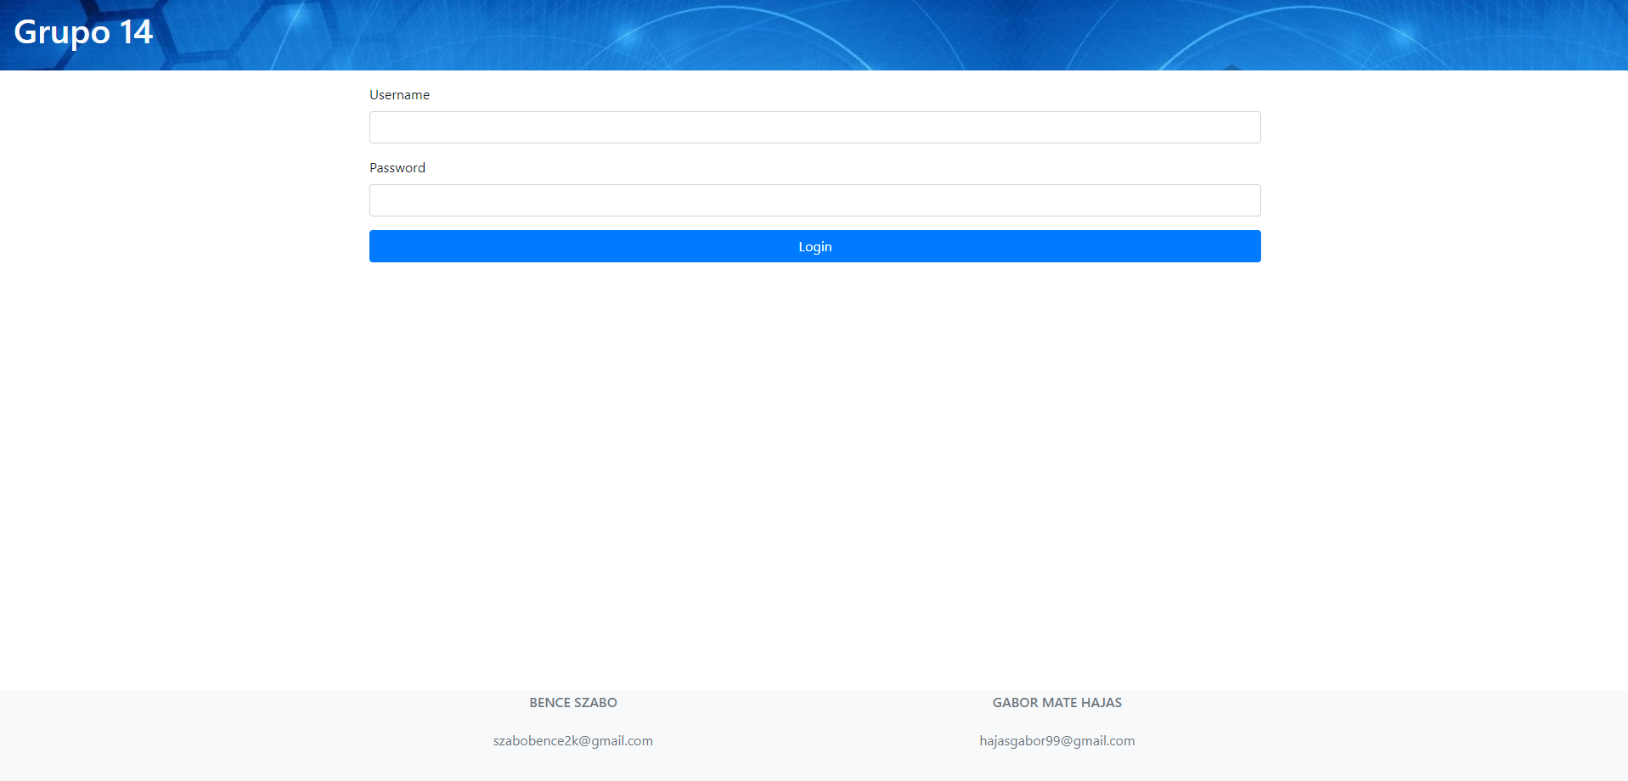

Slide 9
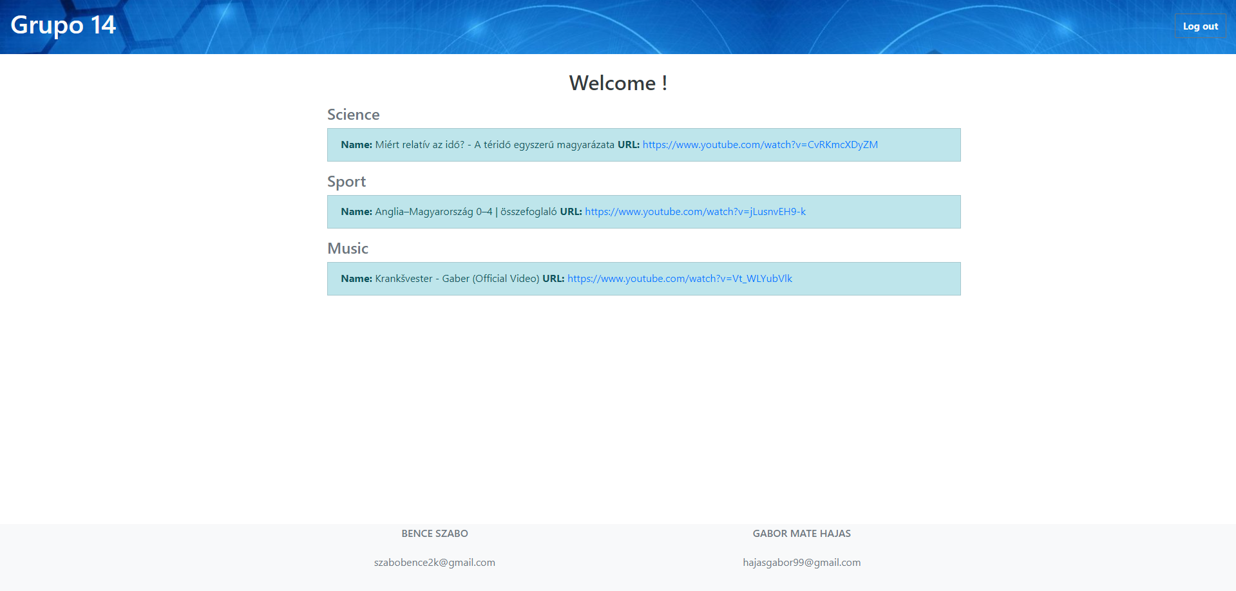

Slide 10
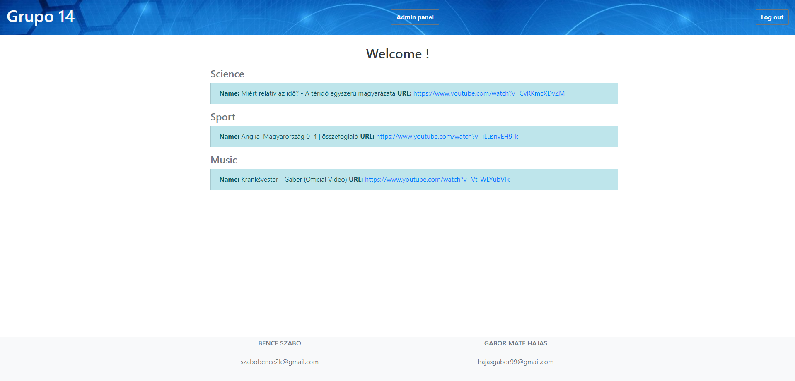

Slide 11
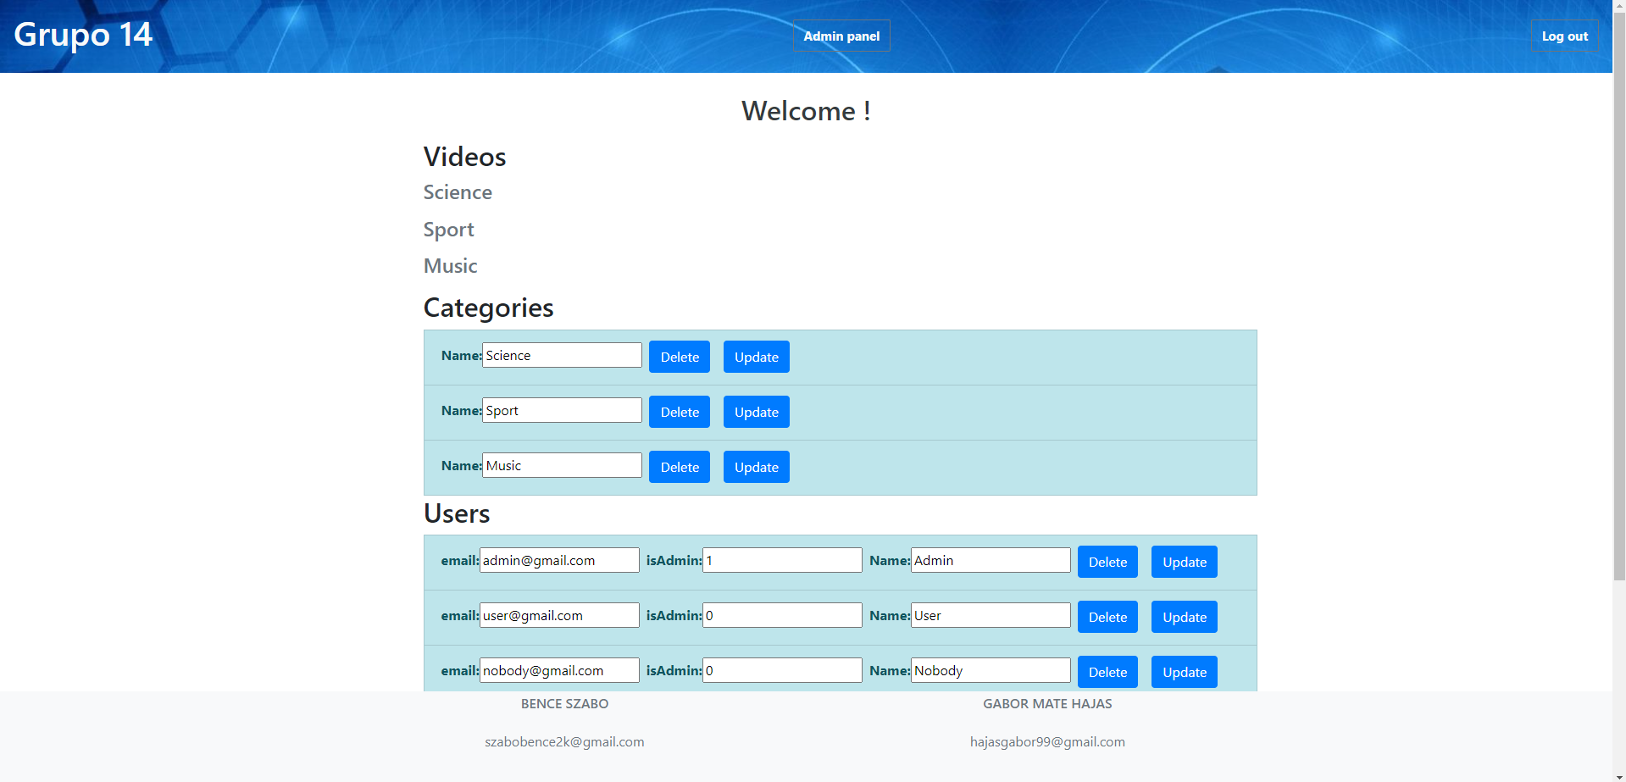

Slide 12
