Slide 1
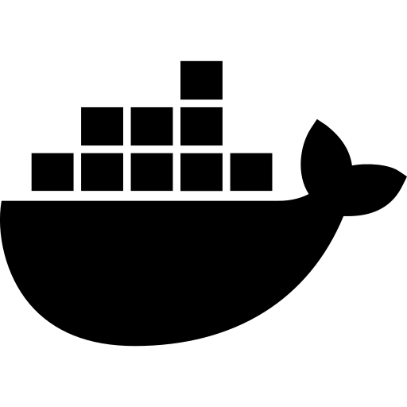
MODULE 1
Introduction to
Virtualization &
Containerization
Docker · Containers · Docker Hub · Installation
March 31, 2025 · 90 min

Slide 2


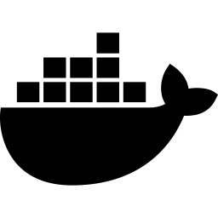


TODAY'S AGENDA
01
Introduction to Virtualization & Containerization
20 min
02
What is Containerization?
20 min
03
Docker Architecture
30 min
04
Overview of Docker Hub
20 min
05
Docker Installation
TBD

Slide 3
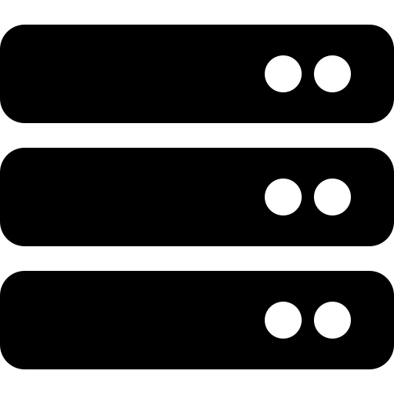
SECTION 1
Introduction to
Virtualization
Running multiple OS environments on a single physical machine

Slide 4



What is Virtualization?
Section 1 · 20 min
Virtualization is the process of creating a software-based (virtual) version of computing resources — including hardware, storage, and networks — on top of a single physical machine.
Hypervisor
Virtual Machine
Software layer that creates & manages VMs. Type 1 (bare-metal) and Type 2 (hosted).
Complete isolated OS environment with its own CPU, RAM, storage, and network.
Resource Sharing
Isolation
Multiple VMs share the same physical hardware, improving utilization.
Each VM is fully isolated — a crash in one does not affect others.

Slide 5
VMs vs Containers — Key Differences
Virtual Machines
Containers
Include full OS
Each VM has its own kernel
Share host OS
No separate kernel needed
Heavy weight
GBs in size
Lightweight
MBs in size
VS
Slower startup
Minutes to boot
Fast startup
Seconds to start
Strong isolation
Hardware-level boundaries
Process isolation
Namespace boundaries
More resource use
Dedicated RAM & CPU
Efficient resources
Shared OS kernel

Slide 6

SECTION 2
What is
Containerization?
Package your app and all its dependencies into one portable unit

Slide 7

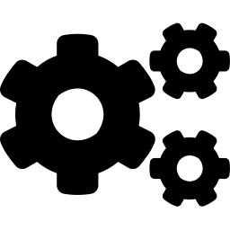
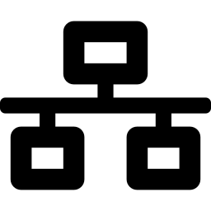


What is Containerization?
Containerization packages an application and its dependencies (code, runtime, libraries, configs) into a single, portable container that runs consistently across any environment.
Portability
Isolation
Efficiency
Runs identically on dev, test, and production — any OS, any cloud.
Apps don't interfere with each other; secure process-level boundaries.
Shares the host OS kernel — uses far less CPU and RAM than VMs.
Scalability
Consistency
Version Control
Spin up thousands of containers instantly. Perfect for microservices.
"Works on my machine" problem solved. Same container everywhere.
Container images are versioned and immutable — roll back instantly.

Slide 8
How Containers Work — Core Concepts
Namespaces
cgroups
Union FS
PID — Process isolation
Limit CPU usage
Layered filesystem
NET — Network isolation
Limit memory usage
Base image layer (read-only)
MNT — Filesystem isolation
Control disk I/O
Container layer (writable)
UTS — Hostname isolation
Control network bandwidth
Efficient storage sharing
IPC — Inter-process isolation
Monitor resource usage
Fast image distribution
💡 Containers use Linux kernel features — namespaces for isolation, cgroups for resource limits, and Union FS for layered images.

Slide 9
SECTION 3
Docker
Architecture
Client · Daemon · Images · Containers · Registries

Slide 10
Docker Architecture Overview
DOCKER CLIENT
DOCKER HOST (DAEMON)
REGISTRY
docker build
IMAGES
CONTAINERS
Docker Hub
docker pull
nginx:latest
web-app
AWS ECR
REST API
ubuntu:22.04
db-service
docker run
GCR
node:18
api-gateway
docker push
Azure ACR
Volumes
Networks
docker ps
Persistent
data storage
Bridge, host,
overlay, none
Self-hosted
docker stop

Slide 11
Docker Key Components
Dockerfile
Docker Image
Docker Container
A text file with instructions to build a Docker image. Every instruction creates a new layer.
Read-only template with all files, dependencies, and instructions needed to create a container.
A running instance of an image. Lightweight, isolated, ephemeral. Has its own filesystem and network.
FROM ubuntu:22.04
RUN apt-get update
COPY app/ /app
CMD ["python", "app.py"]
docker build -t myapp:1.0 .
docker images
docker image inspect myapp:1.0
docker run -d -p 80:8080 myapp:1.0
docker ps
docker exec -it <id> bash

Slide 12

SECTION 4
Overview of
Docker Hub
The world's largest library of container images

Slide 13
Docker Hub — The Container Registry
What is Docker Hub?
Popular Official Images
Cloud-based registry
Store & distribute images
nginx
ubuntu
node
Web server
Linux OS
Node.js runtime
Public repositories
Free for open source
postgres
python
redis
Database
Python runtime
Cache / MQ
Private repositories
Secured team images
Hub Commands
Official images
Verified by Docker
docker search nginx
# Search images
Automated builds
Git → image pipeline
docker pull nginx:latest
# Download image
Webhooks
CI/CD integrations
docker push myuser/myapp:1.0
# Upload to Hub
docker login
# Authenticate

Slide 14

SECTION 5
Docker
Installation
Windows · macOS · Linux (Ubuntu)

Slide 15
Docker Installation Guide
WIN
Windows
MAC
macOS
NIX
Linux (Ubuntu)
Requires: Windows 10/11 Pro, WSL 2
Requires: macOS 12+ (Intel or Apple Silicon)
Requires: Ubuntu 20.04 / 22.04 LTS
1
Download Docker Desktop from docker.com
1
Download Docker Desktop for Mac
1
sudo apt-get update
2
Run installer → Enable WSL 2 backend
2
Drag Docker.app to Applications
2
sudo apt-get install ca-certificates curl
3
Restart computer
3
Launch Docker from Applications
3
curl -fsSL https://get.docker.com | bash
4
Launch Docker Desktop
4
Grant necessary permissions
4
sudo usermod -aG docker $USER
5
docker --version
5
docker --version
5
docker --version

Slide 16
Verify & Run Your First Container
Verification Commands
$ docker run hello-world
Hello from Docker!
This message shows that your
installation appears to be
working correctly.
$ docker --version
Check Docker CLI version
$ docker info
Show system-wide info
$ docker run hello-world
Run test container
What happens behind the scenes?
$ docker ps
Docker client contacts the daemon
List running containers
Daemon pulls hello-world from Docker Hub
$ docker images
Daemon creates container from image
List downloaded images
Container runs and prints message
Container exits

Slide 17
Key Takeaways
What you learned today
Virtualization
Containerization
Docker Architecture
Hypervisors enable multiple OS instances on one physical machine.
Packages apps with all dependencies for consistent, portable deployment.
Client, Daemon, Images, Containers, and Registries work together.
Docker Hub
Installation
World's largest registry — pull, push, and share container images.
Docker Desktop for Win/Mac, apt/script for Linux. Verify with hello-world.

Slide 18
Q&A
Questions & Discussion
Further Resources
docs.docker.com — Official documentation
hub.docker.com — Docker Hub registry
play-with-docker.com — Free online playground
Module 1 · Introduction to Virtualization & Containerization · March 31, 2025

