Slide 1

Rajeev Institute of Technology
Miniproject on
“COVID-19 TESTING MANAGEMENT SYSTEM
USING PHP AND MYSQL’’
Under The Guidance of:
Dr. Pramod H B Associate Professor,
Dept. of CSE
Submitted By:
Hajeera Khanum
4RA20SCS03

Slide 2
Contents
Abstract Introduction
Problem Statement
Objective
Requirements Specification
Methodology
Advantages
Conclusion
References

Slide 3
Abstract
Nowadays, COVID-19 Testing Management System is one of the most essential tools that are mostly used in Testing Lab.
The Our main intention is to allow this application to be used in most retailing COVID19 lab, where a small point of customization will be required to each COVID19 lab in the implementation period.
This system is designed to overcome all challenges related to the management of diagnostic that were used to be handled locally and manually.
It will manage all activities around the COVID19 lab that minimizing the risk of getting loss because all transactions are recorded to the system.

Slide 4
Introduction
COVID19 Testing Management System is web based technology which brings up various diagnosis works online.
Once registered with their address and contact details, the patients may now see a variety of tests conducted by the lab.
After successful sample collection patient can track their test history using the name, order and registered mobile number.
The system allows admin to attach a copy of the report into the system and automatically shown on user side so user can downloads report.

Slide 5
Problem Statement
Today also we have to go to the COVID19 Test Lab center, wait in the queue to get our COVID19 test done. As Technology is growing rapidly we are also moving to a technical world where everything we want to be online. So with the help of this project we are bringing the use of technology in the field of medical diagnosis where patients can avail all the diagnosis facilities at their door steps.

Slide 6
Objective
This project makes the diagnosis process easy and reduces the burden of patients. At a same time its help the diagnostic center to track all their patients details with their test reports. This access friendly software provides quick and effective services which helps the diagnostic center to increase their sales and profit. The main purpose of COVID19 Testing management system to provide a platform where patients can book the test online and get their COVID19 test done at home.

Slide 7
Requirements Specification
Hardware Configuration:
PROCESSOR : Intel Core ,i5
RAM : 1 GB
HARD DISK : 80 GB
Software Requirement:
OPERATING SYSTEM : Windows 7/ XP/8 /10
FRONT END : HTML, CSS, JAVA SCRIPT.
SERVER SIDE SCRIPT : PHP
DATABASE : MYSQL
WEB BROWSER : Gooogle Chrome or any compatible bowser

Slide 8
Methodology
In COVID19 Testing Management System we use PHP and MySQL database. It has three modules i.e.
Admin
User (Patient)
Public website
The transaction procedure is successful only if the input data by the card holder matches with the database.

Slide 9
Admin Module
Admin is the super user of the website who can manage everything on the website. Admin can log in through the login page
Dashboard: In this section, the admin can see all detail in brief like the total, assigned and the sample collected and completed tests.
Phlebotomist: In this section, the admin can manage Phlebotomist (add, update, delete).

Slide 10
Testing: In this section, the admin can manage all the tests like assign the test to Phlebotomist and update the history.
Report: In this section, the admin can generate two types of report. One is between dates reports and another one is by search. Admin can search the report by order number, name and mobile number.
Notification: In this section, the admin will get a notification for every new test request (notification bell).
Admin can also update his profile, change the password and recover the password.

Slide 11
User (Patient) Module
Testing: This section divided into two parts. One is for new user and another one is for registered user.
Report: In this section, Users can search their test report using order number, name and registered mobile number.
Dashboard: In this section, the User can see the in which State of how many tests are done.
Public Website
About COVID19
Symptoms
Prevention

Slide 12
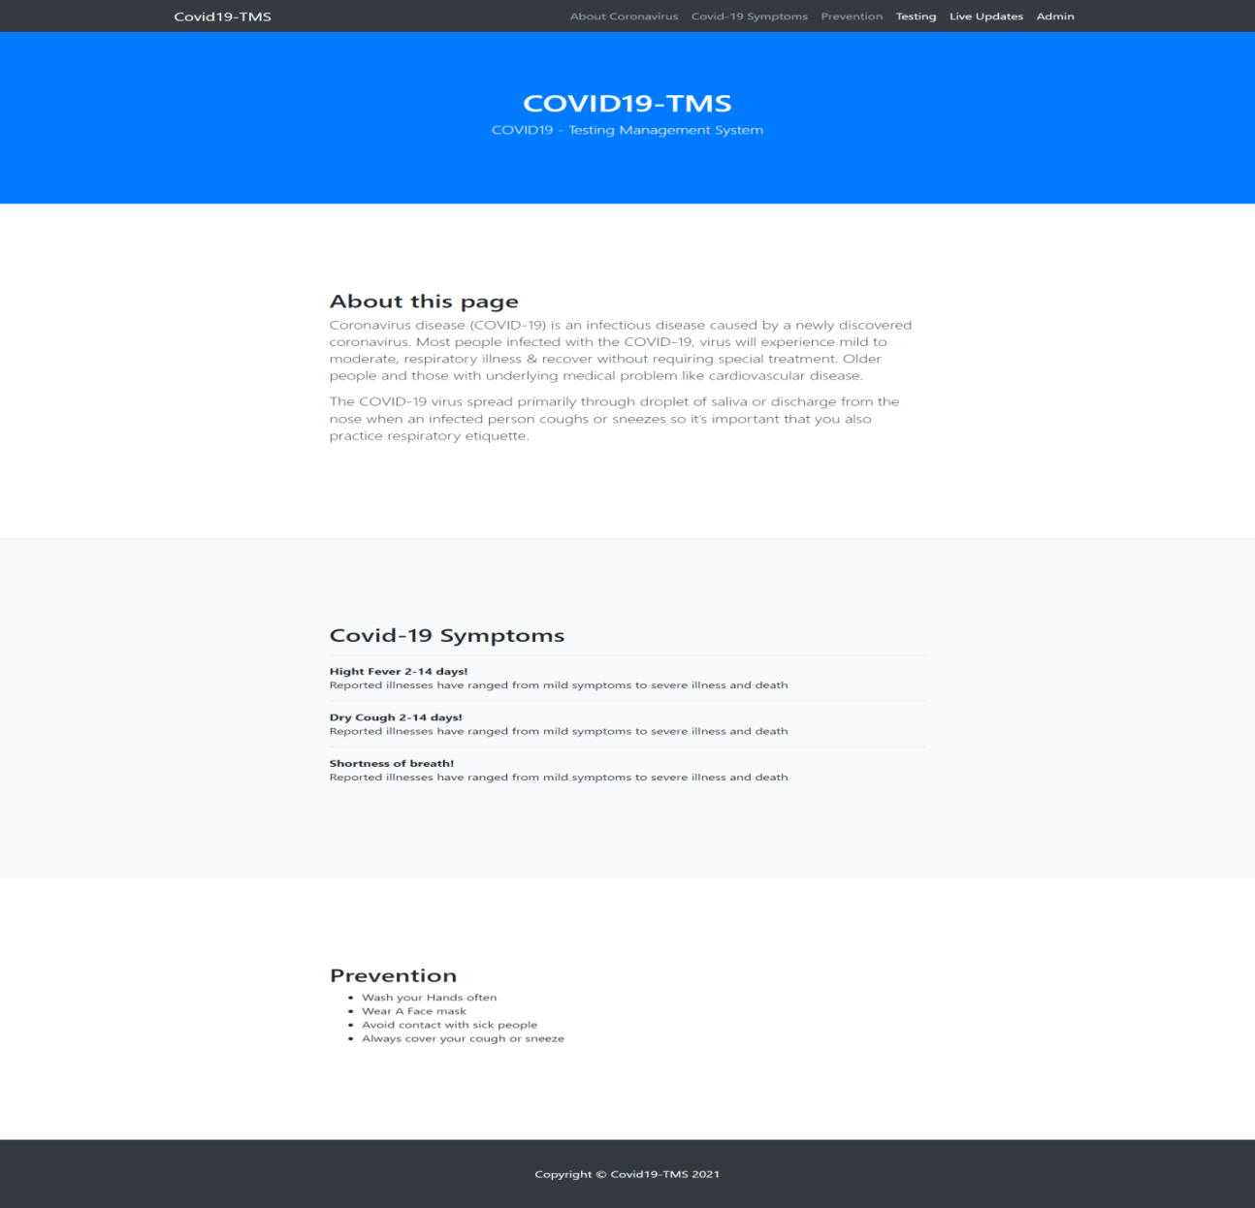
Screenshots

Slide 13
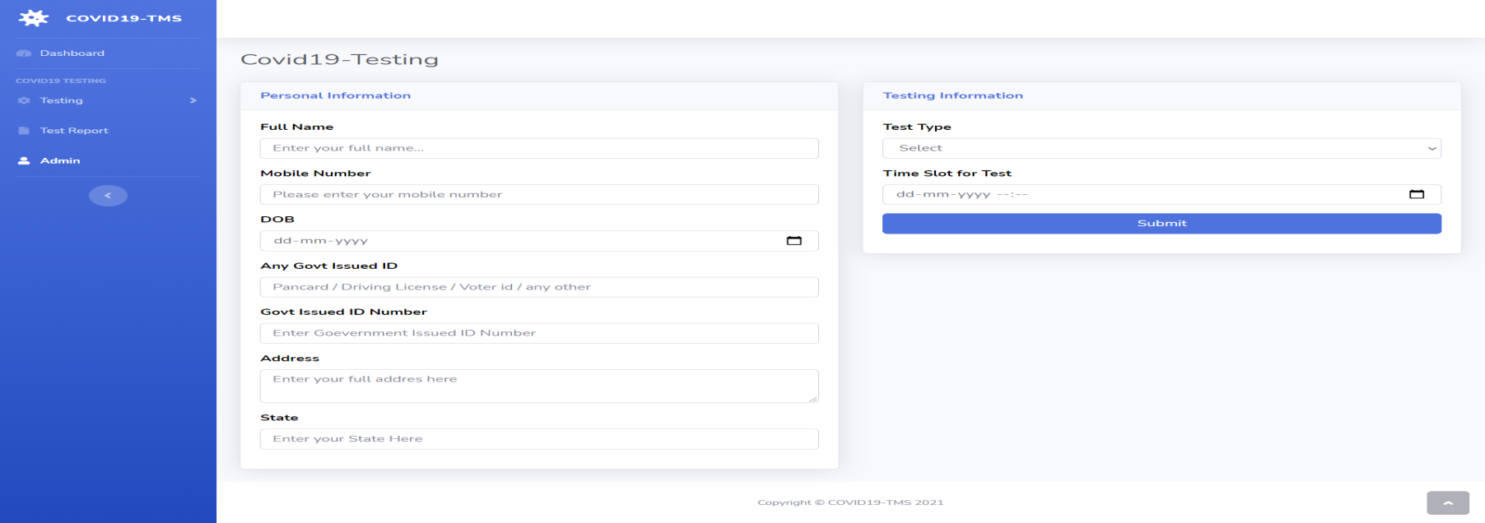
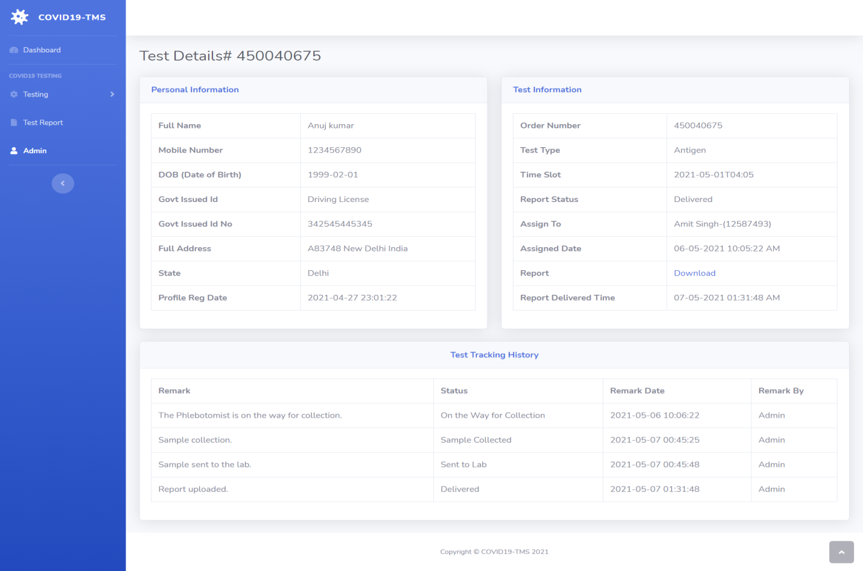

Slide 14
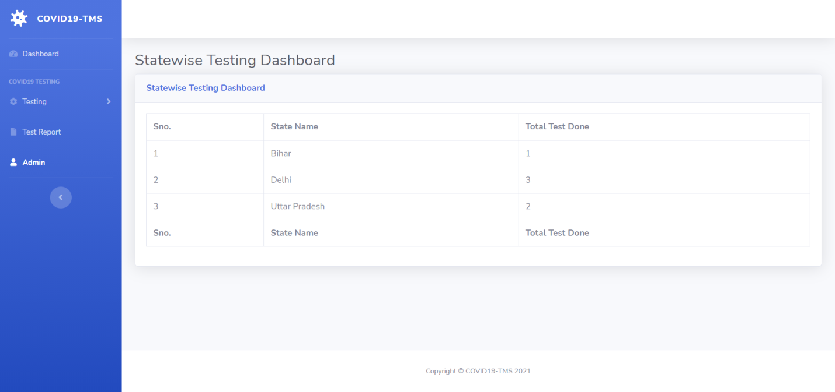
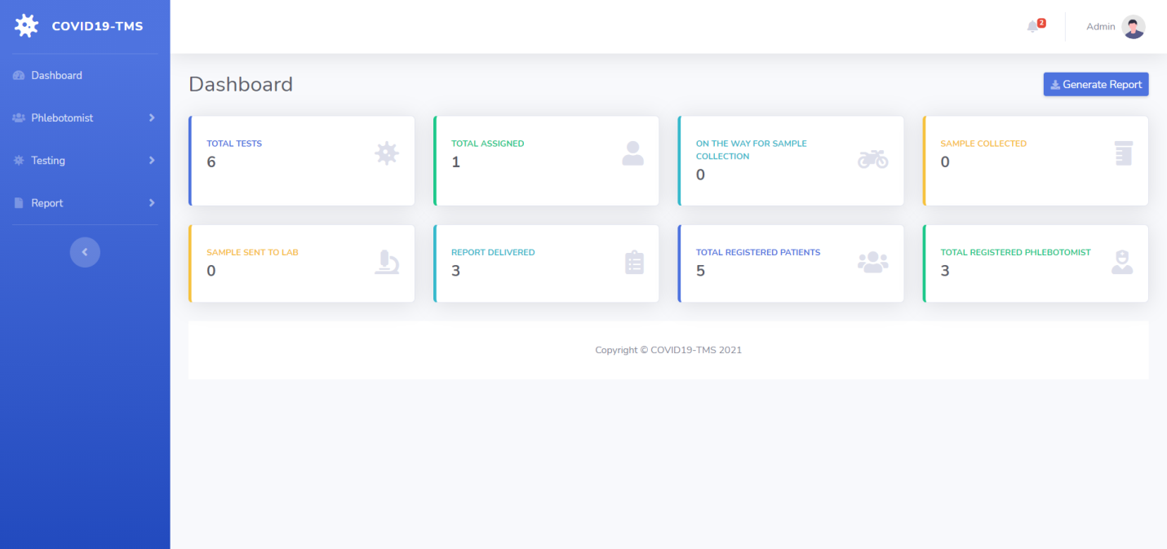

Slide 15
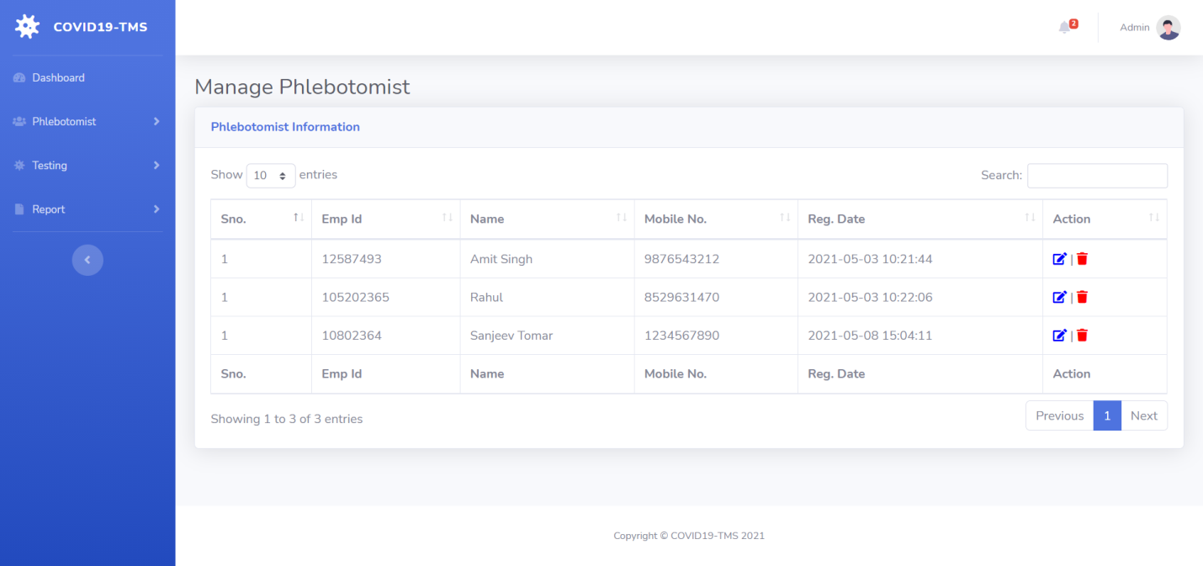
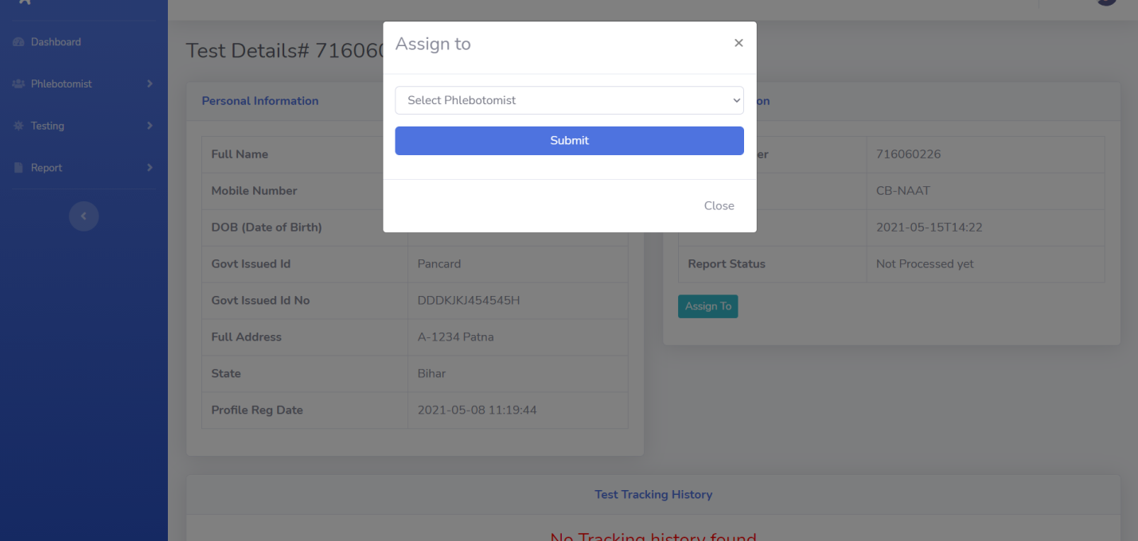

Slide 16
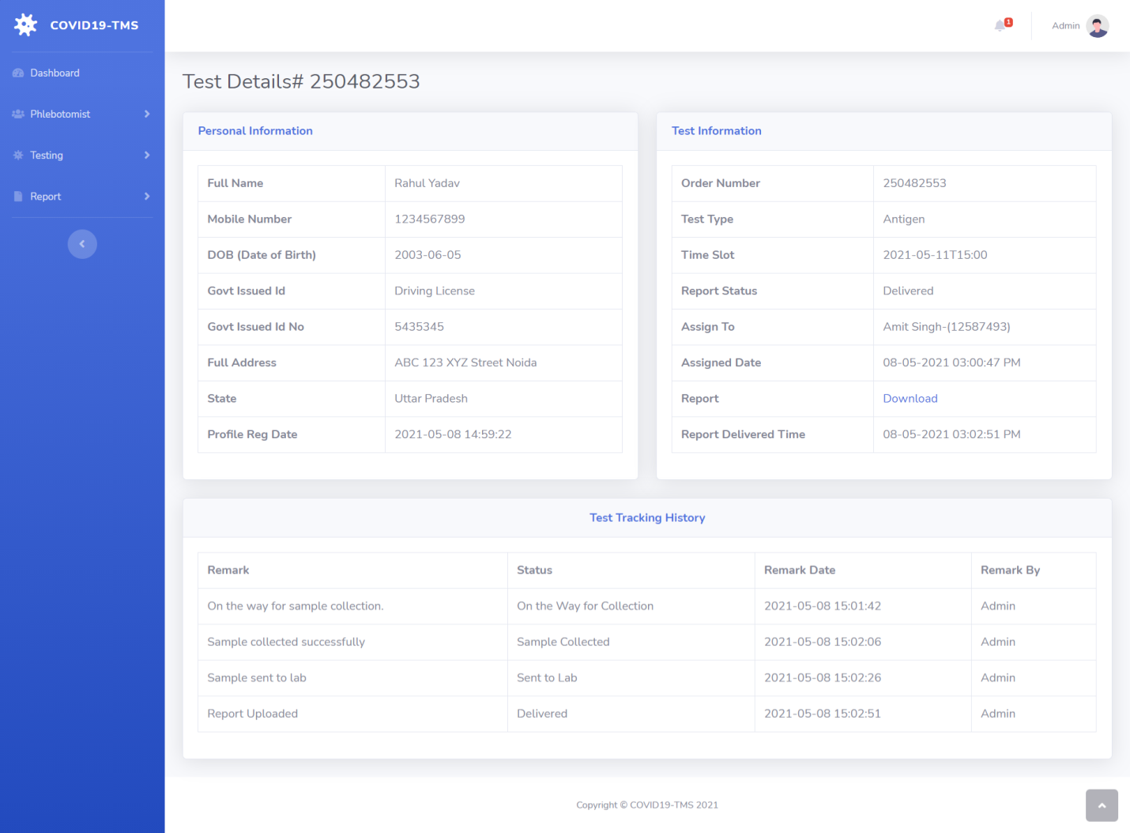

Slide 17
Advantages
The system allows automate diagnosis system.
Allows for faster service.
Allows increased sales and profits for diagnostic labs.
Easy, user friendly GUI.
Validation of data will be ensure only accurate valid and complete data stored in the database.
Easy retrieval or data will be made possible by finding techniques.
Report generation will help made it easy to analyze the performance.

Slide 18
Conclusion
This project provides a friendly graphical user interface which proves to be better when compared to the existing system.
It gives appropriate access to the authorized users depending on their permissions.
It effectively overcomes the delay in communications.
Updating of information becomes so easier. System security, data security and reliability are the striking features.

Slide 19
References
Gollier and Gossner (2020, March). Group Testing Against Covid-19. EconPol Policy : Evidence on COVID-19 in Scandinavia (SSRN Scholarly Paper ID 3594014).
Baunez, C., Degoulet, M., Luchini, S., Pintus, P., & Teschl, M. (2020). Sub-National Allocation of COVID-19 Tests: An Efficiency Criterion with an Application to Italian Regions, Social Science Research Network.
Carlsson-Szlezak et al, Phillip, Reeves, M., & Swartz, P. (2020, March). What Coronavirus Could Mean for the Global Economy.
Martín-Calvo, D., Aleta, A., Pentland, A., Moreno, Y., & Moro, E. (2020).Effectiveness of social distancing strategies for protecting a community from a pandemic with a datadriven contact network based on census and real-world mobility data. MIT Connection Science, 13.

Slide 20
THANK YOU

