Slide 1
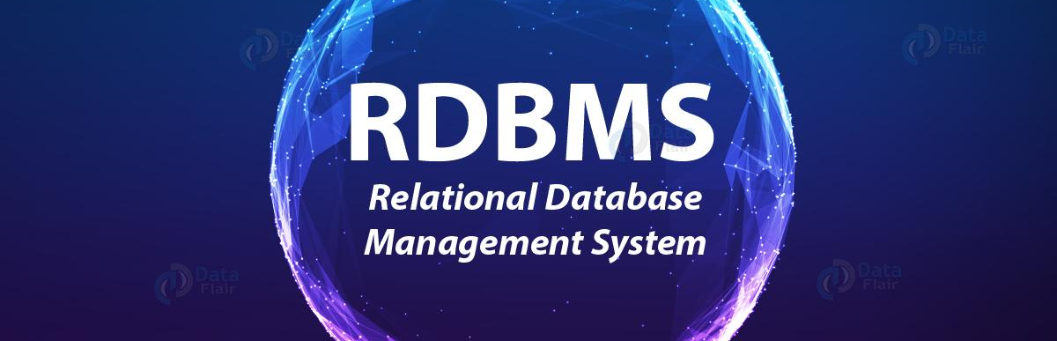
Checkpoint RDBMS
Hajer Benzarti

Slide 2
Introduction RDBMS
RDBMS stands for Relational Database Management System. RDBMS is the basis for SQL, and for all modern database systems like MS SQL Server, IBM DB2, Oracle, MySQL, and Microsoft Access.
A Relational database management system (RDBMS) is a database management system (DBMS) that is based on the relational model as introduced by E. F. Codd.
The data in an RDBMS is stored in database objects which are called as tables. This table is basically a collection of related data entries and it consists of numerous columns and rows.

Slide 3
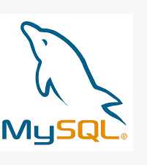
MySQL

Slide 4
What’s My SQL?
MySQL is a relational database management system (RDBMS) based on SQL (structured Query Language). MySQL works on virtually all platforms, including Linux and windows. It is fully multithreaded with a core of threads, and provides APIs for many programming languages, including C, C++, Effel, Java, Perl, PHP, PYTHON and Tcl.
MySQL is used in a wide range of applications , e-commerce, web databases …

Slide 5
MySQL strengths:
Multi Thread
It is easy to understand (simple syntax)
Language is functional: it works on many different platforms
It has an extensive library of functions and APIs
High Storage capacity

Slide 6
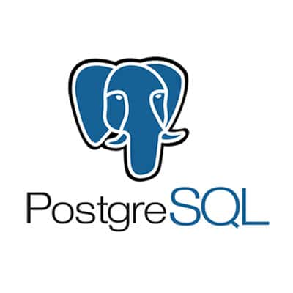
Postgre SQL

Slide 7
What is PostgreSQL?
PostgreSQL is an advanced, enterprise-class, and open-source relational database system. PostgreSQL supports both SQL (relational) and JSON (non-relational) querying.
PostgreSQL is a highly stable database backed by more than 20 years of development by the open-source community.
PostgreSQL is used as a primary database for many web applications as well as mobile and analytics applications.

Slide 8
Open-Source DBMS
Diverse indexing techniques
support languages PL/pgSQL, PL/Python, PL/Perl, C/C++, and PL/R.
ACID and Transaction
Diverse Community
Flexible Full-text search
Diversified extension functions
Diverse kinds of replication
Postgre SQL strengths:

Slide 9
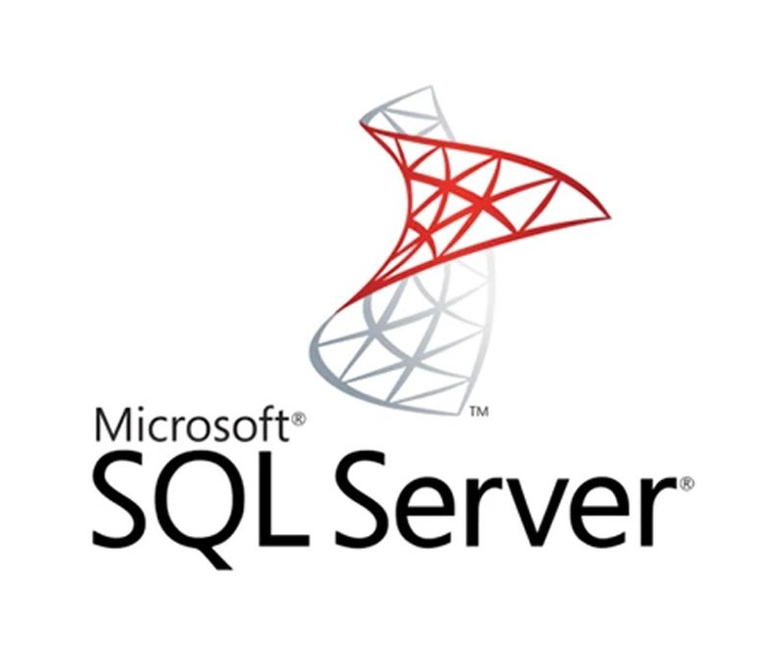
SQL Server

Slide 10
What is Microsoft SQL Server?
Microsoft SQL Server, relational database management (RDBMS)Microsoft SQL Server is a database management system (DBMS) in SQL language incorporating, among other things, an RDBMS (relational DBMS) developed and marketed by the Microsoft company.
SQL server Express is a free entry-level version of the database that is ideal for learning as well as for building desktop applications and small servers up to 10 GB of data
It works on windows and linux OS, but It is possible to launch it on MacOs via Docker.

Slide 11
SQL server strengths:
SQL Server Management Studio : easy to manage databe
Data compression and backups
Very good performance in general under windows
Extensive security options
Integration with other Microsoft products
Free Express version

Slide 12
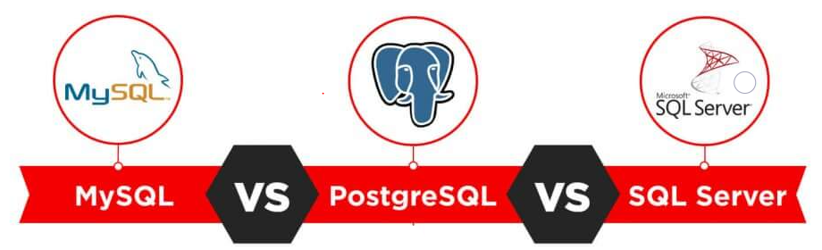

Slide 13
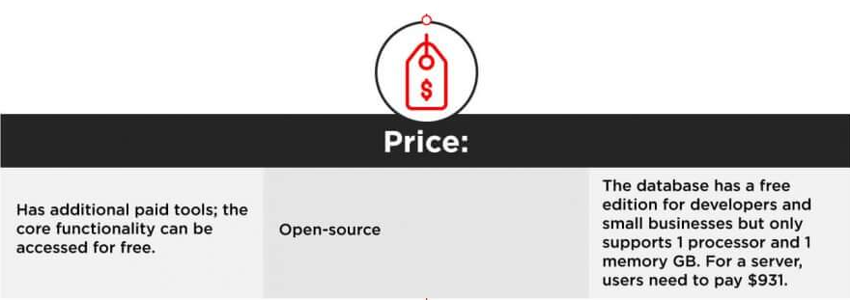
MySQL
Postgre SQL
SQL Server

Slide 14
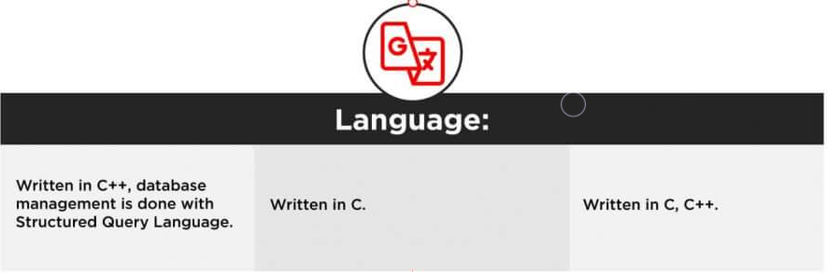
MySQL
Postgre SQL
SQL Server

Slide 15
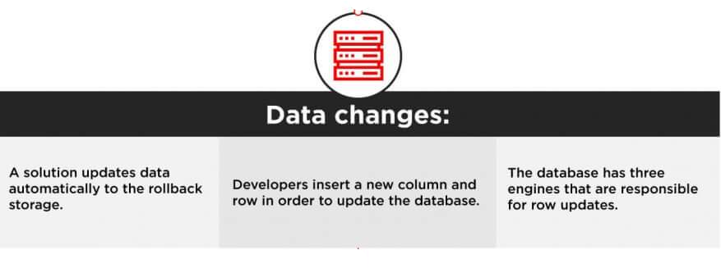
MySQL
Postgre SQL
SQL Server

Slide 16
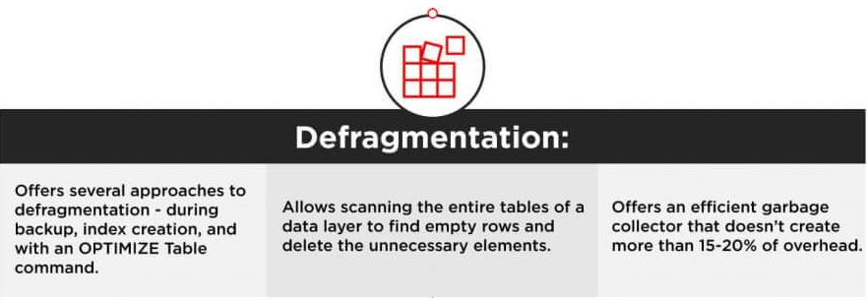
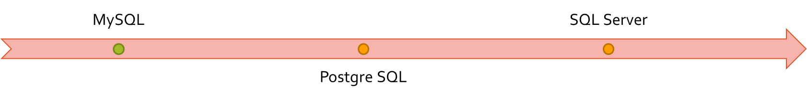

Slide 17
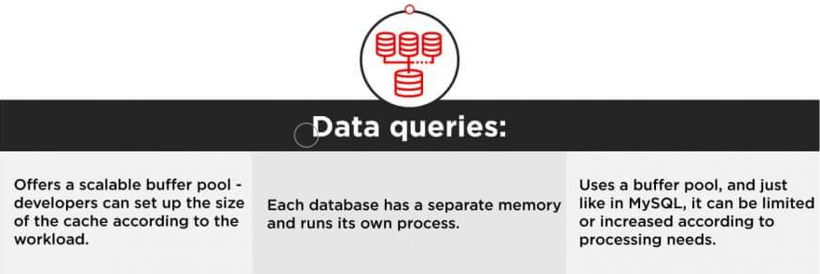
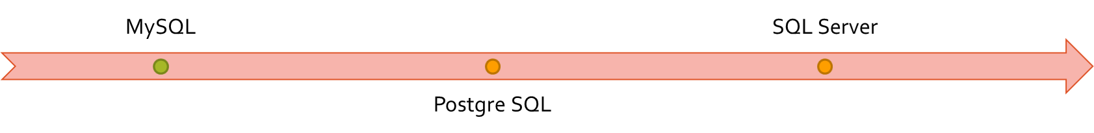

Slide 18
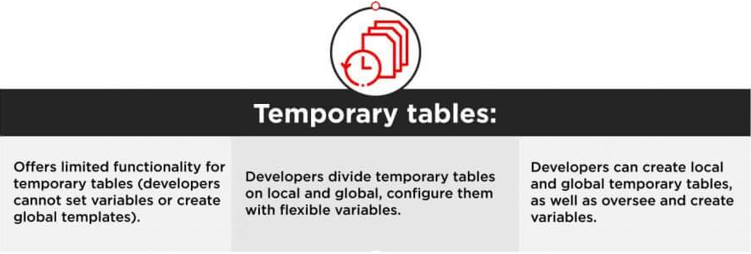

Slide 19
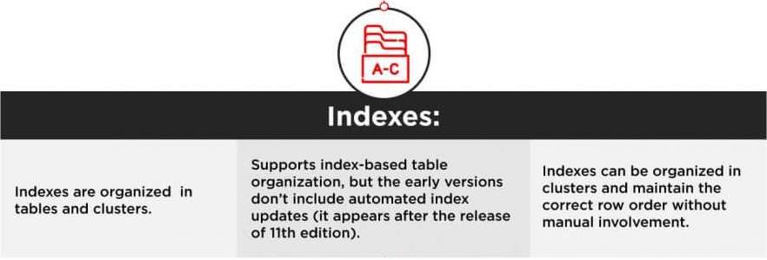

Slide 20
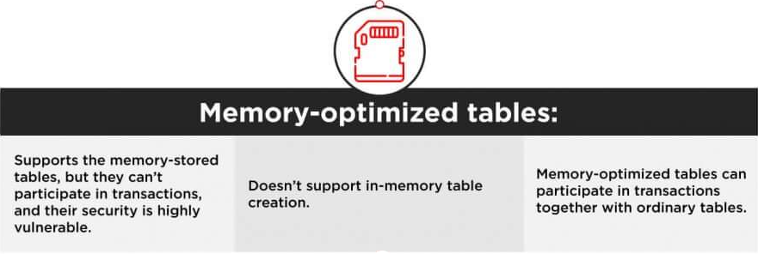
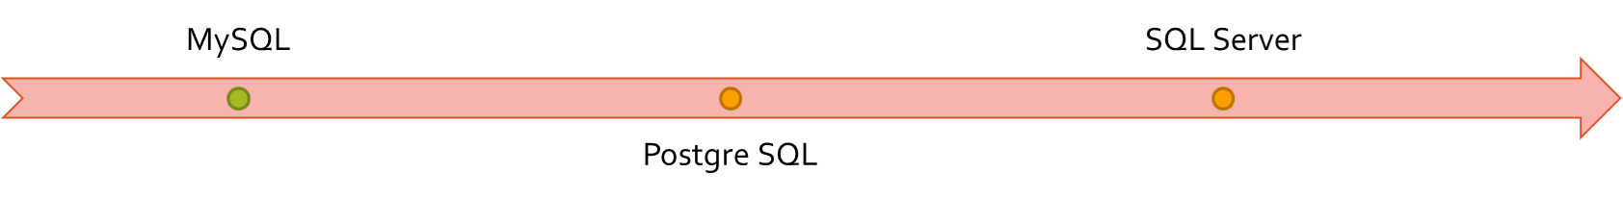

Slide 21
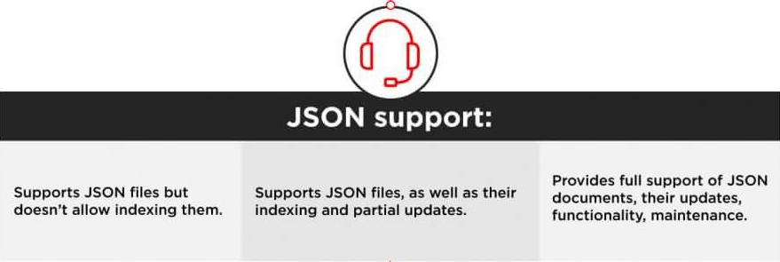
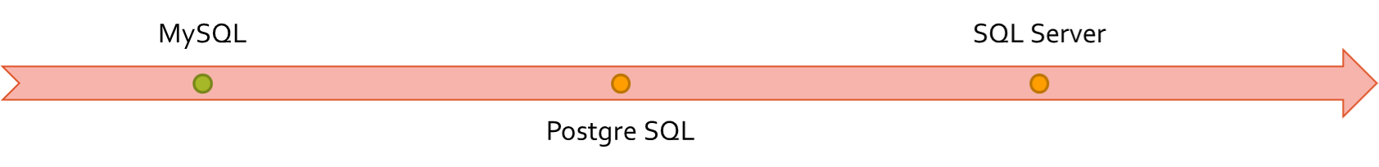

Slide 22
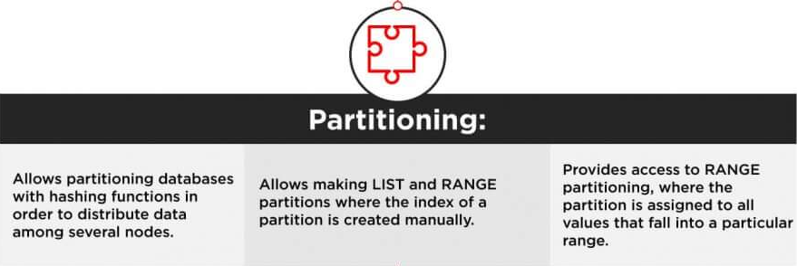


Slide 23
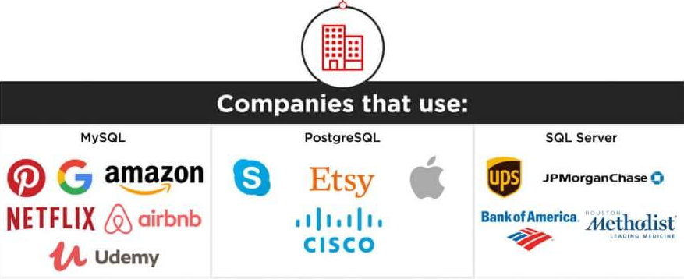


Slide 24
Conclusion
The choice between the three most popular databases ultimately boils down to the comparison of the functionality, use cases, and ecosystems. Companies that prioritize flexibility, cost-efficiency, and innovation usually choose open-source solutions. They can be integrated with multiple free add-ons, have active user communities, and are continuously updated.

