Slide 1
MergeSort

Slide 2
MERGESORT
Mergesort
3
7
5
4
1
6
8
2

Slide 3
MERGESORT
Mergesort
3
7
5
4
1
6
8
2
Mergesort
3
7
5
4

Slide 4
MERGESORT
Mergesort
3
7
5
4
1
6
8
2
Mergesort
Mergesort
3
7
5
4
1
6
8
2

Slide 5
MERGESORT
Mergesort
3
7
5
4
1
6
8
2
Mergesort
Mergesort
3
7
5
4
1
6
8
2
Mergesort
Mergesort
3
7
5
4

Slide 6
MERGESORT
Mergesort
3
7
5
4
1
6
8
2
Mergesort
Mergesort
3
7
5
4
1
6
8
2
Mergesort
Mergesort
Mergesort
Mergesort
3
7
5
4
1
6
8
2

Slide 7
MERGESORT
Mergesort
3
7
5
4
1
6
8
2
Mergesort
Mergesort
3
7
5
4
1
6
8
2
Mergesort
Mergesort
Mergesort
Mergesort
3
7
5
4
1
6
8
2
Mergesort
Mergesort
3
7

Slide 8
MERGESORT
Mergesort
3
7
5
4
1
6
8
2
Mergesort
Mergesort
3
7
5
4
1
6
8
2
Mergesort
Mergesort
Mergesort
Mergesort
3
7
5
4
1
6
8
2
Mergesort
Mergesort
Mergesort
Mergesort
3
7
5
4

Slide 9
MERGESORT
Mergesort
3
7
5
4
1
6
8
2
Mergesort
Mergesort
3
7
5
4
1
6
8
2
Mergesort
Mergesort
Mergesort
Mergesort
3
7
5
4
1
6
8
2
Mergesort
Mergesort
Mergesort
Mergesort
Mergesort
Mergesort
3
7
5
4
1
6

Slide 10
MERGESORT
Mergesort
3
7
5
4
1
6
8
2
Mergesort
Mergesort
3
7
5
4
1
6
8
2
Mergesort
Mergesort
Mergesort
Mergesort
3
7
5
4
1
6
8
2
Mergesort
Mergesort
Mergesort
Mergesort
Mergesort
Mergesort
Mergesort
Mergesort
3
7
5
4
1
6
8
2

Slide 11
MERGESORT
3
7
5
4
1
6
8
2

Slide 12
MERGESORT
3
7
Merge
3
7
5
4
1
6
8
2

Slide 13
MERGESORT
3
7
4
5
1
6
2
8
Merge
Merge
Merge
Merge
3
7
5
4
1
6
8
2

Slide 14
MERGESORT
3
4
5
7
1
2
6
8
Merge
Merge
3
7
4
5
1
6
2
8
Merge
Merge
Merge
Merge
3
7
5
4
1
6
8
2

Slide 15
MERGESORT
1
2
3
4
5
6
7
8
Merge
3
4
5
7
1
2
6
8
Merge
Merge
3
7
4
5
1
6
2
8
Merge
Merge
Merge
Merge
3
7
5
4
1
6
8
2

Slide 16
How is Merge working?
Merge
3
4
5
7
1
2
6
8
Left Index
Right Index

Slide 17
How is Merge working?
Merge
3
4
5
7
3 > 1
1
2
6
8
Left Index
Right Index

Slide 18
How is Merge working?
1
Merge
3
4
5
7
3 > 1
1
2
6
8
Left Index
Right Index

Slide 19
How is Merge working?
1
Merge
3
4
5
7
1
2
6
8
Left Index
Right Index

Slide 20
How is Merge working?
1
Merge
3
4
5
7
3 > 2
1
2
6
8
Left Index
Right Index

Slide 21
How is Merge working?
1
2
Merge
3
4
5
7
3 > 2
1
2
6
8
Left Index
Right Index

Slide 22
How is Merge working?
1
2
Merge
3
4
5
7
1
2
6
8
Left Index
Right Index

Slide 23
How is Merge working?
1
2
Merge
3
4
5
7
3 < 6
1
2
6
8
Left Index
Right Index

Slide 24
How is Merge working?
1
2
3
Merge
3
4
5
7
3 < 6
1
2
6
8
Left Index
Right Index

Slide 25
How is Merge working?
1
2
3
Merge
3
4
5
7
1
2
6
8
Left Index
Right Index

Slide 26
How is Merge working?
1
2
3
Merge
3
4
5
7
4 < 6
1
2
6
8
Left Index
Right Index

Slide 27
How is Merge working?
1
2
3
4
Merge
3
4
5
7
4 < 6
1
2
6
8
Left Index
Right Index

Slide 28
How is Merge working?
1
2
3
4
Merge
3
4
5
7
1
2
6
8
Left Index
Right Index

Slide 29
How is Merge working?
1
2
3
4
Merge
3
4
5
7
5 < 6
1
2
6
8
Left Index
Right Index

Slide 30
How is Merge working?
1
2
3
4
5
Merge
3
4
5
7
5 < 6
1
2
6
8
Left Index
Right Index

Slide 31
How is Merge working?
1
2
3
4
5
Merge
3
4
5
7
1
2
6
8
Left Index
Right Index

Slide 32
How is Merge working?
1
2
3
4
5
Merge
3
4
5
7
7 > 6
1
2
6
8
Left Index
Right Index

Slide 33
How is Merge working?
1
2
3
4
5
6
Merge
3
4
5
7
7 > 6
1
2
6
8
Left Index
Right Index

Slide 34
How is Merge working?
1
2
3
4
5
6
Merge
3
4
5
7
1
2
6
8
Left Index
Right Index

Slide 35
How is Merge working?
1
2
3
4
5
6
Merge
3
4
5
7
7 < 8
1
2
6
8
Left Index
Right Index

Slide 36
How is Merge working?
1
2
3
4
5
6
7
Merge
3
4
5
7
7 < 8
1
2
6
8
Left Index
Right Index

Slide 37
How is Merge working?
1
2
3
4
5
6
7
Merge
3
4
5
7
1
2
6
8
Left Index
Right Index

Slide 38
How is Merge working?
1
2
3
4
5
6
7
8
Merge
3
4
5
7
1
2
6
8
Left Index
Right Index

Slide 39
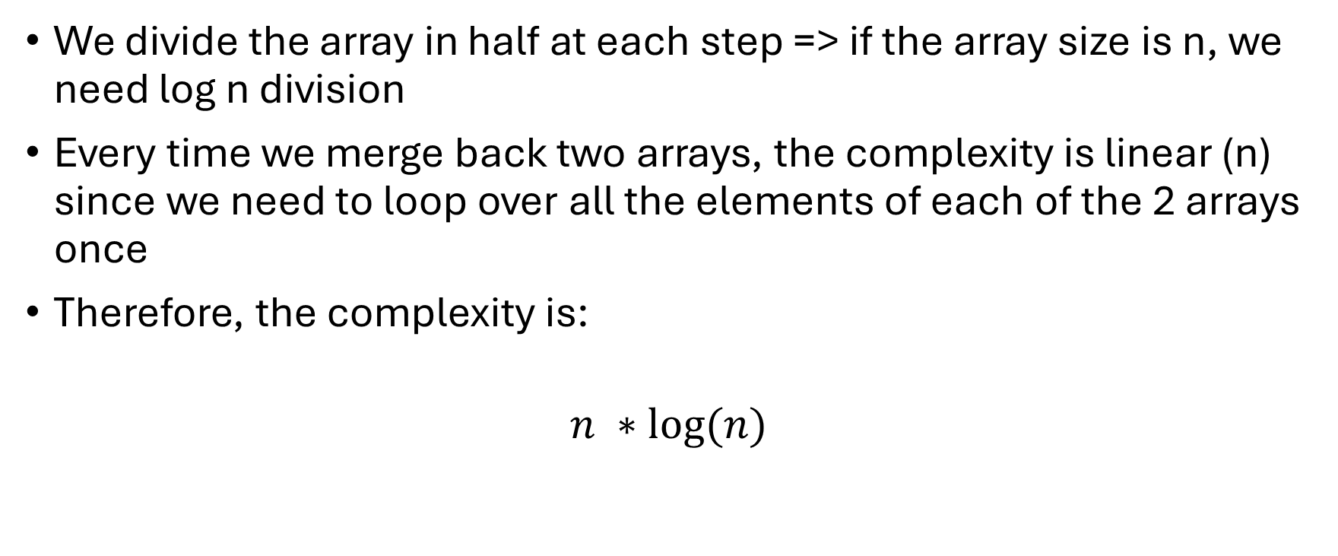
Complexity
We divide the array in half at each step => if the array size is n, we need log n division
Every time we merge back two arrays, the complexity is linear (n) since we need to loop over all the elements of each of the 2 arrays once
Therefore, the complexity is:
$$n ∗log⁡(n)$$

