Slide 1
Sleep Health and Lifestyle Analysis
Base statistics analysys
Data Scientist: Hajime Kawata
© 2024 Udacity.

Slide 2
Agenda
Results of sleep health and lifestyle analysis
Data Description
Typical Amount of Physical Activity
Number of Daily Steps
Distribution of Heart Rates

Slide 3
Data Description
As you inspect the health and sleep quality dataset, notice there are examples of all the data types you are now familiar with.
Age, Sleep Duration (hours), Physical Activity Level (minutes/day), and Blood Pressure (systolic/diastolic) are examples of a continuous variable in the dataset.
Quality of Sleep (scale: 1-10), Stress Level (scale: 1-10), Heart Rate (bpm), and Daily Steps are examples of an integer variable in the dataset.
BMI Category is an example of an ordinal categorical variable in the dataset.
Gender, Occupation, Sleep Disorder and are examples of a nominal categorical variable in the dataset.

Slide 4
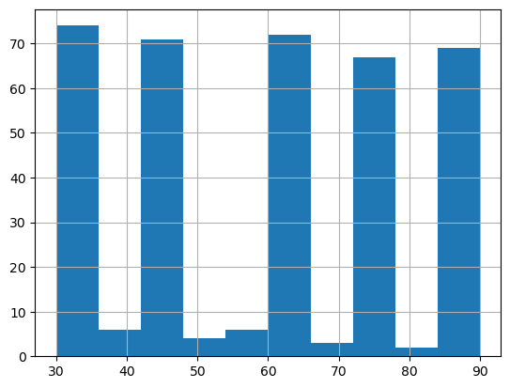
Typical Amount (Minutes) of Physical Activity
On this slide, provide the mean, median, and mode number of minutes of physical activity in the dataset.
Base statistics number of "Minutes of physical activity“
mean: 59.17
median: 59.59
mode: 0 20 30
45 59 60
75 90 374
skewness: 2.61
The data is higly and strongly positively skwed. while the average and the median is around 59.
Seeing the histogram, it is not a type of data series in normal distribution.

Slide 5
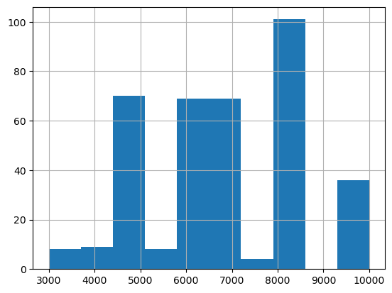
Analysis of Daily Steps Taken
On this slide, provide the standard deviation, maximum, minimum, and range associated with the number of steps taken.
Daily Steps Taken
mean : 6816.84
standard deviation : 1617.92
max : 10000.0
min : 3000.0
Ranges from 3000 to 10000
skew: 0.17827733092832274

Slide 6
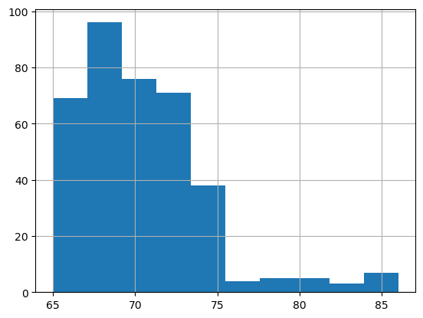
Distribution of Heart Rates
On this slide, include a plot (graph) of the distribution of heart rates. What is the shape of the distribution? Are there any outliers?
Distribution of Heart Rates
skew: 1.2248235470533522
mean: 70.16577540106952
median: 70.0
The distribution is “right skewed” as seen in the graph. The distribution has a longer "tail" towards the larger values on the right side.
The majority of the data points are clustered on the left side of the distribution.
But the median and the mean is almost the same.
So while skewed, those data is not that pulling the distribution.

