Slide 1
Calculator
This project contain Scientific Calculator and Simple Calculator in which it take input from user and calculate its answer.

Slide 2
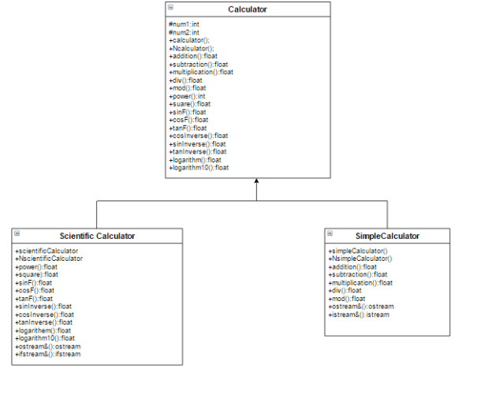
UML_Diagram

Slide 3
Concept used:
Encapsulation.
Inheritance.
Polymorphism.
Exception Handling.

Slide 4
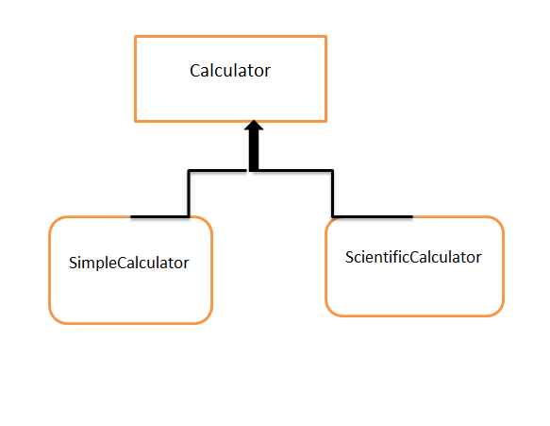
Class Diagram:

Slide 5
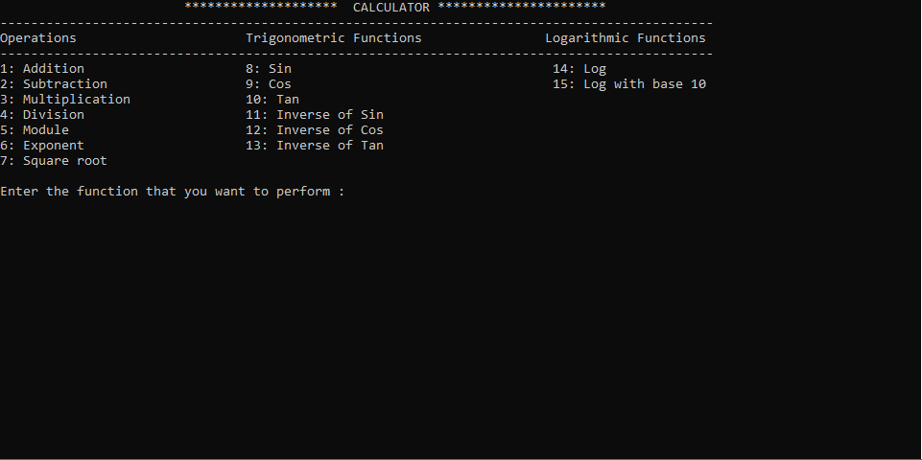
Calculator overview

