Slide 1

Plant disease detection
Group Members: Abduhu khan Hajra Mohsin Varda Sarfraz

Slide 2

INTRODUCTION
Problem Statement:
Develop a system that utilizes artificial intelligence for detection of plant diseases to assist farmers in implementing timely and effective disease management strategies.
Objectives:
To identify plant diseases by performing digital image processing on the available dataset.
To apply machine learning models and techniques for incorporating the feature extraction in order to achieve prediction results of the diseases.
To compare the performance of machine learning models on the same dataset to achieve the desired goal.

Slide 3
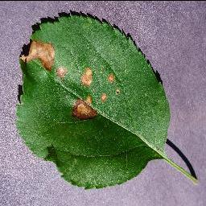
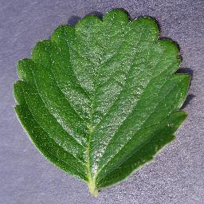
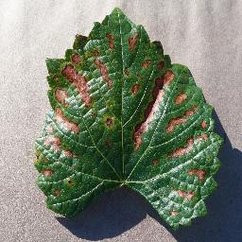
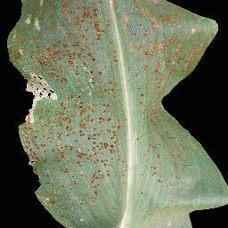
DATASET
New plant diease detection dataset on kaggle
Approx 87k images
38 classes
Healthy and diseased leaves of multiple plants

Slide 4
Methodology
1.⁠ ⁠Image Loading and Preprocessing:
Load the dataset consisting of plant images representing various diseases.
Resize the images to a standardized dimension (e.g., 64x64 pixels) for consistency.
Convert the images to 8-bit unsigned integer depth.
2.⁠ ⁠Color Space Transformation:
Convert the preprocessed images from the RGB color space to the HSV (Hue, Saturation, Value) color space.
Utilize HSV representation for better disease-specific feature extraction.
3.⁠ ⁠Image Segmentation:
Apply segmentation techniques to isolate disease-affected regions from the plant images.
Utilize HSV thresholds to create masks for leaf and spots.
Refine segmentation using morphological operations (e.g., opening) to reduce noise.
Identify contours in the segmented regions and filter out small contours.

Slide 5
Methodology
4.⁠ ⁠Feature Extraction from Segmented Regions:
Extract diverse features from the segmented leaf and spot regions:
Statistical Features:
Calculate mean and standard deviation of pixel intensities.
Texture Features (LBP):
Utilize Local Binary Pattern (LBP) to capture texture information.
Shape Features (Contour-based):
Leverage contours obtained from segmentation for shape characteristics.
Color Histogram Features:
Compute color histograms in the HSV space.
5.⁠ ⁠Model Input Creation:
Combine features extracted from the segmented regions to form a comprehensive feature vector.
Concatenate this feature vector with histogram-based features previously computed.

Slide 6
Methodology
6.⁠ ⁠Dataset Splitting and Standardization:
Split the dataset into training and testing sets for model evaluation.
Standardize features by removing the mean and scaling to unit variance using the StandardScaler.
7.⁠ ⁠Model Training:
Employ Random Forest Classifier with a specified number of trees (e.g., 2000) for training.
Train the model using the standardized training dataset.
8.⁠ ⁠Model Evaluation:
Assess the model's performance on the standardized testing dataset.
Calculate accuracy as a performance metric.

Slide 7
Flow Chart
Image Loading and Preprocessing
Color Space Transformation
Image Segmentation
Feature Extraction
Model Input Creation
Dataset Splitting
Model Training
Model Evaluation

Slide 8
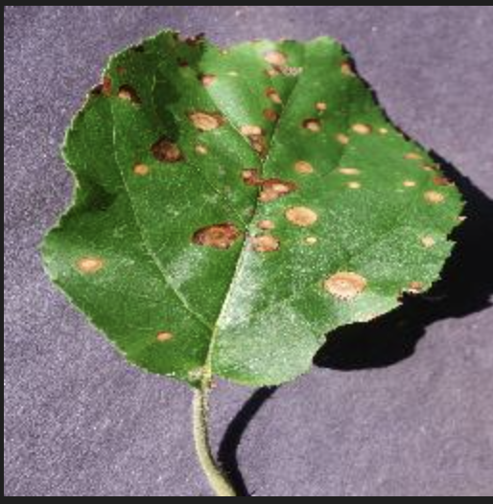
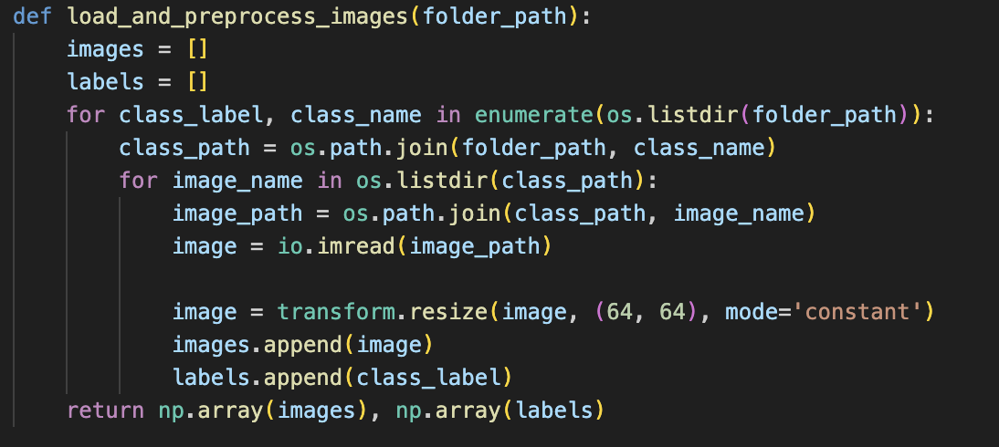
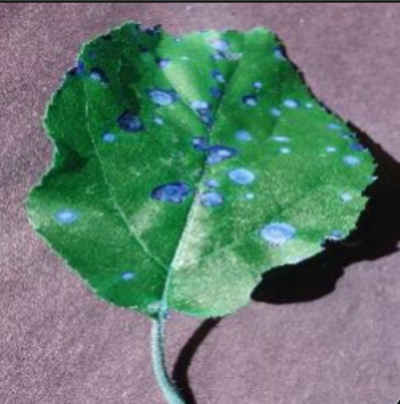
Intermediate Process
Preprocessing:

Slide 9
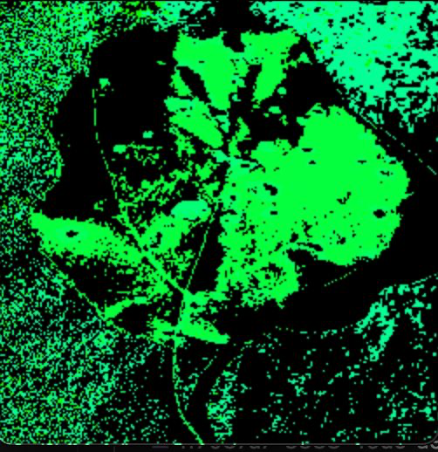
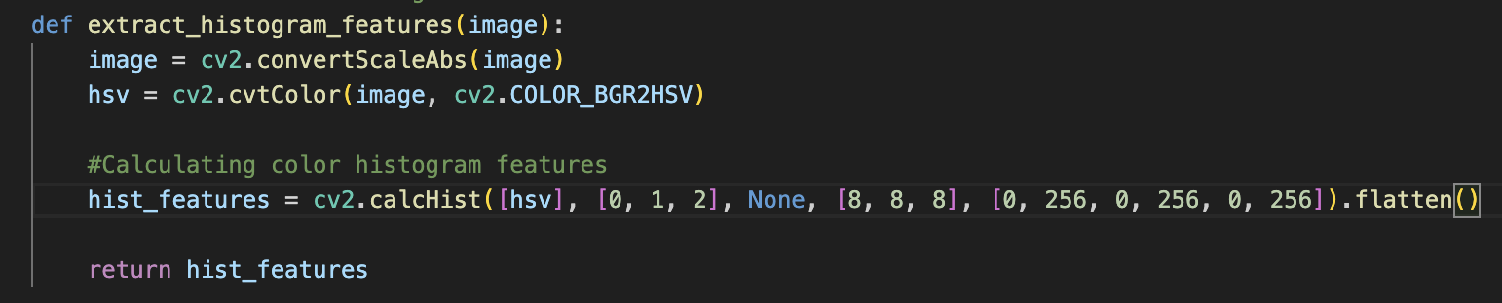
Intermediate Process
Extracting Histogram Features:

Slide 10
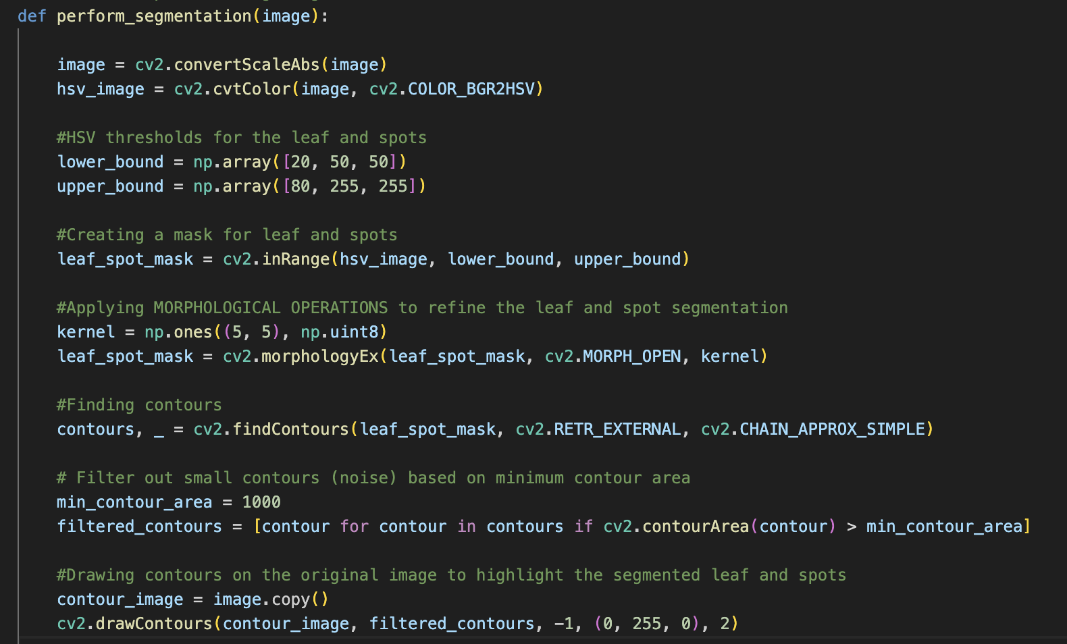
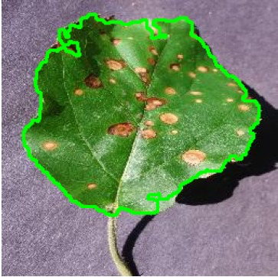
Intermediate Process
Segmentation:

Slide 11
Segmentation
Contours:
cv2.findContours(leaf_spot_mask, cv2.RETR_EXTERNAL, cv2.CHAIN_APPROX_SIMPLE)
leaf_spot_mask: The binary image containing the segmented regions (in this case, the leaf and spots).
cv2.RETR_EXTERNAL: Retrieves only the extreme outer contours. It ignores contours inside other contours.
Morphological Operations:
cv2.MORPH_OPEN:
Opening is a morphological operation that is a combination of erosion followed by dilation. It is useful for removing noise from binary images.
kernel = np.ones((5, 5), np.uint8): This line creates a 5x5 rectangular kernel (structuring element) consisting of ones. The size of the kernel determines the extent of the morphological operation.
leaf_spot_mask = cv2.morphologyEx(leaf_spot_mask, cv2.MORPH_OPEN, kernel): The opening operation helps smooth the binary mask and remove small unwanted elements.

Slide 12
Feature Extraction from segmented regions:
Local Binary Patterns (LBP):
LBP works by encoding the local patterns of pixel intensities in an image. LBP is particularly effective for texture classification.
How LBP works?
Local Neighborhood: For each pixel in an image, a local neighborhood (usually a 3x3 window) is defined around it.
Binary Encoding: The intensity value of the center pixel is compared with the intensity values of its neighbors. For each neighbor, a binary digit (0 or 1) is assigned based on whether the neighbor's intensity is greater than or equal to the center pixel's intensity.
Rotation Invariance: The binary values are read in a circular pattern, and the resulting binary string is treated as a binary number. This binary number is then converted to its decimal equivalent. The idea is to achieve rotation invariance, meaning that the same pattern is detected regardless of the orientation.
Histogram Calculation: The decimal values obtained for all pixels in the image form a histogram, where each bin represents a unique local pattern. This histogram can be used as a feature vector for texture analysis.

Slide 13
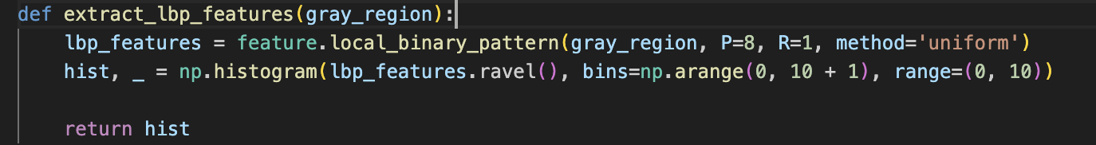
Feature Extraction from segmented regions:
Local Binary Patterns (LBP):
Since LBP patterns are sensitive to local contrast variations, allowing them to highlight areas with significant intensity changes.
P: Number of neighbors considered in the feature. In this case, 8 neighbors are considered.
R: Radius from the center pixel to the neighboring pixels.
method: 'Uniform' method is used, which classifies patterns into uniform and non-uniform to reduce dimensionality.
np.histogram: Computes a histogram of the LBP pattern, capturing the distribution of different patterns.

Slide 14
Feature Extraction from segmented regions:
Histogram of Oriented Gradients (HOG):
Feature.hog function is used which extracts HOG features from grayscale image
Parameters of the function include:
orientations: The number of bins in the histogram of gradients. It determines the number of directions the gradient information is divided into.
pixels_per_cell: The size of each cell for which the histogram of gradients is computed. Larger cells capture more global information, while smaller cells capture finer details.
cells_per_block: Defines the local neighborhood for which normalization is applied. It helps in enhancing contrast and handling illumination changes.

Slide 15
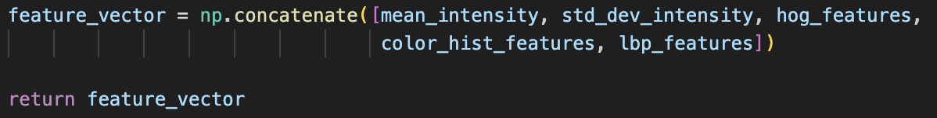
Intermediate Process
Feature Concatenation:
Concatenates histogram_features and segmented_features along the second axis to form X_combined.
Concatenates the corresponding labels along the first axis to form y_combined.

Slide 16
AI MODEL (Random Forests)
Introduction:
Ensemble Learning: Random Forest constructs multiple decision trees for robust predictions.
Why Random Forest?
Versatility: Effective for classification tasks.
Overfitting: Robust to overfitting, suitable for diverse datasets.
Application:
Feature Importance: Provides insights into significant image features.
Diversity: Trees trained on subsets reduce overfitting.
Training:
Number of Trees: Utilized a large number (e.g., 2000) for improved performance.
Standardization: Features standardized for consistent scaling.

Slide 17
AI MODEL (Random Forests)
Evaluation:
Accuracy Metric: Evaluated accuracy on a standardized testing dataset.
Comparative Analysis: Results compared with other models (e.g., CNN).
Advantages:
High Accuracy: Renowned for achieving accurate predictions.
Interpretability: Offers feature importance insights.
Future Considerations:
Parameter Tuning: Explore enhancements through hyperparameter tuning.
Ensemble Methods: Investigate alternative ensembles for improved robustness.

Slide 18
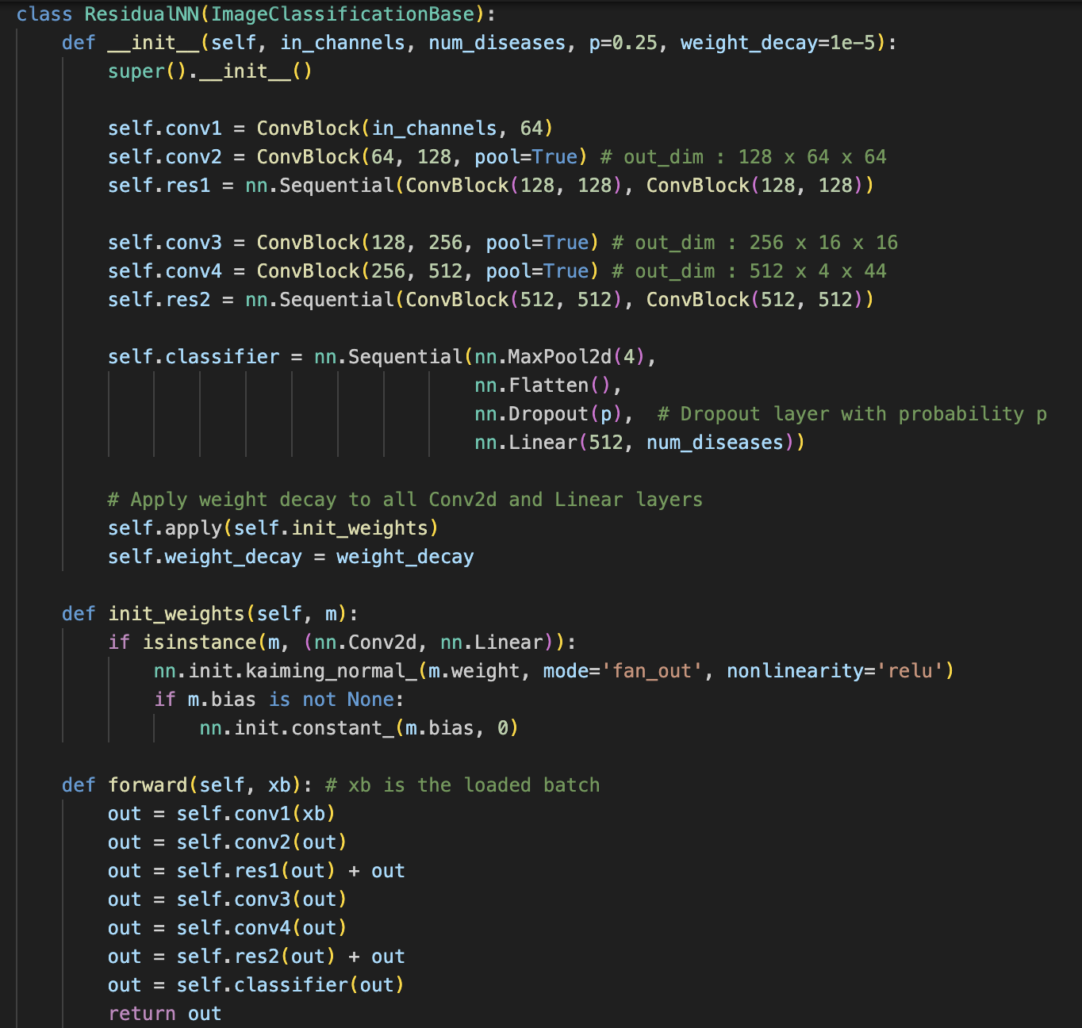
AI MODEL (Convolutional)

Slide 19


Thank you
No questions please :)

