Slide 1



Quantum Financial Forecasting
Alex, Florian, Leonard, Mohamad

Slide 2
What did we achieve?
Model adjustment to predict 10 days in advance
Save and load model
Evaluation plots
Paper draft ideas
Quantum Financial Forecasting

Slide 3
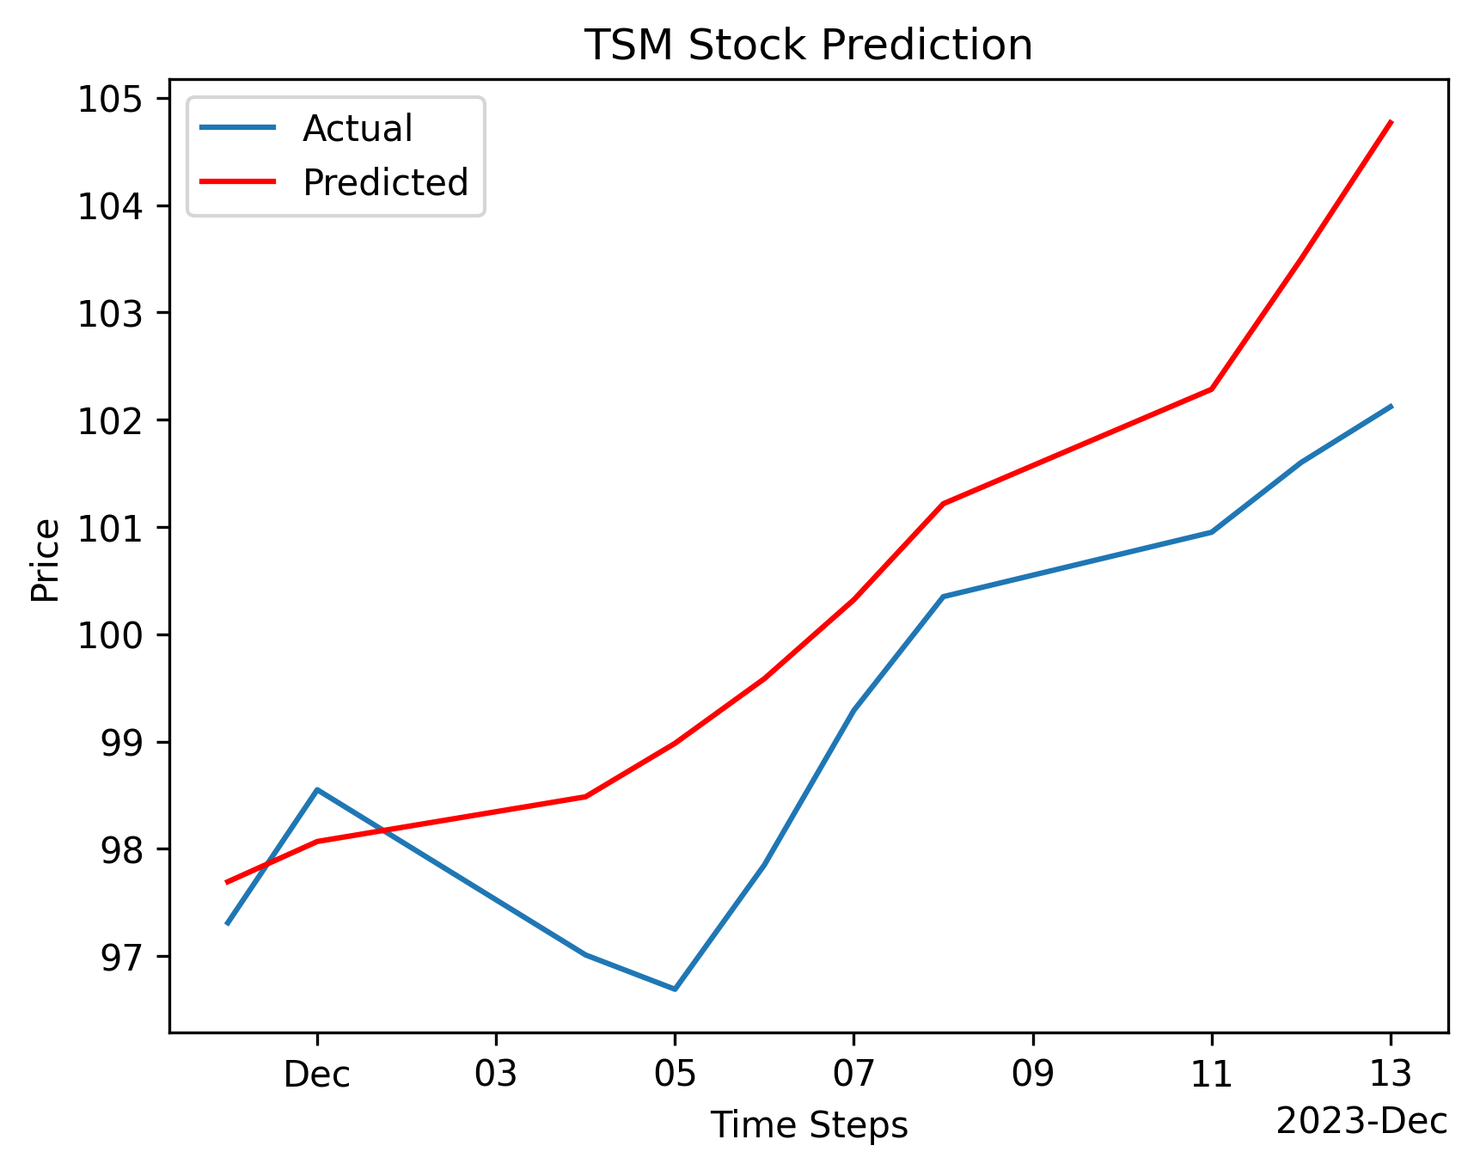
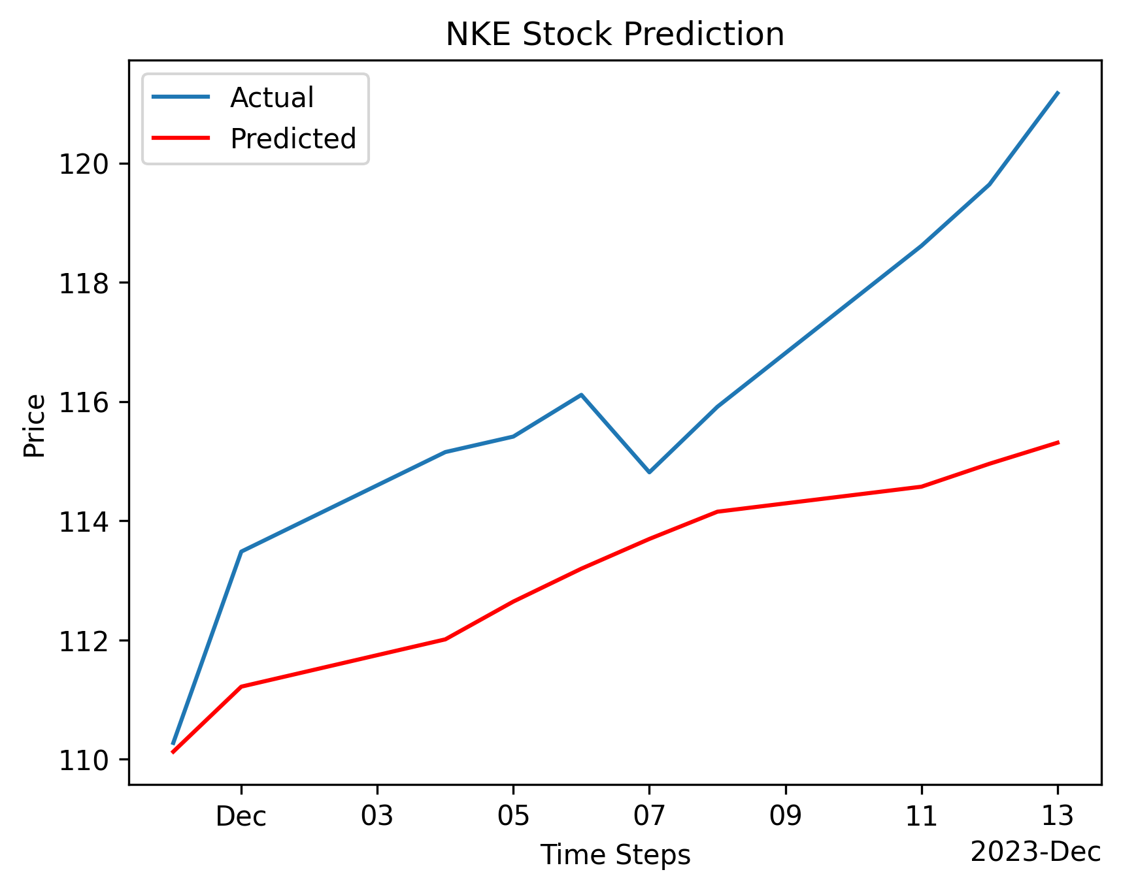
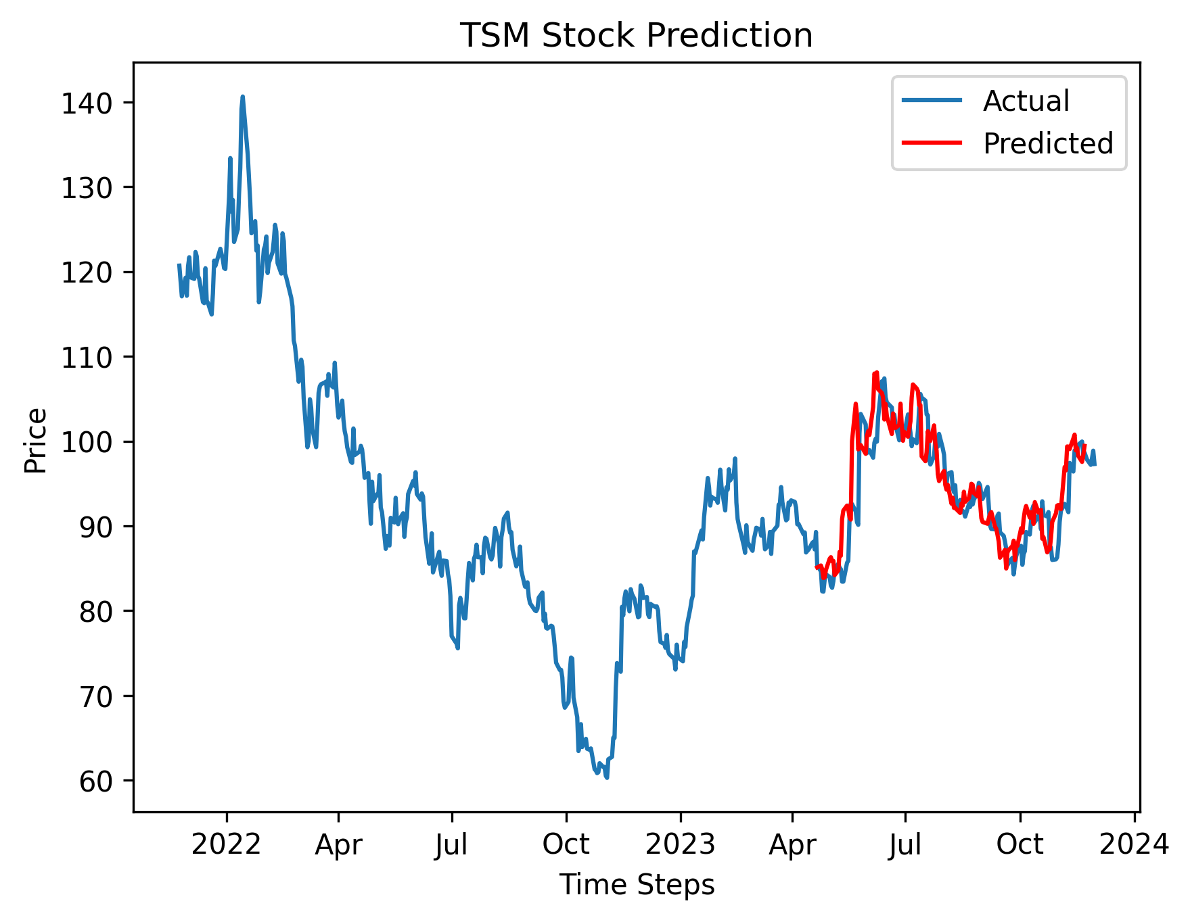
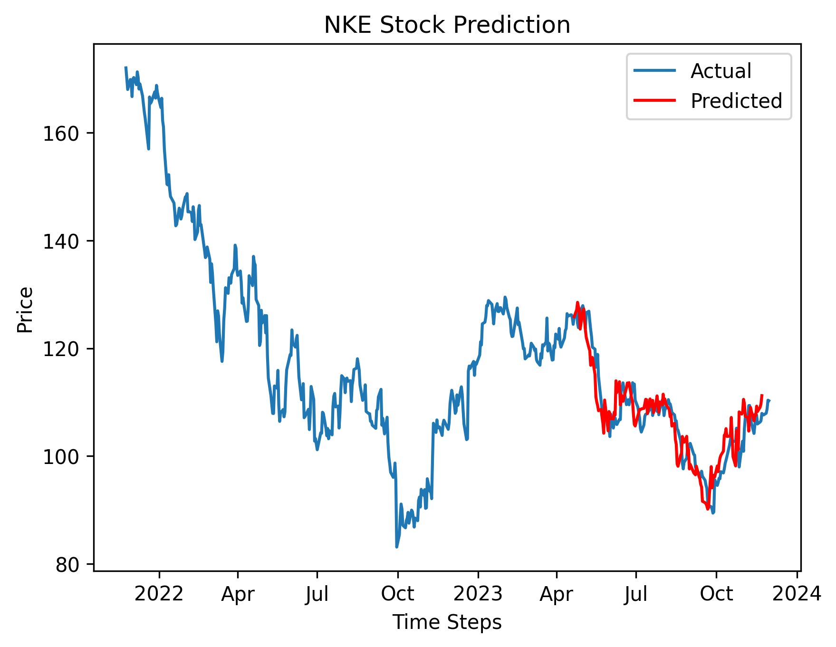
10 Day Prediction Results
Quantum Financial Forecasting

Slide 4
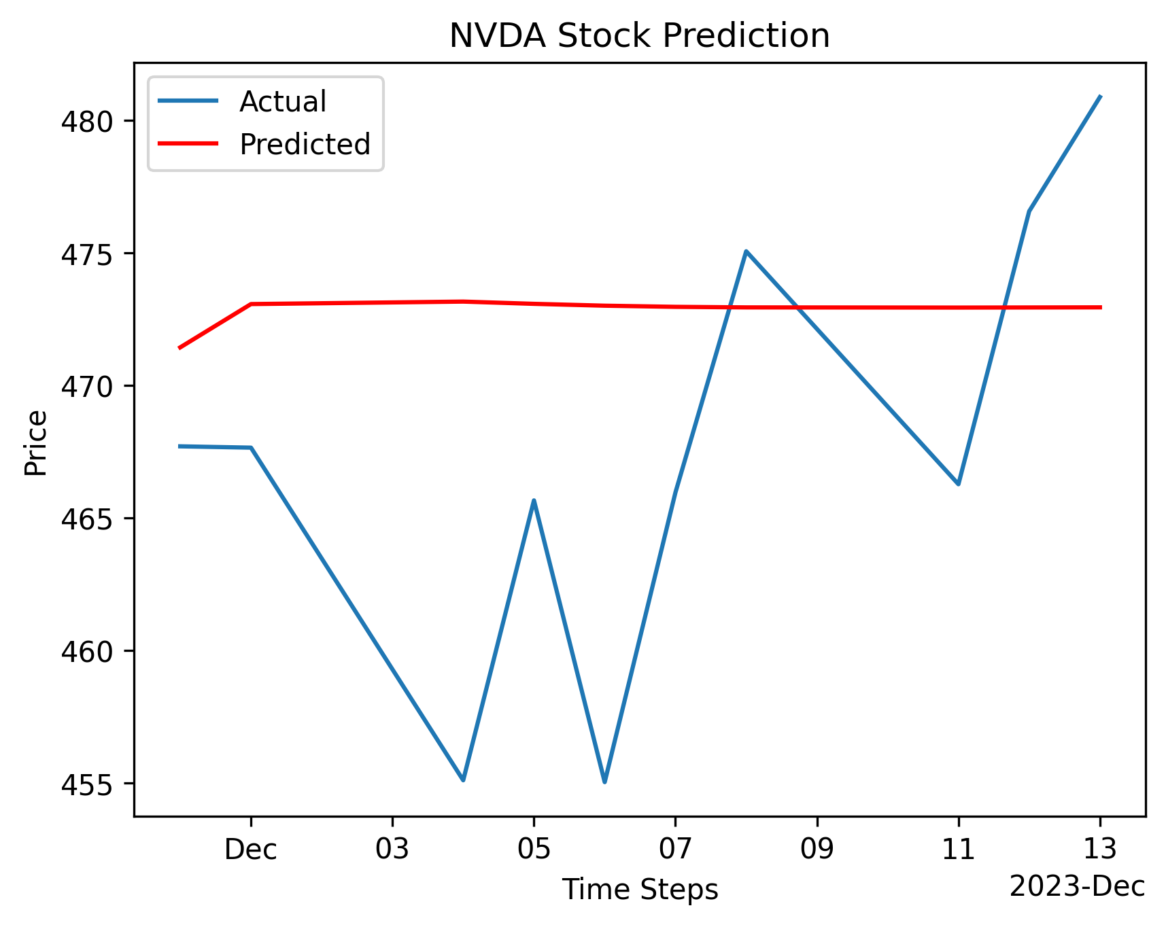
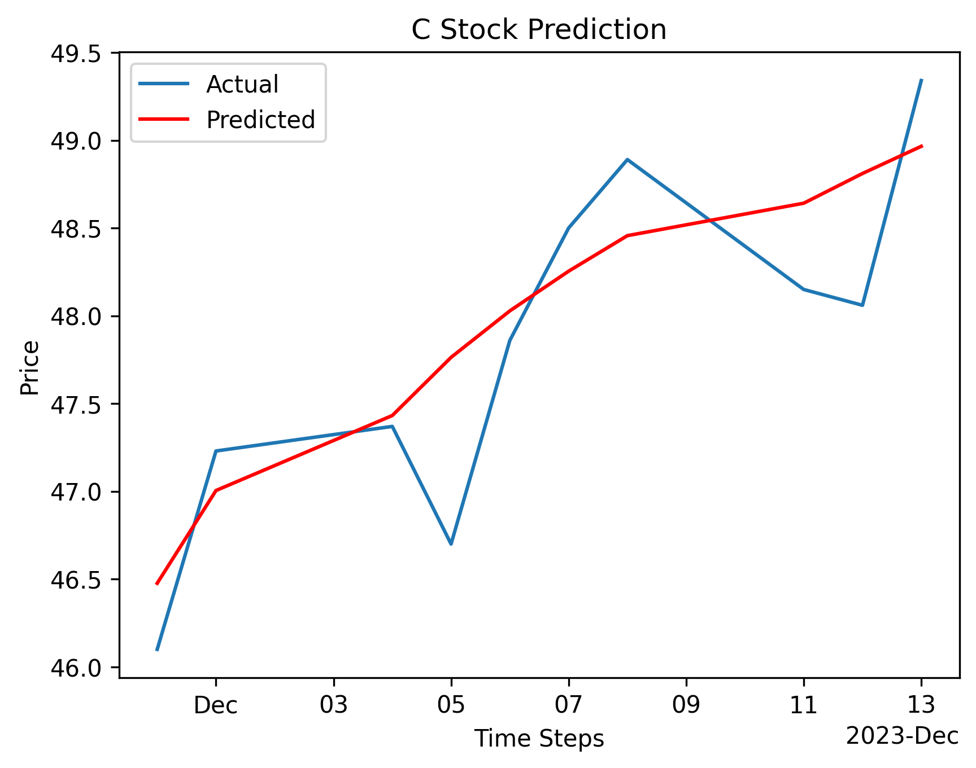
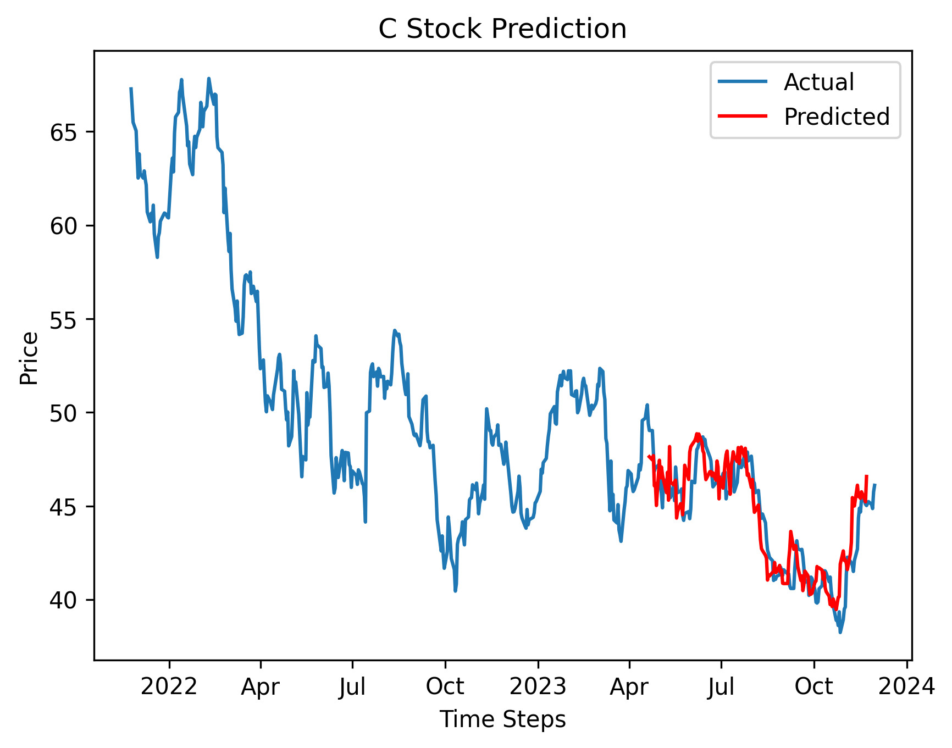
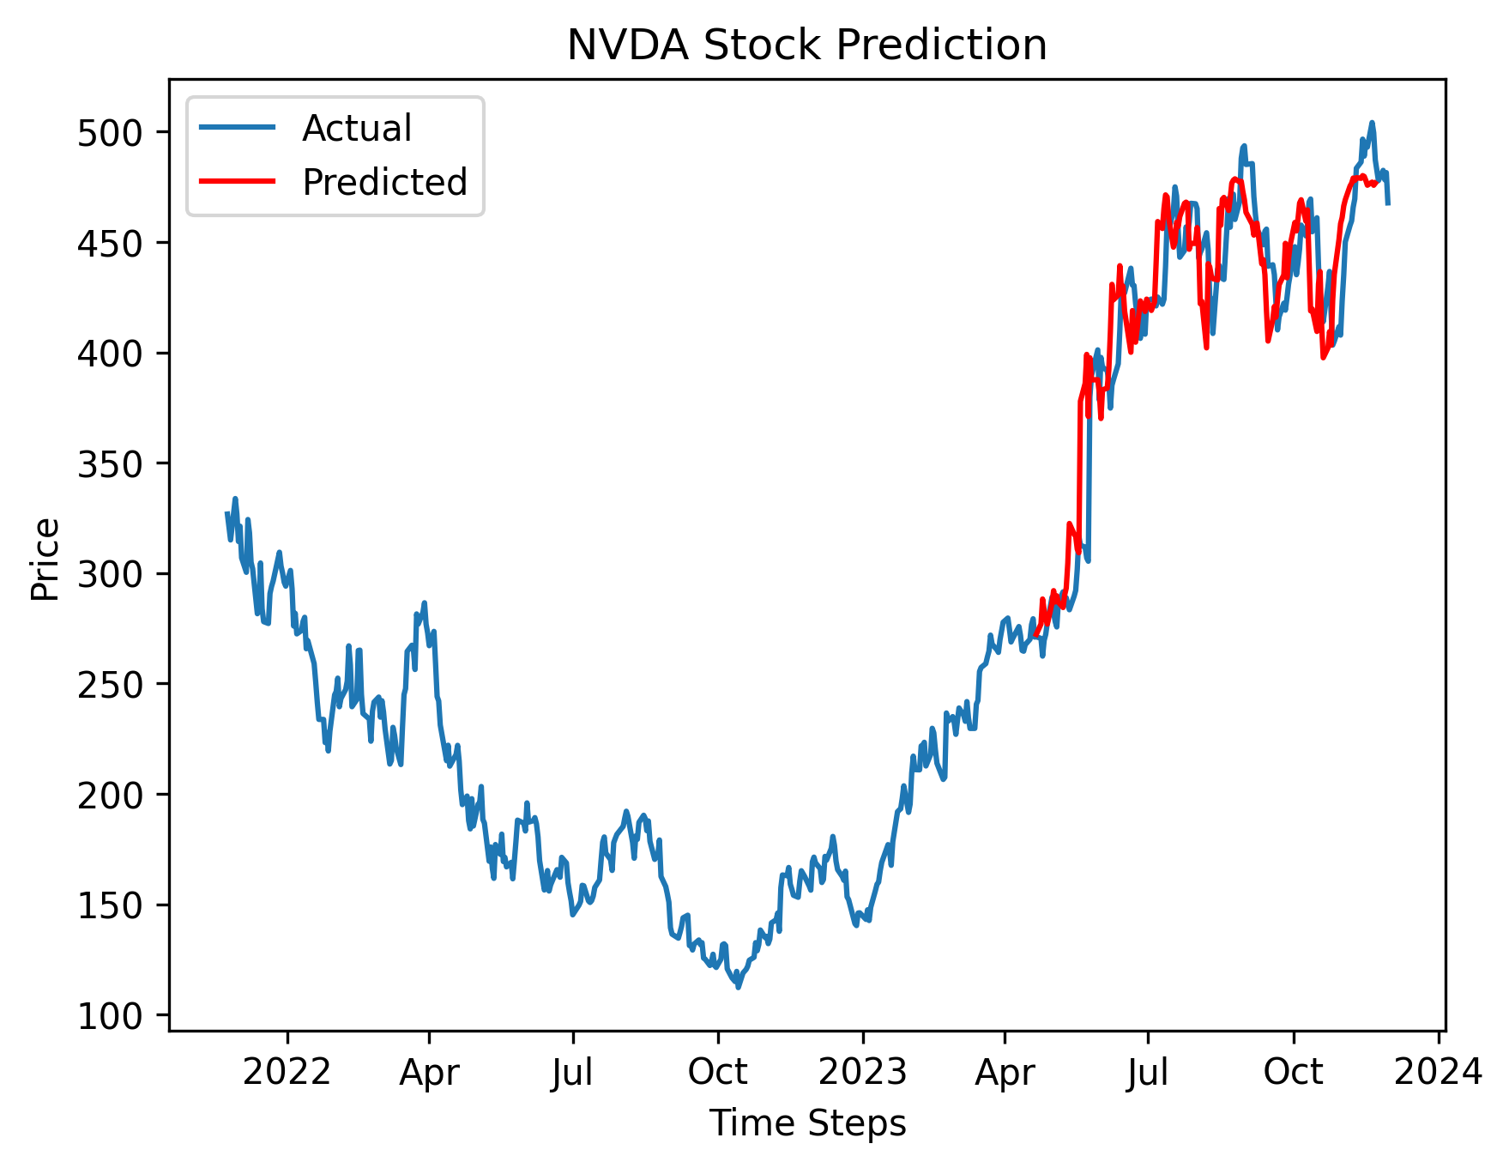
10 Day Prediction Results
Quantum Financial Forecasting

Slide 5
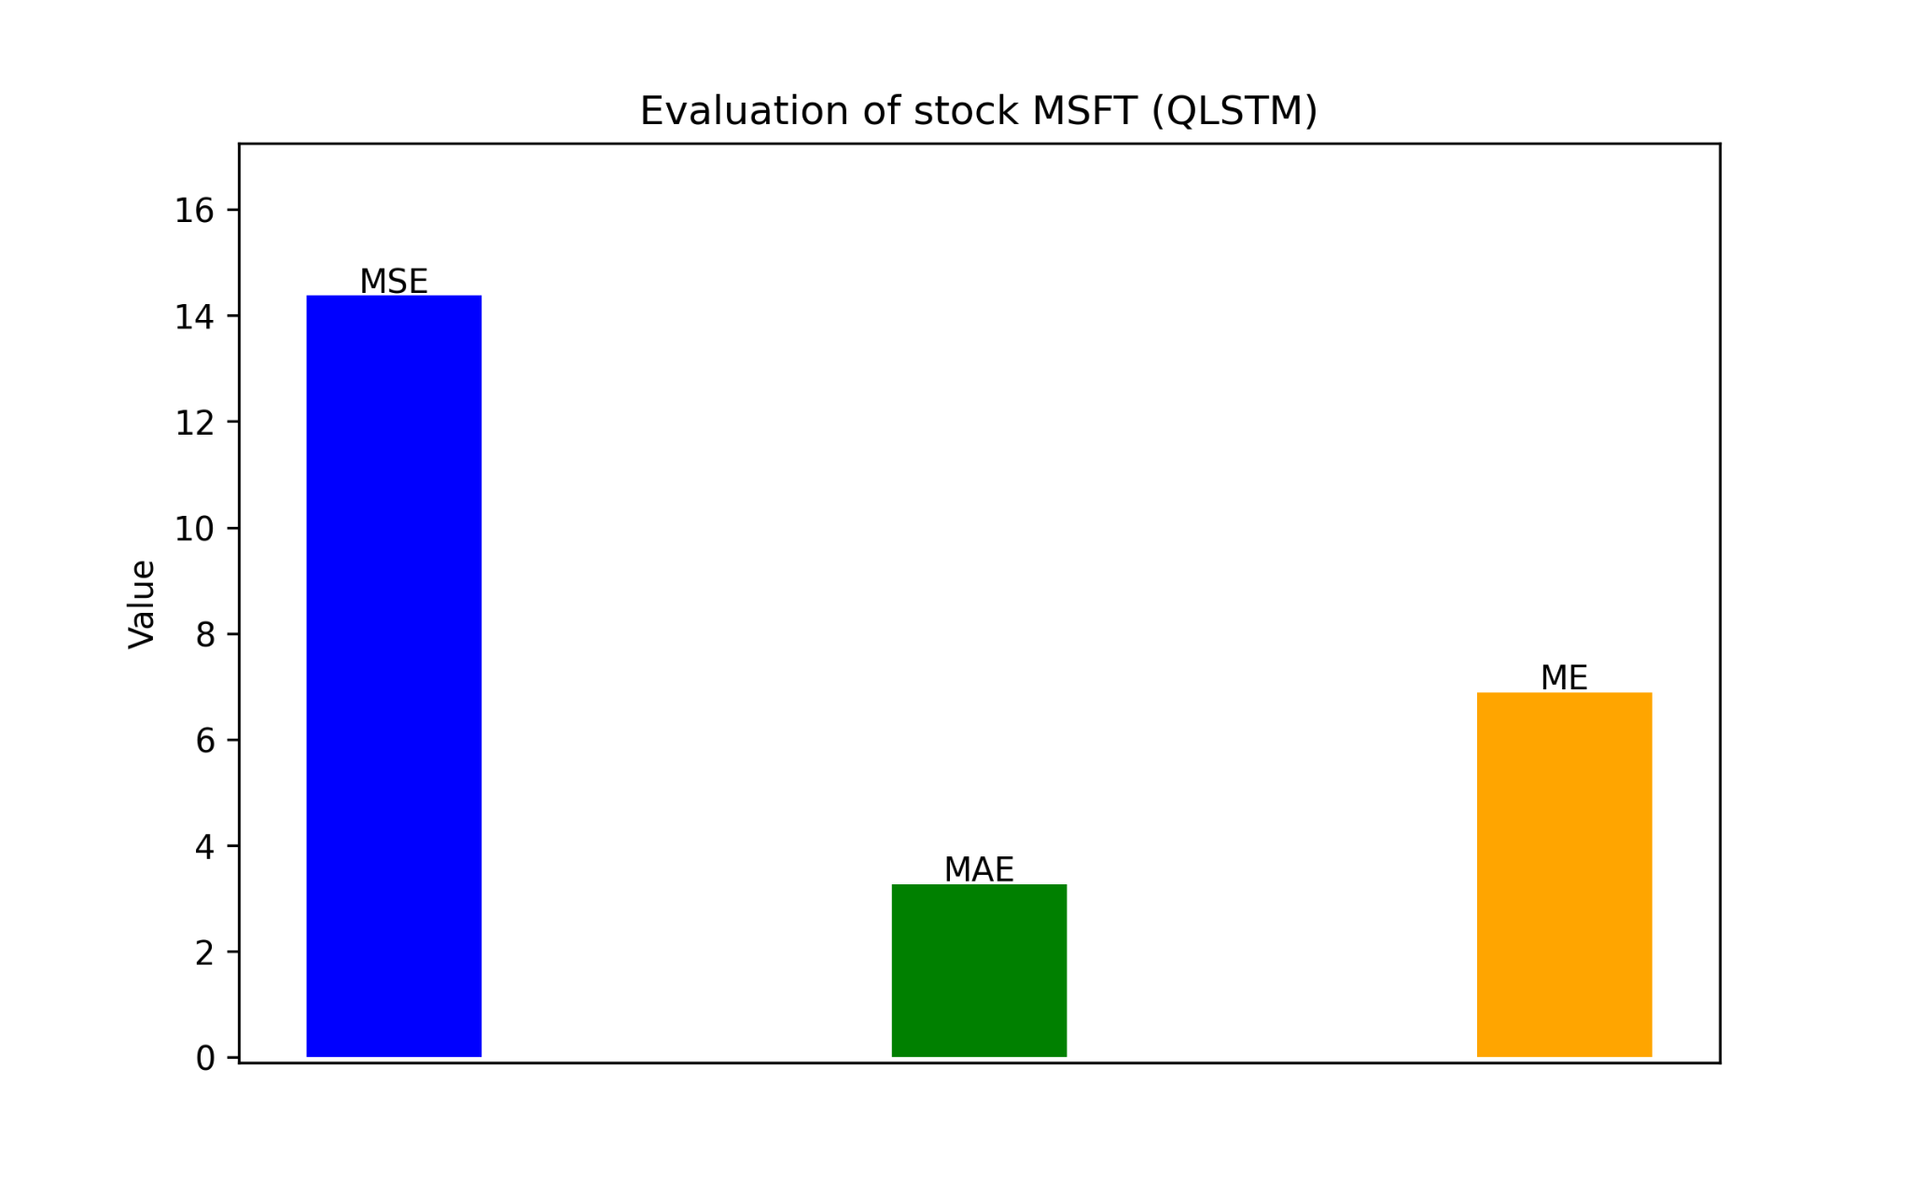
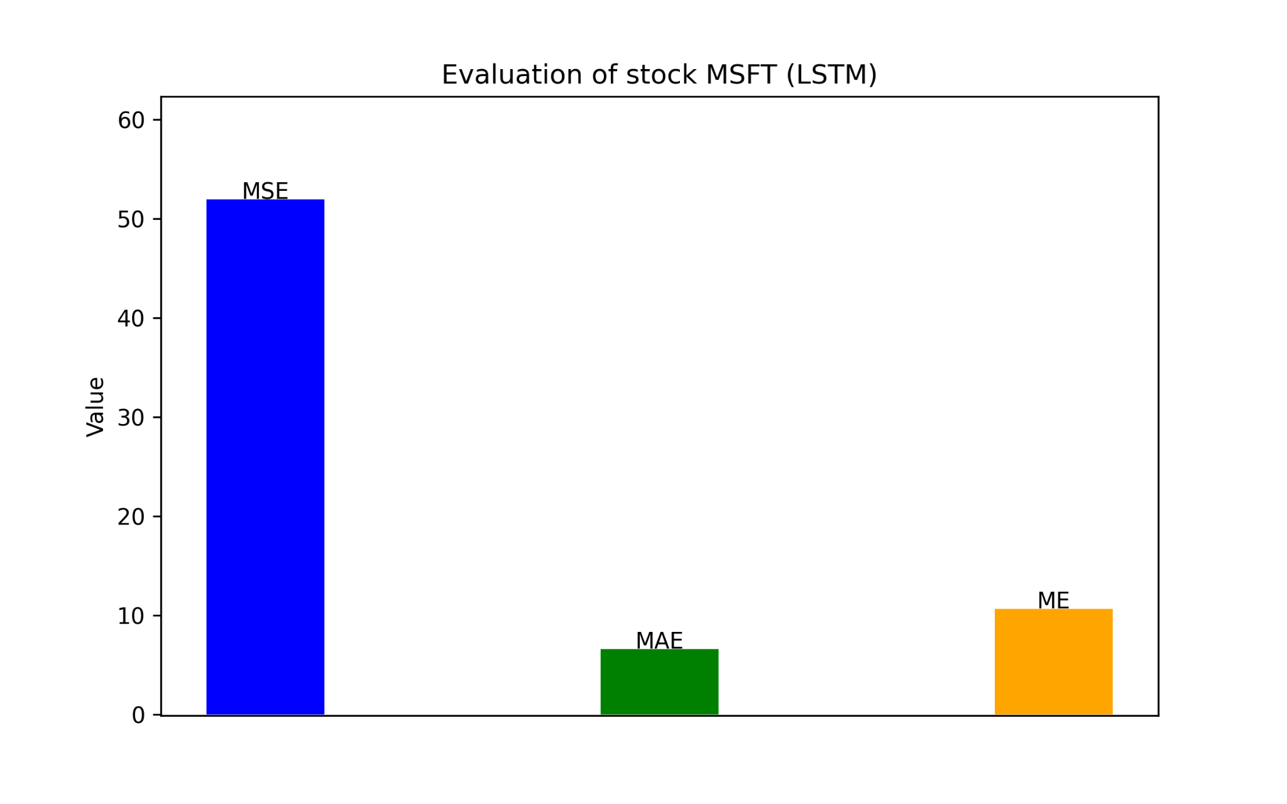
Evaluation
Mean Squared Error, Mean Absolute Error, Max Error
Quantum Financial Forecasting

Slide 6
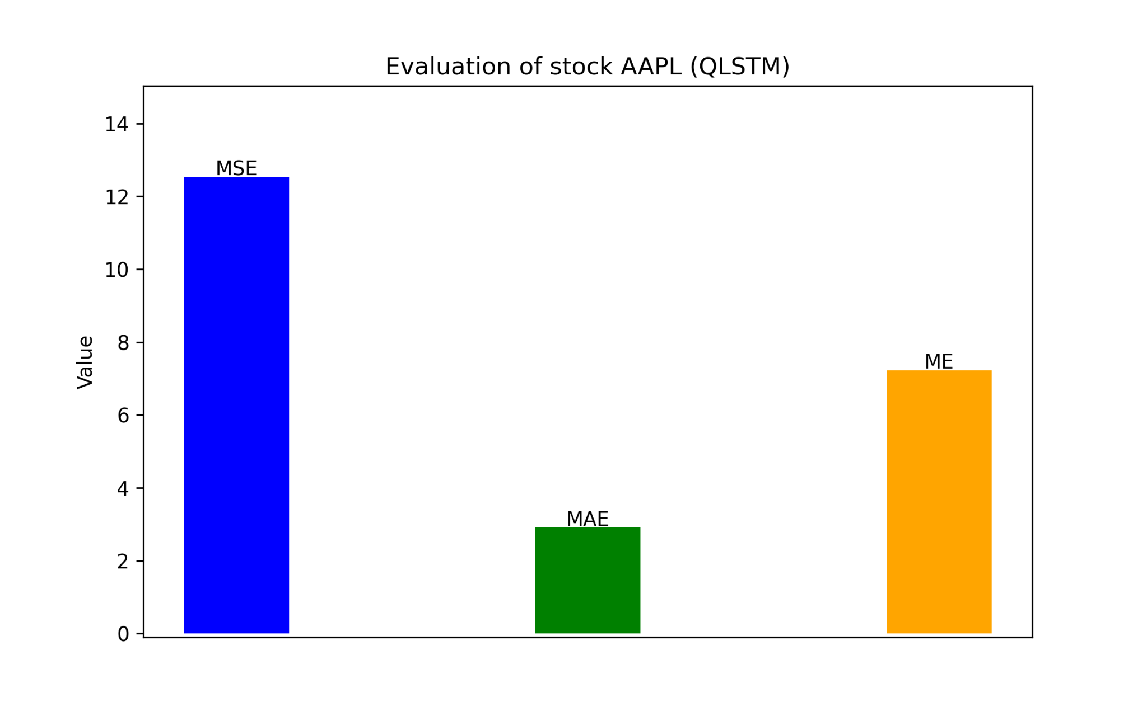
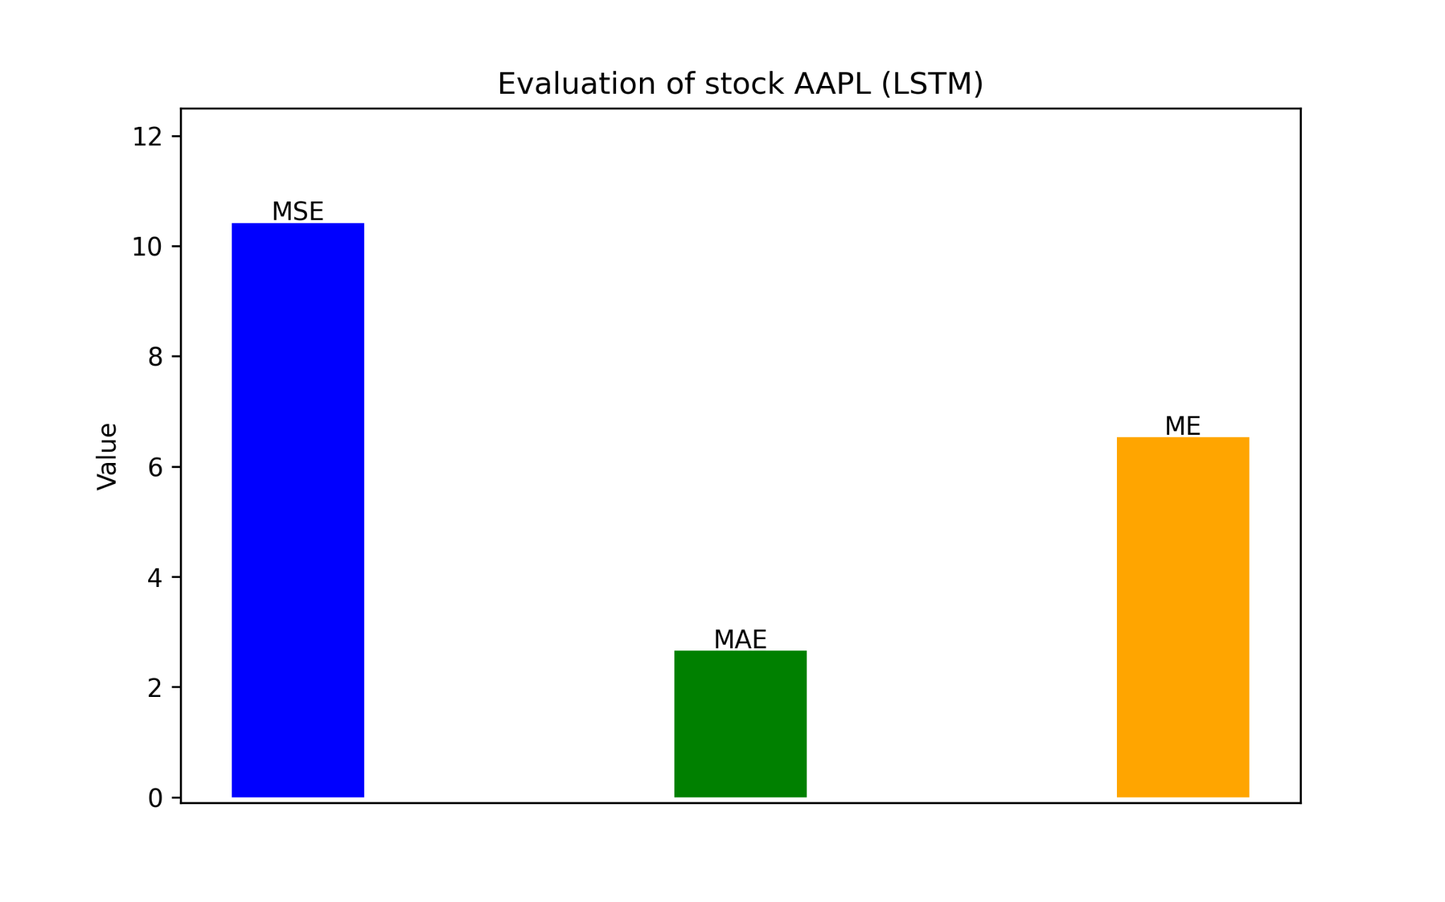
Evaluation
Mean Squared Error, Mean Absolute Error, Max Error
Quantum Financial Forecasting

Slide 7
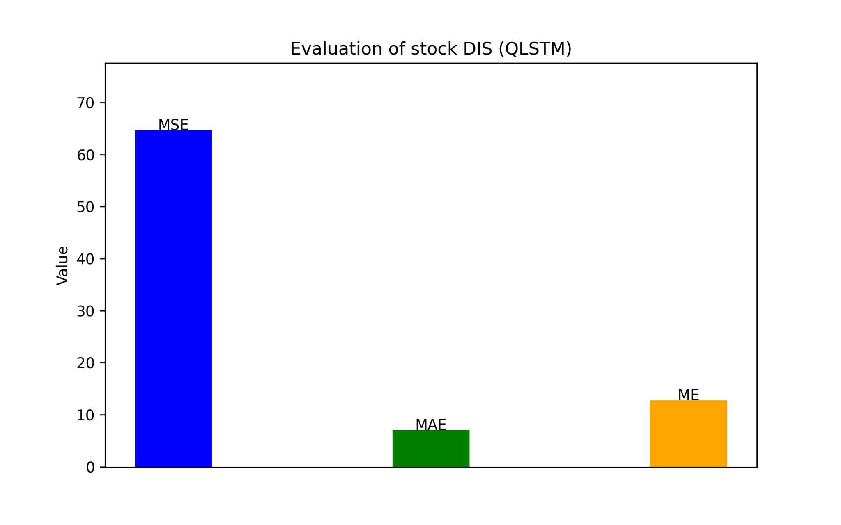
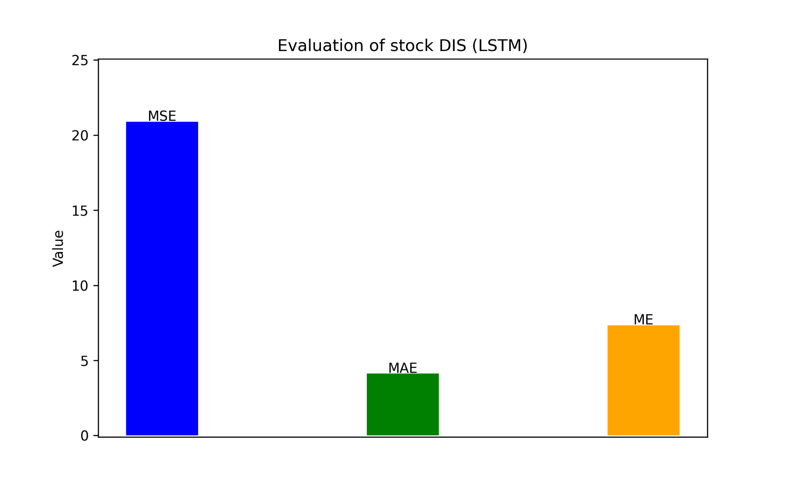
Evaluation
Mean Squared Error, Mean Absolute Error, Max Error
Quantum Financial Forecasting

Slide 8
Paper Draft Ideas
Compare prediction results of different models as main target (classical vs. quantum)
Background on QML, Time Series Forecasting and LSTM
Training, testing and validation for Methodology
Plots of different stock predictions as part of Evaluation
Quantum advantage discussion as Conclusion
Depiction of used models - Experimental Setup
Quantum Financial Forecasting

Slide 9
Outlook
Data Logging
Hyperparameter Optimization
QPU Access
Evaluation
Loss curve plot
Adding other metrics
Comparing models
Paper Draft
Quantum Financial Forecasting

