Slide 1



Quantum Financial Forecasting
Alex, Florian, Leonard, Mohamad

Slide 2
What did we achieve?
QLSTM Architecture
Baseline Implementation
Evaluation Metrics
Catch - Up meeting with Caitlin
Quantum Financial Forecasting

Slide 3
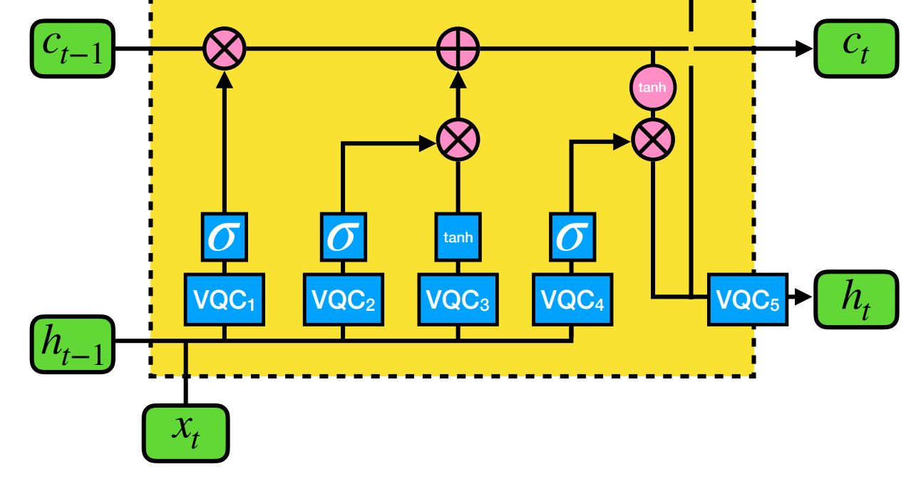
QLSTM Architecture
Cell
State
Forget
Gate
Hidden State
Input and
Update Gate
Output Gate
Input State
Quantum Financial Forecasting
3

Slide 4
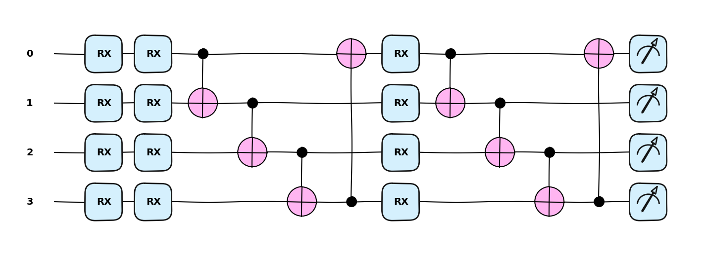
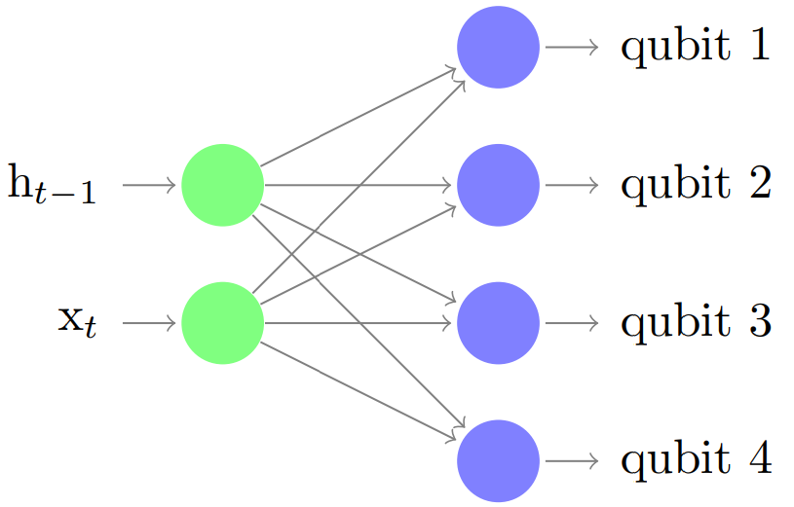
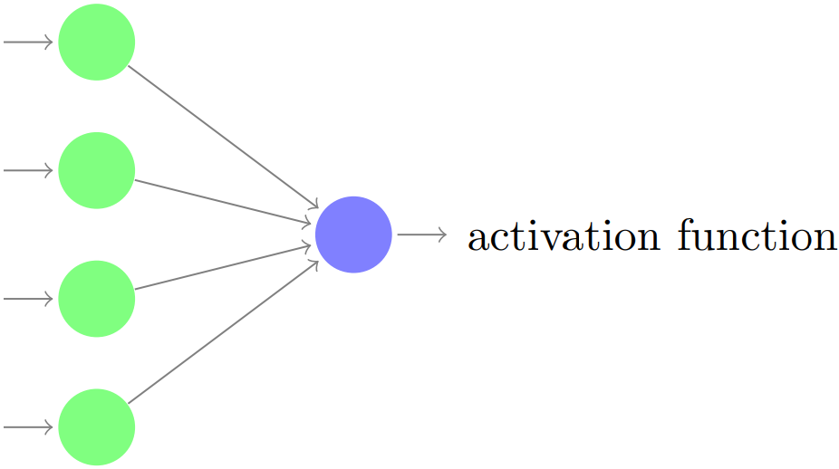
QLSTM Architecture
VQC
Linear NN
Linear NN
Quantum Financial Forecasting
4

Slide 5
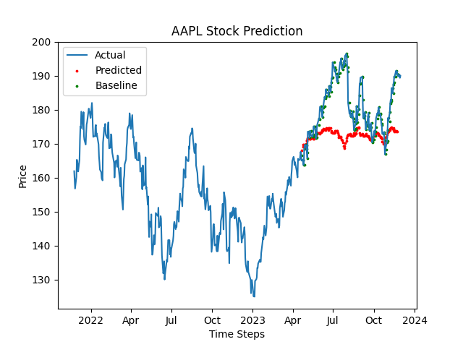

Baseline Implementation
Implementing a simple baseline
Price of previous day is used as the value of the next day
Quantum Financial Forecasting

Slide 6
Evaluation Metrics
Average Loss
Mean Squared Error
Mean Absolute Percentage Error
Root Mean Squared Error
Accuracy Score
Quantum Financial Forecasting

Slide 7
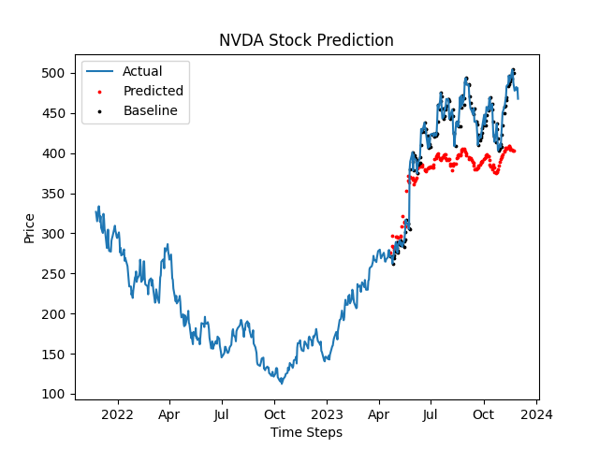
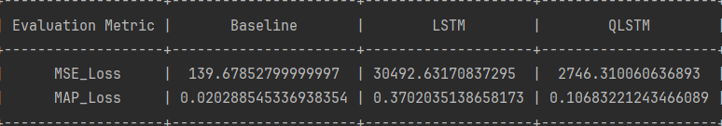
Evaluation Comparison
Baseline
Classical LSTM
QLSTM
Quantum Financial Forecasting

Slide 8
Catch - Up meeting with Caitlin
5 - 10 Day Prediction
Start with adding one additional feature at a time
Baseline Idea
2 week prediction better on static data
Input change from stock price to percentage change
Quantum Financial Forecasting

Slide 9
Outlook
Predict more than one day in advance
Hyperparameter Optimization
Autoencoder
Paper Draft
Test on QPU
Quantum Financial Forecasting

