Slide 1


Quantum Financial Forecasting
Alex, Florian, Leonard, Mohamad

Slide 2
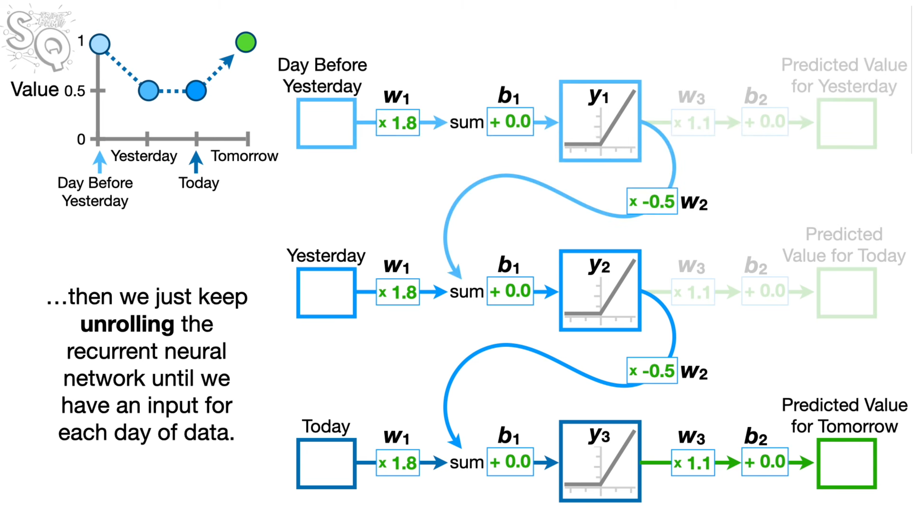
Research
Classical Recurrent Neural Network
https://www.youtube.com/watch?v=AsNTP8Kwu80
Quantum Financial Forecasting

Slide 3
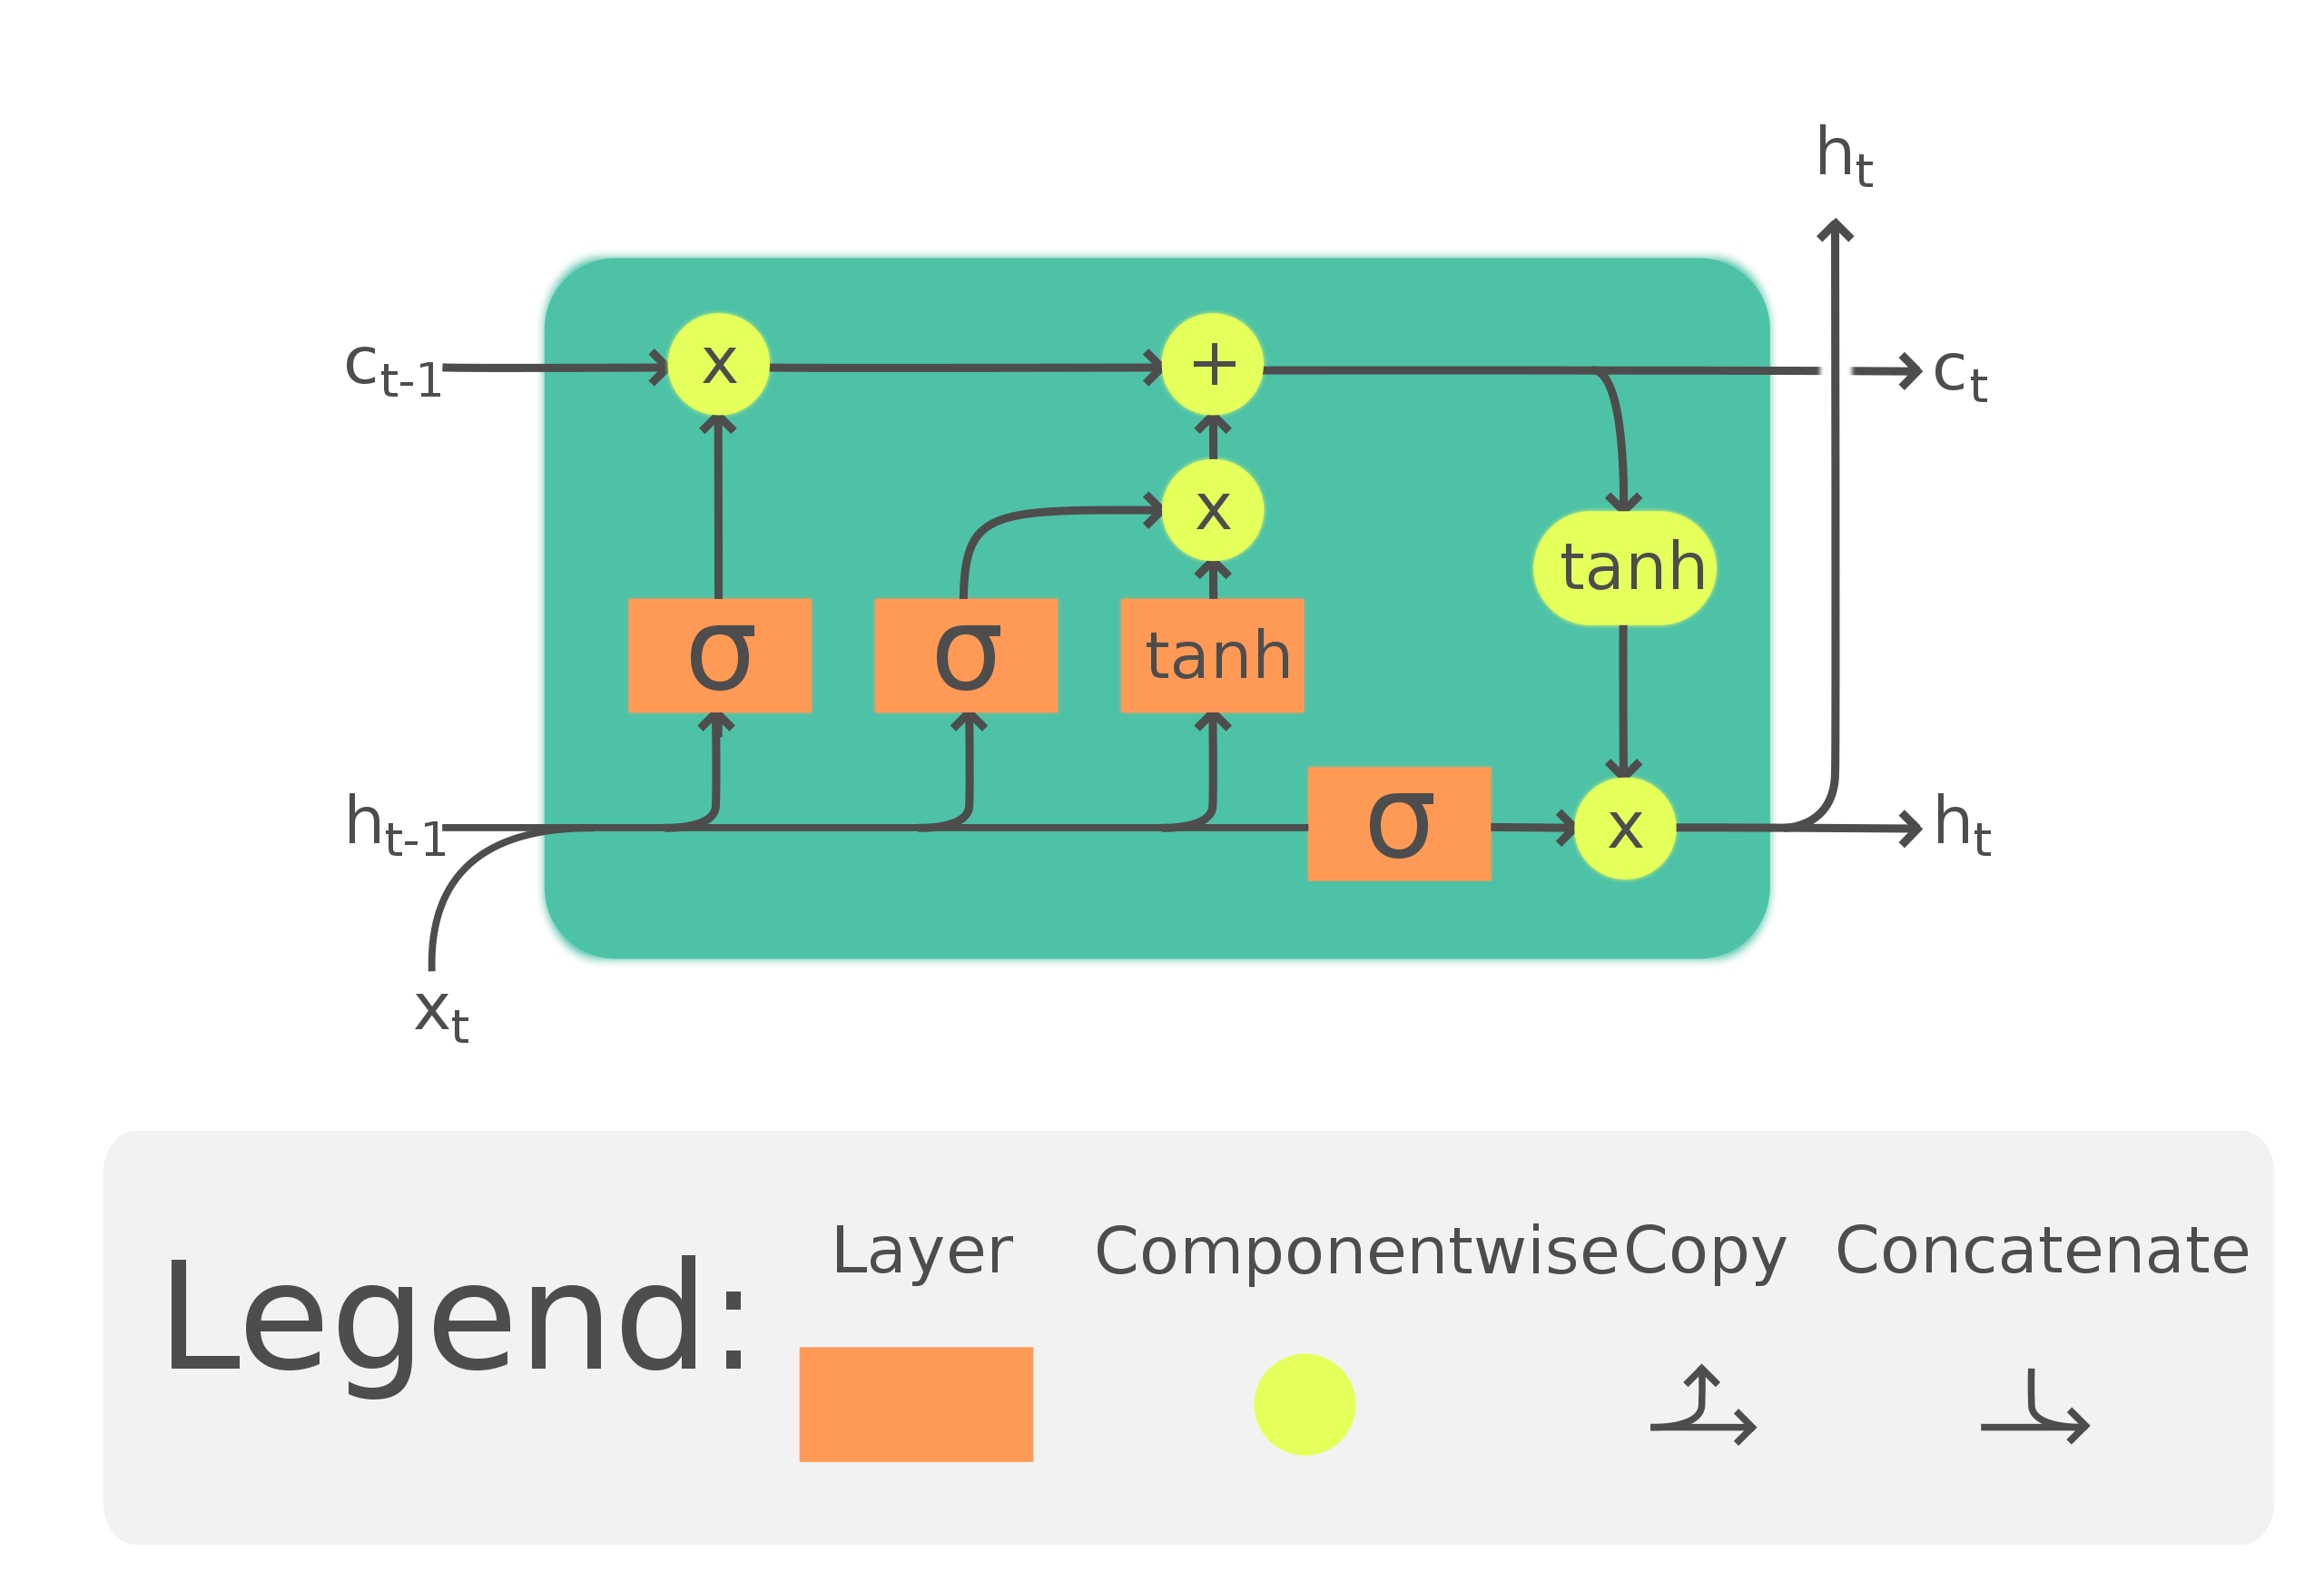
Research
LSTM
Quantum Recurrent Neural Network
(Recurrent Quantum Neural Networks – Johannes Bausch)
https://en.wikipedia.org/wiki/Long_short-term_memory
Quantum Financial Forecasting

Slide 4
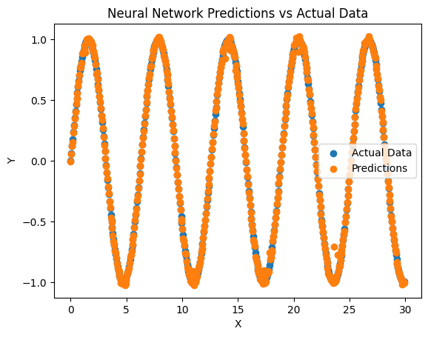
Basic Classical Neural Network
Implementations & Testing
Datasets: multiple simple mathematical functions
Task: predict the values after learning
Encode x-value into input layer
One hidden layer with 128 neurons
Output layer predicts the y-value
Quantum Financial Forecasting

Slide 5
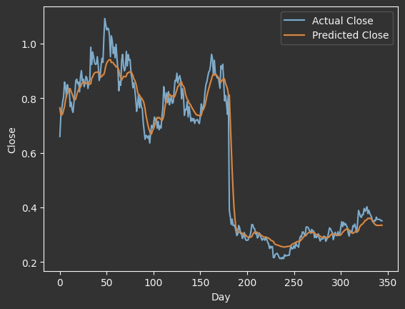
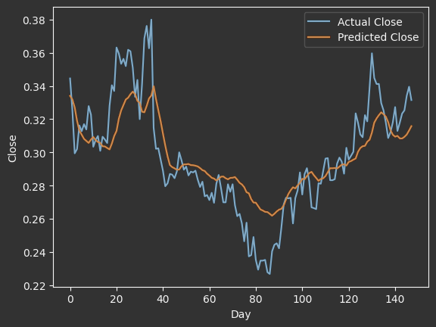
Implementations & Testing
Classical Long Short-Term Memory (LSTM)
Dataset: Apple stock daily data
Quantum Financial Forecasting

Slide 6
Next Week ToDos
Collect and prepare stocks datasets from AlphaVantage
Simple Quantum Neural Network with Pennylane
Testing on different mathematical Curves
Compare to classical NN with a similar number of parameters
Quantum Recurrent Neural Network
Compare QRNN with classical RNN
Outlook:
Quantum LSTM
Hyperparameter Optimization (e.g. Learning Rate)
Different quantum circuit architectures
Quantum Financial Forecasting

