Slide 1
Quantum Financial Forecasting
Alex, Florian, Leonard, Mohamad

Slide 2
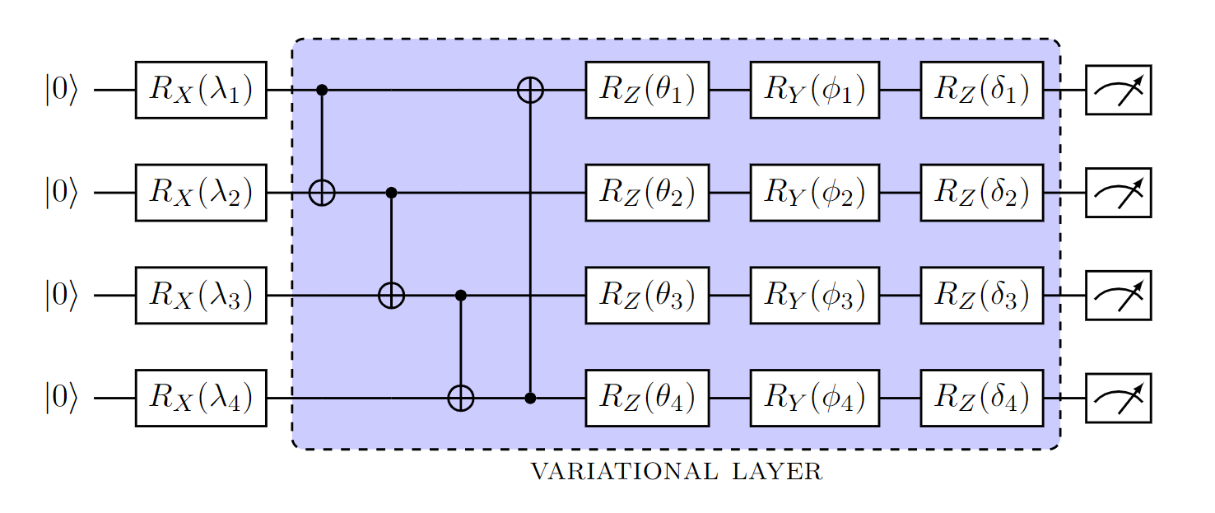

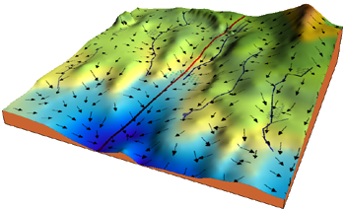
Background
Classical Financial Forecasting
Intuition
Statistics and linear regression
technical and fundamental analysis
Neural Networks
Quantum neural networks
Classical parameters optimization

Slide 3
Related Work
Using Neural Networks to Forecast Stock Market Prices
Comparison between different NN Architectures (e.g., recurrent, self-organizing) and statistical/regression techniques
NN predicts market movement 90% of the time correct vs.
statistical methods 60 – 70%
NN also outperformed the index averages (e.g., S&P 500)

Slide 4
Related Work
Quantum Machine Learning in Finance: Time Series Forecasting
PQC (QNN) vs. BiLSTM
Time Series Signals (deterministic component, trend, noise component)
AAPL, BitCoin, and more stocks
Results
PQC is trained faster
96 trainable parameters (PQC) vs. 175.648 trainable parameters (BiLSTM)
PQC outperforms BiLSTM on signals with higher noise coefficient

Slide 5
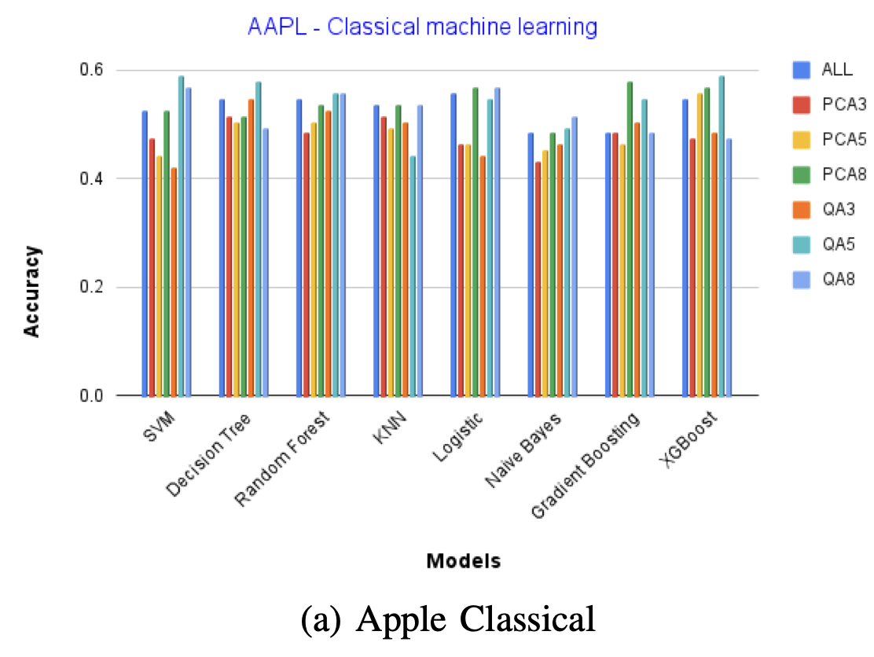
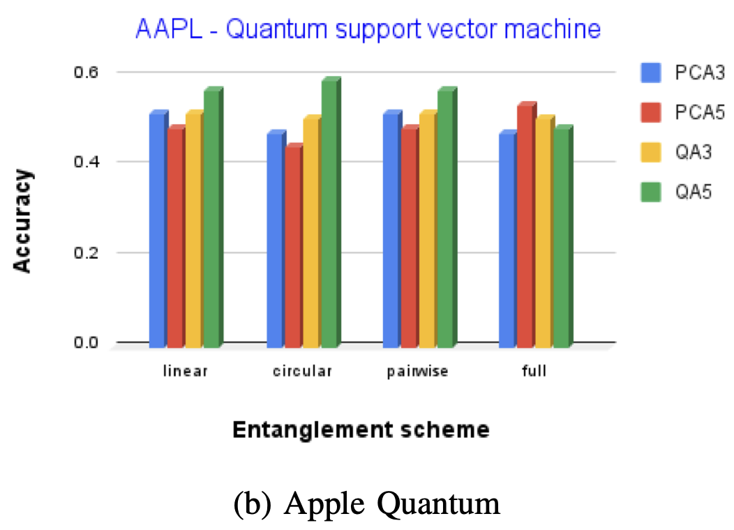
Related Work
The Potential of Quantum Techniques for Stock Price Prediction
Model: Quantum Support Vector Machines
Dataset: Apple, Visa, Johnson and Jonson, and Honeywell
Results: Quantum model performance is similar to the classical model SVM
Compared:
different architectures and
entanglement schemes.
Different future research
Suggestions (LSTM)

Slide 6
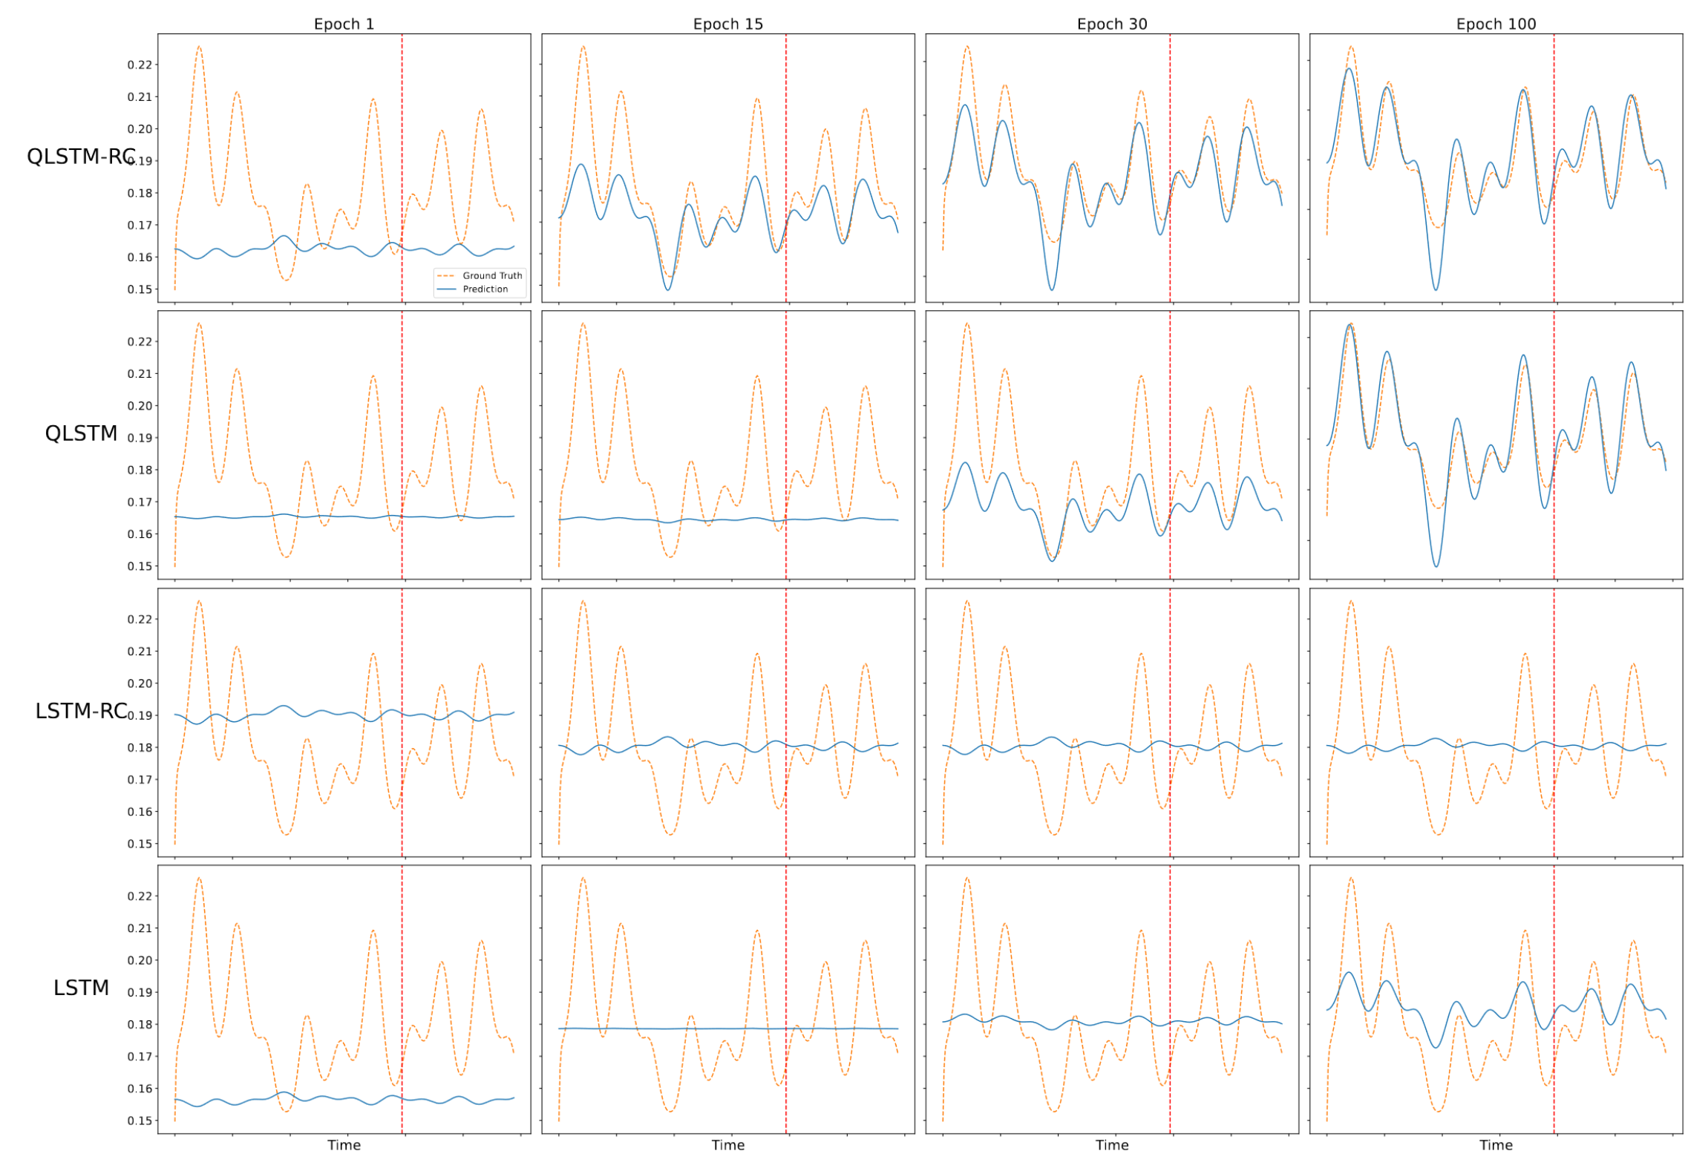
Related Work
Reservoir Computing via Quantum Recurrent Neural Networks
reservoir computing framework to QRNN -> QRNN-RC
Training complexity is significantly reduced
Results compared to:
QRNN
Classical RNN

Slide 7
Methodology
Classical
ARIMA
LSTM
Quantum
Quantum neural network models, e.g.:
Quantum Long Short-Term Memory
Quantum reservoir computing
Quantum support vector machines

Slide 8
Next Steps
Basic algorithm implementations (classical and quantum)
Stock Dataset collection (e.g., Alpha Vantage)
Basic performance comparison (RC Quantum, QSVM, QLSTM)
Test how sensitive quantum models are to noise in the data
Test Calman filter to handle noise
Test how scalable quantum models are

