Slide 1
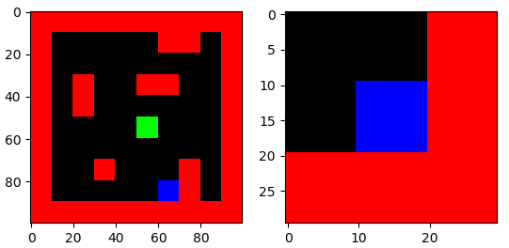
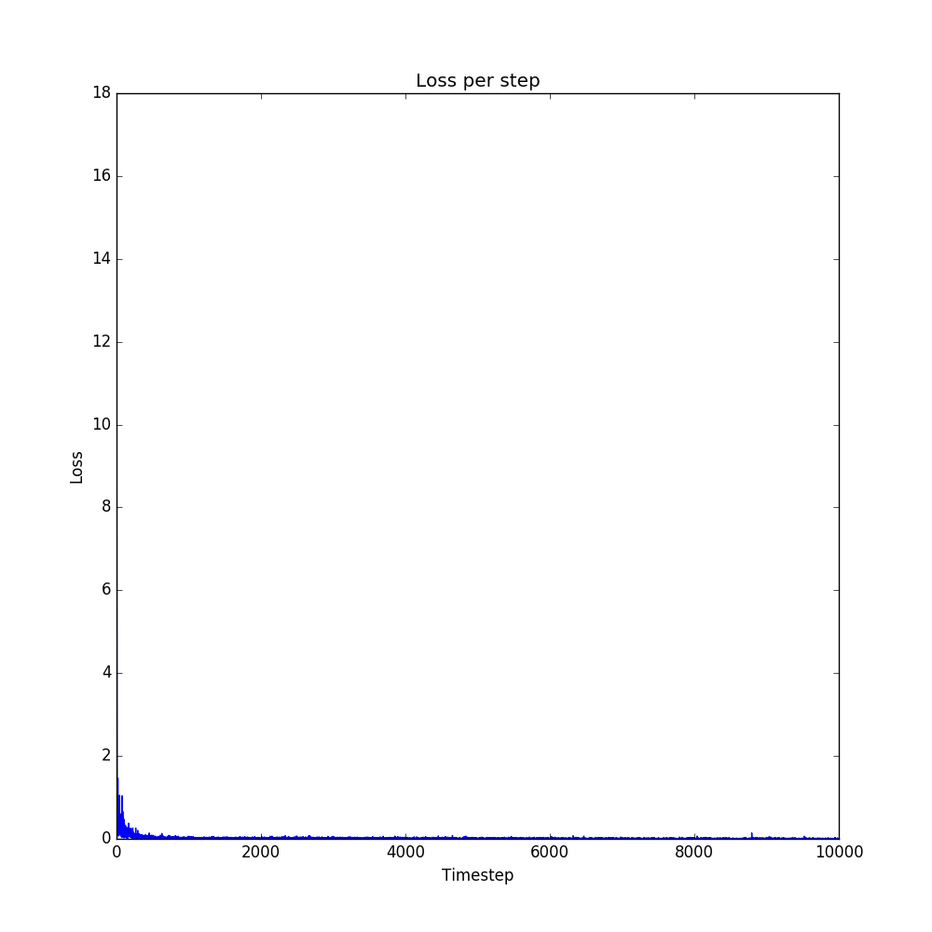
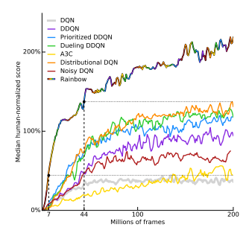
Rainbow DQN in Planning
Navigating the maze task using extended DQN
Theresa Eimer, Maryna Kapitonova, Hakan Yilmaz
Objective
Prioritized Experience Replay [3]
The goal of this project was the navigation of an agent through a maze with fixed goal position using Deep Q-Learning (DQN) and variants thereof.
Standard DQN using experience replay and e.g. a CNN as q-value approximator turns out to be highly limited. This potentially complicates the training procedure and leads to poor navigation performance. To increase performance and training efficiency, several extensions (combinations are referred to as “Rainbow” version in [1]) have been developed. Here, we implement a selection of these extensions and use the standard DQN performance as a benchmark [1]. The training was performed using the TensorFlow framework [2].
In standard DQN, experiences are stored and uniformly sampled from during training without considering learning potentials of different experiences. To make the learning process more efficient, experiences with highest learning power are prioritized. To achieve that, experiences are drawn from a probability distribution based on the TD-error. This leads to more frequently drawn experiences with relatively high TD-error, the agent‘s “weaknesses“ are trained.
Noisy Nets [4]
Traditional exploration means the decision whether to follow the agent‘s predicted best action or a random action in each step independently (e.g. ε-greedily). The maze task, however, is a problem where subsequent steps are highly correlated. Noisy nets provide an exploration method which allows for exploration over multiple steps. The fully connected layers of the network now feature noisy weights and biases whose exploration effects attenuate in the course of training.
Fig. 1: Maze task. Left: Full environment. Right: Partial observation.
Multi-Step Learning [5]
The reward in the maze problem is given per used step but does not consider the agent’s following actions. To make the reward a better representation of performance, we accumulate the rewards of each step taken until n steps afterwards (e.g. n=3). We don‘t use the reward per step but the reward accumulated after it.
Methods
Target Network
In standard DQN, approximations of one network are used to update this same network (target = agent). This potentially leads to feedback loops during training. To prevent the target to depend too heavily on the agent network‘s predictions, we use a fixed target network which is slowly updated towards our agent. The corresponding loss function is:
Results
We had high expectations that our results, unfortunately, didn‘t match. The performance wasn‘t very good, in fact it wasn‘t better than our previous try at 10^5 episodes. Our loss, however, did decrease consistently, so the most likely issue was training time. Increasing it dramatically wasn‘t feasible even on the university GPUs,however, which leads us to believe the problem is a runtime one as the problem itself and also the addition of noise simply need a lot of episodes to get good results.
Double DQN (DDQN)
The usage of the maximal Q-value approximation as target can cause overestimations. To counteract this, we still use the target network‘s predicted values, but let the agent choose the action. The loss function is now:
Fig. 2: Our loss function went down reliably
Fig. 3: The performance we‘d have hoped for
[1] M Hessel, J Modayil, H van Hasselt, T Schaul, G Ostrovski, W Dabney, D Horgan, B Piot, M G Azar, D Silver, “Rainbow: Combining Improvements in Deep Reinforcement Learning, 2017.
[2] TensorFlow: Large-scale machine learning on heterogeneous systems, 2015. Software available from tensorflow.org.
[3] T Schaul, J Quan, I Antonoglou, D Silver, „Prioritized Experience Replay“, 2015
[4] M Fortunato, M Azar, B Piot, J Menick, I Osband, A Graves, V Mnih, R Munos, D Hassabis, O Pietquin, C Blundell, S Legg, „Noisy Networks for Exploration“, 2017
[5] K de Asis, J Hernandez-Garcia, G Holland, R Sutton, „Multi-step Reinforcement Learning“, 2017
Notes:
<Foliennummer>

