Slide 1

RatingCurve
By Maartje Korver
May 28, 2019
A tutorial on plotting stage-discharge rating curves using the R scripts of the RatingCurve repository.

Slide 2
RatingCurve
Prepare dataset
Assess stage-discharge data
Plot rating curve

Slide 3
Prepare dataset
The data input is loaded from Googlesheets and requires the following headers:
ID (Date and time of measurement)
WTY (Water Year)
Shift (Used to create segments for shifted rating curves)
Old_new (Whether measurement has not been processed in a rating curve yet (‘New’) or has been processed in a rating curve before (‘Old’))
Event_no (ID of storm event)
Date
Final_rating_curve (‘Y’ if using the measurement for rating curve, ‘N’ if not)
Stage_avg (5 min average stage from 5 sec stage data in cm)
Stage_stdv (Standard deviation of 5 min average stage)
Stage_delta (whether hydrograph was rising (‘R’), falling (‘F’) or constant (‘C’) during measurement
Q_meas (Discharge measurements value in m3/s)
Q_rel_unc (Relative uncertainty of discharge measurement)

Slide 4
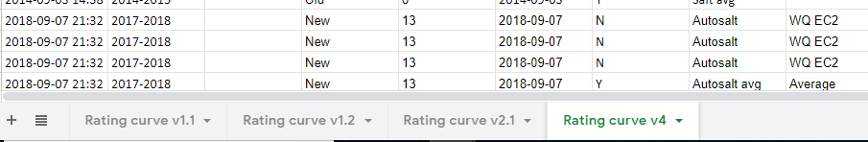
Prepare dataset
Duplicate the tab of the latest Rating curve version and change the name to the next version, in this example: ‘Rating curve v5’.

Slide 5
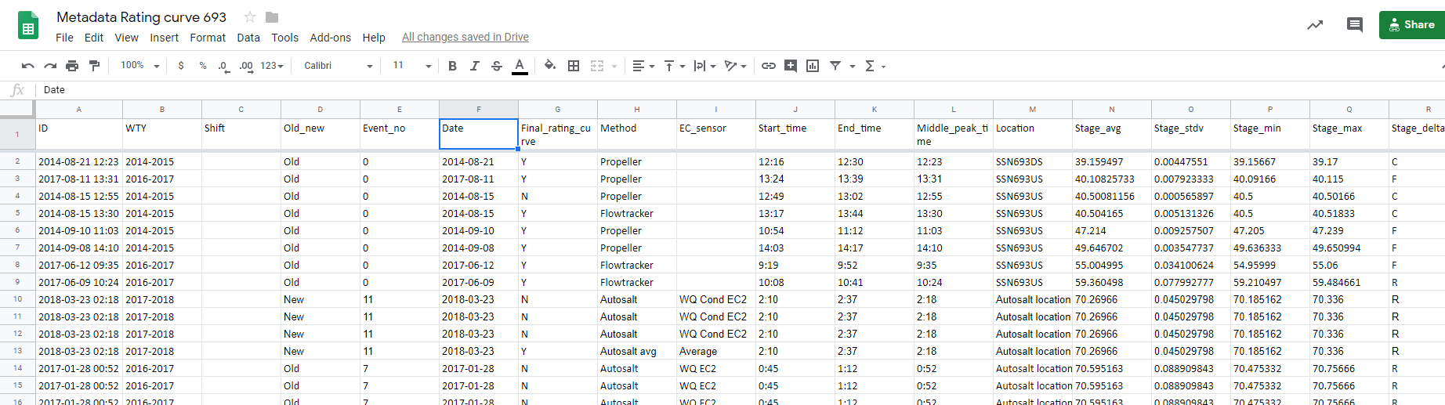
Prepare dataset
Set all values in ‘Old_new’ column to ‘Old’
‘Final_rating_curve’ column determines which measurements will be used for the rating curve. Any measurements that were omitted in the last version can be changed back to ‘Y’ so that these measurements can be reassessed with the new data.
Each autosalt measurement consists of multiple entries: one for each sensor result. However, only the ‘Autosalt avg’ value should make its way into the rating curve, so all sensor results should be set to ‘N’ and the ‘Autosalt avg’ to ‘Y’.

Slide 6
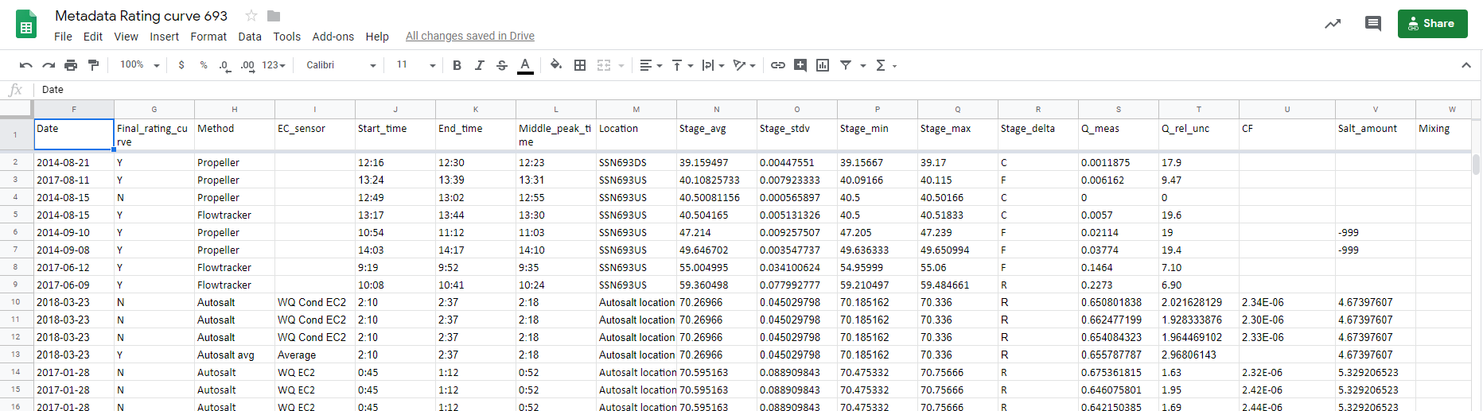
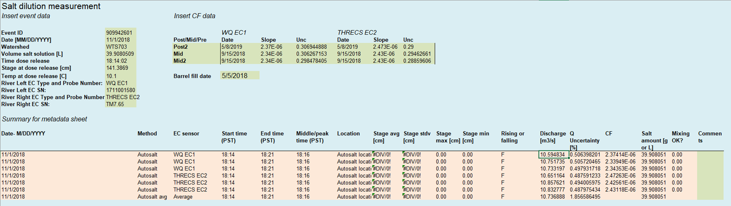
Prepare dataset
Enter metadata from Discharge calculation files (manual and automatic) into the rating curve metadata sheet

Slide 7
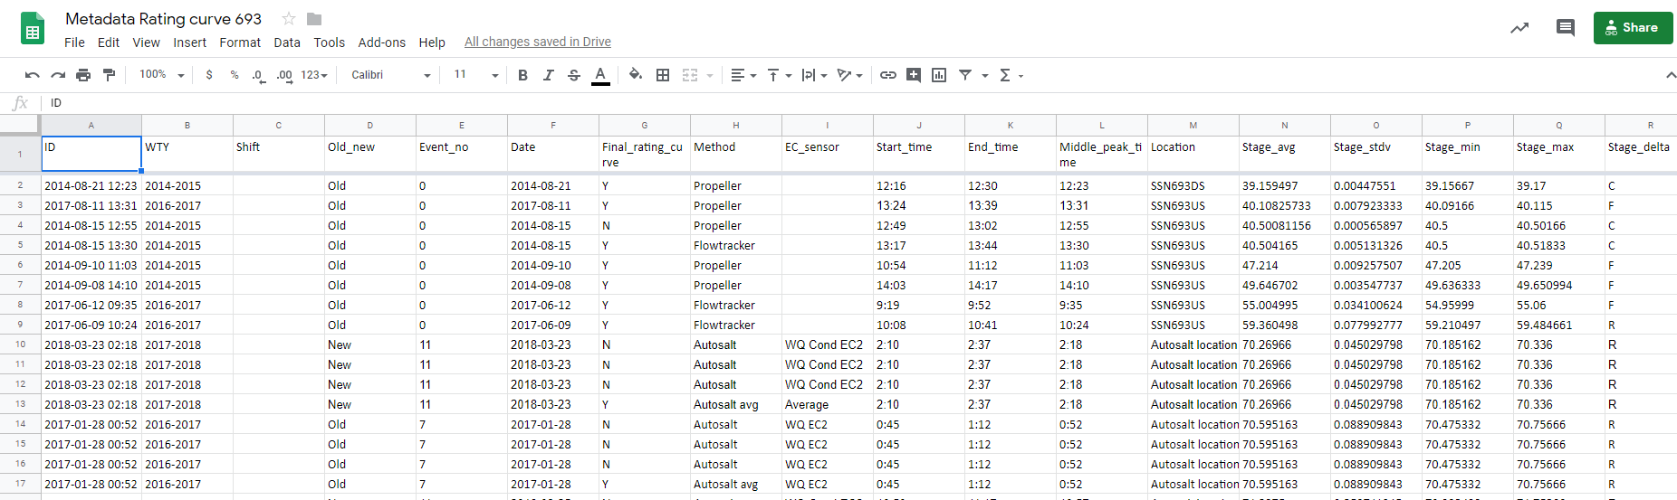
Prepare dataset
Set ‘Old_new’ to New for all newly inserted measurements
Assign new ‘Event_no’ to all discharge measurements that were taken during one and the same storm event (along rising or falling limb).
Assign ID and WTY. Column ‘Shift’ can be left blank for now.

Slide 8
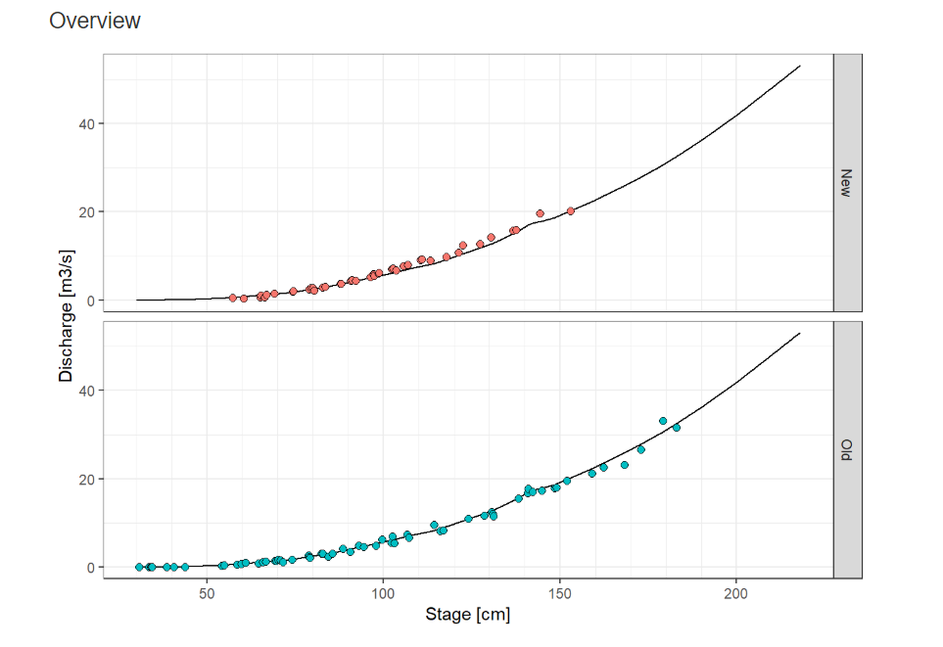
Assess discharge data
Before plotting the rating curve you need to assess the stage-discharge data and decide:
If outlier data should be omitted
Whether rating curve has shifted
Use R Markdown script: ‘QH_data_assessment.Rmd’ or
‘QH_data_assessment_Shifted.Rmd’

Slide 9

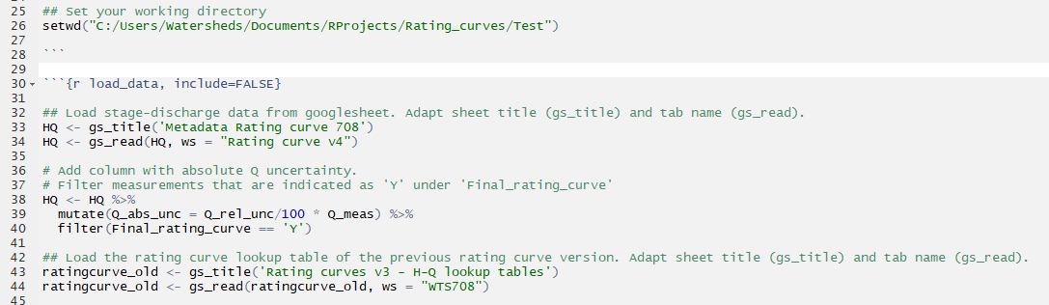
Assess discharge data
Use R Markdown script: ‘QH_data_assessment.Rmd’
Or if previous rating curve consisted of one or more shifts: ‘QH_data_assessment_Shifted.Rmd’
Change date, name, working directory, title and tab name of HQ and old rating curve data to import

Slide 10
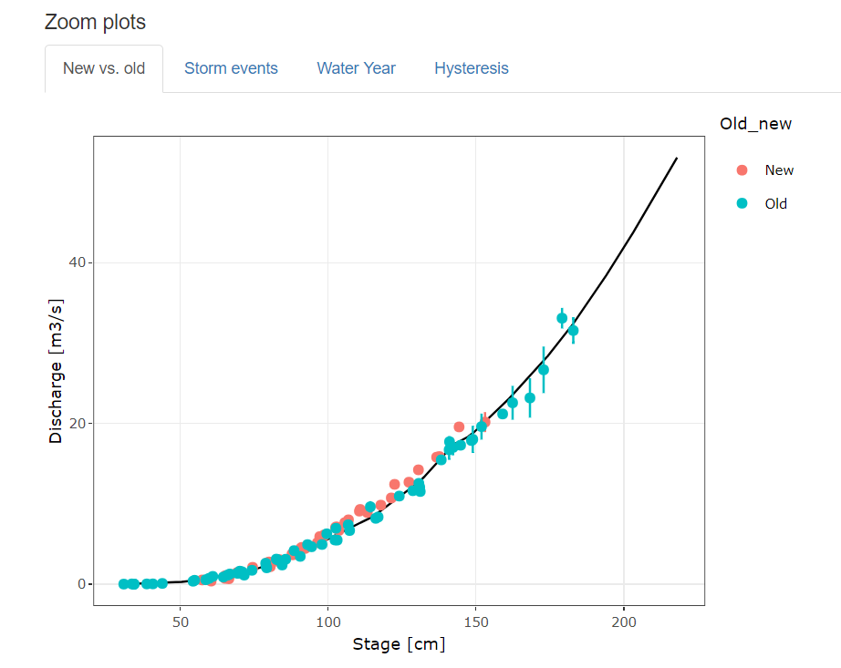
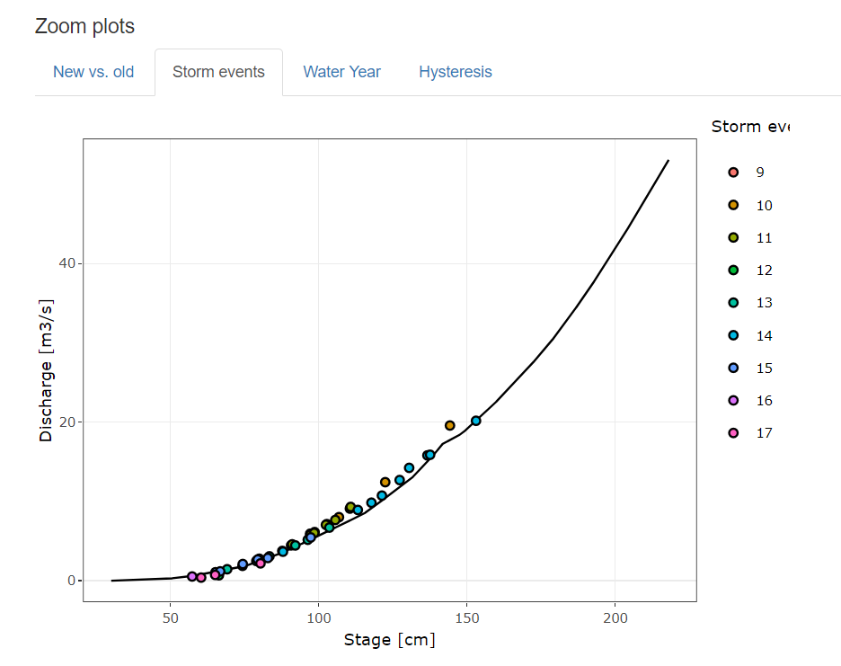
Assess discharge data

Slide 11
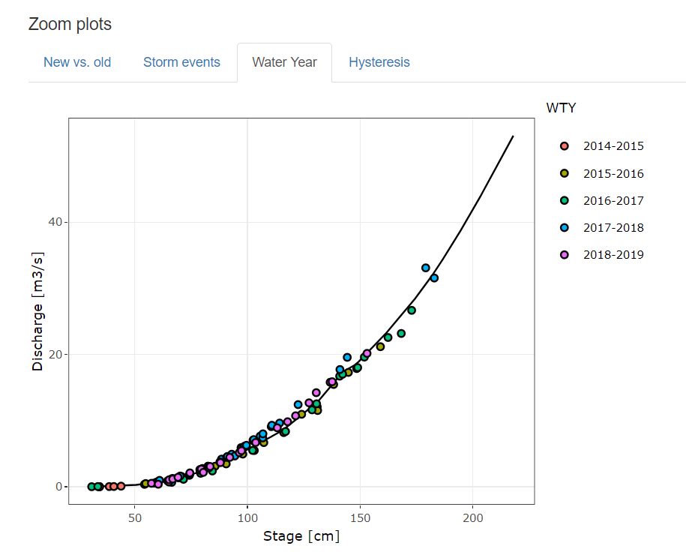
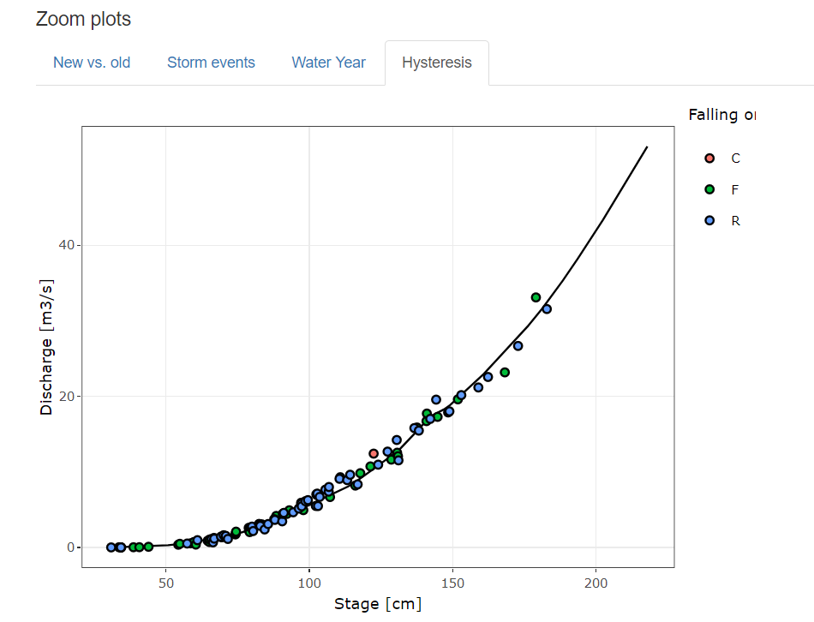
Assess discharge data

Slide 12
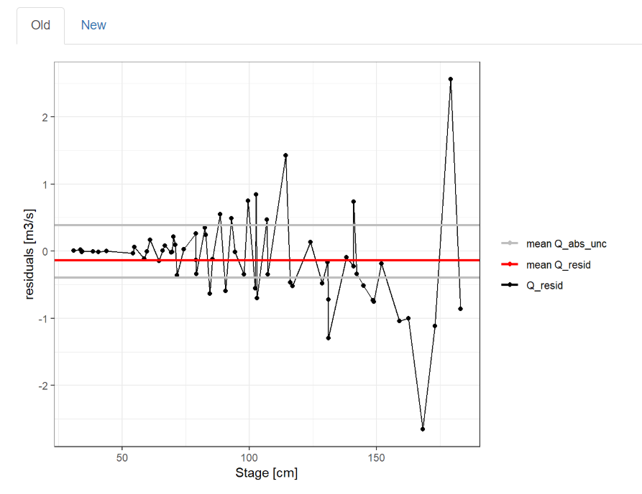
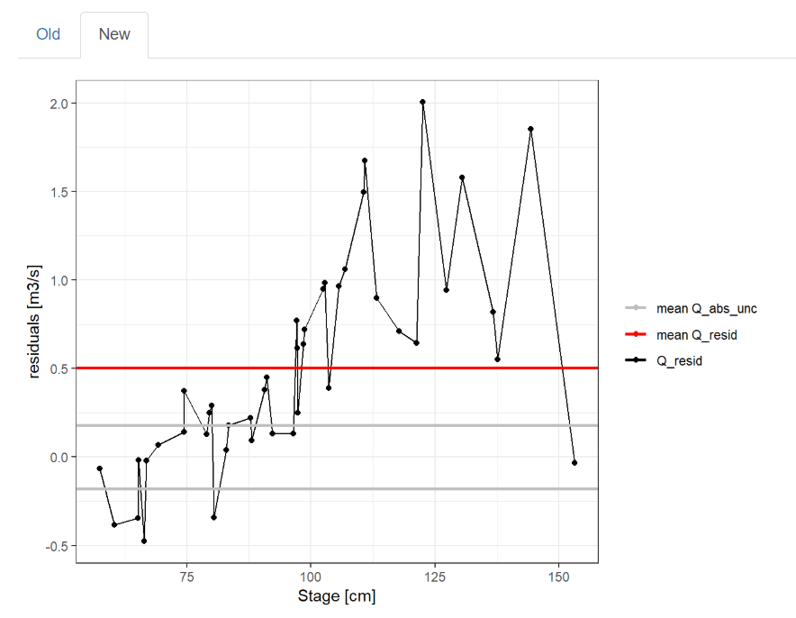
Assess discharge data

Slide 13
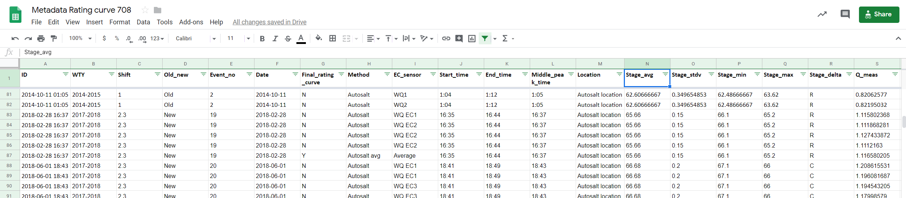
Assess discharge data
If omitting certain data points, change to ‘N’ in ‘Final_rating_curve’ column
If rating curve has shifted, organize data points by shift segment in ‘Shift’ column. For example, ‘1’ for all low flow measurements that have not shifted, ‘2.1’ for all high flow measurements prior to a shift and ‘2.2’ for all measurements after a shift.

Slide 14
Plot rating curve
Use R Markdown script: ‘Rating_curve.Rmd’ or if rating curve consists of one or more shifts: ‘Rating_curve_Shifted.Rmd’
Only
‘Rating_curve_Shifted.Rmd’
Extrap_values.csv
Load data
Separate rating curve dataframes
Span Width
Extrapolate curve
Interpolate curve
Assess
Select
Tidydata_stagedischarge.R
selectspan.R
interp1.R
Extrap_values.csv
CI (95%)
Interpolate CI
Extrapolate CI
Finish
WTSxxxratingcurve_vx.csv
RatingCI.csv
WTSxxxstagedischarge_vx.csv
interp2.R
HQ_unc.R
CI_model_input.R
CI.R

Slide 15
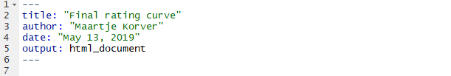
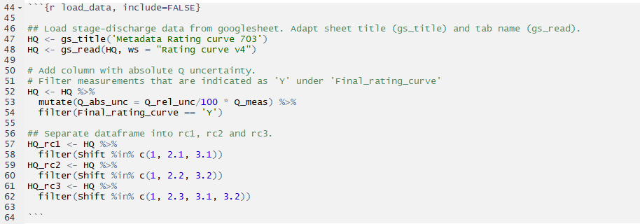
Plot rating curve
Change date, name, working directory, title and tab name of HQ data to import
Load data
In ‘Rating_curve_Shifted.Rmd’ only:
Separate rating curve dataframes
Create separate dataframes for each rating curve (rc1, rc2, rc3,…) using shift segment numbers from ‘Shift’ column

Slide 16
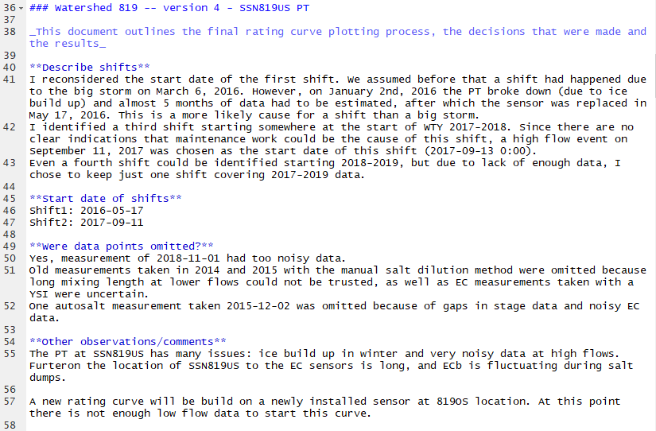
Plot rating curve
Record important information on rating curve shifts, discarded data points and any other issues with the data

Slide 17
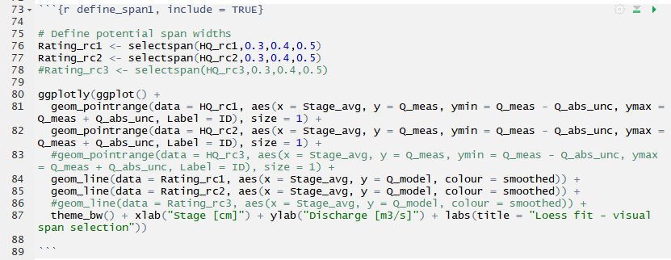
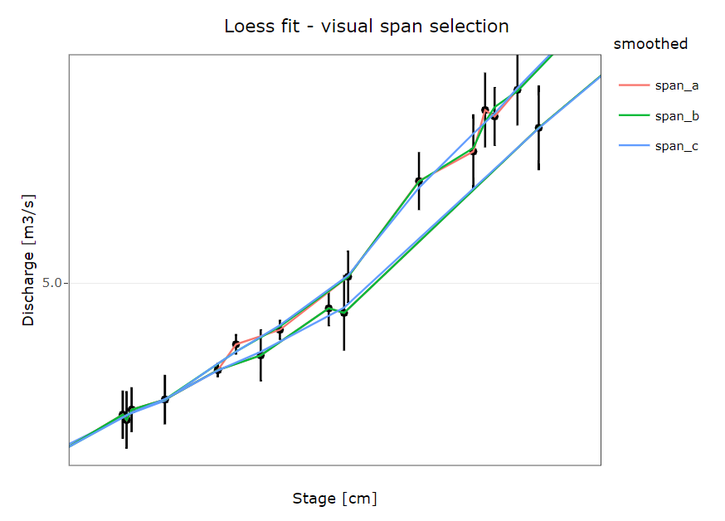
Plot rating curve
Span Width
Assess
Try different span widths for Loess fit and assess visually
selectspan.R

Slide 18
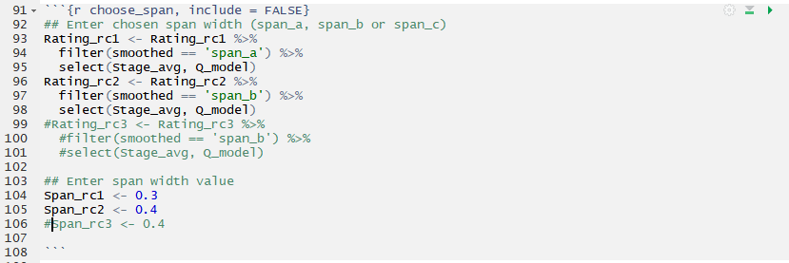
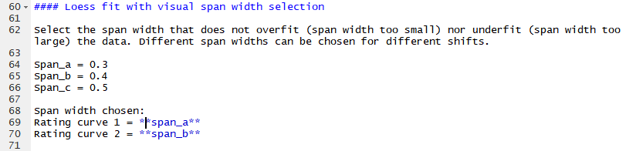
Plot rating curve
Span Width
Select
Enter selected span widths

Slide 19
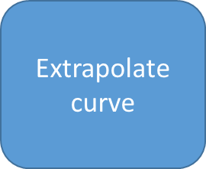
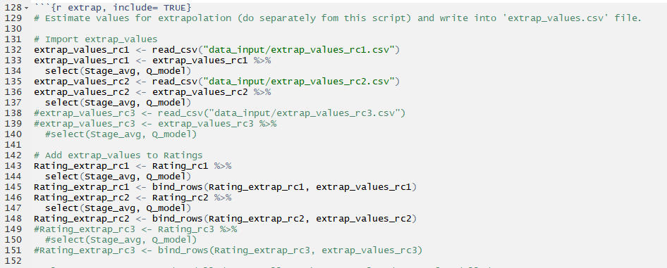

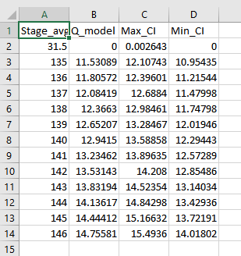
Plot rating curve
Look up min and max stage recorded so far from https://hecate.hakai.org/sn
Estimate Q values for extrapolated part.

Slide 20
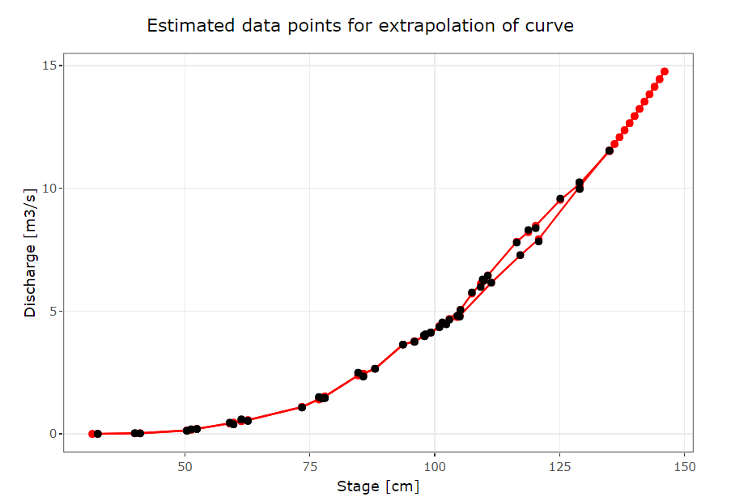
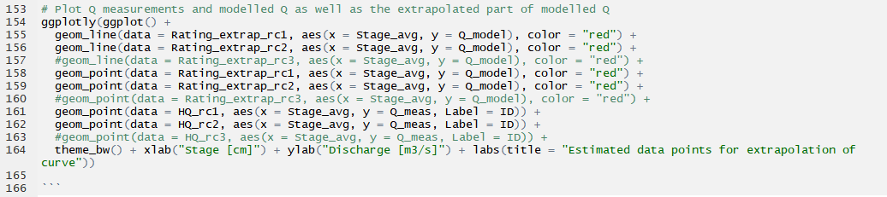
Plot rating curve

Slide 21
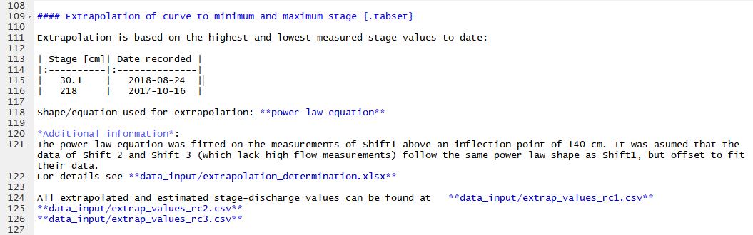
Plot rating curve
Note min and max stage and date recorded
Note how high flows were extrapolated, i.e. wit a power law equation or linear. Add explanation excel sheet if needed.

Slide 22
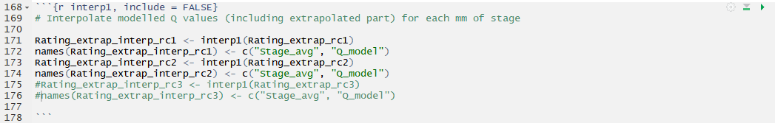
Plot rating curve
Interpolate curve
The rating curve is linearly interpolated between data points, for each mm of stage.
interp1.R

Slide 23
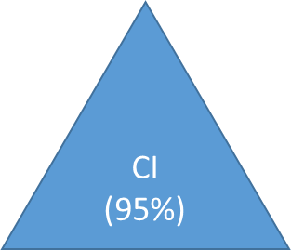

Plot rating curve
First, the uncertainty in stage is expressed as uncertainty in Discharge by error propagation, and added to Discharge uncertainty.

Slide 24

Plot rating curve
Second, 500 new H-Q datasets are created by randomized sampling of Q, minQ or maxQ at each stage value
CI_model_input.R

Slide 25
Plot rating curve
Second, 500 new H-Q datasets are created by randomized sampling of Q, minQ or maxQ at each stage value
CI_model_input.R
You can adjust the number of datasets you want to create

Slide 26
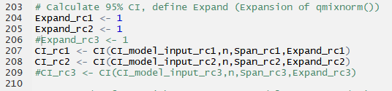
Plot rating curve
500 rating curves from 500 datasets are created using Loess fit with previously defined span width
For each stage value, the loess fit provides 500 estimated discharge values and 500 standard deviations
For each stage value, CI (95%) is calculated by combining these 500 discharge values + standard deviations in a Gaussian mixture model
CI.R
If model produces ‘NaN’ values for CI bands, this means that the ‘Expand’ value should be lowered.
More info on ‘Expand’ in qmixnorm() → https://www.rdocumentation.org/packages/KScorrect/versions/1.2.4/topics/dmixnorm

Slide 27
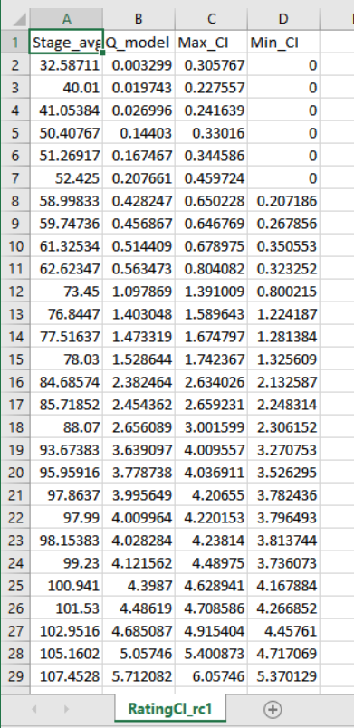
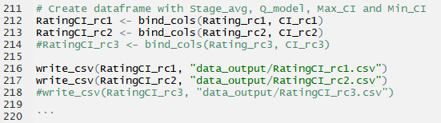
Plot rating curve
RatingCI.csv
RatingCI.csv
A .csv is created so you can check the results for NaN values before proceeding

Slide 28
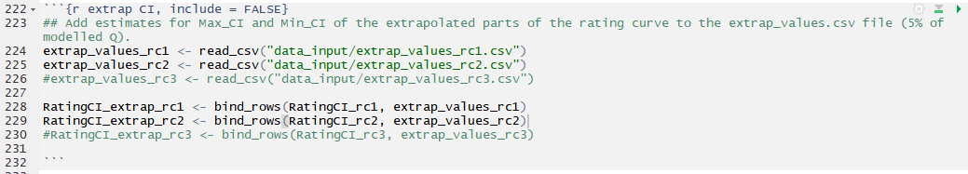
Plot rating curve
Extrapolate CI
Add estimates for the CI’s of the extrapolated part of the rating curve. I have used Q_model ± 5% of Q_model as an estimate.

Slide 29
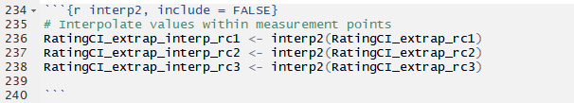
Plot rating curve
Interpolate CI
The CI’s of the rating curve are linearly interpolated between data points, for each mm of stage.
interp2.R

Slide 30
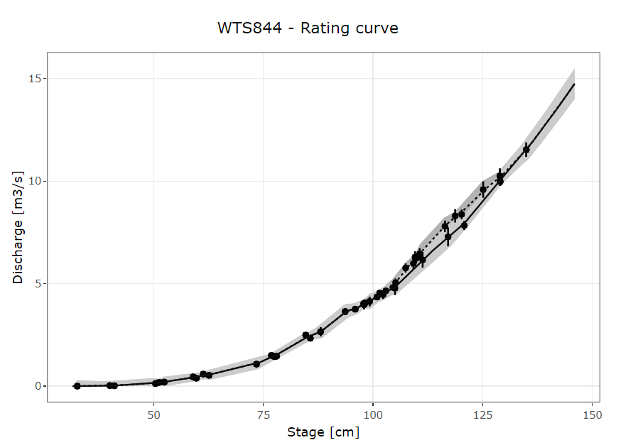
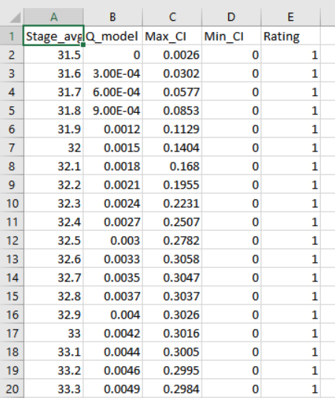
Plot rating curve
Hopefully you will create something like this!
Finish
WTSxxxstagedischarge_vx.csv
WTSxxxratingcurve_vx.csv

Slide 31
Plot rating curve
Finish
Two common causes for funny looking plots/errors:
‘Metadata Rating curve xxx’ sheet has to be sorted by increasing ‘Stage_avg’!!
‘Stage_avg’ value cannot be the same for two different stage-discharge measurements. Add 0.01 (negligible small amount) to differentiate between the two measurements
WTSxxxstagedischarge_vx.csv
WTSxxxratingcurve_vx.csv

