Slide 1

Spending Allowance Token
(SAT)
Demo
By :-

Slide 2
Index
Introduction to Spending Allowance Token
Tools used in Demo
Introduction to Metamask
Connecting to ixxo node using Metamask
Introduction to Remix
How to buy SAT
Sending tokens
  Originated from person
    Person to Person and Person to Smart Contract
  Originated from Smart Contract
    Smart contract to smart contract and Smart contract to person

Slide 3
Introduction to SAT
Spending Allowance Token
It is a stable mintable token , as it maintains and record the flow and movement of each SAT in the system.
Can be minted by minting entity only (bank)
It represents the any fiat currency in the system as “Stable Tokens”
SAT is used as payment module in ixxo network for buying of service, sending to money (to entity in network), etc

Slide 4


Tools used
Metamask
Remix browser-IDE

Slide 5
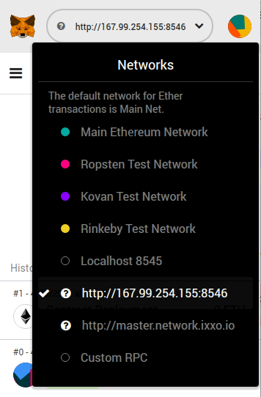
Connecting to ixxo node
To connect to ixxo network use Metamask
Enter the ixxo RPC End Point in custom rpc option , and save it
Click on options of different network ,then select ixxo RPC
Now , we are connect to ixxo

Slide 6
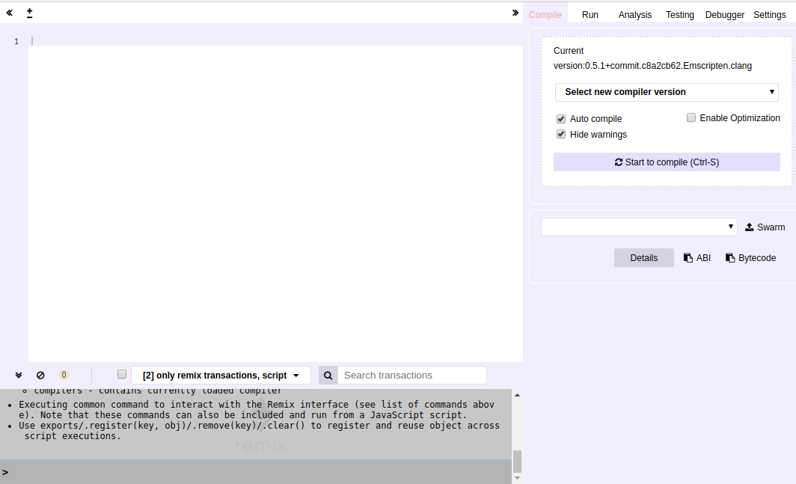
Introduction to Remix
Open browser and thrn go to remix.ethereum.org
Remix is not just an ide , but also provide facility to interact with already deployed contract.
We will use contract abi and contract address to fetch the SAT instance and interact with it .
Contract address is generated when contract is deployed for the first time in the network

Slide 7
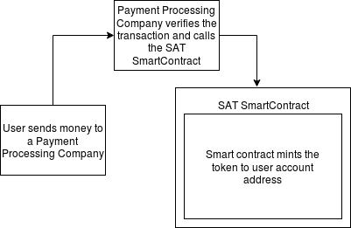
How to buy SAT
To buy SAT an entity need to send fiat currency to the Payment Processing Company.
Payment Processing Company mints more SAT then receiving amount, this rate is set by ixxo in compliance with Payment Processing Company
Then Payment Processing Company mints the SAT to the entities account automatically once payment is received successfully.
Bank calls the SAT token function “startTokenAllocation()” to mint the tokens.

Slide 8

Sending Of Tokens
SAT are primary spending allowances in ixxo network
They can also be used as payment mode across the entities in the system
If an entity sends SAT to other entity ixxo takes very minimal amount of commission to smoothly facilitate the transaction
Sending of token can be from person account or Smart contract , on this basis , SAT are handled

Slide 9

Tokens originating form Person
In this type of transaction person tries to send the SAT from persons account to other person account or Smart Contract.
This type of transaction needs to be validated from transaction initiator.

Slide 10

Tokens Originating from Smart Contract
In this type of transaction Smart Contract tries to send the SAT from Smart Contract to other Smart Contract or person account.
This type of transaction do not need validation from transaction initiator

Slide 11
Test
Now , we are going to demonstrate how Spending Allowance Tokens work.
For this purpose , we are going to use several test cases.
This will guide us the behavior of SAT in different scenarios

Slide 12
Test 1 A
Original Transaction
A => SmartContract1
SmartContract1 => B (after 30 seconds)
Expected Result
Transaction should be generated in second period Starting

Slide 13
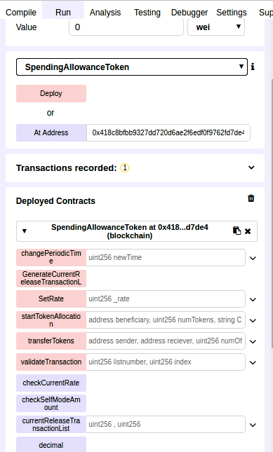
Test 1 A : step 1
Retrieve SAT instance using SAT contract address and abi.
Then deploying test Smart Contract ,with SAT contract address as parameter . So that test contract interact with same SAT instance.

Slide 14
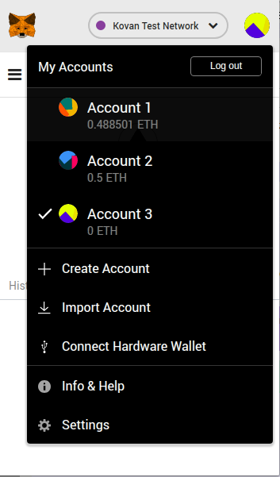
Test 1 A : Step 2
Using Metamask switch account . Let account 2 be A .
We can always switch accounts using Metamask . Here we are doing so , to mimic the multi-party interaction

Slide 15
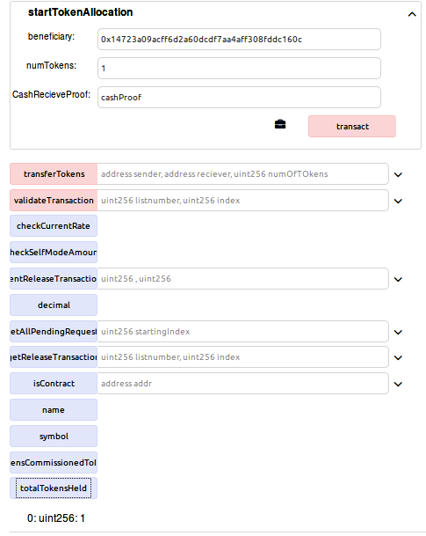
Test 1 A : Step 3
Allocating 1 SAT to account A .
For this startTokenAllocation() is invoked by bank , when entity A sends real money to minting entity.

Slide 16
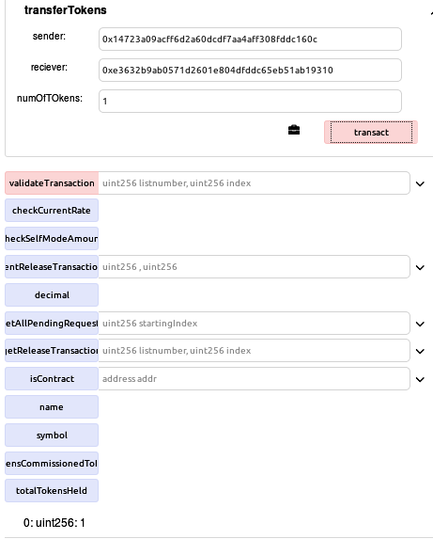
Test 1 A : Step 4.1
Sending token from account A to test contract SmartContract 1 .

Slide 17
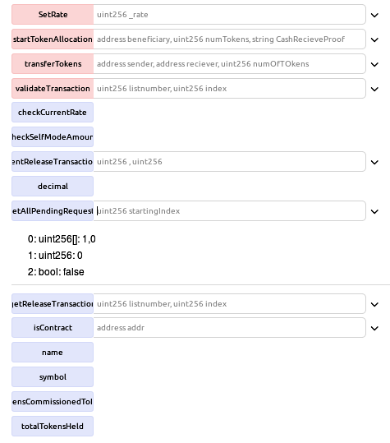
Test 1 A : Step 4.2
We can use function
“getAllPendingRequests()”, for getting all the pending request
This function returns the period number and index of the transaction
It returns one transaction at a time and directs if any further pending transaction is there or not .

Slide 18
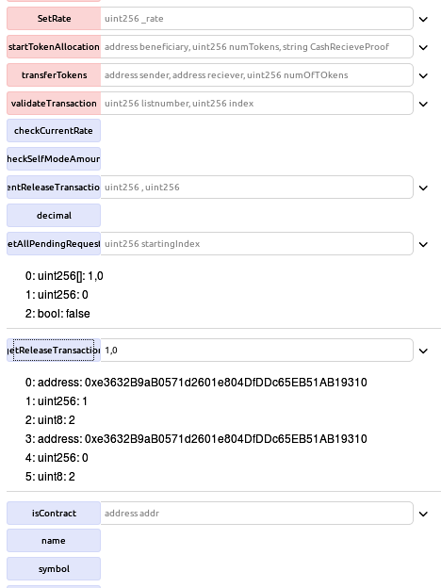
Test 1 A : Step 4.3
Now use function “getReleaseTransaction()” with period number and index .
This will reuturn the full information regarding that transaction .

Slide 19
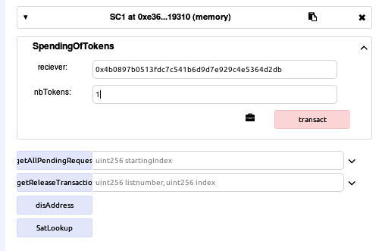
Test 1 A : Step 5
SmartContract1 holds token for 30 second , so that first period is passed(which is of 20 seconds)
And then send the SAT to account 3 (which we will call B)

Slide 20
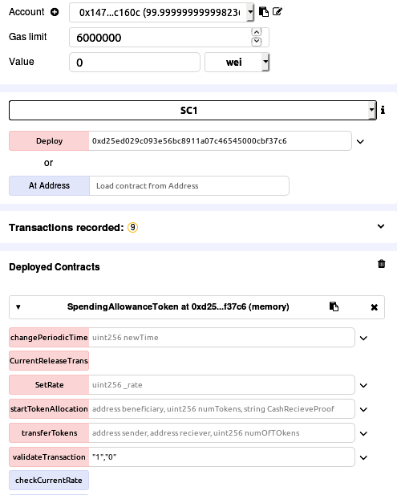
Test 1 A : Step 6
A validates the transaction.
Since transaction originated from person account has to be validated in order to make transfer successful

Slide 21
Test 1 A : Result
On validation all the transaction are chained and released in second period as :
A => SmartContract1 => B , period2 (Original)
A=>B , period2 (chained)

Slide 22
Test 1 B
Original Transaction
A send 1 SAT to C Hour = 1
B send 1 SAT to C Hour = 1
C send 2 SAT TO D Hour = 1.5
Expected Result
At end of Period1 :
A => C (1 SAT)
B => C (1 SAT)

Slide 23
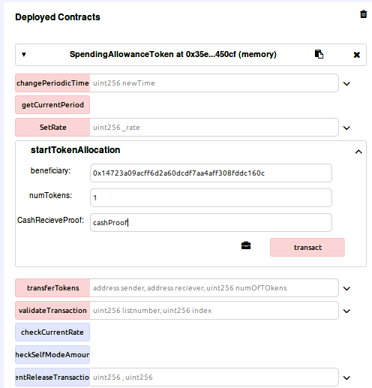
Test 1 B : Step 1
Allocate 1 SAT to account A
Allocate 1 Sat to account B.

Slide 24
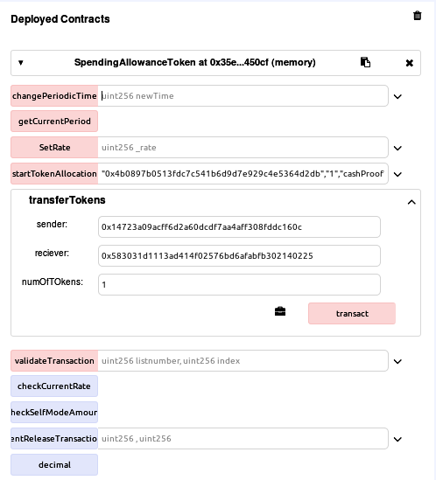
Test 1 B : Step 2
Send 1 SAT from account A to account C
Send 1 SAT from account B to account C.

Slide 25
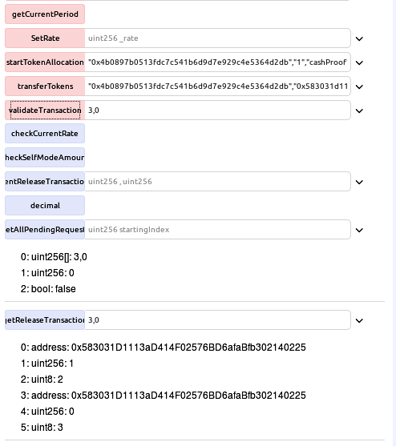
Test 1 B : Step 3
Validate transaction from A
Validate Transaction from B

Slide 26
Test 1 B : Results
Transactions :
  A => C
  B => C
C will have 2 SAT

Slide 27
Test 1 C
Original Transaction
A send 1 SAT to C HOUR = 1
B send 1 SAT to C HOUR = 1
C send 2 SAT to smartContract SC1, who locks the money HOUR = 1.5
SC1 => SC2 SC1 unlocks the money and sends to smart contract SC2 at HOUR = 3
SC2 sends the money to A at HOUR = 3.5
Expected Result
PERIOD = 1 no payment
PERIOD = 2 (4H). Payments generated are
B => A (A SAT)

Slide 28
Test 1 C : Step 1
Allocate 1 SAT to account A
Allocate 1 SAT to account B

Slide 29
Test 1 C : Step 2
A sends 1 SAT to C
B sends 1 SAT to C

Slide 30
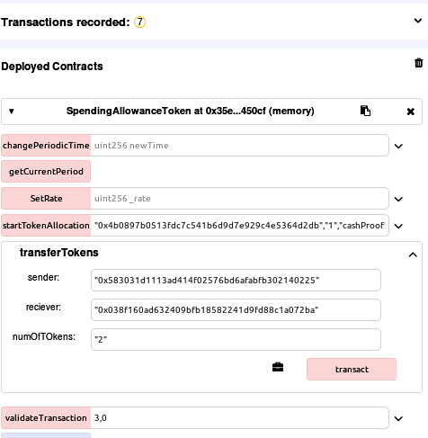
Test 1 C : Step 3
C sends 2 SAT to SmartContract1

Slide 31
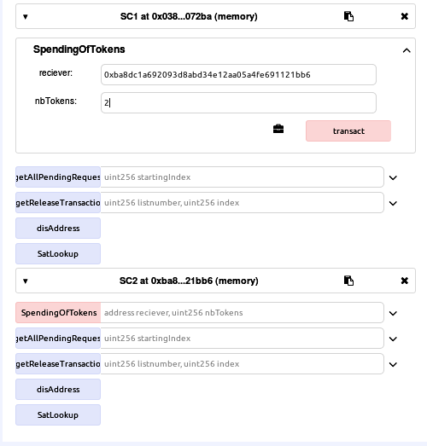
Test 1 C : Step 4
Smart Contract1 sends 2 SAT to Smart Contract2

Slide 32
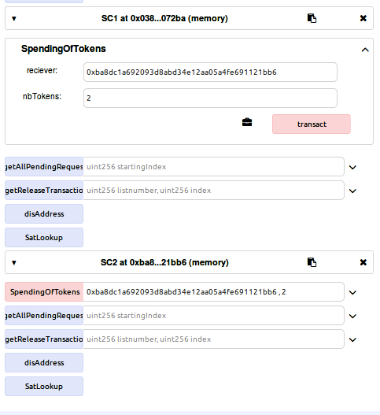
Test 1 C : Step 5
Smart Contract2 sends 2 SAT to A

Slide 33
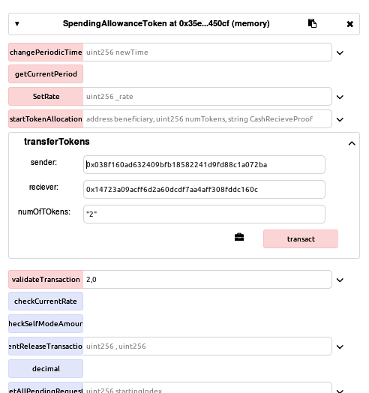
Test 1 C : Step 6
Validating transaction from A

Slide 34
Test 1 C : Result
Final Transaction
A => A , 1 SAT (due to chaining , no actual transaction takes place)
B => A , 1 SAT

Slide 35
Test 2
Original Transaction
A => B 1SAT 10 MIN
B => C 2 SAT 20 MIN
C => D 3 SAT 30 MIN
D => A 4 SAT 40 MIN
Expected Result
AT PERIOD 1, WE SHOULD HAVE THE FOLLOWING PAYMENTS
D => A (1 SAT)
C => A (1 SAT)
B => A (1 SAT)

Slide 36
Test 2 : Step 1
Let account 2 be A , Let account 3 be B , Let account 4 be C ,
Let account 5 be D
Allocating 1 token to each account using function startTokenAllocation ()

Slide 37
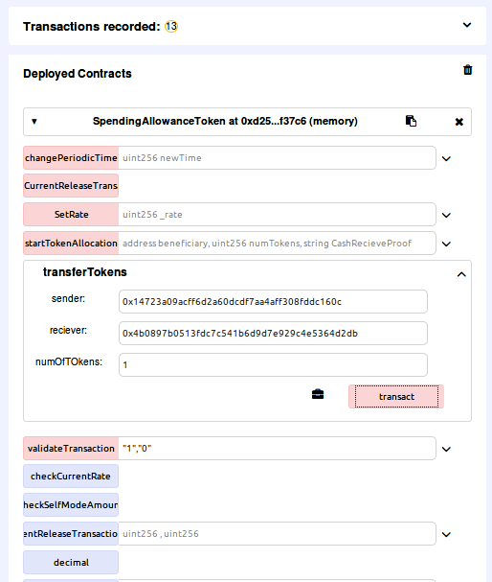
Test 2 : Step 2
Sending 1 SAT from acount A to B

Slide 38
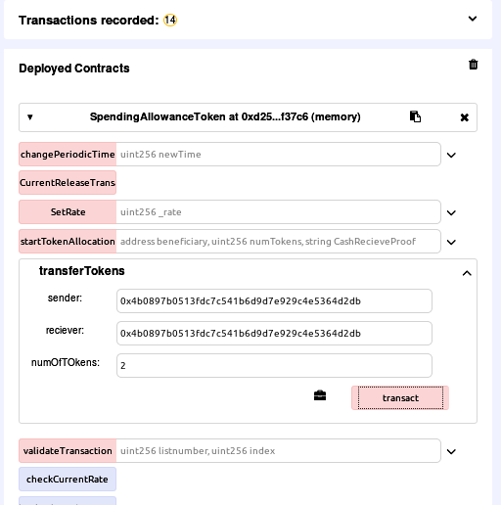
Test 2 : Step 3
Sending 2 tokens from B to C
Point to remember is that B only has 1 SAT but sending 2 SAT to C. This is where SAT logic comes in play by chaining transactions

Slide 39
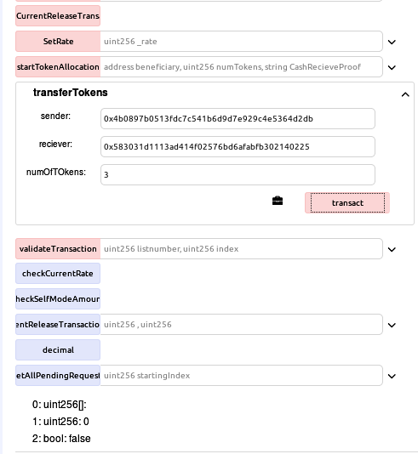
Test 2 : Step 4
Sending 3 SAT from C to D

Slide 40
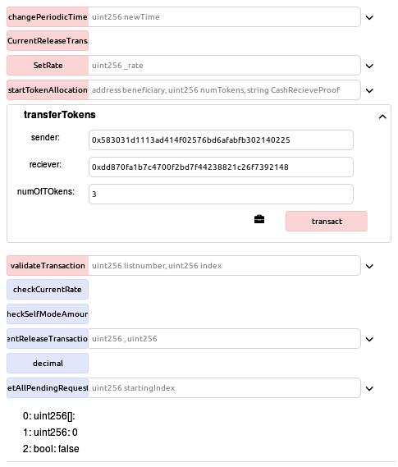
Test 2 : Step 5
Sending 4 SAT from D to A
Same situation , here since D initially has 1 SAT only but tries to send 4 SAT to A

Slide 41
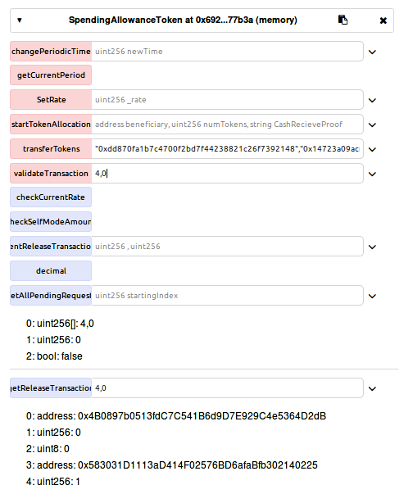
Test 2 : Step 6
Validating transacion from A
Result :
Original : A=>B (1 SAT)
After chaining A=>B=>C=>D=>A
A=>A (1 SAT)

Slide 42
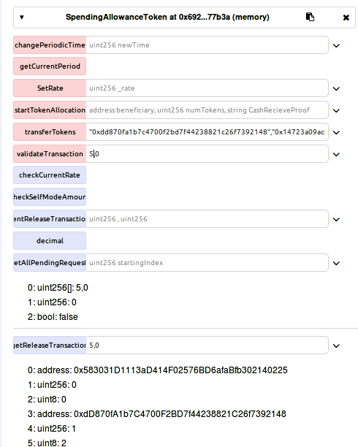
Test 2 : Step 7
Validating transaction
from B
Result : Original B=>C (2 SAT)
Chained
B=>C=>D=>A B=>A (1 SAT)

Slide 43
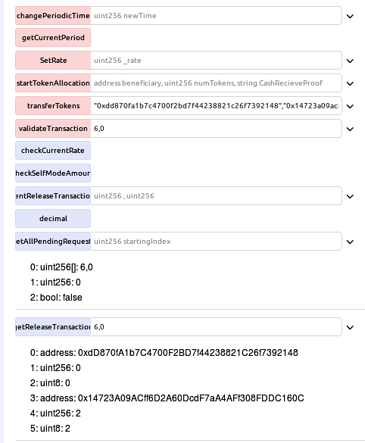
Test 2 : Step 8
Validating Trnasaction from C
Original Transaction C => D
Chained Transaction C => D => A (3 SAT) C=> A (1 SAt)

Slide 44
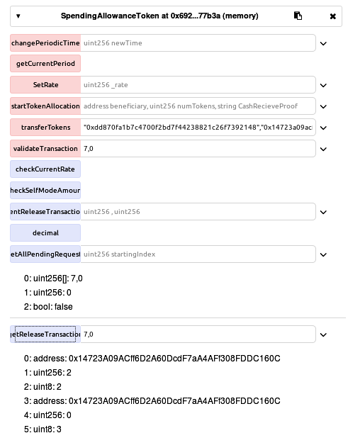
Test 2 : Step 9
Validating Transaction from D
Original Transaction : D => A
Chained Transaction
D=>A (1 SAT)

Slide 45
Test 2 : Result
Transaction which are generated from test case are :
    A=>A (1 SAT, no actual transfer)
    B=>A (1 SAT)
    C=>A (1 SAT)
    D=>A (1 SAT)

Slide 46
Test 3
Original Transaction
A => B 10 SAT
B => C 4 SAT
B => D 4 SAT
B => E 2 SAT
C => F 2 SAT
Expected Result
AT PERIOD 1 :
  A => C 4 SAT
  A => D 4 SAT
  A => E 2 SAT
  A => F 2 SAT

Slide 47
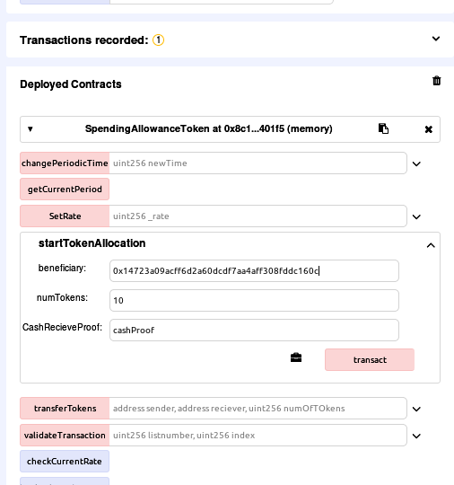
Test 3 : step 1
Allocating 10 SAT to account A

Slide 48
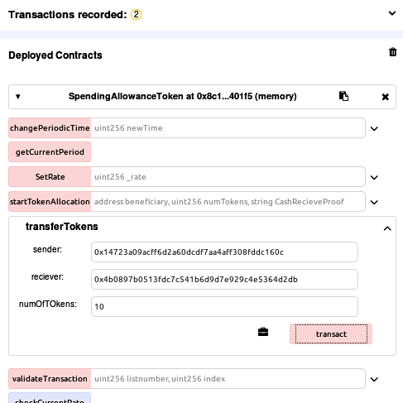
Test 3 : step 2
Sending 10 SAT from A to B

Slide 49
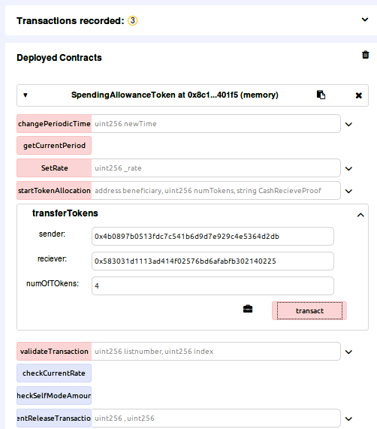
Test 3 : Step 3
Sending SAT from B
  B => C (4 SAT)
  B => D (4 SAT)
  B => E (2 SAT)

Slide 50
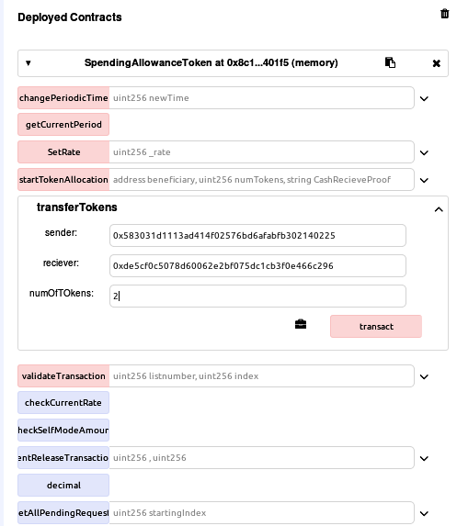
Test 3 : Step 4
Sending 2 SAT from account C to F

Slide 51
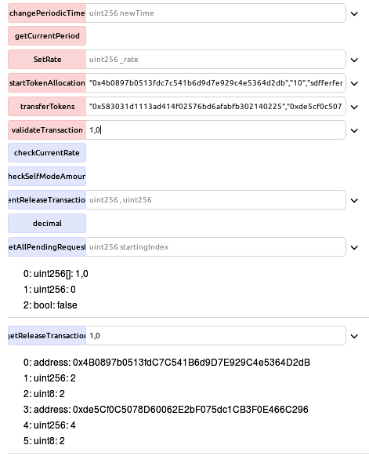
Test 3 : Step 5
Validating transaction from A
Original Transaction
  A=>B (10 SAT)
Chained Transaction
  A => B=> C=>F (2 SAT)
  A => B (8 SAT)

Slide 52
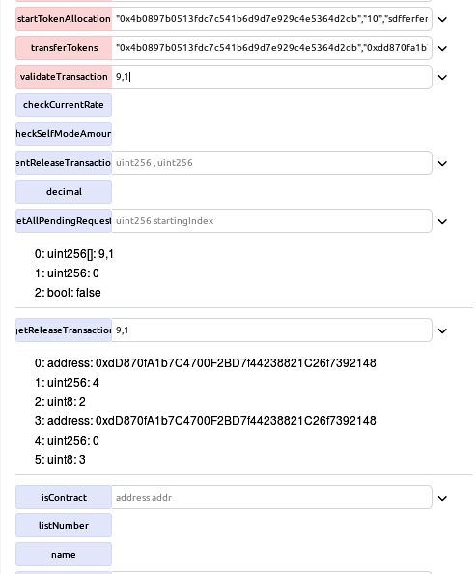
Test 3 : Step 6
Validating transaction from B
Transaction
  B => D
  B => E

Slide 53
Test 3 : Result
Resulted Transaction :
  A => C
  A => D
  A => E
  A => F

Slide 54


