Slide 1

A Survey on Threat Hunting
in Enterprise Networks
Hakan Duran
Yasin Enes Polat
December 25, 2024

Slide 2
Overview
Motivation
Definition of the Problem
Overview of the Project
Threat Hunting Essentials
Threat Hunting Architecture
Threat Hunting Standards
Threat Hunting Methods
Threat Hunting Solutions
Conclusion

Slide 3
Motivation
The paper focuses on exploring threat hunting methodologies used in enterprise networks.
Critical evaluation of existing solutions
The lack of emphasis enterprises place on threat hunting.
We selected this paper because security and threat hunting are critical to the stability and integrity of modern networks.

Slide 4
Problem Description
Failing to recognize the importance of threat hunting as a proactive security measure.
Existence of not clearly understanding what threat hunting entails, including its methodologies and essential concepts.
Lack of surveys and in-depth discussions on threat hunting
Difficult for professionals and researchers to find consolidated knowledge on the topic.

Slide 5
Overview of Project
The Bird’s-Eye View
  Threat Actors, Threat Hunting Methodology, Threat Hunting Types.
The General Architecture
  Data Sources and the Threat Hunting System
Threat Hunting Taxonomy
  ML/AI, Rule-Based and Statistical-Based Threat Hunting
The Standardization
  MISP for threat intelligence sharing, the relationship between SIEM/SOAR/XDR tools and threat hunting.

Slide 6
Threat Hunting Essentials
Threat Actor: An individual, group, or entity responsible for initiating a cyberattack or security breach.
Attack Vector: The method or path used by cybercriminals to breach a system (e.g., phishing, malicious commands, or malware file).
Incident Response is a reactive process that begins after a security breach or event has been detected.
Threat Hunting, on the other hand, is a proactive security practice where security teams actively search for potential threats before they cause harm.

Slide 7
Threat Hunting Essentials
Indicators of Compromise (IOCs): Artifacts or data that indicate a system has been compromised, such as IP addresses, file hashes, and URLs.
Indicators of Attack (IOAs): Patterns or tactics used by attackers that help identify malicious activity, often before a compromise occurs.
Tactics, Techniques, and Procedures (TTPs): The behavior of threat actors, used to identify, track, and defend against cyberattacks.
Advanced Persistent Threat (APT): A prolonged and targeted cyberattack where attackers stealthily gain access to a network for espionage or other malicious purposes.

Slide 8
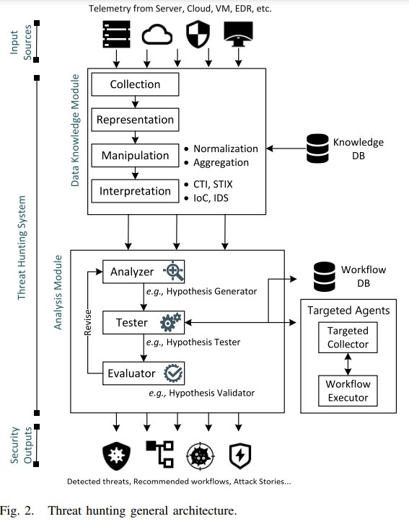
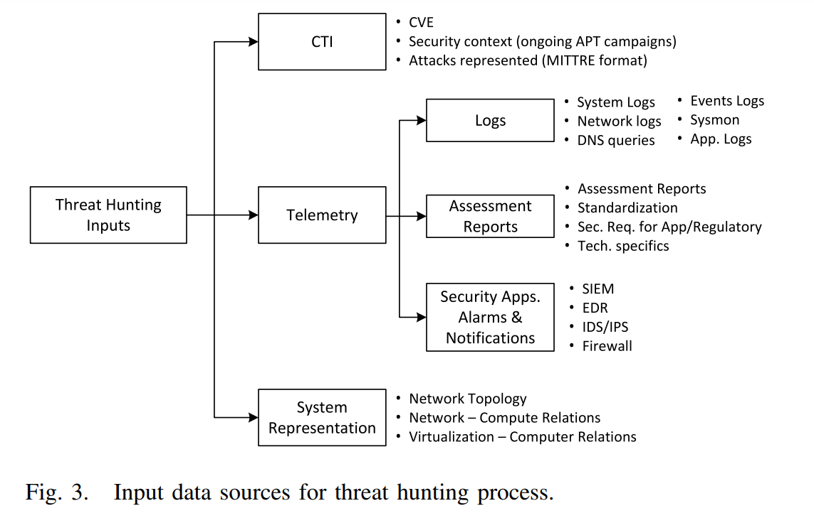
Threat Hunting Architecture

Slide 9
Threat Hunting Essentials
Threat Hunting Methodology
  New IOCs, IOAs, TTPs of APT groups obtained from Threat Intelligence services.
  Hyphothesis formulated as "This [attack vector] of [APT group] has infiltrated our internal network. The attack vector they use includes [those IOCs, IOAs, TTPs]."
  Validity of hyphothesis is evalueted by investigation of network by threat hunting experts.

Slide 10
Threat Hunting Architecture
Hyphothesis generation:
  This [Pikabot Malware] of [Wizard Spider APT Group] has infiltrated our internal network.
  The attack vector they use includes malicious file with sha256 9b8ffdc8ba2b2caa485cca56a82b2dcbd251f65fb30bc88f0ac3da6704e4d3c6 sent by HTTP and DNS data exfiltration by *.dns.steasteel.net.
IOC: sha256 value, IOA and TTPs: Malware usage, data exfiltration using DNS channel

Slide 11
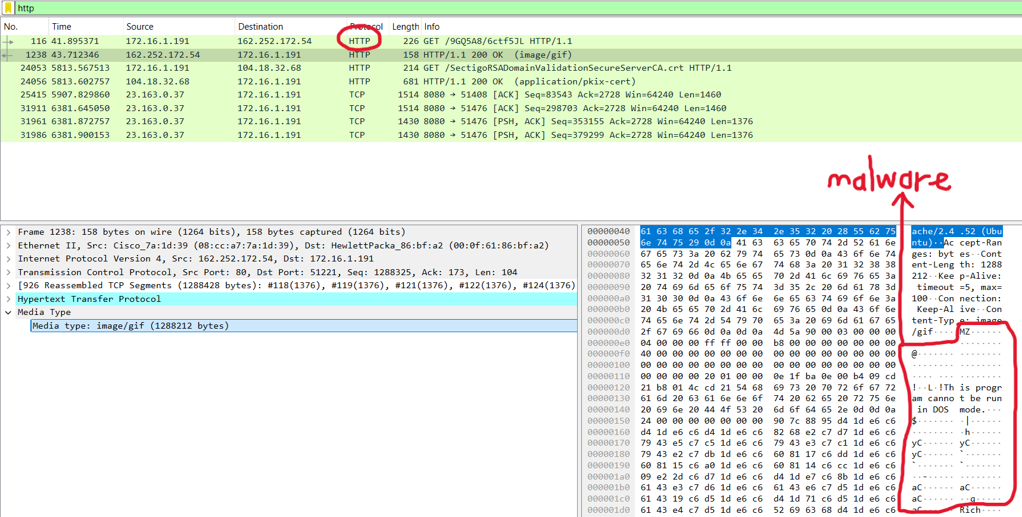
Threat Hunting Architecture
Hyphothesis validation:

Slide 12
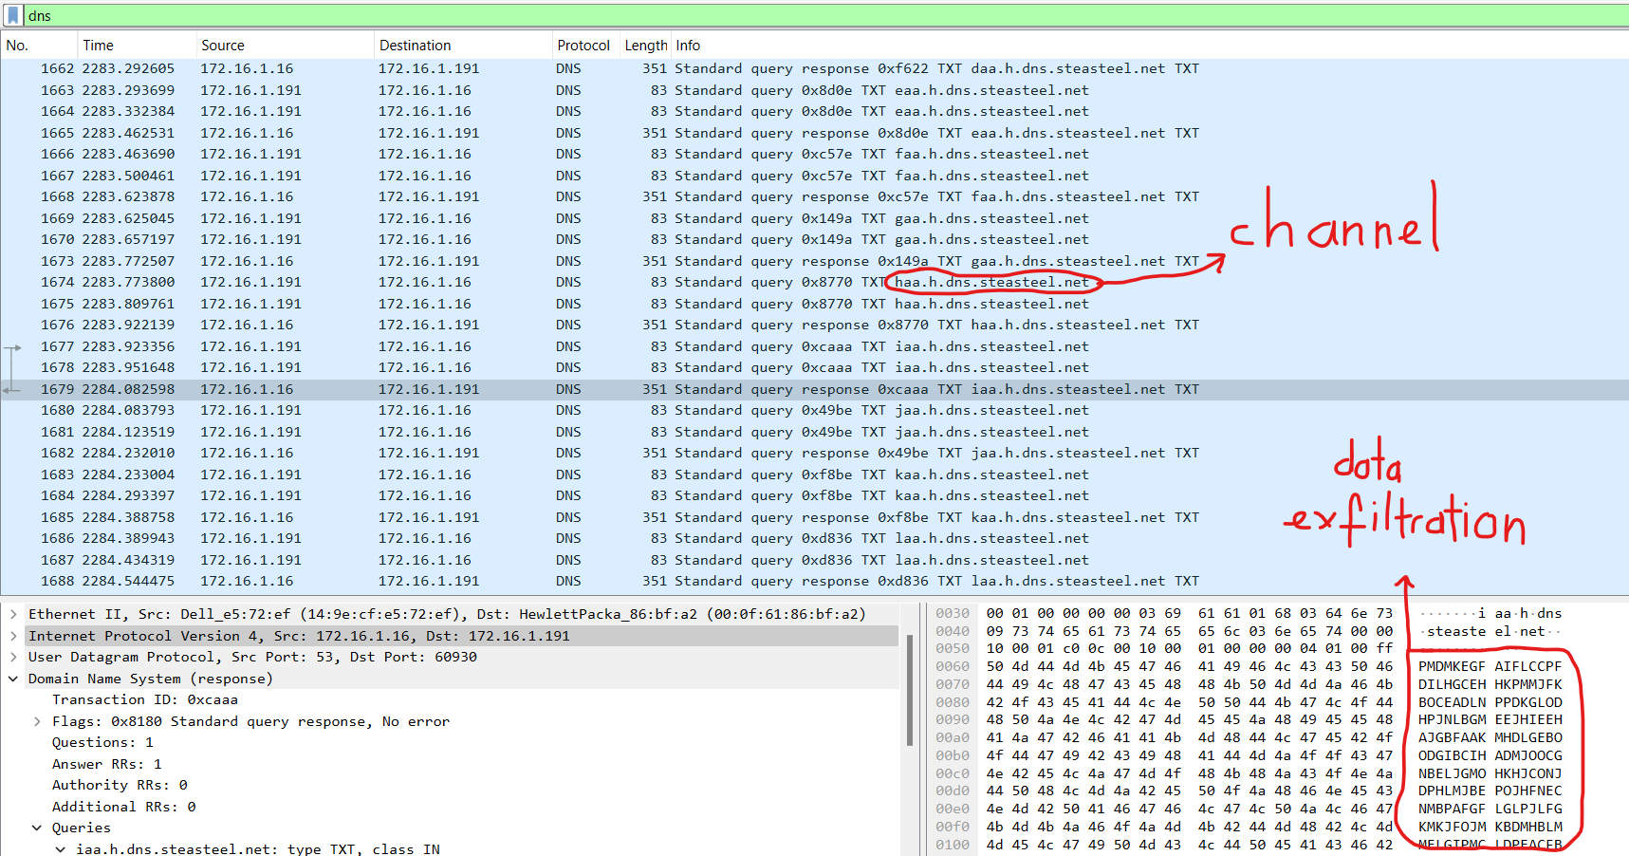
Threat Hunting Architecture
Hyphothesis validation:

Slide 13
Threat Hunting Standards
Cyber Threat Intelligence (CTI) Sharing:
  Improves automated threat hunting.
  Standardized formats and methodologies are needed for structuring and representing information.
Data Representation:
  STIX facilitates threat pattern detection, TTP representation.
  Enables consistent sharing and collaboration across organizations.

Slide 14
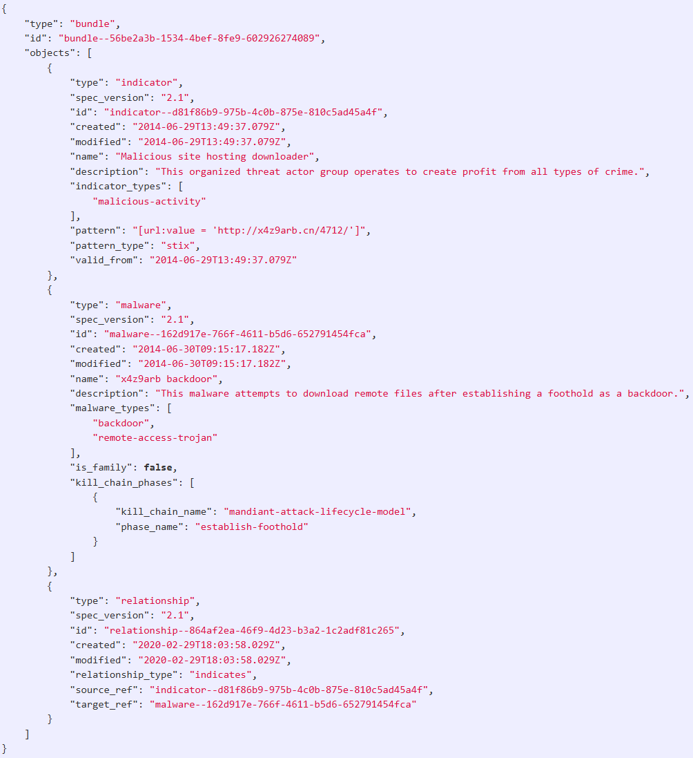
STIX
Indicator for Malicious URL

Slide 15
Threat Hunting Standards
Query Languages:
  Interoperability among cybersecurity tools.
  IBM Kestrel efficient threat hunting processes by data consolidation.
Operational Languages:
  Workflow automation and better integration.

Slide 16
Threat Hunting Standards
Sharing Platforms:
  MISP (Malware Information Sharing Platform): Store, share, correlation of IoCs.
  OpenDXL (Data Exchange Layer): Data integration.
  OpenC2: Command standardization and automation.
Testbeds for Security and Analysis:
  DeterLab: Focusing on scenario-based evaluations.
  Cyber Range: A simulated enterprise environment.

Slide 17
Threat Hunting Methods
Machine Learning and AI:
  Supervised Learning:
    Struggles with zero-day threats or novel attack patterns not in the training data.
  Unsupervised Learning:
    Clusters data to identify outliers or unknown threats.
    Early-stage detection of Advanced Persistent Threats (APTs).
  Reasoning Techniques:
    Combine logic-based reasoning with graph-based models.
  Example Tools: Cortex XDR, Splunk

Slide 18
Threat Hunting Methods
Graph-Based Approaches:
  Graphs represent relationships.
  Connected malicious entity identification by graph traversal algorithms.
  Techniques:
    Node-based behavior extraction.
    Event relationship mapping using graph databases.
  Challenges:
    Computational intensity in processing large-scale graph datasets.
    Dependency on accurate data.

Slide 19
Threat Hunting Methods
Statistical Techniques and Challenges:
  Detect stealthy activities that bypass signature-based methods.
  Applications:
    Identifying rare events
    Standard deviation, percentile analysis.
  Challenges:
    High dependency on quality and variety of input data.
    False positives due to natural variations in system behavior.

Slide 20
Threat Hunting Solutions
Understanding Core Security Tools:
  SIEM, SOAR/XSOAR, and XDR interconnect in threat detection and response workflows.
  These tools primarily focus on reactive threat detection
Integration of Threat Hunting with Security Tools:
  Falcon, ArcSight ESM, Helix, and Cisco XDR integrate threat hunting processes

Slide 21
Threat Hunting Solutions
Capabilities of Modern Platforms:
  Cortex XDR:
    Combines machine learning, rule-based detection, and behavior analytics.
    Includes XQL for flexible data exploration.
  QRadar:
    Analyzes network traffic and events via STIX/TAXII.
  Splunk:
    Provides real-time monitoring and analytics, using machine learning to visualize and respond to threats.

Slide 22
Conclusion
MITRE ATT&CK enhances consistency and accuracy in identifying threats.
Automation through AI and reasoning techniques improves efficiency and reduces time.
Graph-based analysis and ML-driven approaches demonstrate potential but face challenges such as false positives.
Future Directions
  Emphasis on automation of hypothesis creation and validation.
  Improving explainability in AI models and integrating scalable, real-time solutions.

Slide 23
References
Indicator for malicious URL. (n.d.). https://oasis-open.github.io/cti-documentation/examples/indicator-for-malicious-url
R. Brown and R. M. Lee, 2021 SANS Cyber Threat Intelligence (CTI) Survey, SANS Inst., Rockville, VA, USA, 2021
G. González-Granadillo, S. González-Zarzosa, and R. Diaz, “Security information and event management (SIEM): Analysis, trends, and usage in critical infrastructures,” Sensors, vol. 21, no. 14, p. 4759, 2021.

Slide 24
  THANK YOU!

Slide 25
QUESTIONS
?

