Slide 1

by
Hakan Hyusein & Luiz Jesus Gomez Saiz
Notes:
Antialiasing – A no. of possible techniques by which the raster images are given the appearance of having smooth edges.e.g the technique of shading pixels along the edge of an image to make them blend progressively into the background.

Slide 2

What was the task?
Creating a web application that provides the basic functionalities of a social network (posting pictures/thoughts, sharing posts, commenting, etc.)

Slide 3
What does aSocialen.bg offer:
User registration & login/logout.
Uploading / deleting pictures which are organized in albums.
Uploading / deleting posts.
Liking and commenting posts.
Sharing posts.
Following other users.
Searching other people.

Slide 4
Languages and technologies used:
Front-End:
  HTML, CSS, JavaScript
  jQuery (AJAX), Bootstrap Framework, JSP, JSTL
Server-side:
  Java EE
  Spring Framework
  JPA(Hibernate)
  MySQL DBMS
  Java Servlets

Slide 5
And more …
Libraries & Tools:
  Apache Commons FileUpload
  Jasypt – password encryptor
  Hibernate C3P0 Connection Pool
  jUnit testing framework
  Server - Apache Tomcat
  Maven
Design Patterns:
  MVC
  DAO
  Factory, Singleton

Slide 6
What can be improved?
Chat system
Notifications
Picture and comment likes
Video sharing
Full Internationalization

Slide 7
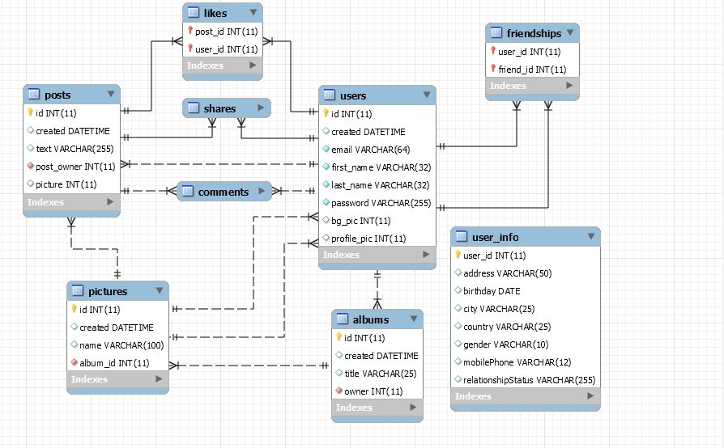
Database Model

Slide 8


