Slide 1

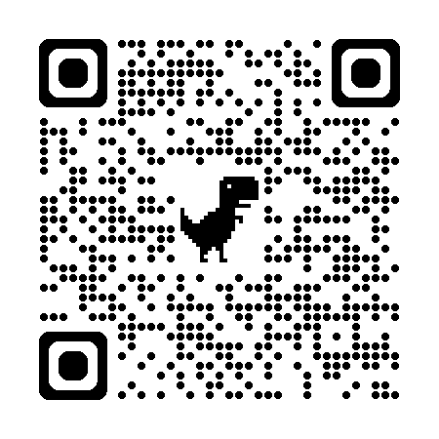
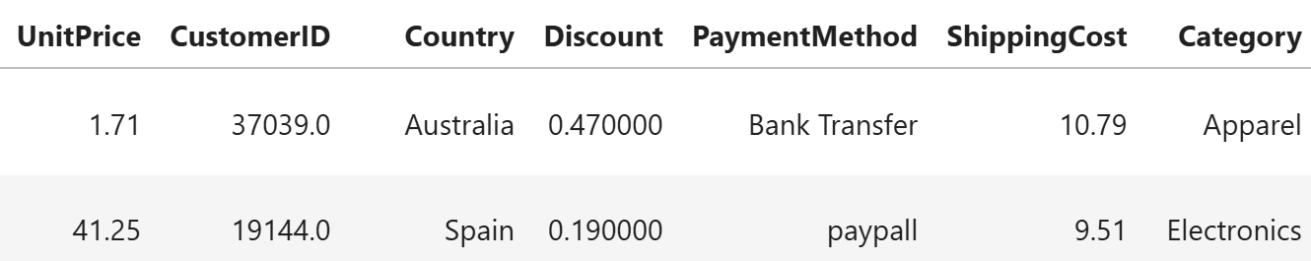

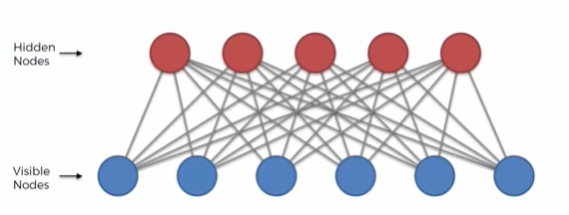
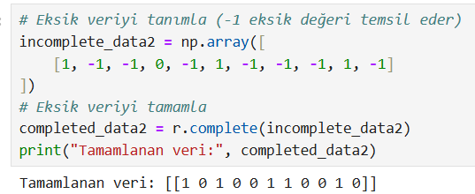
Customer Segmentation using RBM
Hakan Birben
2025 /GN
“Funding Information”
Information”
Information”
Abstract
Methodology
Results and Dıscussıon
In this project it is explored that the use of Restricted Boltzman Machine(RBMs) for customer segmentations. RBMs are unsupervised generative neural networks capable of learning complex distributions. After selecting and processing a real-world customer dataset, we implemented an RBM model to discover hidden patterns in customer behaviour. Though evaluation metrics such as F1-score and accuracy were not yet applied, initial model training and latent feature extraction demonstrated promising structure in the resulting customer clusters.
Dataset Selection: A publicly available dataset related to customer purchases or behavior was chosen (Online Sales Dataset).
Preprocessing: The data was cleaned and transformed to fit the binary or normalized numerical input format required by RBMs. Binary input data was created by evaluating the features that a new user might like about a product with certain weights and determininig a treshold. Categorical variables were scaled between 0 and 1.
After completing data preprocessing and RBM model training, we extracted latent features from the hidden layer to represent each user's behavior in a compressed, meaningful way. The training process showed consistent convergence, with the reconstruction error decreasing steadily across epochs, indicating that the RBM successfully learned the internal structure of the data.
To assess the RBM’s ability to generalize and produce meaningful outputs, a small portion of the training data was held back and later used for informal testing. When this subset was passed through the trained RBM, the reconstructed output closely matched the original inputs.
Although the model showed strong potential in producing meaningful clusters and feature representations, evaluation metrics such as accuracy, precision, recall, and F1-score were not applied during this phase due to time constraints. However, these metrics are applicable and will be essential for quantitatively validating the model’s performance in future iterations.
Figure 1: Online Sales Dataset
Figure 2: User Product Matrix
RBM Implementation:
We implemented the RBM using Python and NumPy.
The network architecture included visible units corresponding to features and a defined number of hidden units for latent feature learning. The model was trained using Contrastive Divergence, with a predefined number of epochs, learning rate, and batch size.
Figure 2: Neural Network Structure
Once the RBM was trained, the activations of the hidden layer were used as new representations (latent features) of each customer. These feature vectors captured high-level patterns and similarities between customer profiles.
Figure 3: Outputs of the Restricted Boltzman Machine
Background
Customer Segmentation using Restrcited Boltzman Machine
Group Members:
-Hakan BİRBEN
Customer segmentation is a key strategy in marketing that involves grouping customers based on shared behaviors, preferences, or demographics, enabling businesses to tailor their services effectively. Traditional methods like k-means or hierarchical clustering are commonly used but often struggle with high-dimensional data or non-linear patterns. Restricted Boltzmann Machines (RBMs), a class of unsupervised neural networks, offer a promising alternative by learning complex, hidden representations from input data. With their two-layer structure—visible and hidden—RBMs can model the underlying distribution of customer data and reveal latent features useful for clustering. Unlike supervised models, RBMs do not require labeled data, making them ideal for exploratory segmentation tasks. They have been successfully applied in areas like recommendation systems and anomaly detection, proving their versatility in real-world scenarios. RBMs are especially effective in handling sparse and noisy data, which is typical in customer behavior datasets.
Conclusion
In this project, we demonstrated the potential of Restricted Boltzmann Machines for customer segmentation. The RBM was able to extract meaningful latent features, which could then be used for clustering. Though no formal evaluation metrics were applied, visual inspection and clustering results suggest that RBMs could serve as a powerful tool for unsupervised segmentation.
The approach provides a scalable solution that can adapt to large and complex datasets.
Special thanks to A. Egemen Yılmaz for believing in my vision and supporting me throughout this journey.
Future Work
In future work, a product-user matrix can be used to model product features based on user interactions. This allows comparison between both approaches and enable visualization of user-user relationships.
“Funding Information”
This Project was carried out without
any fundings.
“Acknowledgments”
Prof. Dr. Asım Egemen YILMAZ
“Sponsors”
There were no sponsors involved in
this project.

