Slide 1
Key Insight on Posey Data Base
By Victor Somadina

Slide 2
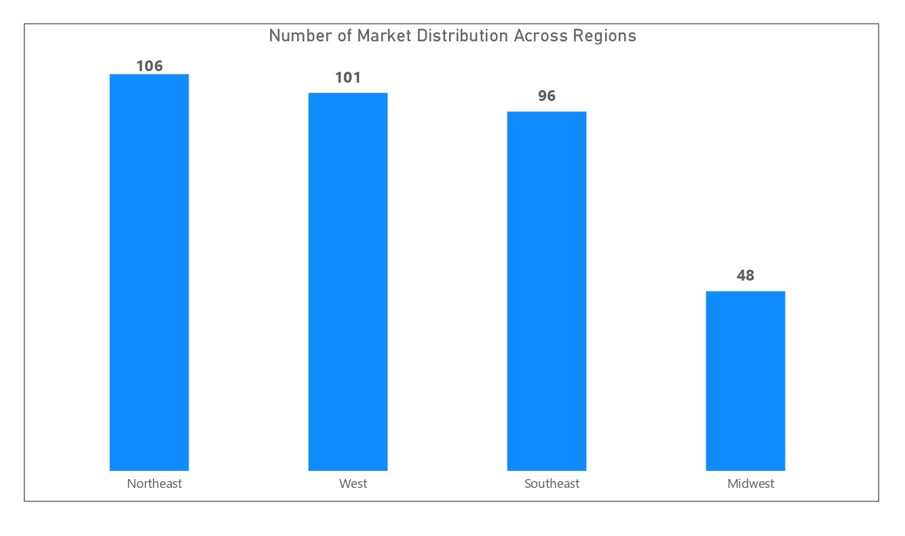
Market Distribution Across Regions
Most markets are in the Northeast, West and Southeast.

Slide 3
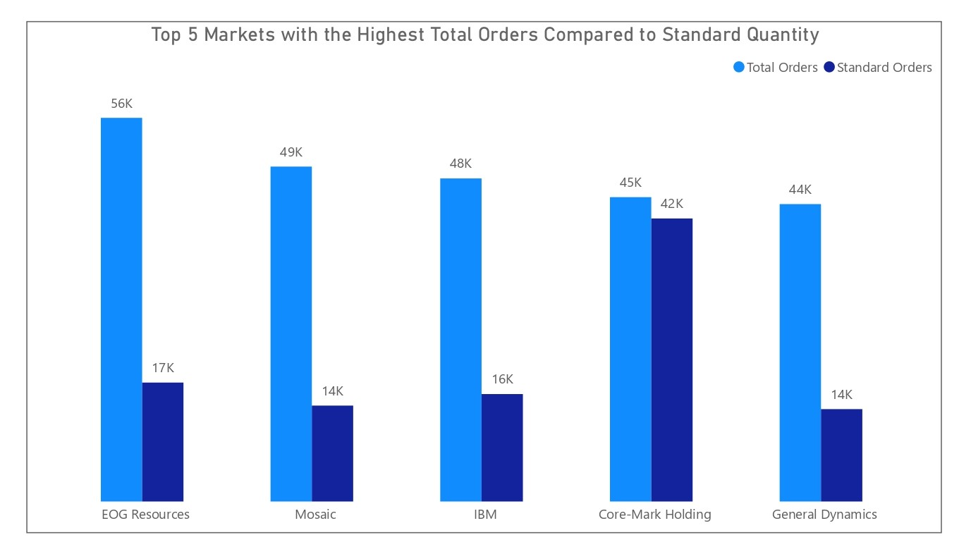
Revenue Growth Rate Performance by Countries
Comparing quantity of orders and quantity of standard orders, it appears that core-market holding gives out the best in terms of quality products.

Slide 4
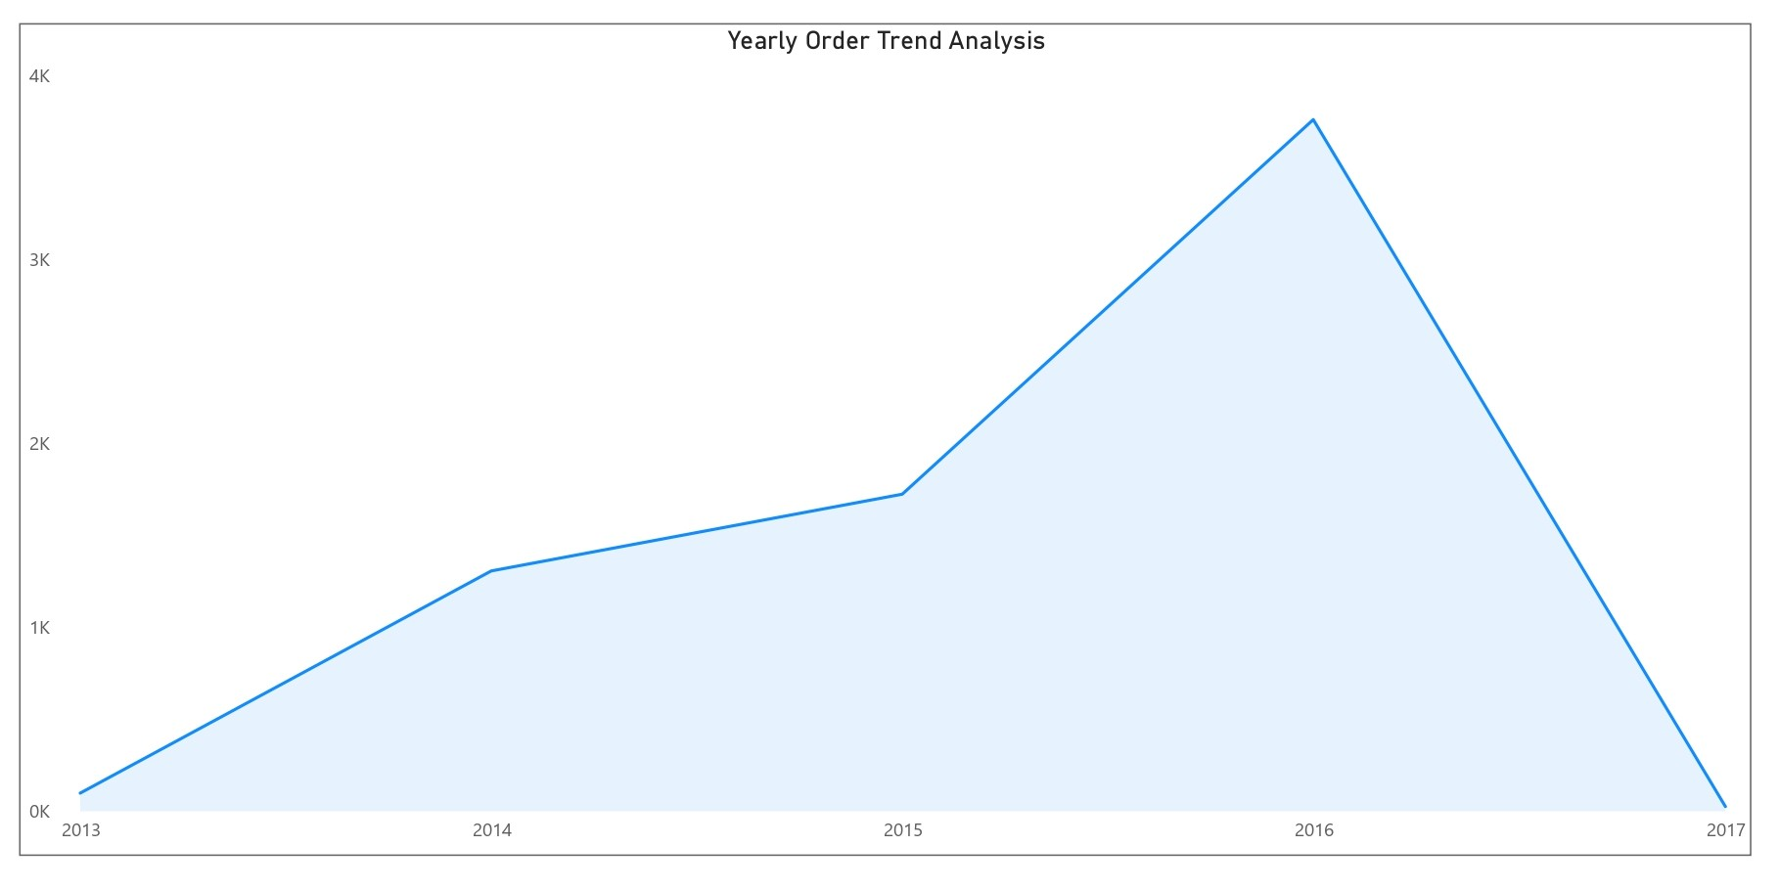
Forecast Monthly Revenue Trend to November 2005
A consistent up trend of quantity of orders was noticed from 2013 to 2016, and then significant drop. Monthly analysis probably will give more insight into what happened from 2016 to 2017.

