Slide 1

Digital Agriculture Discussion #1
1/19/22

Slide 2
What is Digital Ag?
“Digital Agriculture encompasses both digitization, which refer to the technical process of converting analogue information into digital data, and digitalization, understood as the social process of adoption of computer technologies” (Hackfort).

Slide 3
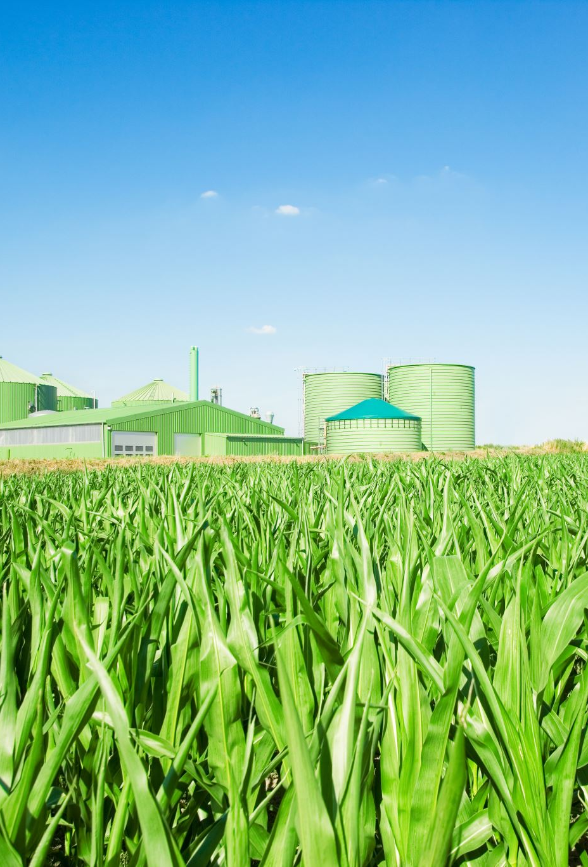
Topic Overview
The history of agriculture in the world is one of constant innovation in the hopes of improving production, yield, or quality in some fashion. Often these have come as new challenges arise. Today the Ag industry is facing the threat of environmental impacts, increased consumption, resource constraints, and other issues that loom over producers. Similar industries have found success in solving problems through technological advancement and digitalization. The hope of this same method applying to the Ag industry is high, but not without challenges. With concerns properly solved, "Digital Agriculture" has the potential to shape every part of the production process from inputs to consumer. Using technologies such as sensors, decision support tools, artificial intelligence, drones, and more are expected to culminate in a new way of conducting business that promotes sustainability and the thoughtful increase in production needed for our world.

Slide 4
Short Synopsis of Readings
"Big Data in Smart Farming - A review" : Describes what Big Data is and how it is connected to the future of agriculture. The role, players, effects, and challenges that are associated with the implementation of data are all addressed.
"Digital Technologies in Agriculture and Rural Areas" : Highlights the need to consider the effects of digitalization on rural populations, especially in concern of further economic and educational division for these groups.
"Patterns of Inequalities in Digital Agriculture”: A Systematic Literature Review" : Provides 5 common ways in which inequalities are or will occur between corporate entities and farmers, while introducing how both intentional product and policy can overcome these.
"Agriculture’s connected future: How technology can yield new growth" : Focuses on the need for connectivity in order for advancement in Digital Ag and joining industries; also includes numerical projections of size and scope of various industries and how they may grow.
"Digital Agriculture" : Provides a broad overview of the context of Digital Agriculture and shares a vision for the future with Digital Ag.

Slide 5
Key Takeaways
The world population in 2050 is the key motivator
Consideration of all parties is key to success
Adoption is hinged on solving roadblocks
Digitalization is the next Agricultural Revolution

Slide 6

Your Takeaways

Slide 7
Main Discussion and Prompted Questions
What are the current roadblocks of Digital Ag? How can they be solved?
How does collaboration play a role in Digital Ag, and what impact does, or could it have?
Where is Digital Ag being used today and who has been successful? Why have they been successful?
Who is being targeted for adoption, and what metrics are important to this group(s)?

Slide 8

Additional Notes

