Slide 1
Software Modeling & Analysis
Principles of OOD
Software Engineering Department
egrinkrug@hse.ru
Higher School of Economics , Moscow, 2013
www.hse.ru
1

Slide 2
Design Quality
What does it mean to be well designed? A system that is well designed is easy to understand, easy to change, and easy to reuse. It presents no particular development difficulties, is simple, terse, and economical. It is a pleasure to work with.
Conversely, a bad design - looks / smells as what?
The smells of a poor design have many different components:
Rigidity («жесткость»):
  The system is hard to change because every time you change one thing, you have to change something else in a never ending succession of changes.
Fragility («хрупкость»):
  A change to one part of the system causes it to break in many other, completely unrelated, parts.
Immobility («неподвижность»):
  It is hard to disentangle the system into components that can be reused in other systems.
(в целом – чугунное изделие – кастлинское литье – раз и навсегда...Критерий «хорошо/плохо» - зависит от целеположения)

Slide 3
Viscosity («вязкость»):
  The development environment is held together with scotch tape and toothpaste. It takes forever to go around the edit, compile, test loop.
Needless Complexity:
  There are lots of very clever code structures that aren’t acutally necessary right now, but could be very useful one day.
Needless Repetition:
  The code looks like it was written by two programmers named Cut and Paste.
Opacity («непрозрачность»):
  Elucidation of the originator’s intent presents certain difficulties related to convolution of expression.
It is our desire to rid the code of these smells. UML diagrams can often help with this because many of the smells can be seen by examining the dependencies in the diagrams.

Slide 4
Dependency Management
Many of these smells are a result of mismanaged dependencies. Mismanaged dependencies conjure the view of code that is a tangled mass of couplings. Indeed, it is this view of entanglement that was the origin of the term “spaghetti code”.
Object oriented languages provide tools that aid in managing dependencies.
  Interfaces can be created that break or invert the direction of certain dependencies.
  Polymorphism allows modules to invoke functions without depending upon the modules that contain them.
Indeed, an OOPL gives us lots of power to shape the dependencies the way we want.
So, how do we want them shaped?
That’s where the following principles come in.

Slide 5
The Single Responsibility Principle (SRP)
A CLASS SHOULD HAVE ONLY ONE REASON TO CHANGE.
You’ve probably read the nonsense about objects needing to know how to draw themselves in a GUI, or save themselves to disk, or convert themselves to XML, right? Beginning OO texts like to say things like that.
Ridiculous! («чушь!»)
Classes should know about only one thing. They should have a single responsibility. More to the point, there should only be one reason for a class to change.

Slide 6
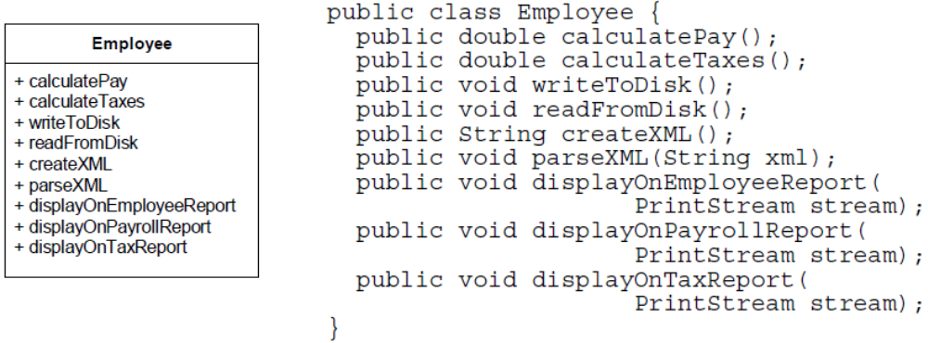
This class knows too much. It knows how to calculate pay and taxes, how to read and write itself on disk, how to convert itself to XML and back, and how to print itself on various reports.
Can you smell the Fragility? Change from SAX to JDOM and you have to change Employee. Change from Access to Oracle, and you have to change Employee. Change the format of the tax report and you have to change Employee. This design is badly coupled.

Slide 7
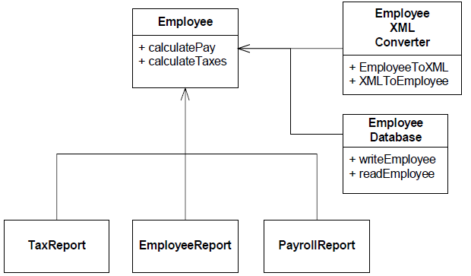
In reality we want to separate all these concepts into their own classes so that each class has one, and only one, reason to change.
  We’d like the Employee class to deal with pay and taxes, an XML related class to deal with converting Employee instances to and from XML, an EmployeeDatabase class to deal with reading and writing Employee instances to and from the database, and individual classes for each of the various reports.
In short, we want a separation of concerns.

Slide 8
Violation of this principle is pretty easy to spot in a UML diagram. Look for classes that have dependencies on more than one topic area. A dead give-away is a class that implements one or more interfaces that endow it with certain properties. Careless use of an interface that endows an object with the ability to be stored on disk, for example, can lead to classes that couple business rules with issues of persistence.
An example follows…

Slide 9
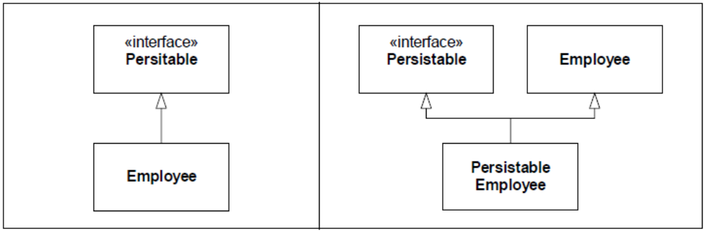
The diagram on the left couples Persistable tighly into Employee. All users of Employee will transitively depend upon Persistable. This dependence may not be great, but it will be there. Changes to the Persistable interface will have the potential of affecting all users of Employee.
The diagram on the right side leaves Employee independen of Persistable, and yet allows for persistence just the same. Instances of PersistableEmployee can be passed around the system as Employees, without the rest of the system knowing about the coupling. The coupling exists, but is hidden to most of the system.

Slide 10
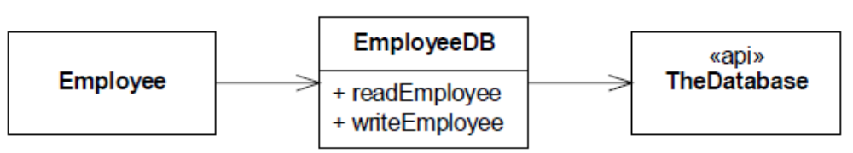
The Open Closed Principle (OCP)
SOFTWARE ENTITIES (CLASSES, MODULES, FUNCTIONS, ETC.) SHOULD BE OPEN FOR EXTENSION, BUT CLOSED FOR MODIFICATION.
This principle has a simple meaning: You should be able to change the environment surrounding a module without changing the module itself.
Consider, for example, the Figure below. It shows a simple application that deals with Employee objects through a database facade named EmployeeDB. The facade deals directly with API of the database. This violates the OCP because a change to the implementation of the EmployeeDB class can force a rebuild of the Employee class. The Employee is transitively bound to the database API. Any system that contains the Employee class must also contain TheDatabase API.

Slide 11
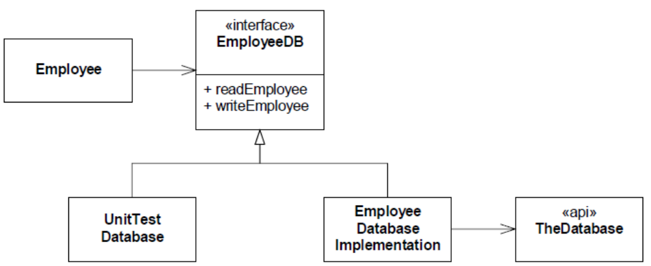
Unit tests are often the places where we want to make controlled changes to the environment.
Consider, for example, how we would test Employee. Employee objects make changes to the database. In a test environment we don’t want the real database to change. We also don’t want to create dummy databases just for the purposes of unit testing.
Instead, we’d like to change the environment so that the test catches all the calls that Employee makes to the database, and verifies that those calls are made correctly.

Slide 12
We can do this by converting EmployeeDB to an interface as in Figure above. Then we can create derivatives that either invoke the true database API, or that support our tests.
The interface separates Employee from the database API, and allows us the change the database environment that surrounds Employee without affecting Employee at all.
Among the systems that are plauged by violations of OCP are GUIs. Despite the fact that MODEL-VIEW-CONTROLLER has been known for nearly three decades, we often can’t seem to get the design of GUI systems right. All too often the code that manipulates the GUI API is inextricably bound to the code that manages and manipulates the data being displayed. (in 3D GUI/Graphics it often happens as well…)

Slide 13
Consider, for example, a very simple dialog box that displays a list of employees. The user selects an employee from the list and then clicks the “Terminate” button. We expect that if no employee is selected, then the “Teminate” button is disabled. On the other hand, if we select an employee from the list, the “Terminate” button will be enabled. When the user clicks the “Terminate” button, the terminated employee disappears from the list, none of the remaining employees is shown as selected, and the terminate button is disabled.
Implementations that violate the OCP would put all this behavior in the class that invokes the calls to the GUI API. OCP compliant systems would separate the manipulation of the GUI from the manipulation of the data.
Figure below shows the structure of an OCP compliant system. The Employee-TerminatorModel manages the list of employees, and is informed when the user selects or terminates an employee. The EmployeeTerminatorDialog manages the GUI. It is given the list of employees to display, and informs its controller when a selection changes or when the terminate button is pressed.

Slide 14
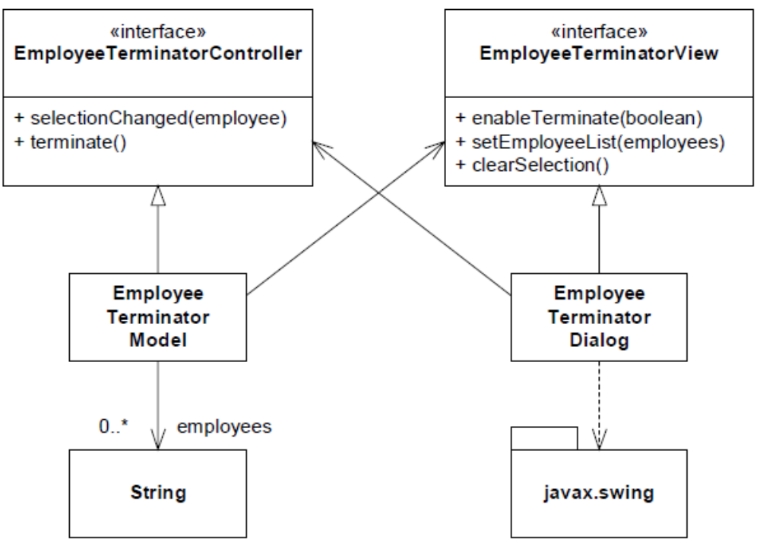

Slide 15
The EmployeeTerminatorModel is responsible for actually deleting the selected employee from the list. It is also responsible for determining whether or not the terminate control is enabled or disabled. It doesn’t know that this control is implemented with a button. It simply tells its associated view whether or not the user is allowed to terminate. Similarly, even though the model doesn’t know anything about a listbox, it can tell its view to clear the selection.
The EmployeeTerminatorDialog is brainless. It makes no decisions on its own, and manages no data. The EmployeeTerminatorModel pulls its strings, and the dialog reacts. If the user interacts with the dialog, it simply tells its controller what’s going on by calling methods on the EmployeeTerminatorController interface. These messages are passed to the model which then interprets and acts upon them.
  Those who know MVC will recognize this as a variation. In more complex situations the controller would be a true object rather than just being an interface for the model. In this case, however, the application is so simple that the controller simply acts as a pass through to the model.

Slide 16
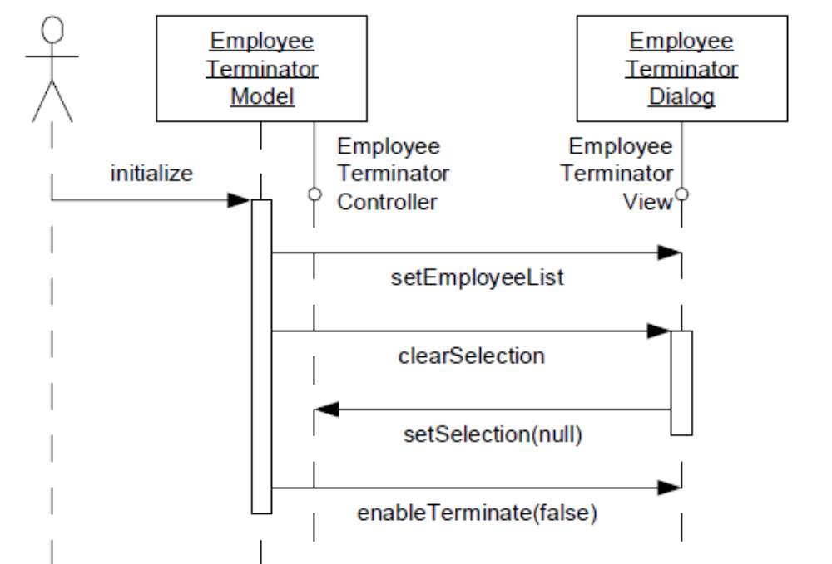
Java implementation is provided in an Idea project (see it there…);
The conformance to the OCP can be seen most clearly when you look at the unit tests for the model and the dialog. These unit test work without the tested modules knowing about their existence.

Slide 17
The Liskov Substitution Principle (LSP)
Did you know – who is B.Liskov (Turing award winner, Hydra OS, CLU,…?)
  about 25 years ago I’d met her friend & colleague– Prof. Bill Wulf – in Moscow…
  Try Google search: “Who Earned First Computer Science Ph.D.?”
  SUBTYPES MUST BE SUBSTITUTABLE FOR THEIR BASE TYPES.
Have you ever seen code that has lots of instanceof expressions in the clauses of if statements. Though there are some legitimate uses for expressions like this, they are few and far between.
Usually they are a result of violating the LSP, and are themselves a violation of the OCP.
The LSP says that the users of base classes should not have to do anything special in order to use derivatives. Specifically, they should not have to use instanceof, or downcasts. Indeed, they should know nothing about the derivatives at all. Not even that they exist.

Slide 18
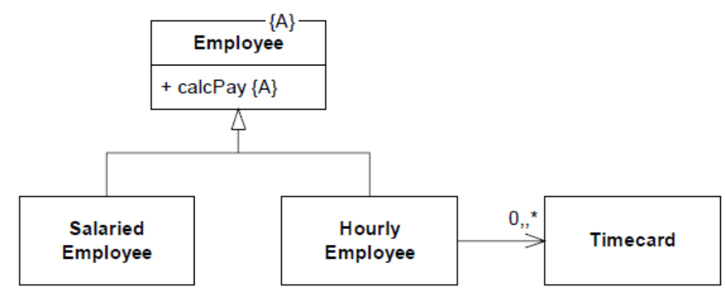
Consider the payroll application shown in Figure below. The Employee class is abstract and has an abstract method named calcPay.
  SalariedEmployee will implement this to return the employee’s salary.
  Hourly-Employee will implement it to return the hourly rate times the sum of the hours on this week’s time cards.

Slide 19
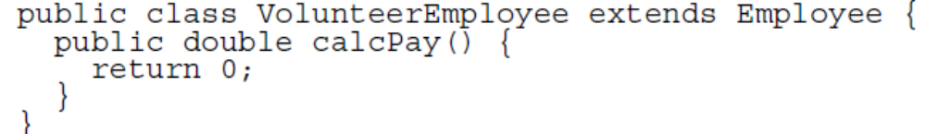
What would happen if we decided to add a VolunteerEmployee? How would we implement calcPay? At first this may seem obvious. We’d implement calcPay to return zero as shown below.
But is this right? Does it make any sense to even call calcPay on a Volunteer-Employee? After all, by returning zero we are implying that calcPay is a reasonable function to call, and payment is possible. We might find ourselves in the strange situation of printing and mailing a paycheck with a gross pay of zero, or something similar...

Slide 20
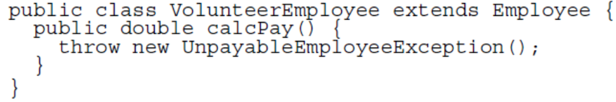
So maybe the best thing to do is to throw an exception, indicating that this function really shouldn’t have been called.
At first this seems like a reasonable thing to do. After all, it’s illegal to call calcPay on a VolunteerEmployee. Exceptions are meant to be thrown for illegal situations like this.
Unfortunately, now, every call to calcPay can throw an UnpayableEmployeeException, so either the exception must be caught or declared by the caller. Thus, a constraint upon a derivative has impacted the users of the base class.

Slide 21

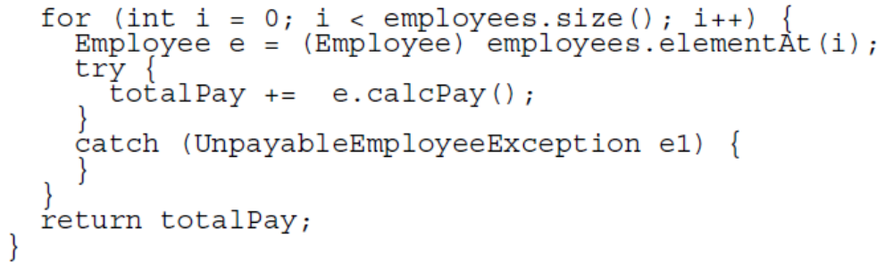
To make matters worse, the following code is now illegal.
To make it legal we have to wrap the call to calcPay in a try/catch block.

Slide 22
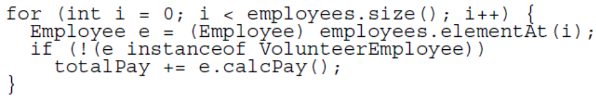
This is ugly, complicated, and distracting. We might easily be tempted to change it to
But this is even worse because now code that was supposed to operate on the Employee base class makes explicit reference to one of its derivatives.
All this confusion has come about because we have violated the LSP. VolunteerEmployee is not substitutable for Employee. Users of Employee are impacted by the very presence of VolunteerEmployee. And this results in strange exceptions and odd instanceof clauses in if statements, all of which violate the OCP.
  It proofs that an employee MUST have a good salary, by the way… ☺

Slide 23
You know you are violating the LSP whenever you try to make it illegal to invoke a function on a derivative. You may also be violating the LSP if you make a derivative method degenerate, i.e. implemented with nothing. In both cases you are saying that this function makes no sense in this derivative. And that’s a violation of LSP that can eventually lead to nasty exceptions and instanceof tests.
What’s the solution to the VolunteerEmployee problem? Volunteers are not employees. It makes no sense to call calcPay on them, so they should not derive from Employee, and they should not be passed to functions that need to call calcPay.
  But again – employee – by definition - MUST have a good salary ☺

Slide 24
The Dependency Inversion Principle (DIP)
A. HIGH LEVEL MODULES SHOULD NOT DEPEND UPON LOW LEVEL MODULES. BOTH SHOULD DEPEND UPON ABSTRACTIONS.
B. ABSTRACTIONS SHOULD NOT DEPEND UPON DETAILS. DETAILS SHOULD DEPEND UPON ABSTRACTIONS.
Better still: Don’t depend upon volatile (potentially changeable) concrete classes. If you inherit from a class, make it an abstract class. If you hold a reference to a class, make it an abstract class. If you call a function, make it an abstract function.
In general, abstract classes and interfaces change far less often than their concrete derivatives. Therefore we would rather depend upon the abstractions than the concretions. Following this principle reduces the impact that a change can have upon the system.

Slide 25
Does this mean we can’t use Vector, or String? After all, they are concrete classes.
Does using them constitute a violation of DIP? No. It is perfectly safe to depend upon concrete classes that are not going to change. Vector and String are not going to change (much) in the next decade, so we can feel relatively safe using them.
It’s the volatile concrete classes that we want to avoid depending upon. These are the concrete classes that are under active development, and that capture business rules that are likely to change. We want to create interfaces for these classes and depend upon those interfaces.
From a UML standpoint, this principle is very easy to check. Follow every arrow in a UML diagram and check to make sure the target of the arrowhead is an interface or an abstract class. If not, and if the concrete class is volatile, then the DIP has been violated, and the system will be sensitive to change.

Slide 26
The Interface Segregation Principle (ISP)
CLIENTS SHOULD NOT DEPEND UPON METHODS THAT THEY DO NOT USE.
Have you ever seen a fat class? A fat class is a class that has dozens or hundreds of methods. Typically we don’t want to have such classes in our systems; but sometimes they are unavoidable.
The problem with fat classes, other than the fact that they are big and ugly, is that their users seldom use all their methods. That is, a user might call just two or three methods on a class that declares dozens. Unfortunately those users are impacted when changes are made to the methods they don’t call.

Slide 27
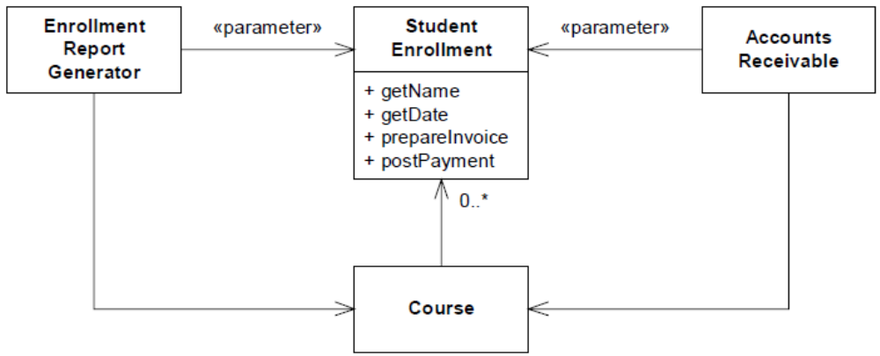
For example, consider the course enrollment system depicted in Figure below. The diagram shows two clients of a class named StudentEnrollment. Clearly the EnrollmentReportGenerator does not invoke methods like prepareInvoice or postPayment.
Lets also suppose that AccountsReceivable does not invoke the methods getName and getDate.

Slide 28
Now, lets assume that the requirements change in a way that forces us to add a new argument to the postPayment method. This change to the declaration of StudentEnrollment may force us to recompile and redeploy EnrollmentReportGenerator.
This is unfortunate because EnrollmentReportGenerator does not care at all about the postPayment method.
We can prevent this unfortunate dependency by following a simple rule. Protect users from methods they don’t need by giving them interfaces with just the methods they do need. Next Figure shows how this rule can be applied.
Each user of a StudentEnrollment object is given an interface that provides just the methods that it is interested in. This protects the user from changes in methods that don’t concern it. It also protects the user from knowing too much about the implementation of the object it is using.

Slide 29
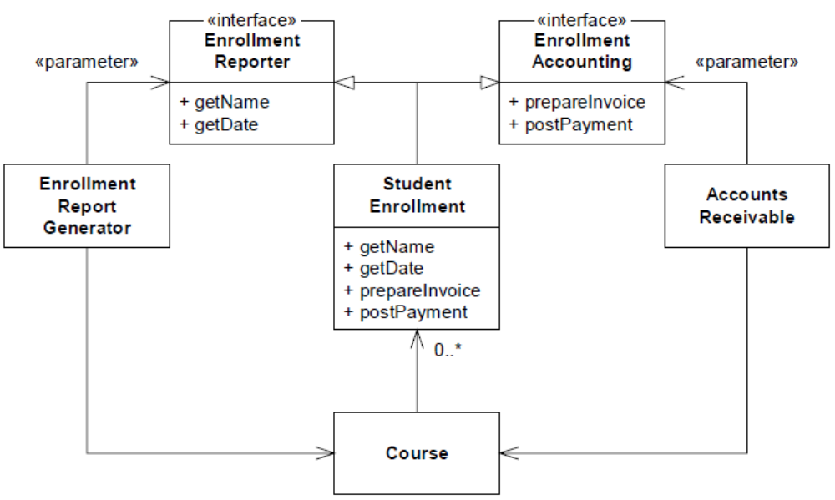

Slide 30
Summary
We’ve discussed five principles:
1. SRP -- A class should have one and only one reason to change.
2. OCP -- It should be possible to change the environment of a class without changing the class.
3. LSP -- Avoid making methods of derivatives illegal or degenerate. Users of base classes should not need to know about the derivatives.
4. DIP -- Depend on interfaces and abstract classes instead of volatile concrete classes.
5. ISP -- Give each user of an object an interface that has just the methods that user needs.
When should these principles be applied? At the first hint of pain. It is not wise to try to make all systems conform to all principles all the time, every time. You’ll spend an eternity trying to imagine all the different environments to apply to the OCP, or all the different sources of change to apply to the SRP. You’ll cook up dozens or hundreds of little interfaces for the ISP, and create lots of worthless abstractions for the DIP.

Slide 31
The best way to apply these principle is reactively as opposed to proactively. When you first detect that there is a structural problem with the code, or when you first realize that a module is being impacted by changes in another, then you should see whether one or more of these principles can be brought to bear to address the problem.
Of course if you take a reactive approach to applying the principles, then you also need to take a proactive approach to putting the kinds of pressure on the system that will create pain early. If you are going to react to pain, then you need to diligently find the sore spots.
One of the best ways to hunt for sore spots is to write lots and lots of unit tests. It works even better if you write the tests first, before you write the code that passes them (Test-Driven Development, TDD).
But that’s a topic for the separate discussion.

Slide 32
Questions & Answers…
20, Myasnitskaya str., Moscow, Russia, 101000
Tel.: +7 (495) 628-8829, Fax: +7 (495) 628-7931
www.hse.ru

