Slide 1
PebbeNote
A simple note-taking app, AGPL licensed, yours to own

Slide 2
PebbeNote
A simple note-taking app, AGPL licensed, yours to own

Slide 3
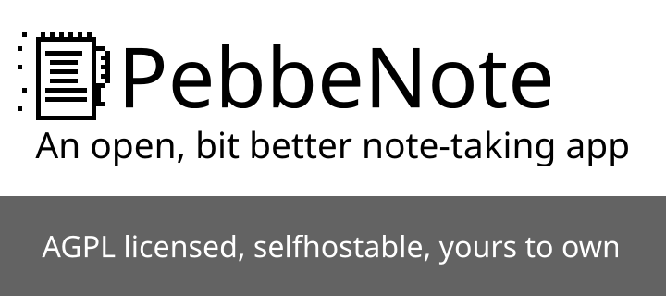
What is PebbeNote?

Slide 4
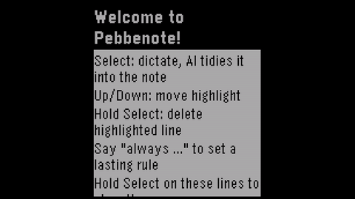
Demo

Slide 5
Where is the value?
We don’t sell the app
We sell the underlying service

Slide 6
What service?
User
Apps
Self hosted
backend
Our Service
The goal is to provide the self-hosted option for the early adopters, and a hosted service for everyone else

Slide 7
Where is the moat?
Community
Defaults
Control of the AGPL source

Slide 8
Who are the users?
Early Adopters
  AI Sceptics
  Privacy advocates (Degooglers etc)
And then people who want to be like early adopters, but lack the resources to self host.
Thats why I plan to show off the app at CCC in Hamburg

Slide 9
Thank you for listening

