Slide 1
Guide to Networking Essentials

Slide 2
Chapter 1:
Introduction to Networks and Networking Concepts

Slide 3
Learning Objectives
Understand basic networked communications and services
Identify essential network components
Describe the benefits of networking
Understand and compare peer-to-peer and server-based networks
continued

Slide 4
Learning Objectives
Apply your knowledge when selecting an appropriate network type for small business use
Suggest possible redesigns for a small but expanding network

Slide 5
What Is Networking?
Involves connecting computers for the purpose of sharing information and resources
Requires a great deal of technology
Offers many possible choices for physical connections and related software

Slide 6
Networking Fundamentals
Consists of two or more computers connected to each other by wire or cable to transmit data back and forth
Primary motivation arises from a need for individuals to share data quickly and efficiently

Slide 7
Primary Benefits of Networking
Permits groups of users to exchange information routinely and to route data from one individual to another
  Single consistent master copy of data files
Improves human communication
  Electronic mail (e-mail)
Enables device sharing

Slide 8
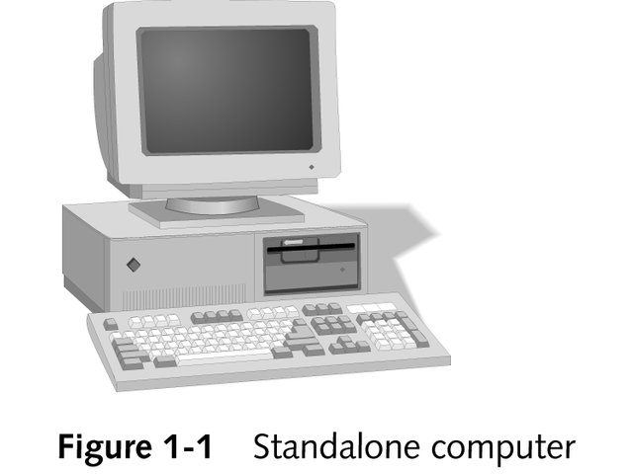
Standalone Computer

Slide 9
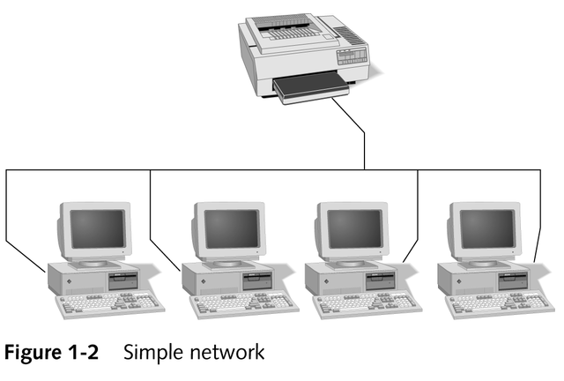
Simple Network

Slide 10
Local and Wide Area Networks
LAN
  A collection of computers and other networked devices that fit within the scope of a single physical network
  Provides the building blocks for internetworks and WANs
WAN
  An internetwork that spans distances measured in miles
  Links together two or more separate LANs

Slide 11
A Networking Lexicon
Clients, peers, and servers
Network medium and network messages
Network protocols
Network software
Network services

Slide 12
Clients, Peers, and Servers
Server
  A computer that shares its resources across the network
  Responds to client requests for information by providing the requested information
Client
  A computer that accesses shared resources
  Requests information

Slide 13
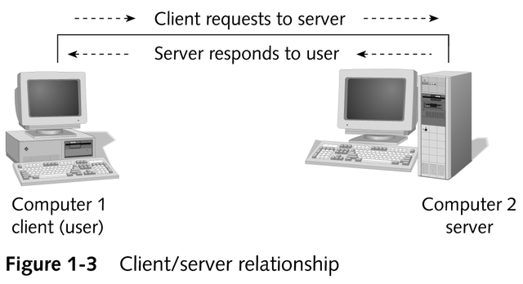
The Client/Server Relationship

Slide 14
Clients, Peers, and Servers
Client/server network
  Certain computers take specialized roles and function mostly as servers
  Ordinary users’ machines tend to function mostly as clients
Peer-to-peer network
  Each computer can be a client to other computers and act as a server as well

Slide 15
The Network Medium Carries Network Messages
Network medium
  Usually refers to the cable (metallic or fiber-optic) that links computers on a network
  Can also describe wireless networking
To access any network, computers must attach to the network medium with a physical interface
  Network interface card (NIC)
  Network adapter

Slide 16
Network Protocols
Sets of rules for communicating across a network
Examples
  TCP/IP
  NetBEUI
  IPX/SPX
  NWLink

Slide 17
Network Software
Issues requests and responses that let computers take the roles of clients and servers
Network operating system (NOS)
  Specialized collection of software that gives a computer the ability to communicate over a network and to take advantage of networking services

Slide 18
Network Services
Reside primarily on servers
Can include file and print services, file-sharing, e-mail and other messaging services

Slide 19
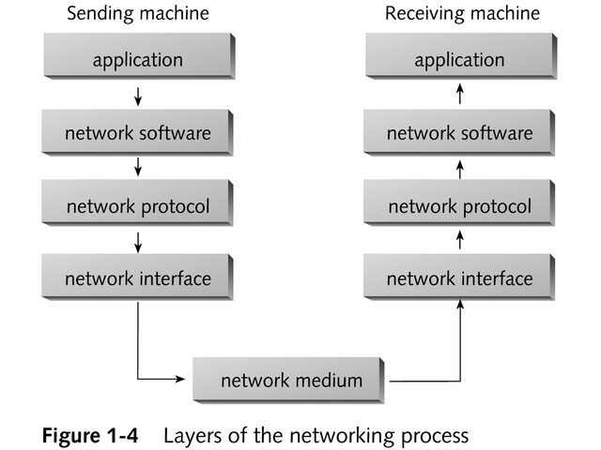
The Layered Nature of Networked Communications

Slide 20
Network Types
Peer-to-peer
Server-based
Storage-area
Hybrid

Slide 21
Peer-to-peer Networking
Any computer can function as either a client or a server
No one computer has any higher priority to access, or heightened responsibility to provide, shared resources on the network
Every user must act as a system administrator

Slide 22
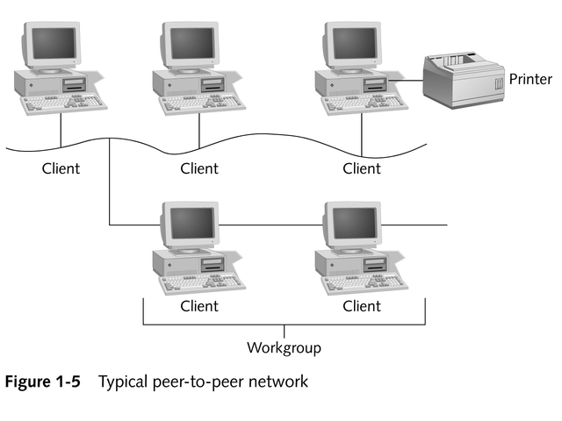
Typical Peer-to-peer Network

Slide 23
Peer-to-peer Networking Advantages
Easy to install and configure
Not dependent on a dedicated server
Individual users control their own shared resources
Inexpensive to purchase and operate
Needs no additional equipment or software beyond a suitable operating system
Needs no dedicated administrator
Works best for networks with 10 or fewer users

Slide 24
Peer-to-peer Networking Disadvantages
Network security applies only to a single resource at a time
Users may be forced to use as many passwords as there are shared resources
Each machine must be backed up individually to protect all shared data
continued

Slide 25
Peer-to-peer Networking Disadvantages
Every time a user accesses a shared resource, the user at the machine where the resource resides suffers reduced performance
No centralized organizational scheme to locate or control access to data
Does not usually work well with more than 10 users

Slide 26
Server-based Networks
Users act as clients of dedicated machines that take the server role

Slide 27
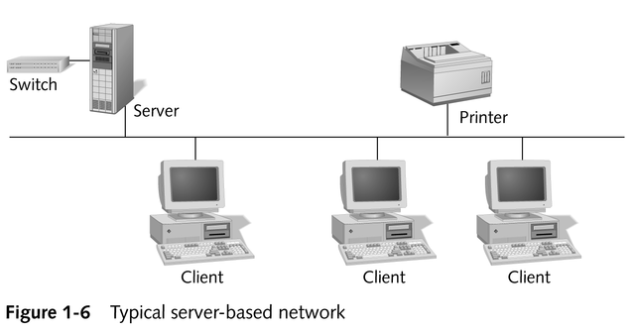
Typical Server-based Network

Slide 28
Server-based Networking Advantages
Simplified network administration: centralized user accounts, security, and access controls
More powerful equipment means more efficient access to network resources
A single password for network logon delivers access to all resources
Appropriate for networks with 10 or more users or any networks where resources are used heavily

Slide 29
Server-based Networking Disadvantages
At worst, server failure renders a network unusable; at best, it results in loss of network resources
Complex, special-purpose server software requires allocation of expert staff, which increases expenses
Dedicated hardware and specialized software add to the cost

Slide 30
Storage-area Networks (SANs)
Centralized network storage
Data transfer occurs over high-speed links for faster access
Appropriate for largest-scale networks

Slide 31
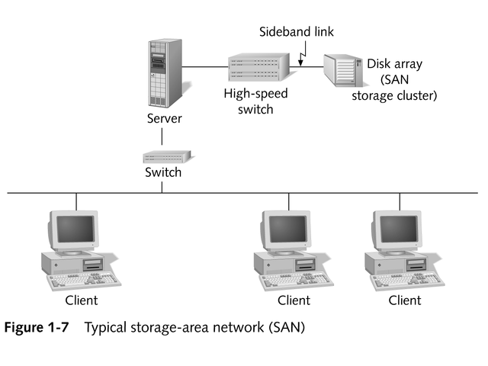
Typical SAN

Slide 32
Storage-area Networking Advantages
Use of high-speed links provides fast access to SAN storage
Consolidation of all server storage
  Permits all backup to occur in a single location
  Permits organizations to buy the fastest, most reliable storage subsystems
  Can add an extra level of security and access controls
Easy to increase storage capacity

Slide 33
Storage-area Networking Disadvantages
More expensive than conventional storage

Slide 34
Hybrid Networks
Incorporates both peer-to-peer and server-based features
Sometimes called combination networks

Slide 35
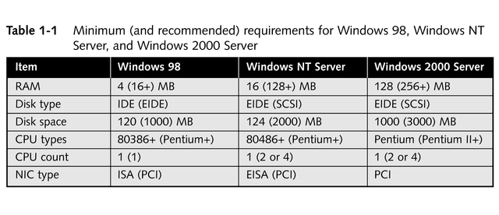
Server Hardware Requirements

Slide 36
Specialized Servers
Application servers
Communication servers
Domain controllers/directory servers
Fax servers
File and print servers
Mail servers
Web servers

Slide 37
Application Servers
Supply the server side of client/server applications, and often the data that goes along with them, to network clients

Slide 38
Communication Servers
Provide access to network resources for users not directly attached to the network (inbound communications)
Permit network users to access external resources not directly attached to the network (outbound communications)

Slide 39
Domain Controllers/
Directory Servers
Handle the logon services and manage the collection of computers, users, and so on in a domain

Slide 40
Fax Servers
Manage fax traffic for a network
  Receive incoming faxes from phone lines and direct them to users across the network
  Collect outgoing faxes across the network before sending them over a phone line
Typically use one or more fax modem interfaces

Slide 41
File and Print Servers
Most common type of network servers
Provide basic networked file storage and retrieval services and access to networked printers
Let users run applications locally but keep their data files on the server

Slide 42
Mail Servers
Manage the flow of e-mail messages for network users
Commonly provide “store-and-forward” services

Slide 43
Web Servers
The combination of hardware and software that stores information that is accessible over the Internet via the World Wide Web (WWW)

Slide 44
Selecting the Right Type of Network
Budget
Number of users
Types of applications or network services
Requirements for centralized administration and control

Slide 45
Choose Peer-to-peer Exclusively Only When…
Network includes no more than 10 users (preferably no more than 5)
All networked machines are close enough to fit within the span of a single LAN
Budget considerations are paramount
No specialized servers are needed

Slide 46
Use Server-based When One or More Is True…
More than 10 users must share network access
Centralized control, security, resource management, or backup is desirable
Users need access to specialized servers, or place heavy demands for network resources
An internetwork is in use, or WAN access is required

Slide 47
Chapter Summary
Basic elements of all networks
  Presence of a networking medium (cabling) of some kind
  Incorporation of a physical interface (network adapter) to that medium
  Networking protocols and software
continued

Slide 48
Chapter Summary
Network types
  Peer-to-peer
  Client/server (server-based)
  Storage-area networks (SANs)
  Hybrid
continued

Slide 49
Chapter Summary
Selecting the right type of network
  Budget
  Number of users
  Types of applications or network services
  Requirements for centralized administration and control

