Slide 1
Chapter 2: Network Design Essentials

Slide 2
Learning Objectives
Design a network layout
Understand the various networking topologies
Integrate the use of hubs into your network
Integrate the use of switches into your network
continued

Slide 3
Learning Objectives
Explore the variations of the standard networking topologies
Select the best network topology for your environment
Construct your network layout

Slide 4
Network Design
Analyze network requirements
Select a network topology and equipment to fit that topology
Map out your design

Slide 5
Designing a Network Layout
Topology
Physical layout of computers, cables, and other resources
How those components communicate with each other
Has a significant effect on performance and growth potential
Impacts type of equipment to purchase and approach to network management

Slide 6
Designing a Network Layout
Deciding how to best situate components in a topology
Understand uses and limitations of various topologies
Provide room for growth
Meet defined security requirements

Slide 7
Standard Topologies
Bus (or linear bus)
A series of computers connected along a single cable segment
Star
Computers connected via a central concentration point (hub)
Ring
Computers connected to form a loop

Slide 8
Bus Topology
Most basic
All components connect via a backbone, a single cable segment that interconnects all the computers in a straight line
Inherent weakness: a single cable break can halt the entire network
Easy to install and troubleshoot
Suited for small offices or temporary configurations

Slide 9
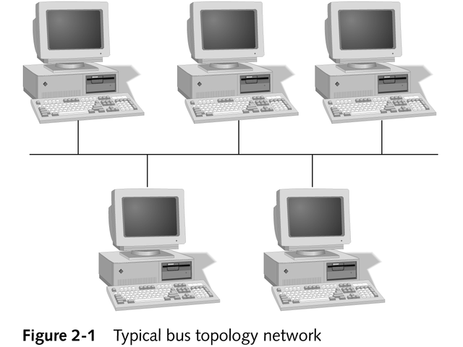
Bus Topology

Slide 10
Bus Communications
A computer addresses data to one or more computers
The data is transmitted across the cable in the form of electronic signals

Slide 11
Sending the Signal
Computer addresses the data, breaks it into packets, and sends it across the network as electronic signals
Signals travel on the backbone; all connected computers receive them
Because packets are addressed, only those computers that these signals are destined for accept the data

Slide 12
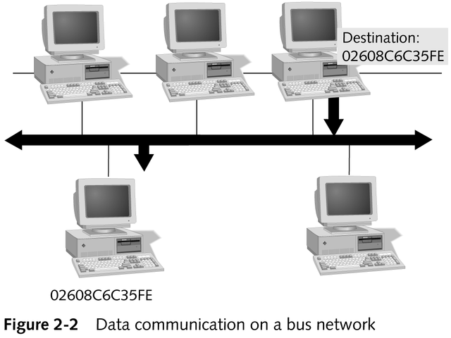
Data Communication on a Bus Network

Slide 13
Bus Communications
Factors affecting speed of a bus network
Number of computers attached to the network (only one computer can send information at a time)
Hardware capabilities of the computers
Number of times a computer tries to send its data
Applications used on the computers
Cables used in the network
Distance between the computers

Slide 14
Bus Communications
Passive topology
Computers only listen for data being sent; they do not move data
If one computer fails, it has no effect on the rest of the network

Slide 15
Signal Bounce
Occurs when a bus is not terminated and signals continue to traverse the network; prevents other computers from sending data
All signals must stop when they reach the end of any segment in a bus topology

Slide 16
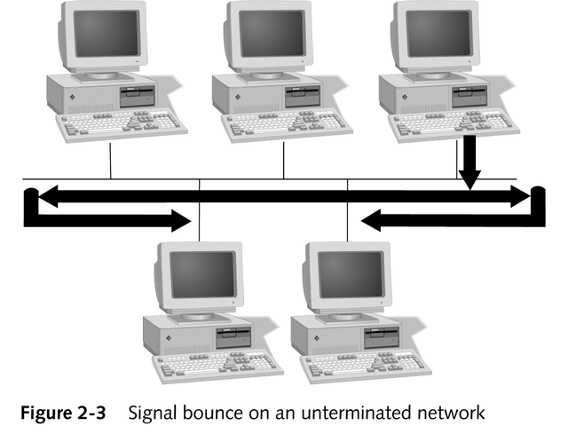
Signal Bounce

Slide 17
Cable Termination
A terminator attached to each end of a cable prevents signals from bouncing
Cable terminators absorb an electronic signal

Slide 18
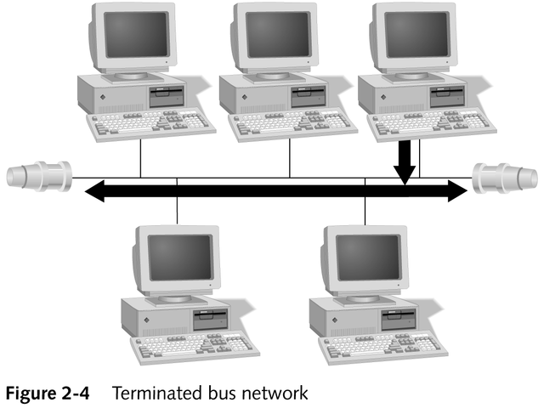
Cable Termination

Slide 19
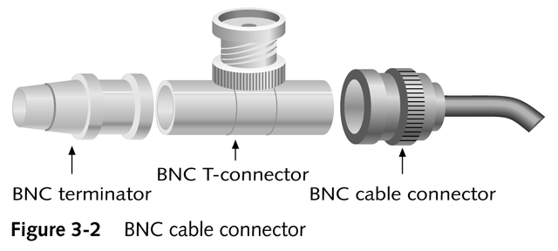
BUS NETWORK CONNECTORS

Slide 20
Cable Failure
Occurs when the cable is physically cut or one end becomes disconnected; the cable is no longer terminated and signals can bounce, halting all network activity
Computers can still function as standalone systems, but no network communications are possible

Slide 21
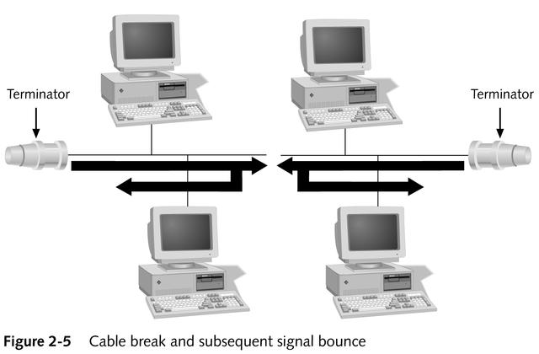
Cable Failure

Slide 22
Bus Network Expansion
When using Ethernet 10Base2 (thinnet), expand networks by attaching a BNC barrel connector between cable segments
Use a repeater to eliminate the effects of signal attenuation

Slide 23
Star Topology
Computers are connected by cable segments to a central hub
Hub receives and retransmits signals down every cable segment to all other computers/devices
Only the computers that such signals address directly pay attention to or act upon that data

Slide 24
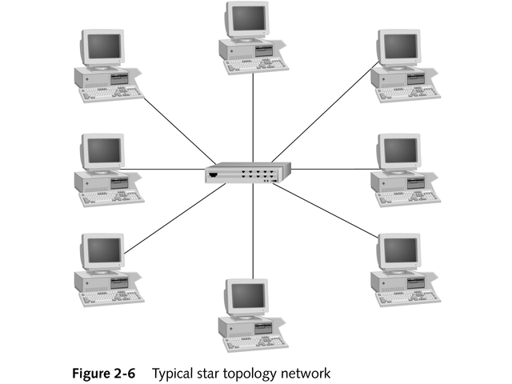
Star Topology

Slide 25
Star Topology
Benefits
Inherent centralization of resources
Higher degree of fault tolerance; if one computer or cable fails, it has no effect on the rest of the network
Drawbacks
Requires more intricate cable installation
If the hub fails, all other attached computers/devices lose network access

Slide 26
Ring Topology
As a computer receives a signal, it either acts on it or regenerates it and passes it along
Signals travel in only one direction around the ring (no termination required)
Token passing
Active topology
Every computer in a ring is responsible for retransmitting the token or data

Slide 27
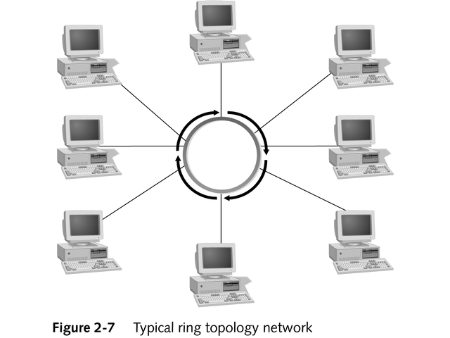
Ring Topology

Slide 28
Ring Topology
Advantages
Very fast
“Smart hubs” recognize a computer’s failure and automatically remove the computer from the ring
Able to share network resources fairly
Drawback
Adding computers consistently degrades network performance

Slide 29
Hubs
Central point of concentration for a star network
Pass electronic signals to the network

Slide 30
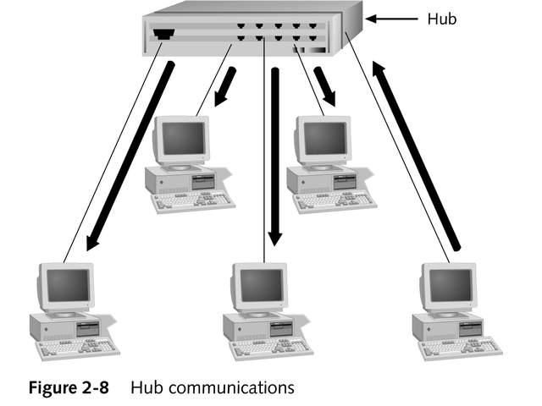
Hubs

Slide 31
Active Hubs
Regenerate the signals as they receive them and send them along
Generally have many ports; sometimes called multiport repeaters
Require electrical power to run

Slide 32
Passive Hubs
Simply a central connection point
Signal passes through the hub without any amplification or regeneration
Require no power

Slide 33
Hybrid Hubs
Interconnect different types of cables
Maximize a network’s efficiency

Slide 34
Switches
Special networking devices that manage network connections between any pair of star-wired devices on a network
Offer greater bandwidth and intelligence
Support a variety of networking topologies
Organize groups of devices into virtual LANs
Manage communications among multiple virtual LANs
Provide comprehensive network management capabilities

Slide 35
Variations of the Major Topologies
Mesh
Star bus
Star ring

Slide 36
Mesh Topology
Most fault tolerant but also most expensive
All computers connect to each other
A single device/cable failure affects network performance only minimally
Used on wide area networking to ensure that all sites remain able to communicate in the event of cable failure

Slide 37
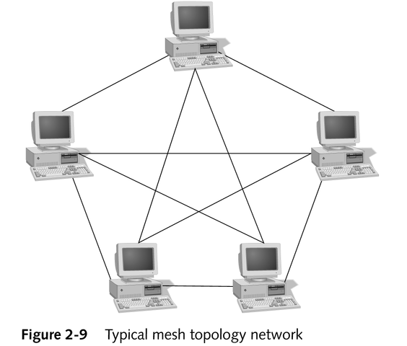
Mesh Topology

Slide 38
Star Bus Topology
Combines star and bus topologies
Centralized management
Star configuration minimizes any single computer failure’s effect on the network
If a hub fails, the computers attached to it cannot communicate, but other hub-computer connections remain intact and communication continues

Slide 39
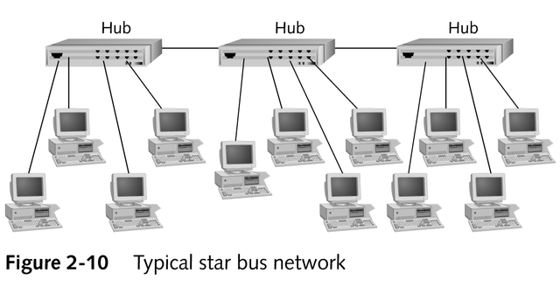
Star Bus Topology

Slide 40
Star Ring Topology
Wired as a star; handles network traffic like a ring
Centralized management
A single computer failure does not affect network traffic

Slide 41
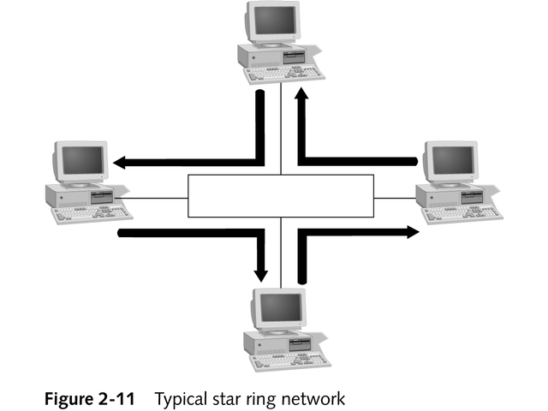
Star Ring Topology

Slide 42
Interconnecting Multiple Virtual LANs
Modern switches can deliver the same functionality as a hub (which links individual devices together into a LAN) and a router (which links multiple LANs together into an internetwork)

Slide 43
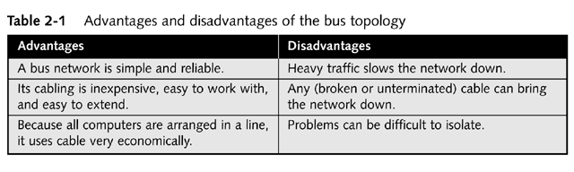
Selecting a Bus Topology

Slide 44
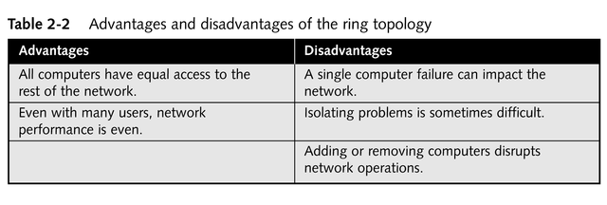
Selecting a Ring Topology

Slide 45
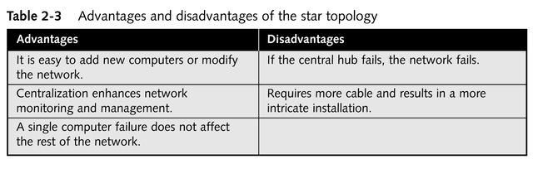
Selecting a Star Topology

Slide 46
VLAN Topology
A configuration setting that groups two or more devices attached to a switch, so that network communications pass among group members as if they were physically wired together in a bus or a ring topology

Slide 47
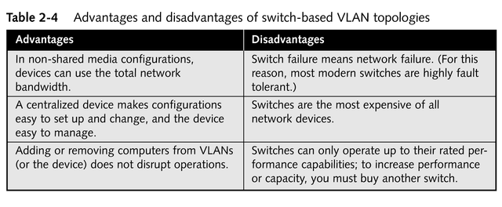
Selecting VLAN Topologies

Slide 48
Constructing a Network Layout
Evaluate underlying requirements
Number of client computers to be attached
Number of servers to be attached
Kind of applications that will run
Peer-to-peer or server-based network?
Amount of fault tolerance required by applications
Budget
Sketch the network layout (third party tools are available)
Put your network map into a computer

Slide 49
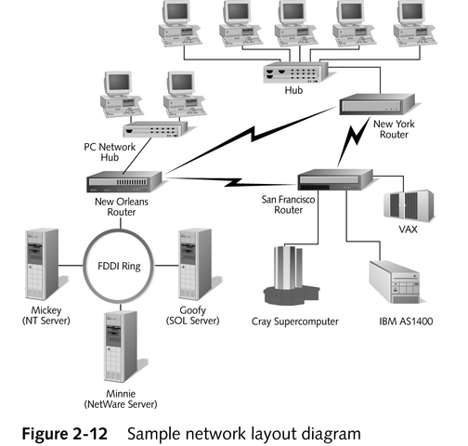

Slide 50
Chapter Summary
Three basic topologies
Bus
Star
Ring
Active and passive hubs
Switches
Variations on major topologies allow even greater fault tolerance and flexibility
Mesh
Star bus
Star ring

