Slide 1
Chapter 3: Networking Media
LAN Design & Installation

Slide 2
Learning Objectives
Define and understand technical terms related to cabling, including attenuation, crosstalk, shielding, and plenum
Identify three major types of both network cabling and wireless network technologies
Understand baseband and broadband transmission technologies and when to use each
continued

Slide 3
Learning Objectives
Decide what kinds of cabling and connections are appropriate for particular network environments
Describe wireless transmission techniques used in LANs
Describe signaling technologies for mobile computing

Slide 4
Network Cabling: Tangible Physical Media
Provides a medium across which network information can travel in the form of a physical signal, whether it is a type of electrical transmission or some sequence of light pulses

Slide 5
Primary Cable Types
Coaxial cable
Twisted-pair (TP) cable
Unshielded (UTP)
Shielded (STP)
Fiber-optic

Slide 6
General Cable Characteristics
Bandwidth rating
Maximum segment length
Maximum number of segments per internetwork
Maximum number of devices per segment
Interference susceptibility
Connection hardware
Cable grade
Plenum rating
Bend radius
Material costs
Installation costs

Slide 7
Primary Techniques for Sending Signals across a Cable
Baseband transmission
Broadband transmission

Slide 8
Baseband Transmission
Uses digital signals sent over a cable without modulation
Sends binary values (0s and 1s) as pulses of different voltage levels
Entire bandwidth of the cable is used to transmit a single data signal
Limits any single cable strand to half-duplex transmission
continued

Slide 9
Baseband Transmission
Signal flow can be bi-directional
Uses repeaters to restore the signal to its original strength and quality before retransmitting it to another cable

Slide 10
Broadband Transmission
An analog transmission technique which may use multiple communication channels simultaneously
Each data channel is represented by modulation on a particular frequency band, for which sending or receiving equipment must be tuned
Signal flow is one-way only; two channels are necessary for computers to send/receive data
continued

Slide 11
Broadband Transmission
Uses amplifiers to detect weak signals, strengthen those signals, and then rebroadcast them
Primary approaches to supporting two-way broadband communications
Mid-split broadband
Dual-cable broadband
Offers higher bandwidths, but generally more expensive than baseband systems

Slide 12
The Importance of Bandwidth
The faster the connection, the better

Slide 13
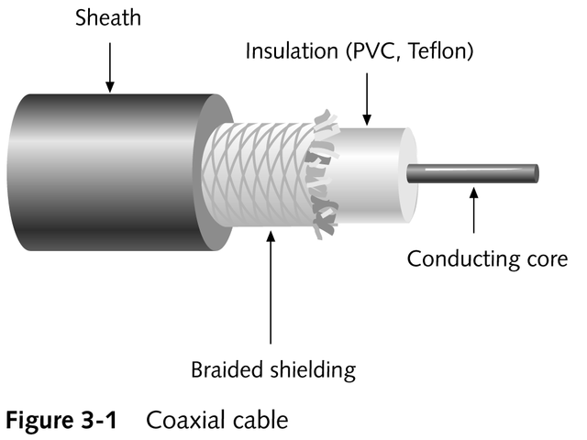
Coaxial Cable
Uses a center conductor -- wrapped by an insulating layer, surrounded by a braided wire mesh and an outer jacket or sheath -- to carry high-bandwidth signals such as network traffic or broadcast television frequencies

Slide 14
Coaxial Cable
Uses shielding to increase the viability of the signals that pass through a cable by absorbing stray electronic signals or fields
Less susceptible to interference and attenuation than twisted-pair cabling, but more so than fiber-optic
A connector must cap each end of the cable, and a terminator must screw into each end

Slide 15
Types of Coaxial Cable for Ethernet
Thin Ethernet (thinnet, thinwire, cheapernet, 10Base2)
Thick Ethernet (thicknet, thickwire, 10Base5)

Slide 16
Thinwire Ethernet
Thin, flexible cable about 0.2” in diameter
Easy to work with
Relatively inexpensive to build or buy
Well suited for small or constantly changing networks
Uses BNC T-connectors to attach directly to networking devices and computers’ network adapter cards

Slide 17
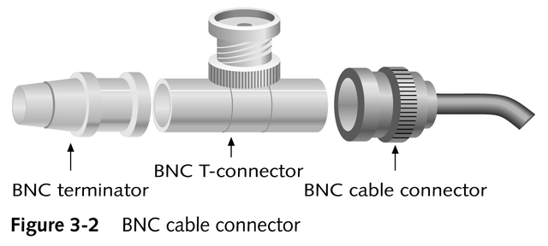
Thinwire Ethernet

Slide 18
Radio Government (RG) Specifications
Coaxial cable designation that reflects coaxial cable’s original use as a conveyance for radio frequency data and signals

Slide 19
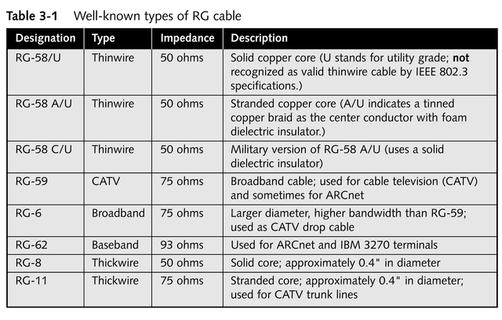
Radio Government (RG) Specifications

Slide 20
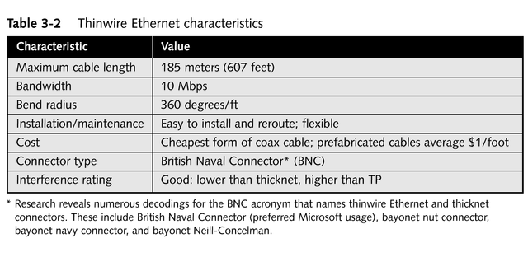
Thinwire Ethernet Cable

Slide 21
Thickwire Ethernet
Uses a rigid cable about 0.4” in diameter (“frozen yellow garden hose”)
Rarely used except as a backbone for a new network installation (due to expense, large diameter, and lack of flexibility)
Uses a vampire tap to attach a device to the cable, which in turn attaches to a transceiver; transceiver attaches to a drop or transceiver cable that plugs into an attachment unit interface (AUI)

Slide 22
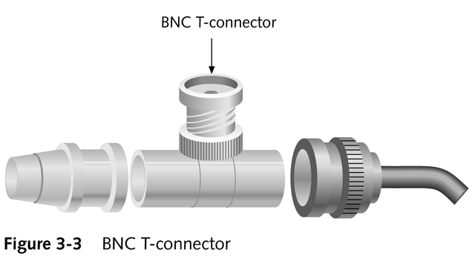
Attaching to Thinwire Ethernet Cable

Slide 23
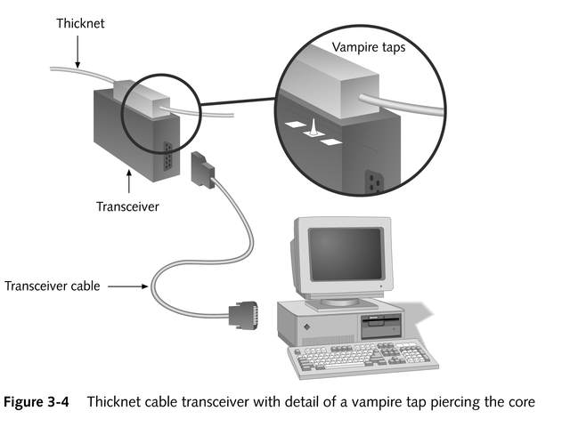
Attaching to Thickwire Ethernet Cable

Slide 24
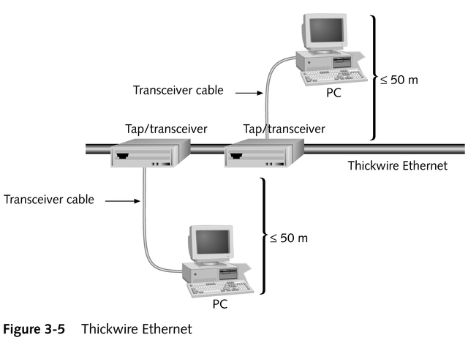
Running Thickwire Cable

Slide 25
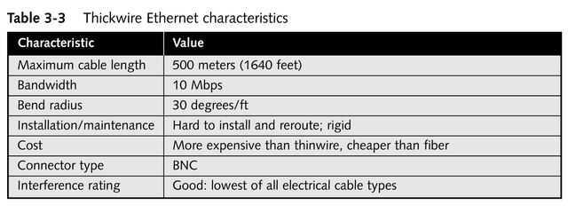
Thickwire Ethernet Cable

Slide 26
Coaxial Cable Characteristics
Can handle moderate to serious bandwidth
Supports intermediate to moderately long cable runs
Relatively affordable
Resistant to interference; relatively safe from electronic “eavesdropping”

Slide 27
Twisted-pair Cable
Consists of one or more pairs of insulated strands of copper wire twisted around one another
Importance of twists
Improve resistance to interference
Limit the influence of crosstalk

Slide 28
Types of TP Cable
Unshielded twisted-pair (UTP)
Contains one or more pairs of insulated wires within an enclosing insulating sheath
Follows the ANSI/EIA/TIA 568 standard
Prone to crosstalk
Shielded twisted-pair (STP)
Encloses each pair of wires within a foil shield, as well as within an enclosing insulating sheath
Supports higher bandwidth over longer distances than UTP
Has no set of standards

Slide 29
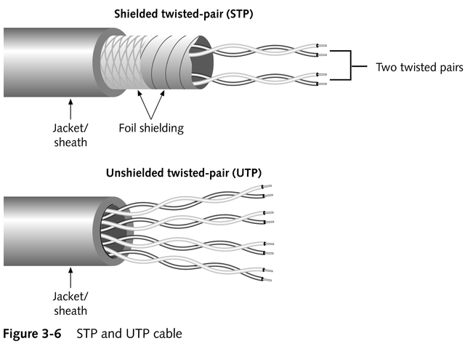
Types of TP Cable

Slide 30
Twisted-pair Network Cabling Schemes
Commonly employ RJ-45 telephone connectors
Typical elements (often in a wiring center)
Punchdown blocks
Patch panels
Wall plates
Jack couplers

Slide 31
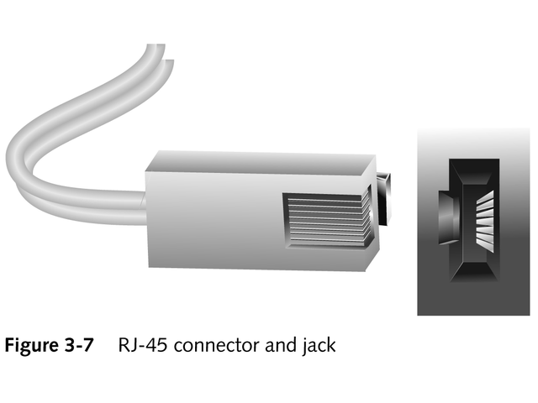
RJ-45 Connector

Slide 32
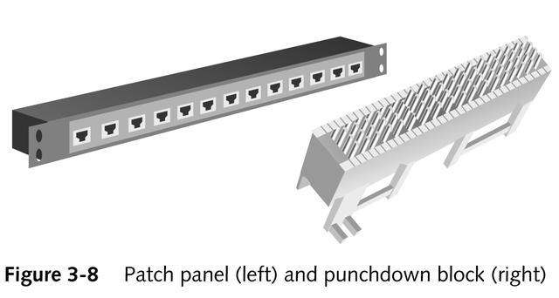
Patch Panels and Punchdown Blocks

Slide 33
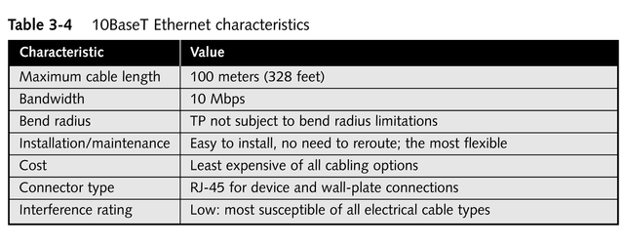
10BaseT’s Networking Characteristics

Slide 34
Fiber-optic Cable
Uses pulses of light sent along a light-conducting fiber at the heart of the cable to transfer information
Sends data in one direction only; two cables are required to permit data exchange in both directions
Consists of a slender cylinder of glass fiber(s), called the core, surrounded by a concentric layer of cladding material and then by an outer sheath

Slide 35
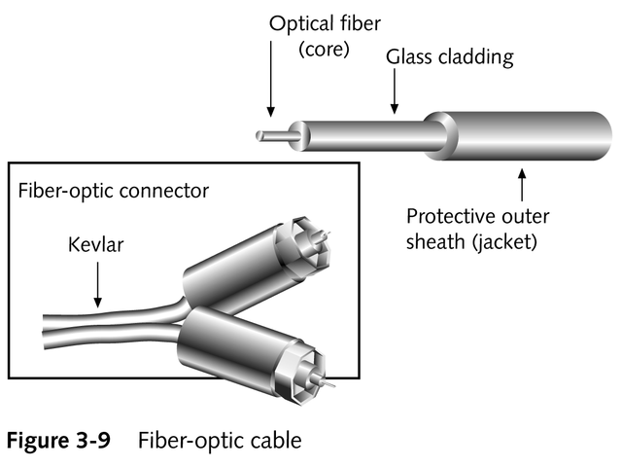
Fiber-optic Cable

Slide 36
Primary Types of Fiber-optic Cables
Single-mode cables
Include only one glass fiber at the core
Cost more
Work with laser-based emitters but span the longest distances
Multi-mode cables
Incorporate two or more glass fibers at the core
Cost less
Work with light emitting diodes (LEDs) but span shorter distances

Slide 37
Fiber-optic Cable Advantages
Immune to interference
Highly secure; eliminates possibility of electronic eavesdropping
Good medium for high-bandwidth, high-speed, long-distance data transmissions

Slide 38
Fiber-optic Cable Drawbacks
High cost
Difficult installation

Slide 39
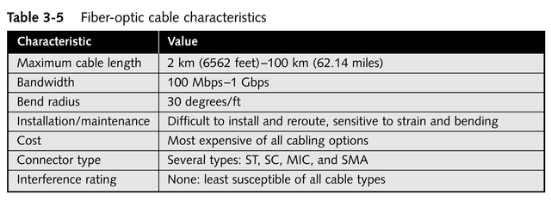
Fiber-optic Cable Characteristics

Slide 40
Fiber-optic Media Connectors
ST (straight tip)
SC (straight connection)
MIC (medium interface connector)
SMA (subminiature type A)

