Slide 1
Cable Selection Criteria
Bandwidth
Budget
Capacity
Environmental considerations
Placement
Scope
Span

Slide 2
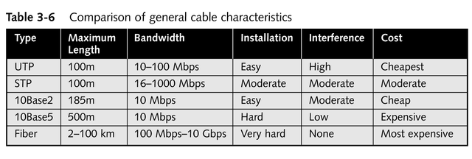
Comparison of General Cable Characteristics

Slide 3
The IBM Cabling System
Numeric cabling designations (Type 1 through Type 9) developed by IBM
  Types 2 and 9 are the most commonly used networking cables
IBM cable connector is the unique feature; any two connectors are able to plug into each other

Slide 4
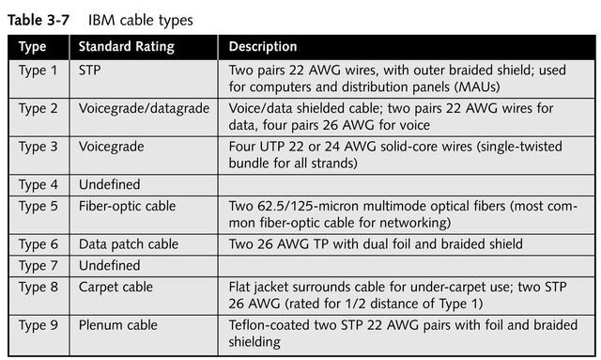
IBM Cable Types

Slide 5
Wireless Networking: Intangible Media
Depends on transmission at some kind of electromagnetic frequency through the atmosphere to carry data transmissions from one networked device to another
Appears most frequently in conjunction with wired networks

Slide 6
Capabilities of the Wireless World
Creates temporary connections to existing wired networks
Establishes back-up or contingency connectivity for existing wired networks
Extends a network’s span beyond the reach of wire- or fiber-optic-based cabling
Permits certain users to roam with their machines, within certain limits

Slide 7
Commercial Applications for Wireless Networking
Ready access to data for mobile professionals
Delivery of network access into isolated facilities
Access in environments in which layout and settings change constantly
Improved customer services in busy areas
Network connectivity in facilities where in-wall wiring would be impossible to install or prohibitively expensive

Slide 8
Types of Wireless Networks
Local area networks (LANs)
Extended LANs
Mobile computing

Slide 9
Wireless LAN Applications
Still necessary to attach a network interface to a computer, but the interface attaches to an antenna and an emitter rather than to a cable
Requires an access point device to bridge wireless components and the wired network

Slide 10
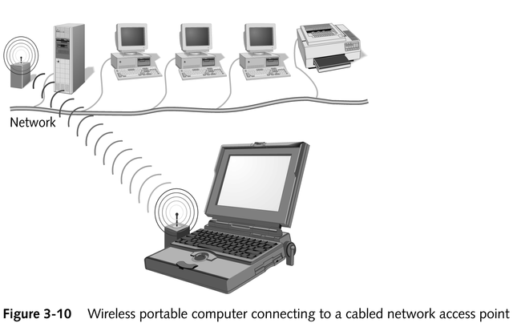
Wireless Access Point Device

Slide 11
Wireless LAN Transmission
Most common frequencies used
  Radio: 10 KHz to 1 GHz
  Microwave: 1 GHz to 500 GHz
  Infrared: 500 GHz to 1 THz
Primary technologies used
  Infrared
  Laser
  Narrowband, single-frequency radio
  Spread-spectrum radio

Slide 12
Broadcast Medium Principles
Inverse relationship between frequency and distance
Direct relationship between frequency and data transfer rate and bandwidth
Higher-frequency technologies often use tight-beam broadcasts and require a clear line of sight between sender and receiver to ensure correct delivery

Slide 13
Infrared LAN Technologies
Use infrared light beams to send signals between pairs of devices
Have high bandwidth; work well for LAN applications
Require a line of sight between sender and receiver

Slide 14
Kinds of Infrared LANs
Line-of-sight networks
Reflective wireless networks
Scatter infrared networks
Broadband optical telepoint networks

Slide 15
Laser-based LAN Technologies
Require a clear line of sight between sender and receiver
Devices are subject to many of the same limitations as infrared but are not as subject to interference from visible light sources

Slide 16
Narrow-band, Single-frequency Radio LAN Technologies
Use low-powered, two-way radio communications
Require no line-of-sight between sender and receiver

Slide 17
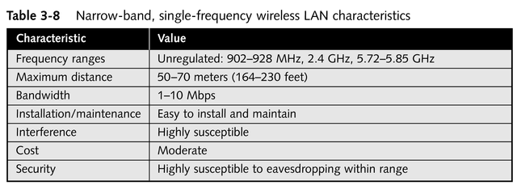
Narrow-band, Single-frequency Wireless LAN Characteristics

Slide 18
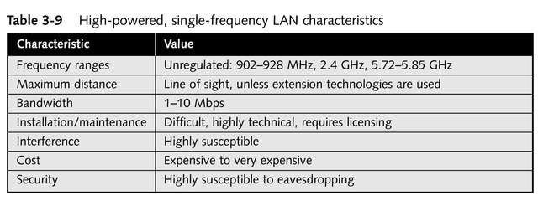
High-powered, Single-frequency LAN Characteristics

Slide 19
Spread-spectrum LAN Technologies
Address weaknesses of single-frequency communications
  Use multiple frequencies simultaneously; improve reliability and reduce susceptibility to interference
  Make eavesdropping more difficult
Two main kinds
  Frequency-hopping
  Direct-sequence modulation

Slide 20
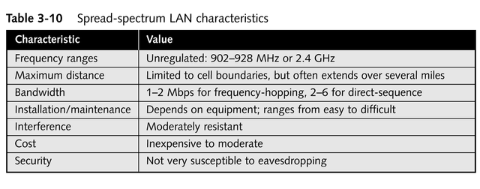
Spread-spectrum LAN Characteristics

Slide 21
Wireless Extended LAN Technologies
Wireless bridge
  A pair of devices, typically narrow-band and tight beam, that relay network traffic from one location to another
  Available using spread-spectrum radio, infrared, and laser technologies
  Can span distances from hundreds of meters up to 25 miles

Slide 22
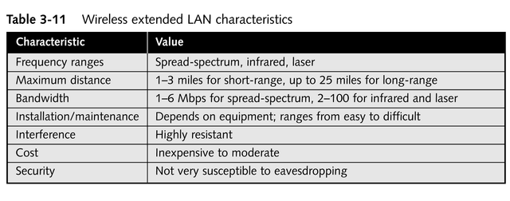
Wireless Extended LAN Characteristics

Slide 23
Microwave Networking Technologies
Can deliver higher transmission rates than radio-based systems
Transmitters and receivers must share a common, clear line of sight
Usually require FCC approval and licensing
More expensive than radio systems
Two types
  Terrestrial
  Satellite

Slide 24
Terrestrial Microwave
Uses line-of-sight communication between pairs of Earth-based transmitters and receivers to relay information
Expensive; usually positioned well above ground level

Slide 25
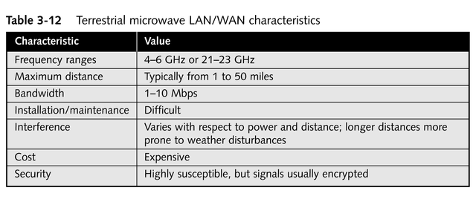
Terrestrial Microwave LAN/WAN Characteristics

Slide 26
Satellite Microwave
Uses geosynchronous satellites to send and relay signals between sender and receiver
Usually leased for an exorbitant fee

Slide 27
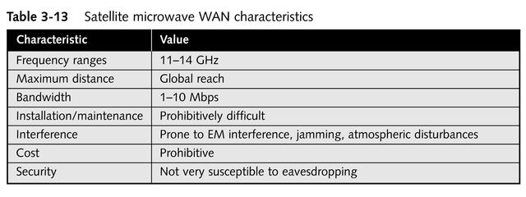
Satellite Microwave WAN Characteristics

Slide 28
High-speed Wireless Networking Technologies
IEEE 802.11 Wireless Networking Standard
Cellular packet radio networking
Cellular Digital Packet Data (CDPD)
Narrow-band sockets

Slide 29
Chapter Summary
Network cabling
Primary cable types
  Twisted-pair (unshielded and shielded) and coaxial conductive cables
  Fiber-optic cables
Cabled network transmission schemes
  Broadband
  Baseband
continued

Slide 30
Chapter Summary
Wireless networking
  Provides cable-free LAN access
  Extends span of LANs
  Provides WAN links
  Supports mobile computing needs
  Uses a variety of electromagnetic frequency ranges
    Narrow-band and spread-spectrum radio
    Microwave
    Infrared
    Laser transmission

