Slide 1
Cable Selection Criteria
Bandwidth
Budget
Capacity
Environmental considerations
Placement
Scope
Span

Slide 2
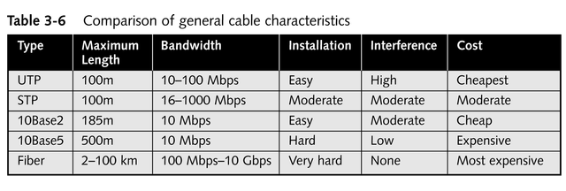
Comparison of General Cable Characteristics

Slide 3
The IBM Cabling System
Numeric cabling designations (Type 1 through Type 9) developed by IBM
Types 2 and 9 are the most commonly used networking cables
IBM cable connector is the unique feature; any two connectors are able to plug into each other

Slide 4
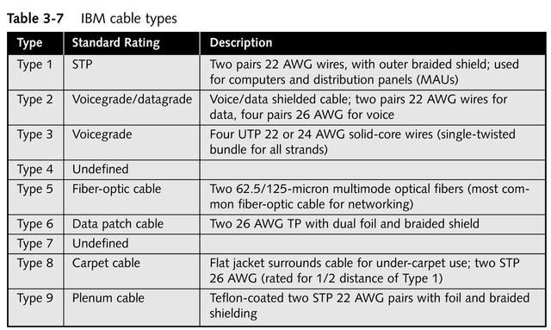
IBM Cable Types

Slide 5
Ethernet
Ethernet is a family of frame –based computer networking technologies for local area networks (LANs)
The name comes from the physical concept of the ether
It defines a number of wiring and signalling standards for the Physical layer of the OSI networking model, through means of network access at the Media Access Control (MAC) / Data Link Layer, and a common addressing format

Slide 6
100Base-TX
The 100Base-TX (sometimes referred to 100Base-T) cable is the most popular cable around since it has actually replaced the older 10Base-T and 10Base-2 (Coaxial)
The 100Base-TX cable provides fast speeds up to 100Mbits and is more reliable since it uses CAT5 cable
There is also 100Base-T4 and 100Base-FX available

Slide 7
So what does 100Base-TX/T4/FX mean ?
The number 100 represents the frequency in MHz (Mega HertZ) for which this cable is made.
In this case it is 100 MHz. The greater the MHz, the greater speeds the cable can handle.
If you try to use this type of cable for greater frequencies (and, therefore, speeds) it will either not work or become extremely unreliable.
The 100 MHz speed translates to 100Mbit per second, which in theory means 12 MBytes per

Slide 8
Base
The word "Base" refers to Baseband
Baseband is the type of communication used by Ethernet and it means that when a computer is transmitting,
it uses all the available bandwith, whereas Broadband (cable modems) shares the bandwidth available
This is the reason cable modem users notice a slowdown in speed when they are connected on a busy node, or when their neighbour is downloading all the time at maximum speed !
Of course with Ethernet you will notice a slowdown in speed but it will be smaller in comparison to broadband.

Slide 9
TX/T4/FX
The "T" refers to "Twisted Pair" physical medium that carries the signal.
This shows the structure of the cable and tells us it contains pairs which are twisted. For example, UTP has twisted pairs and this is the cable used in such cases. The 100Base-T is used sometimes to refer to the 100Base-TX cable specification.
For more information, see the "UTP -Unshielded Twisted Pair" page where you can find information on pinouts for the cables
All 100Mbit rated cables, except the 100Base-FX, use CAT5 cable.

Slide 10
100Base-TX
The TX (sometimes refered as "T" only) means it's a CAT5 UTP straight through cable using 2 of the 4 available pairs and supports speeds up to 100Mbits
Maximum length is 100 meters and minimum length between nodes is 2.5 meters.

Slide 11
100Base-T4
The T4 means it's a CAT5 UTP straight through cable using all 4 available pairs and supports speeds up to 100Mbits
Maximum length is 100 meters and minimum length between nodes is 2.5 meters.

Slide 12
100Base-FX
The FX means it's a 2 strand fiber cable and supports speeds up to 100Mbits
Maximum length is usually upto 2 kms.

Slide 13
Understanding 10BASE-T/2/5/F/35-Ethernet
To make it simpler to distinguish cables they are categorised; that's how we got the CAT1, 2, 3 etc cables
Each category is specific for speed and type of network
But since one type of cable can support various speeds, depending on its quality and wiring, the cables are named using the "BaseT" to show exactly what type of networks the specific cable is made to handle

Slide 14
10
The number 10 represents the frequency in MHz (Mega HertZ) for which this cable is made. In this case it is 10 MHz
The greater the MHz, the greater speeds the cable can handle. If you try to use this type of cable for greater frequencies (and, therefore, speeds) then it either will not work or become extremely unreliable
The 10 MHz speed translates to 10Mbit per second, which in theory means 1.2 MBytes per second. In practice though, you wouldn't get more than 800 KBytes per second

Slide 15
Base
The word "Base" refers to Baseband. Baseband is the type of communication used by Ethernet and it means that when a computer is transmitting, it uses all the available bandwidth, whereas Broadband (cable modems) shares the bandwidth available

Slide 16
T/2/5/F/35
The "T" refers to "Twisted Pair" physical medium that carries the signal. This shows the structure of the cable and tells us it contains pairs which are twisted

Slide 17
10Base-2
This specification uses Coaxial cable which is usually black, sometimes also called "Thin wire coax", "Thin Ethernet" or "RJ-58" cable.\
Maximum length is 185 meters while the minimum length between nodes is 0.5 meters. 10Base-2 uses BNC connectors which, depending on the configuration, require special terminators

Slide 18
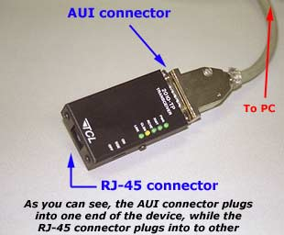
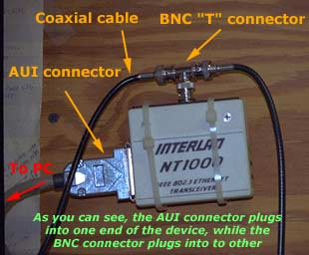
10Base-2

Slide 19
10Base-5
This specification uses what's called "Thickwire" coaxial cable, which is usually yellow
The maximum length is 500 meters while the minimum length between nodes is 2.5 meters
Also, special connectors are used to interface to the network card, these are called AUI (Attachment Unit Interface) connectors and are similar to the DB-15 pin connectors most soundcards use for their joystick/MIDI port.

Slide 20
10Base-F
This specification uses fibre optic cable. Fibre optic cable is considered to be more secure than UTP or any other type of cabling because it is nearly impossible to tap into
It is also resistant to electro magnetic interference and attenuation

Slide 21
10Base-35
The 10Base-35 specification uses broadband coaxial cable
It is able to carry multiple baseband channels for a maximum length of 3,600 meters or 3.6 Kms

Slide 22
Wireless Networking: Intangible Media
Depends on transmission at some kind of electromagnetic frequency through the atmosphere to carry data transmissions from one networked device to another
Appears most frequently in conjunction with wired networks

Slide 23
Capabilities of the Wireless World
Creates temporary connections to existing wired networks
Establishes back-up or contingency connectivity for existing wired networks
Extends a network’s span beyond the reach of wire- or fiber-optic-based cabling
Permits certain users to roam with their machines, within certain limits

Slide 24
Commercial Applications for Wireless Networking
Ready access to data for mobile professionals
Delivery of network access into isolated facilities
Access in environments in which layout and settings change constantly
Improved customer services in busy areas
Network connectivity in facilities where in-wall wiring would be impossible to install or prohibitively expensive

Slide 25
Types of Wireless Networks
Local area networks (LANs)
Extended LANs
Mobile computing

Slide 26
Wireless LAN Applications
Still necessary to attach a network interface to a computer, but the interface attaches to an antenna and an emitter rather than to a cable
Requires an access point device to bridge wireless components and the wired network

Slide 27
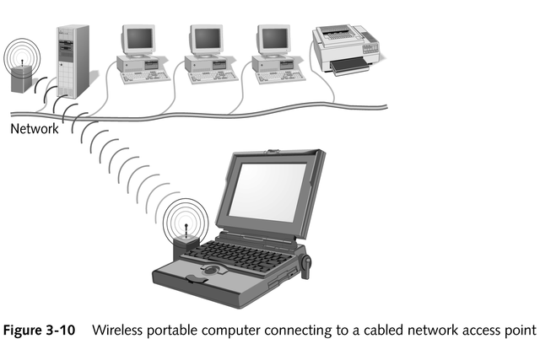
Wireless Access Point Device

Slide 28
Wireless LAN Transmission
Most common frequencies used
Radio: 10 KHz to 1 GHz
Microwave: 1 GHz to 500 GHz
Infrared: 500 GHz to 1 THz
Primary technologies used
Infrared
Laser
Narrowband, single-frequency radio
Spread-spectrum radio

Slide 29
Broadcast Medium Principles
Inverse relationship between frequency and distance
Direct relationship between frequency and data transfer rate and bandwidth
Higher-frequency technologies often use tight-beam broadcasts and require a clear line of sight between sender and receiver to ensure correct delivery

Slide 30
Infrared LAN Technologies
Use infrared light beams to send signals between pairs of devices
Have high bandwidth; work well for LAN applications
Require a line of sight between sender and receiver

Slide 31
Kinds of Infrared LANs
Line-of-sight networks
Reflective wireless networks
Scatter infrared networks
Broadband optical telepoint networks

Slide 32
Laser-based LAN Technologies
Require a clear line of sight between sender and receiver
Devices are subject to many of the same limitations as infrared but are not as subject to interference from visible light sources

Slide 33
Narrow-band, Single-frequency Radio LAN Technologies
Use low-powered, two-way radio communications
Require no line-of-sight between sender and receiver

Slide 34
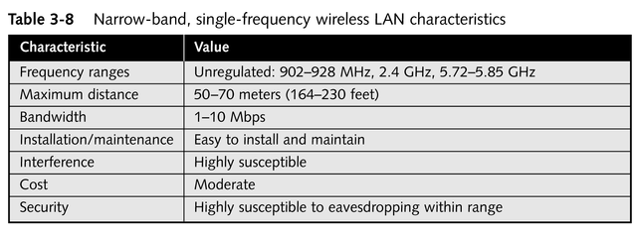
Narrow-band, Single-frequency Wireless LAN Characteristics

Slide 35
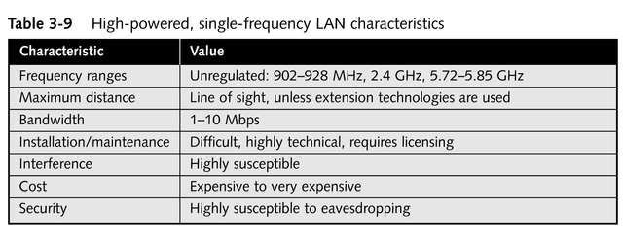
High-powered, Single-frequency LAN Characteristics

Slide 36
Spread-spectrum LAN Technologies
Address weaknesses of single-frequency communications
Use multiple frequencies simultaneously; improve reliability and reduce susceptibility to interference
Make eavesdropping more difficult
Two main kinds
Frequency-hopping
Direct-sequence modulation

Slide 37
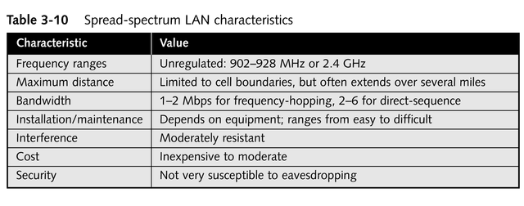
Spread-spectrum LAN Characteristics

Slide 38
Wireless Extended LAN Technologies
Wireless bridge
A pair of devices, typically narrow-band and tight beam, that relay network traffic from one location to another
Available using spread-spectrum radio, infrared, and laser technologies
Can span distances from hundreds of meters up to 25 miles

Slide 39
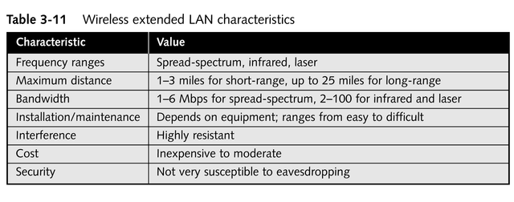
Wireless Extended LAN Characteristics

Slide 40
Microwave Networking Technologies
Can deliver higher transmission rates than radio-based systems
Transmitters and receivers must share a common, clear line of sight
Usually require FCC approval and licensing
More expensive than radio systems
Two types
Terrestrial
Satellite

Slide 41
Terrestrial Microwave
Uses line-of-sight communication between pairs of Earth-based transmitters and receivers to relay information
Expensive; usually positioned well above ground level

Slide 42
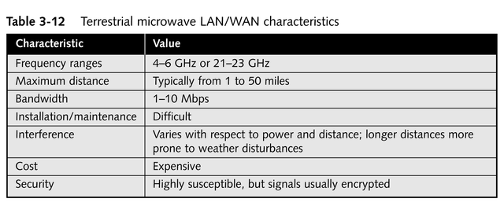
Terrestrial Microwave LAN/WAN Characteristics

Slide 43
Satellite Microwave
Uses geosynchronous satellites to send and relay signals between sender and receiver
Usually leased for an exorbitant fee

Slide 44
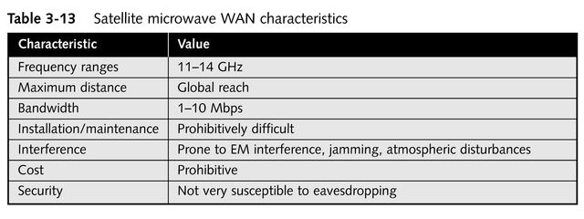
Satellite Microwave WAN Characteristics

Slide 45
High-speed Wireless Networking Technologies
IEEE 802.11 Wireless Networking Standard
Cellular packet radio networking
Cellular Digital Packet Data (CDPD)
Narrow-band sockets

Slide 46
Chapter Summary
Network cabling
Primary cable types
Twisted-pair (unshielded and shielded) and coaxial conductive cables
Fiber-optic cables
Cabled network transmission schemes
Broadband
Baseband
continued

Slide 47
Chapter Summary
Wireless networking
Provides cable-free LAN access
Extends span of LANs
Provides WAN links
Supports mobile computing needs
Uses a variety of electromagnetic frequency ranges
Narrow-band and spread-spectrum radio
Microwave
Infrared
Laser transmission

