Slide 1
Chapter 4:
Network Interface Cards
LAN Design & Installation

Slide 2
Learning Objectives
Describe what role a network adapter card plays in networked communications
Explain how network adapters prepare data for transmission, accept incoming network traffic, and control how networked communications flow
Understand the variety of configurable options for network adapters and describe common settings
continued

Slide 3
Learning Objectives
Describe important characteristics for selecting adapter cards
Recount network adapter enhancements that can improve performance
Explain the role of driver software in network adapters

Slide 4
Network Interface Card Basics
Crucial tasks performed by a NIC
  Establishes and manages the computer’s network connection
  Translates digital computer data into signals (appropriate for the network medium) for outgoing messages; translates signals into digital computer data for incoming messages

Slide 5
From Parallel to Serial, and Vice Versa
A network adapter grabs outgoing transmissions from the CPU in parallel form and recasts them into their serial equivalents
  Parallel transmission
    Spreads individual bits of data across multiple, parallel data lines to transmit them simultaneously, rather than according to an ordinal and temporal sequence
  Serial transmission
    Sends each bit’s worth of data (or its analog equivalent) one at a time, one after another, in sequence
Reverses the process for incoming messages

Slide 6
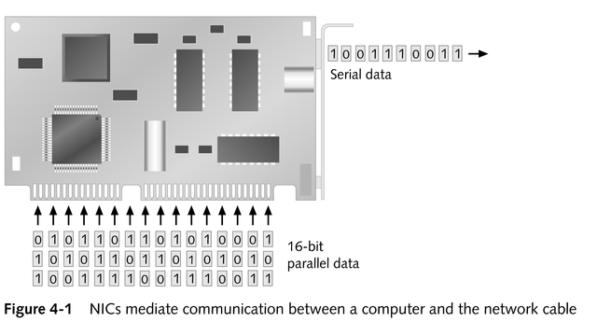
From Parallel to Serial, and Vice Versa

Slide 7
From Parallel to Serial, and Vice Versa
Memory is an important component on a network adapter that acts as a holding tank, or buffer
Bus width
  Number of parallel lines that make up a bus
Transceiver
  A device that transmits and receives network information

Slide 8
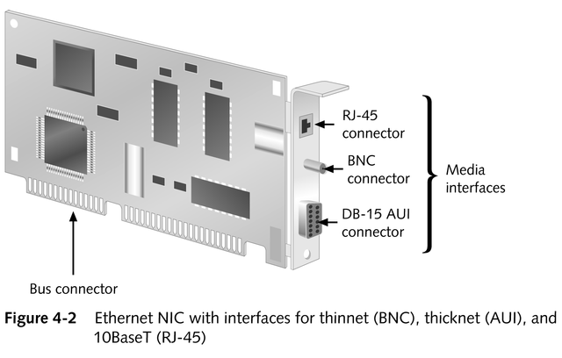
An Ethernet NIC

Slide 9
From Parallel to Serial, and Vice Versa
NIC packages all the bits into orderly collections called packets and then transmits individual packets serially onto the network medium
Using a network address, the NIC determines whether the computer is the appropriate recipient of data sent

Slide 10
Summary of NIC Basics
Manages and controls network access
Creates a physical link between a computer and a network medium
Handles data transfers to and from the network and CPU and translates which forms such data can take between parallel and serial representation
Interacts with the medium to determine when data transmission is permissible

Slide 11
PC Buses
Specialized collections of parallel lines in a PC used to ship data between the CPU and peripheral devices
Primary bus architectures
  ISA (Industry Standard Architecture)
  EISA (Extended ISA)
  MCA (Micro Channel Architecture)
  PCI (Peripheral Component Interface)
  AGP (Accelerated Graphics Port)

Slide 12
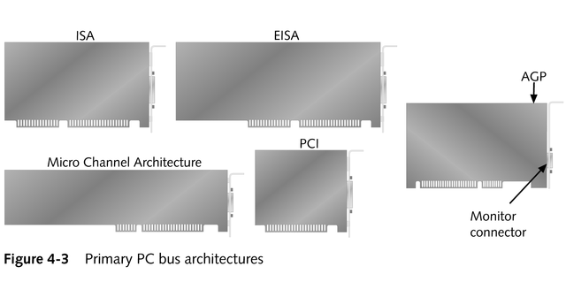
Primary Bus Architectures

Slide 13
Other PC Interfaces Used for Networking
USB (Universal Serial Bus)
FireWire (also known as IEEE 1394)

Slide 14
Principles of NIC Configuration
Plug and Play architecture
Manual configuration involves working with three types of PC settings:
  Interrupt request line (IRQ)
  Base I/O port
  Base memory address
Two ways of setting hardware configurations
  Jumper blocks
  DIP (dual inline package) switches

Slide 15
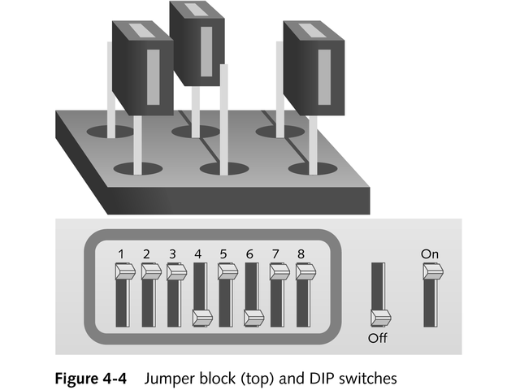
Setting Hardware Configurations

Slide 16
Interrupt Request Lines (IRQs)
Any of 16 unique signal lines between the CPU and the bus slots on a PC
Define the mechanism whereby a peripheral device can stake a claim on the PC’s attention

Slide 17
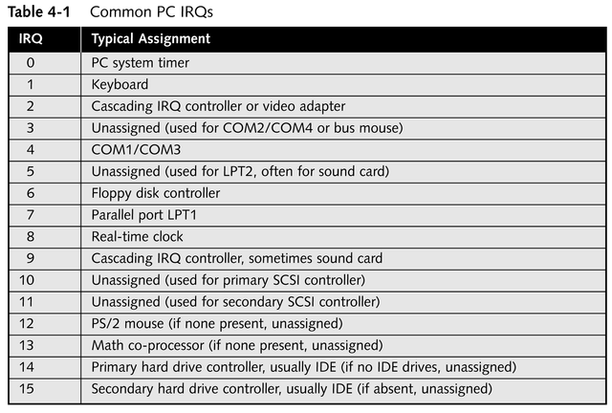
Most Common PC IRQs

Slide 18
Base I/O Port
The memory address where the CPU and an adapter check for messages that they leave for each other
Must be unique

Slide 19
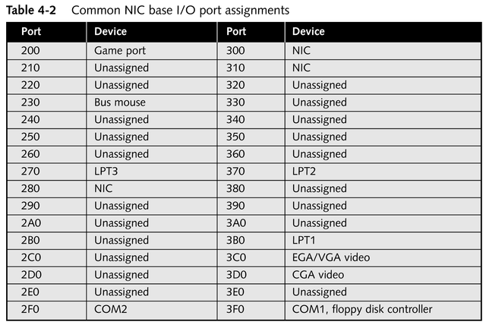
Common NIC Base I/O Port Assignments

Slide 20
Base Memory Address (membase)
Starting address for NIC’s buffer space
Bounded by size of the buffer’s extent

Slide 21
Making the Network Attachment
Importance of matching the adapter you choose with the medium to which it must attach
When a network adapter supports more than one media type, selecting the one to use becomes another configuration option
  Normally involves changing DIP switches or shifting a jumper block

Slide 22
Choosing Network Adapters for Best Performance
Identify the physical characteristics the card must match
Consider other hardware-enhancement options to help improve overall network performance

Slide 23
Hardware-enhancement Options
Direct Memory Access (DMA)
Shared adapter memory
Shared system memory
Bus mastering
RAM buffering
On-board co-processors
Security features
Traffic management or grooming
Improved fault tolerance

Slide 24
Considerations when Purchasing a Network Adapter
Bus width
Bus type
Memory transfer
Special features required
Bus mastering
Vendor factors

Slide 25
Special-purpose NICs
Interfaces for wireless networks
Interfaces for diskless workstations (a.k.a. thin clients), which must access the network to load an operating system as they boot up
  Support remote boot or remote initial program load

Slide 26
Wireless Adapter Components
Indoor antenna and antenna cable
Software to enable the adapter to work with a particular network environment
Diagnostic software to check initial installation or to troubleshoot thereafter
Installation software

Slide 27
Remote Boot Adapters
Some include a chip socket for Boot PROM (programmable read-only memory)
Once a diskless workstation finishes booting, it can use the network to read and write additional needed data

Slide 28
Driver Software
Permits a network adapter to communicate with a computer’s operating system
Recommendations
  Ensure that a valid driver is available for your operating system before purchasing an adapter
  Obtain the latest driver version before installing a network adapter
  Make regular driver upgrades part of your network maintenance routine

Slide 29
Major Driver Vendor Standards
NDIS (Network Device Interface Specification)
WDM (Win32 Driver Model)
ODI (Open Data-link Interface)

Slide 30
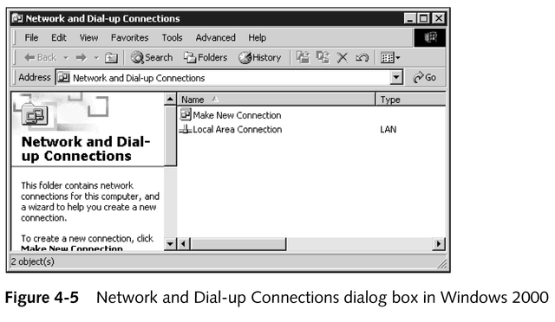
Installing a New Network Connection

Slide 31
Chapter Summary
What a network interface does and how it works
How to install and configure network adapters
How to select an appropriate adapter for your situation

