Slide 1
Chapter 5:
Making Networks Work
LAN Design and Installation

Slide 2
Learning Objectives
Understand and explain the OSI reference model
Understand and explain the IEEE 802 networking model and related standards
Explain the OSI reference model’s layers and their relationship to networking hardware and software

Slide 3
OSI and 802
Networking Models
OSI
  Proposed by the International Standards Organization (ISO)
  Widely used
  Supplies important network terminology
IEEE 802
  Influential set of networking standards
  Encompasses most types of networking
  Open-ended; allows addition of new types of networks

Slide 4
Role of a Reference Model
Provides a common frame of reference that breaks networking into a series of interconnected, but discrete, topical areas

Slide 5
Protocol Stacks
Provide the software that enables computers to communicate across a network
Protocols + drivers = network access

Slide 6
Most Common Protocol Stacks
Transmission Control Protocol/Internet Protocol (TCP/IP)
Internetwork Packet eXchange/Sequenced Packet eXchange (IPX/SPX)
NetBIOS Enhanced User Interface (NetBEUI)
AppleTalk
Systems Network Architecture (SNA)

Slide 7
OSI Reference Model
Breaks networking communications into a series of interconnected tasks and activities (layers)
Creates a method to solve big problems by deconstructing them into a series of smaller problems with individual solutions

Slide 8
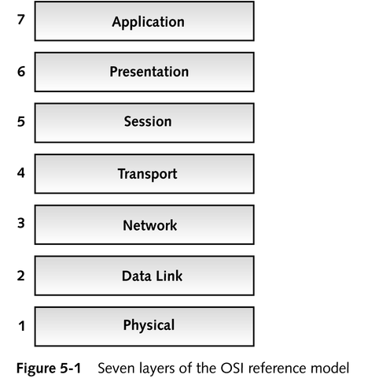
OSI Reference Model Structure
Each layer has its own set of well-defined functions
Layers communicate and interact with the layers immediately above and below

Slide 9
Broad View of the OSI Reference Model
Layers 1 and 2 (Physical and Data Link)
  Define network’s physical media and the signaling characteristics necessary to send and receive information across the network medium and to request access to the medium for transmission
Layers 3 and 4 (Network and Transport)
  Move information from sender to receiver and handle the data to be sent or received
continued

Slide 10
Broad View of the OSI Reference Model
Layers 5 through 7 (Session, Presentation, and Application)
  Manage “conversations” across a network and deal with how data is to be represented and interpreted for use in specific applications or for delivery across the network

Slide 11
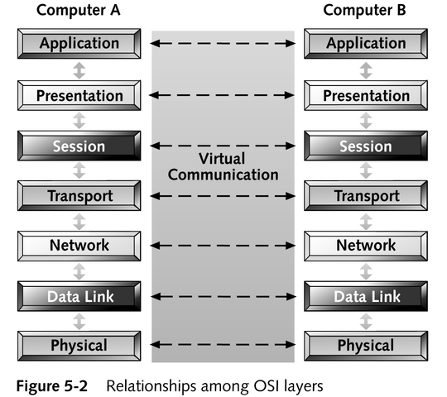
Relationships Among OSI Layers
Each layer shields the higher layer
from the details of how its services
are implemented

Slide 12
Application Layer (Layer 7)
Provides interfaces to permit applications to request and receive network services
Handles general network access, flow control, and error recovery

Slide 13
Presentation Layer (Layer 6)
Handles data format information for networked communications
Handles protocol conversion, data encryption or decryption, character set issues, and graphics commands
May compress data to reduce volume

Slide 14
Session Layer (Layer 5)
Sets up, maintains, and ends ongoing sequences of communications (sessions) across networks
Provides synchronization services between tasks on both ends of a connection

Slide 15
Transport Layer (Layer 4)
Manages conveyance of data from sender to receiver across a network by fragmenting large PDUs (protocol data units) from the Session layer
Inserts sufficient integrity controls and manages delivery mechanisms to allow for their error-free reassembly on the receiving end of a network transmission
Handles flow control and error handling

Slide 16
Network Layer (Layer 3)
Handles addressing messages for delivery
Translates logical network addresses and names into their physical counterparts
Decides how to route transmissions from sender to receiver, based on network conditions, quality of service information, cost of alternative routes, and delivery priorities
Handles packet switching, data routing, and congestion control
Permits packets from one kind of medium to traverse another kind of medium

Slide 17
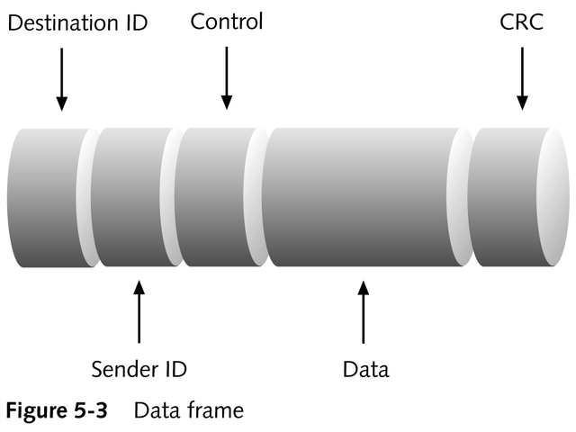
Data Link Layer (Layer 2)
Manages access to the networking medium
Ensures error-free delivery of data frames from sender to receiver

Slide 18
Physical Layer (Layer 1)
Transmits and receives signals
Manages computer’s interface to the network medium and instructs driver software and network interface what to send across the medium
Specifies physical details of cables, adapter cards, connectors, and hardware behavior

Slide 19
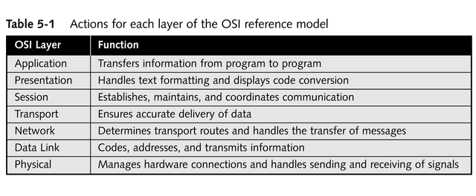
OSI Reference Model Summary

Slide 20
IEEE 802 Networking Specifications
Define a set of LAN standards to ensure that network interfaces and cabling from multiple manufacturers would be compatible
Describe physical elements of a network
Describe how NICs may access and transfer data across a variety of networking media
Describe what is involved in attaching, managing, and detaching devices in a networked environment

Slide 21
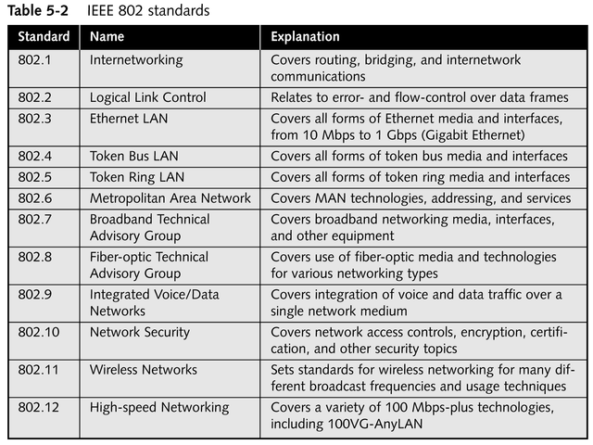
IEEE 802 Standards

Slide 22
IEEE 802 Extensions to the OSI Reference Model
Break the Data Link layer into two sublayers:
  Logical Link Control (LLC) sublayer
    Error correction
    Flow control
  Media Access Control (MAC) sublayer
    Access control

Slide 23
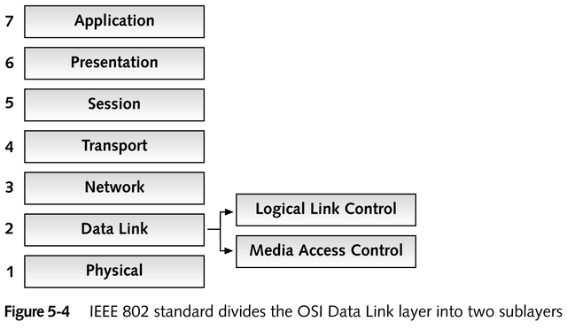
IEEE 802 Extensions to the OSI Reference Model

Slide 24
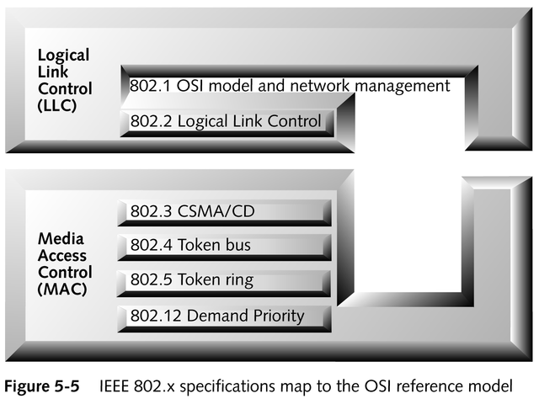
IEEE 802 Extensions to the OSI Reference Model

Slide 25
Chapter Summary
Two different, but complementary, theoretical models for what networks are and how they work
  OSI model and its orderly, seven-layered approach
  IEEE 802 model and its standards
How the two models fit together
Where networking hardware plugs into each model

