Slide 1
Server Message Block (SMB)
Operates at the Presentation layer
Used by Microsoft networks to communicate between the redirector and the server software
Used if a client requires a connection to a Microsoft LAN Manager server

Slide 2
IPX/SPX
NWLink is Microsoft’s implementation of the IPX/SPX protocol suite used by Novell’s NetWare and intraNetWare
Routable protocol suite; network expansion is easier than with NetBEUI
All computers on the network must use the same Ethernet frame type

Slide 3
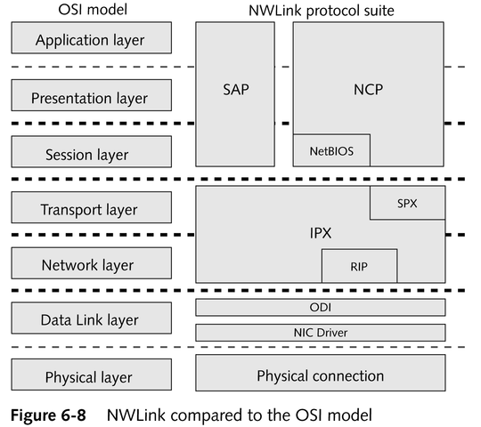
IPX/SPX’s Relation to the
OSI Model

Slide 4
IPX/SPX’s Constituent Protocols
Open Data-link Interface (ODI)
Internetwork Packet Exchange (IPX)
Routing Information Protocol (RIP)
Sequenced Packet Exchange (SPX)
NetWare Core Protocol (NCP)
Service Advertising Protocol (SAP)
Service Lookup Protocol (SLP)

Slide 5
AppleTalk
Defines the physical transport in Apple Macintosh networks
Establishes a suite of protocols used by those computers to communicate
Divides computers into zones
AppleTalk Phase II allows connectivity outside the Macintosh world

Slide 6
Xerox Network System (XNS)
Created by Xerox for use in its Ethernet networks
Seldom found in today’s networks

Slide 7
DECNet
A complete, routable protocol suite generally used only by Digital systems
Current iteration, Phase IV, closely resembles the OSI model

Slide 8
X.25
Set of wide-area protocols created to connect remote terminals to mainframes and used in packet-switching networks
Still widely used in Europe

Slide 9
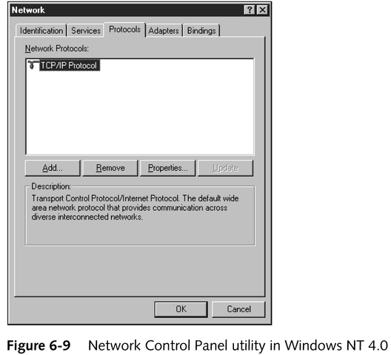
Implementing and Removing Protocols
Relatively easy in most operating systems

Slide 10
Putting Data on the Cable: Access Methods
How computers put data on the cable
How computers ensure that data reaches its designation undamaged

Slide 11
Function of Access Methods
Define the rules that determine which computer can send data across the network, thereby preventing data loss through collisions
Handled at the Media Access Control (MAC) sublayer of the Data Link layer in the OSI model

Slide 12
Major Access Methods
Contention
Token passing
Demand priority
Polling
Switching

Slide 13
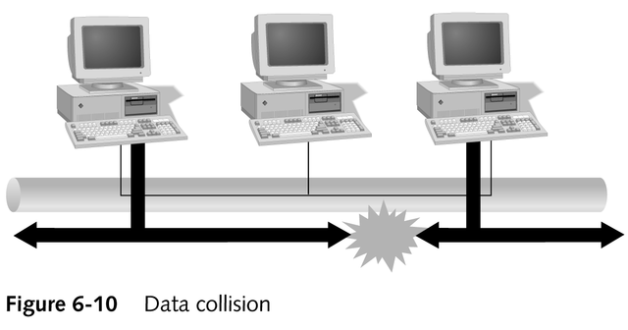
Contention
Computers vie for time on the network

Slide 14
Contention
Two carrier access methods were created to organize contention-based networks:
  Carrier Sense Multiple Access with Collision Detection (CSMA/CD)
  Carrier Sense Multiple Access with Collision Avoidance (CSMA/CA)

Slide 15
CSMA/CD
Prevents collisions by listening to the channel to see if another computer is sending data
  If no data is sensed, the computer sends the message
  If data is sensed, the computer waits a random amount of time and checks again until the channel is free

Slide 16
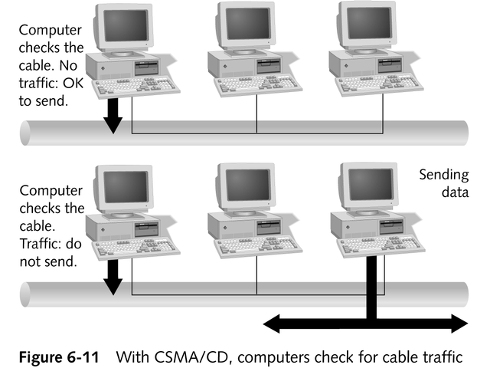
CSMA/CD

Slide 17
Limitations of CSMA/CD
Not effective at distances over 2500 meters because of attenuation and signal length restrictions
The more computers on the network, the more collisions are likely to occur
Computers have unequal access to the media

Slide 18
CSMA/CA
Uses collision avoidance to prevent collisions
More reliably avoids collisions than CSMA/CD
Additional overhead created by the “intent-to-transmit” packages significantly reduces network speed

Slide 19
Token Passing
A function of the ring topology
Ensures equal access to all computers on a network through the use of a special packet called the token
Best suited for time-sensitive environments

Slide 20
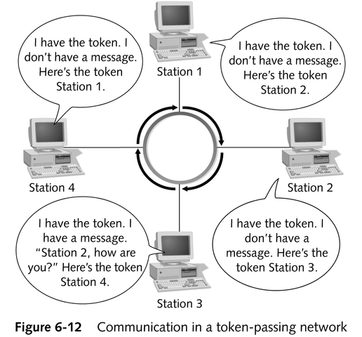
Token Passing

Slide 21
Disadvantages of Token Passing
Even if only one computer on the network has data to send, it must wait to receive the token
Requires more expensive equipment

Slide 22
Demand Priority
High-speed channel access used by 100VG-AnyLAN
Runs on a star bus topology

Slide 23
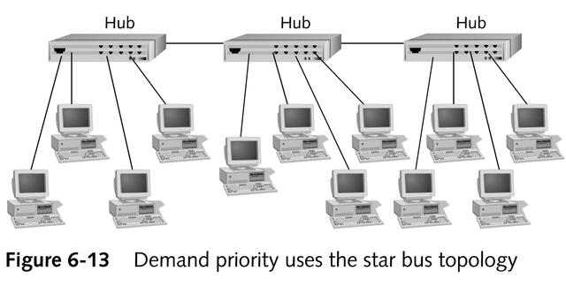
Demand Priority

Slide 24
Demand Priority
Certain computers can be assigned higher priority than others
Makes most efficient use of available network media
  Hubs respond only when computers signal for service
  Packets are sent directly from the computer to the hub, eliminating extraneous network traffic
Expensive; requires special hubs and other equipment

Slide 25
Polling
Primary device asks secondary devices in sequence whether they have data to send

Slide 26
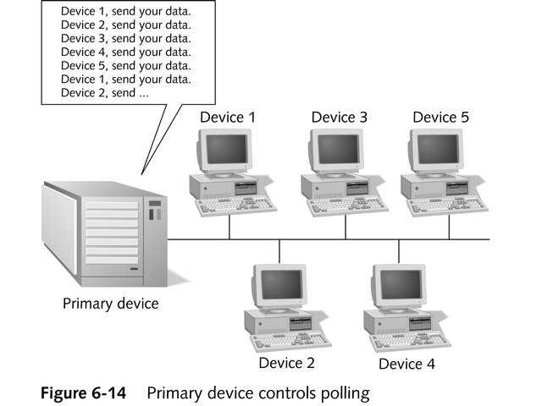
Polling

Slide 27
Polling
Advantages
  Allows all computers equal access to the channel
  Central controller allows centralized management and certain computers can receive priority over other computers
Disadvantages
  Does not make efficient use of the media
  Primary device failure causes network failure

Slide 28
Switching
Uses a network switch to manage media or channel access
Helps increase overall bandwidth
Provides greater bandwidth to senders and receivers
Can emulate other access methods based on the switch’s built-in capabilities

Slide 29
Switching
Advantages
  Fairer than strict contention-based technologies
  Supports centralized management and certain computers can receive priority over other computers
Disadvantages
  Higher cost
  Switch failure causes network failure

Slide 30
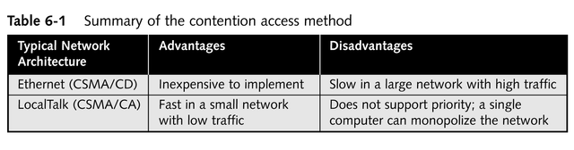
Choosing an Access Method
Network topology is the biggest factor
continued

Slide 31
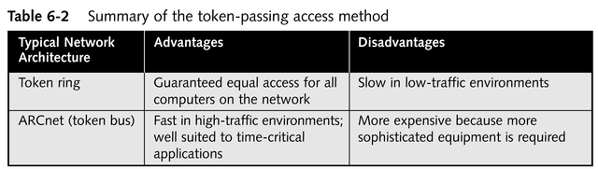
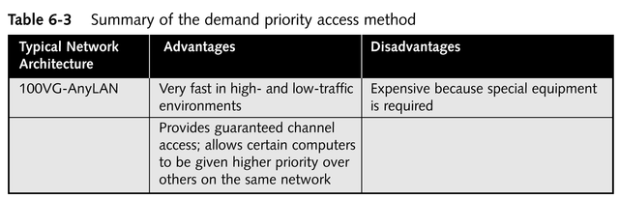
Choosing an Access Method
continued

Slide 32
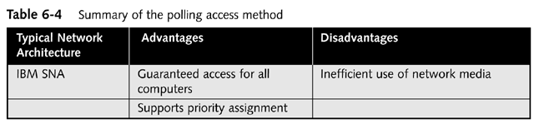
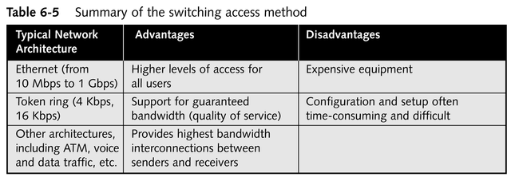
Choosing an Access Method

Slide 33
Chapter Summary
Function and structure of packets in network communications
Function of protocols
Channel access methods

