Slide 1
Chapter 6: Network Communications and Protocols
COSC 352

Slide 2
Learning Objectives
Understand the function and structure of packets in a network and analyze and understand those packets
Understand the function of protocols in a network, discuss the layered architecture of protocols, and describe common protocols and their implementation
Understand channel access methods

Slide 3
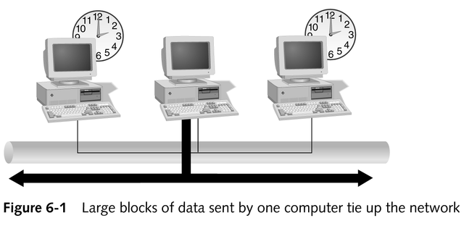
Function of Packets in Network Communications
Networks split data into packets because:
Large units of data sent across a network hamper effective communications by saturating the network
Networks can be unreliable

Slide 4
Function of Packets in Network Communications
Packets provide more reliable data delivery and ease network traffic
If errors occur during transmission, the receiving computer can request that only the packet with errors be resent

Slide 5
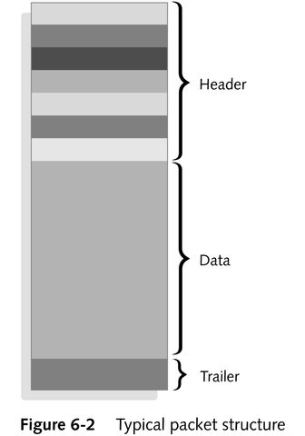
Packet Structure
Packet header
Source and destination addresses
Alert signal
Clocking information
Data section (payload)
Actual data being sent
512 bytes to 16 kilobytes
Packet trailer
Error-checking information
Verifies validity of packet’s contents

Slide 6
Packet Creation
As data travels through layers of the OSI model, each layer adds its own header or trailer information to the packet
As receiving computer processes the packet, each layer strips its header/trailer information and properly resequences segmented messages; when the application receives the data, the packet is in its original form

Slide 7
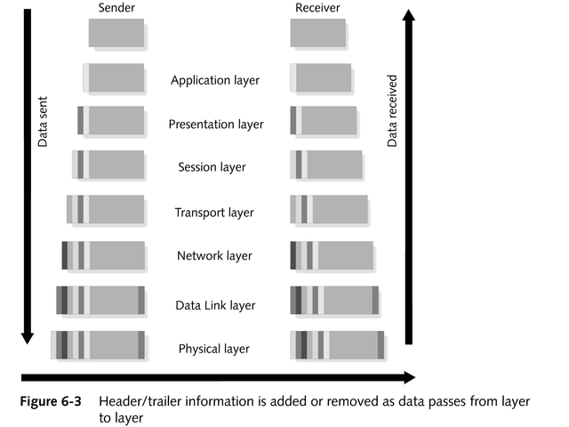
Packet Creation

Slide 8
Understanding Packets
Most packets are addressed to only one computer
Broadcast packet
Destination address specifies all computers on a network or network segment
Multicast packet
Uses a special network address to make itself readable to any receiving computer that wants to read its payload
Usually transports streaming data where many receivers want to access data from same sender

Slide 9
Protocols
The rules and procedures for computers to communicate with each other
Each protocol has a different purpose and function

Slide 10
The Function of Protocols
May work at one or many layers in the OSI model
Protocol stack (protocol suite)
A set of protocols that works together cooperatively to achieve maximum performance
Examples: TCP/IP, Internet protocol suite, IPX/SPX
Methods for delivering data across a network
Connectionless protocols
Connection-oriented protocols

Slide 11
Connectionless vs. Connection-oriented Protocols
Connectionless protocols
Send data across the network to its destination without guaranteeing receipt
Fast; require little overhead
Connection-oriented protocols
Establish a formal connection between two computers, guaranteeing the data will reach its destination
Slower; more reliable

Slide 12
Routable vs. Nonroutable Protocols
Routers move data across multiple networks
Routable protocols
Include network layer information and can be forwarded by a router
Nonroutable protocols
Do not include network layer, or network address, information

Slide 13
Protocols in Layered Architecture
Each protocol performs a specific function and has its own rules
A protocol stack often has a different protocol for each layer

Slide 14
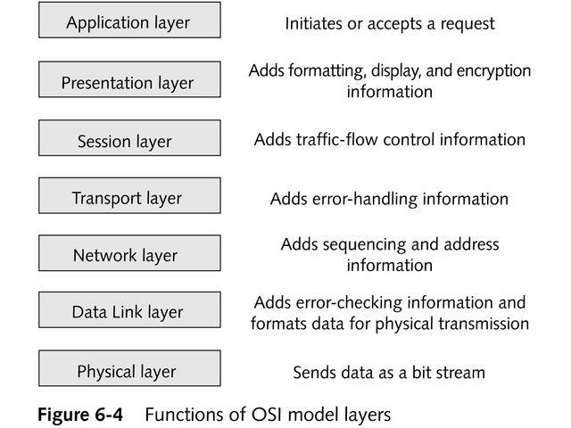
Protocols in Layered Architecture

Slide 15
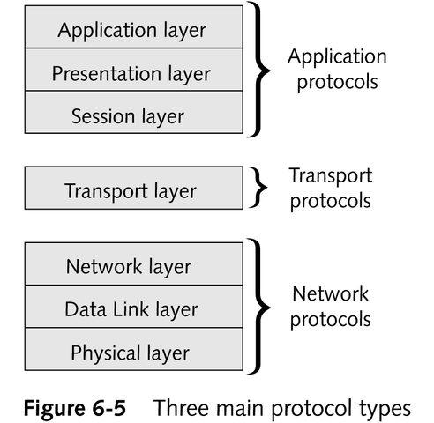
Protocols in Layered Architecture
Tasks required for network communica-tion combine to form three major protocol types
Application
Transport
Network

Slide 16
What Network Protocols Provide
Addressing and routing information
Error checking
Retransmission requests
Rules for communicating in some particular networking environment
Link services

Slide 17
Popular Network Protocols
IP (Internet Protocol)
IPX (Internetwork Packet eXchange) and NWLink (or Novell IPX ODI Protocol)
NetBEUI
DDP (Delivery Datagram Protocol)
DLC (Data Link Control)

Slide 18
Transport Protocols
Handle data delivery between computers
Widely used transport protocols
TCP (Transmission Control Protocol)
SPX (Sequenced Packet eXchange) and NWLink
ATP (AppleTalk Transaction Protocol) and NBP (Name Binding Protocol)
NetBIOS/NetBEUI

Slide 19
Application Protocols
Operate at upper layers of the OSI model to provide application-to-application services
Prevalent application protocols
SMTP (Simple Mail Transport Protocol)
FTP (File Transfer Protocol)
SNMP (Simple Network Management Protocol)
NCP (NetWare Core Protocol)
AFP (AppleTalk File Protocol)

Slide 20
Common Protocols
TCP/IP
NWLink (IPX/SPX)
NetBIOS/NetBEUI
AppleTalk
DLC
XNS
DECNet
X.25

Slide 21
TCP/IP
Most commonly used protocol suite
Enables easy communications across platforms
Provides basis for the global Internet
Default protocol in Windows 2000 and Windows NT
Utilizes highly compartmentalized and specialized protocols

Slide 22
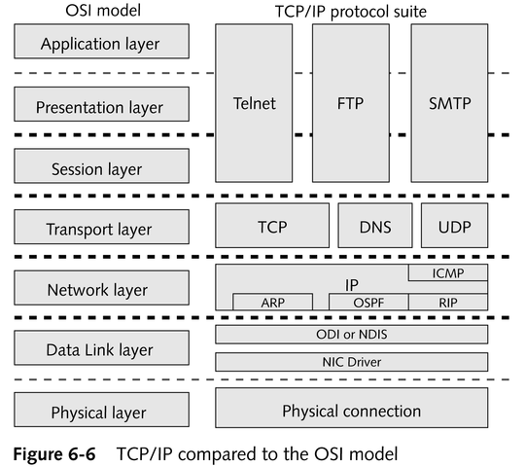
TCP/IP’s Relation to the OSI Model

Slide 23
TCP/IP’s Constituent Protocols
Internet Protocol (IP)
Internet Control Message Protocol (ICMP)
Address Resolution Protocol (ARP)
Transmission Control Protocol (TCP)
User Datagram Protocol (UDP)
continued

Slide 24
TCP/IP’s Constituent Protocols
Domain Name System (DNS)
File Transfer Protocol (FTP)
Telnet
Simple Mail Transport Protocol (SMTP)
Routing Information Protocol (RIP)
Open Shortest Path First (OSPF)

Slide 25
IP Addressing
IP is responsible for addressing and routing in the TCP/IP environment
IP addresses
Logical addresses, which are 32 bits (4 bytes) long
A decimal number from 0 to 255, separated by periods, represents each byte or octet
Two sections
One defines the network a computer is on
One defines the host ID for a computer
Example: 172.24.206.18

Slide 26
IP Addressing
Originally, three classes of IP addresses
Class A
Large corporations
ID numbers between 1 and 126
Class B
Medium-sized networks
Network IDs between 128 and 191
Class C
Small networks
Range from 192 to 223
IP address registries manage the total collection of valid IP addresses

Slide 27
IP Addressing
IP addresses are rapidly becoming scarce
TCP/IP’s technical governing body has reserved a series of addresses for private networks
IETF is working on a new implementation of TCP/IP (IPv6) that uses addresses that are 8 bytes long but retain backward compatibility with IPv4 4-byte addresses

Slide 28
Classless Inter-domain Routing (CIDR)
A more efficient way to assign IP addresses than using IP address “classes”
The network and host demarcation is not always made on octet boundaries, but may be made any specific number of bits from the beginning of the address

Slide 29
Subnet Masks
The “all ones” bit pattern that masks the network portion of an IP address
Class A address default: 255.0.0.0
Class B address default: 255.255.0.0
Class C address default: 255.255.255.0

Slide 30
Simple Binary Arithmetic
Converting between binary and decimal
Converting between decimal and binary
Understanding how setting high-order bits to one in 8-bit binary numbers corresponds to specific decimal numbers
Recognizing the decimal values for the numbers that correspond to low-order bits when they are set to one
Calculating a subnet mask
Calculating supernets

Slide 31
Dynamic Host Configuration Protocol (DHCP)
A TCP/IP protocol that allows automatic IP addresses and subnet mask assignment
Major benefit is ease with which computers can be moved

Slide 32
NetBIOS and NetBEUI
Although NetBIOS and NetBEUI work closely together and are often confused with each other, they are neither inseparable nor the same

Slide 33
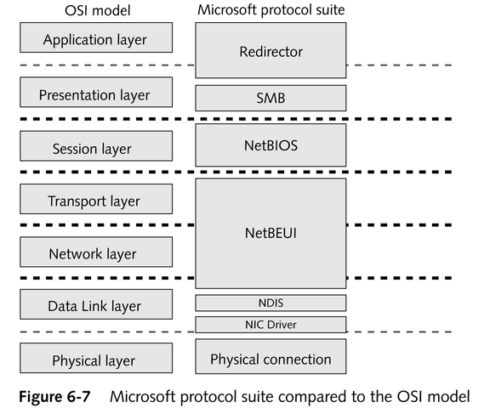
NetBIOS and NetBEUI

Slide 34
NetBIOS (Network Basic Input/Output System)
A connection-oriented protocol responsible for establishing, maintaining, and terminating network connections
Can use connectionless communications, if necessary
A unique 15-character name identifies each computer
continued

Slide 35
NetBIOS
Operates at the Session layer to provide peer-to-peer network application support
Can utilize a number of other lower-layer protocols, including TPC/IP and IPX/SPX, for transport and lower-layer services
A nonroutable protocol; can be routed when using a routable protocol for transport

Slide 36
NetBEUI
Small, fast, nonroutable Transport and Data Link layer protocol designed for use with NetBIOS on small networks
Low overhead; ideal for DOS-based computers that require network connectivity
Speed and size make it a good choice for slow serial links

