Slide 1
Chapter 7: Network Architectures
LAN Design and Installation

Slide 2
Learning Objectives
Understand the different major network architectures, including Ethernet, token ring, AppleTalk, ARCnet, FDDI, and ATM
Understand the standards governing network architectures
Understand the limitations, advantages, and disadvantages of each standard or architecture

Slide 3
Network Architecture
Refers to Overall structure of a network
Topology
Physical media
Channel access method
Defines
How data is placed on the network
How that data is transmitted and at what speed
How problems in the network are handled

Slide 4
Popular Network Architectures
Ethernet
Token ring
AppleTalk
ARCnet (Attached Resource Computer Network)
FDDI (Fiber Distributed Data Interface)
ATM (Asynchronous Transfer Mode)

Slide 5
Ethernet
First version (1972) provided a stable method for sending data between computers
Digital, Intel, and Xerox teamed to introduce a viable version for public use
Eventually became the basis for IEEE Ethernet 802.3 standard which transmits data at 10 Mbps

Slide 6
Overview of Ethernet
Most popular network architecture
Advantages
Ease of installation
Low cost
Supports many different networking media
Uses hardware address of the NIC to address packets
Address is “burned in” to the ROM on the NIC
When a packet is sent, the hardware (MAC) addresses of both the source and destination computers are added to the packet header

Slide 7
Overview of Ethernet
Three categories based on transmission speed and media
10 Mbps IEEE standards
100 Mbps IEEE standards
1 Gbps IEEE 802.3z standards

Slide 8
10 Mbps IEEE Standards
Four implementations
10Base5: Ethernet using thicknet coaxial cable
10Base2: Ethernet using thinnet coaxial cable
10BaseT: Ethernet over unshielded twisted-pair (UTP) cable
10BaseF: Ethernet over fiber-optic cable

Slide 9
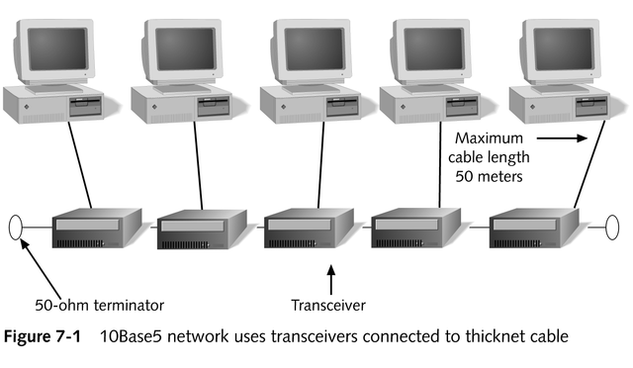
10Base5

Slide 10
The 5-4-3 Rule
Applies to coaxial Ethernet networks (10Base5 and 10Base2)
States that a network can have a maximum of five cable segments with four repeaters, with three of those segments being populated
An “end-to-end” rule, as opposed to a “total population” rule

Slide 11
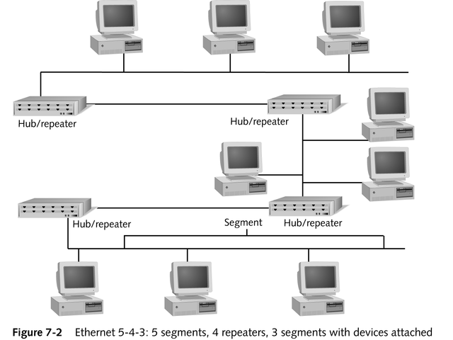
The 5-4-3 Rule

Slide 12
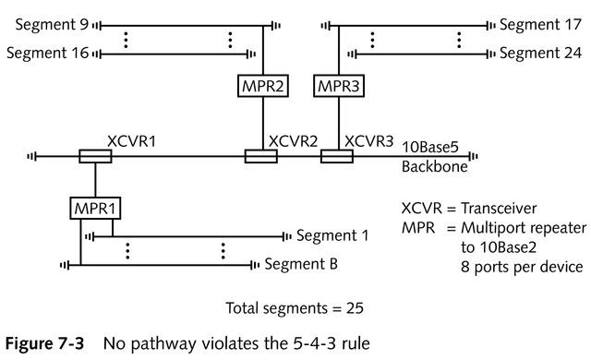
The 5-4-3 Rule

Slide 13
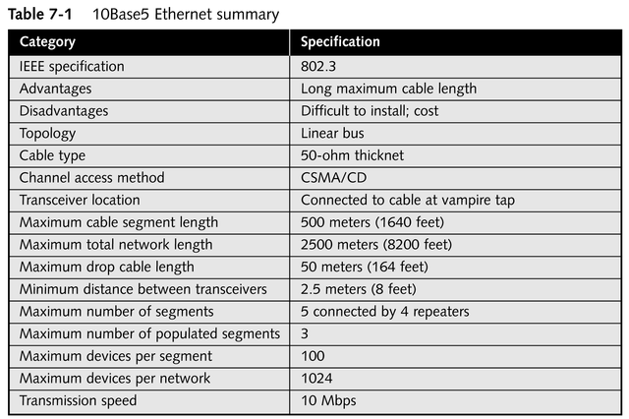
10Base5 Ethernet Specifications

Slide 14
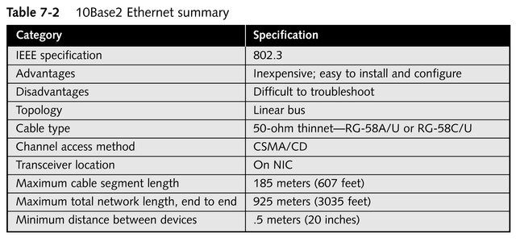
10Base2 Ethernet Specifications
continued

Slide 15
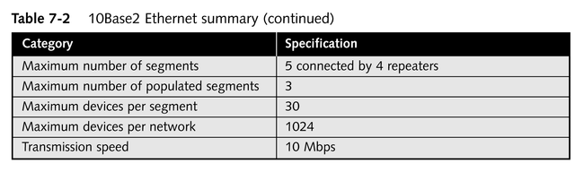
10Base2 Ethernet Specifications

Slide 16
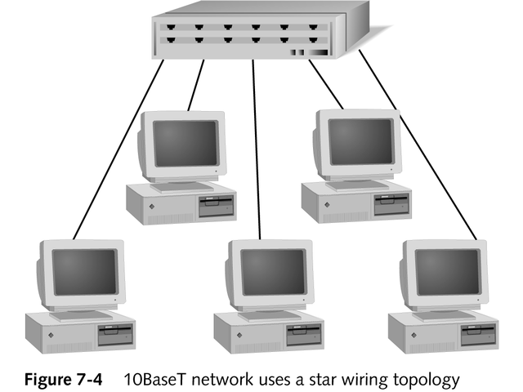
10BaseT

Slide 17
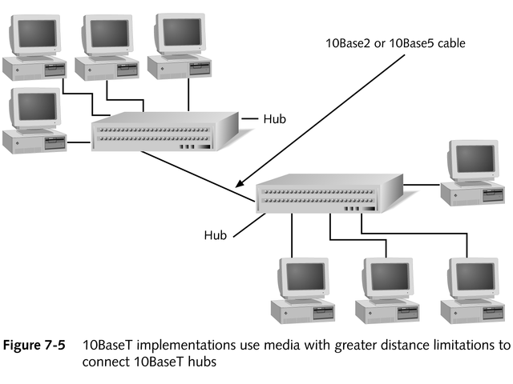
10BaseT

Slide 18
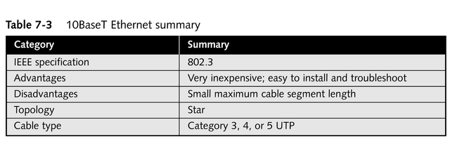
10BaseT Ethernet Specifications
continued

Slide 19
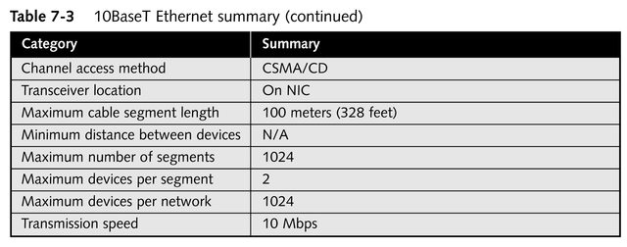
10BaseT Ethernet Specifications

Slide 20
10BaseF
Three subcategories
10BaseFL
Links computers in a LAN environment (fiber to the desktop)
10BaseFP
Links computers using passive hubs rather than repeaters
Maximum cable length of 500 meters
10BaseFB
Uses fiber-optic cable as a backbone between hubs

Slide 21
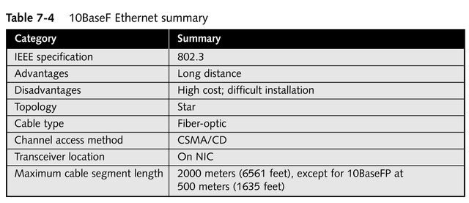
10BaseF Ethernet Specifications
continued

Slide 22
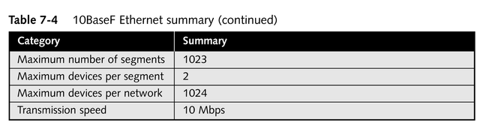
10BaseF Ethernet Specifications

Slide 23
100 Mbps IEEE Standards
Most widely accepted
Higher speeds suit these technologies for applications such as video, CAD, CAM, and imaging
Two implementations of 100 Mbps Ethernet
100VG-AnyLAN
100BaseT (fast Ethernet)

Slide 24
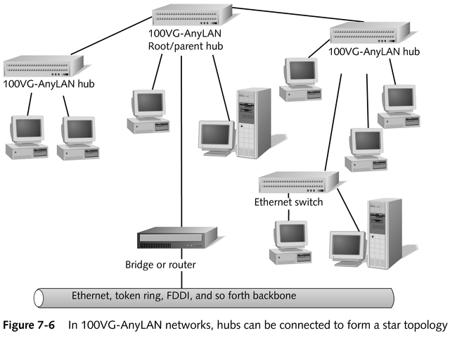
100VG-AnyLAN

Slide 25
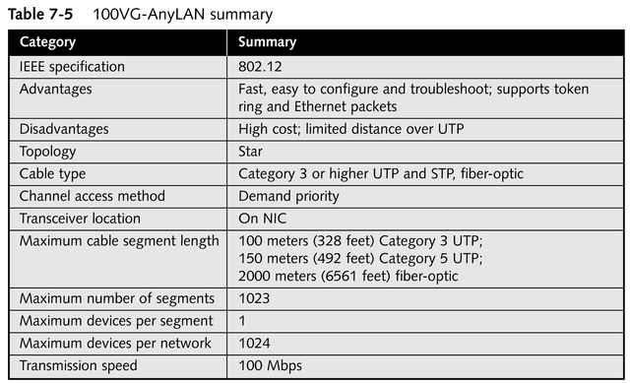
100VG-AnyLAN Specifications

Slide 26
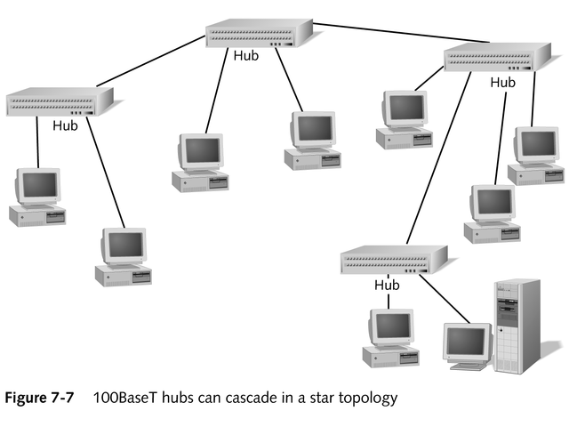
100BaseT

Slide 27
100BaseT
Three subcategories that define cable types
100BaseT4
Four-pair Category 3, 4, or 5 UTP
100BaseTX
Two-pair Category 5 UTP
Most widely accepted; generally referred to as fast Ethernet
100BaseFX
Two-strand fiber-optic cable

Slide 28
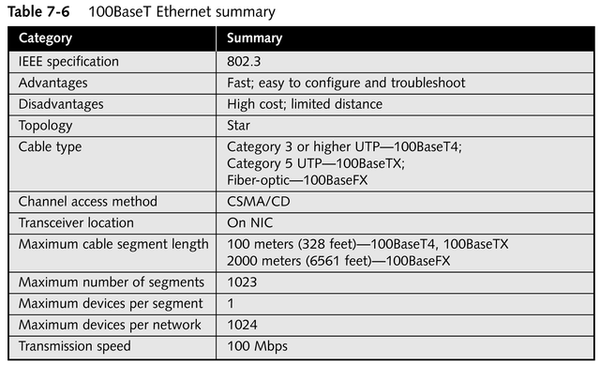
100BaseT Ethernet Specifications

Slide 29
Gigabit Ethernet: 1 Gbps IEEE 802.3z Standards
Allows for 1000-Mbps transmission using CSMA/CD and Ethernet frames
Most implementations work in full-duplex mode
Specifications are based on the ANSI X3.230-1994 standard for Fiber Channel
Two separate extensions to the 802.3 specification cover 1000BaseX and 1000BaseT

Slide 30
Extensions to the 802.3 Specification
802.3z-1998 covers 1000BaseX specifications
L (long wavelength laser/fiber-optic)
S (short wavelength laser/fiber-optic)
C (copper jumper cables)
802.3ab-1999 covers 1000BaseT specifications
Require four pairs of 100-ohm Category 5 cable or better

Slide 31
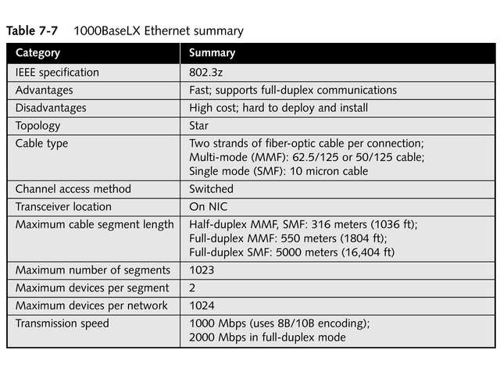
1000BaseLX Ethernet Specifications

Slide 32
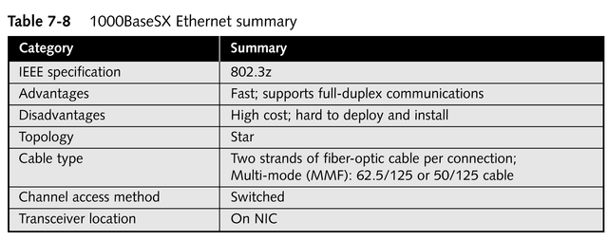
1000BaseSX Ethernet Specifications
continued

Slide 33
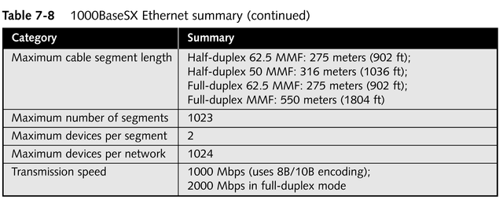
1000BaseSX Ethernet Specifications

Slide 34
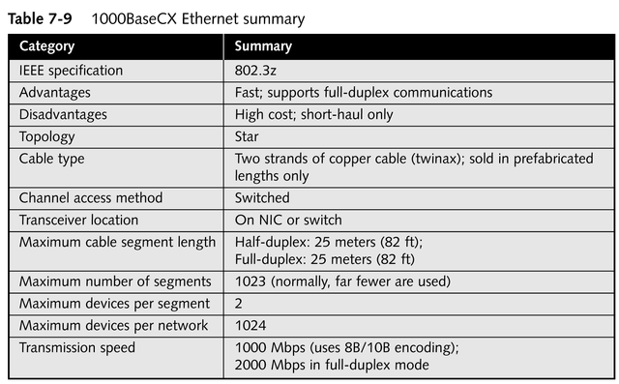
1000BaseCX Ethernet Specifications

Slide 35
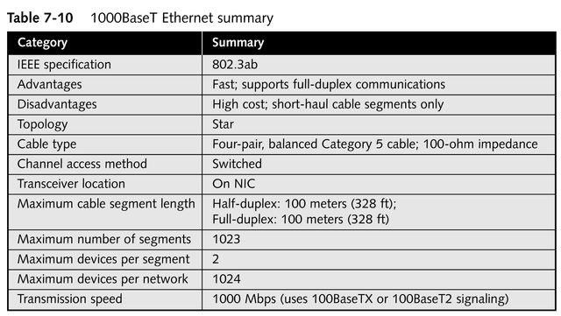
1000BaseT Ethernet Specifications

Slide 36
Ethernet Frame Types
Four frame types
Ethernet 802.3
Ethernet 802.2
Ethernet SNAP
Ethernet II
Each is unique and does not work with the others
All support a packet size between 64 and 1518 bytes
All can be used by every network architecture mentioned previously

Slide 37
Ethernet 802.3
Generally used by IPX/SPX on Novell NetWare 2.x and 3.x networks

Slide 38
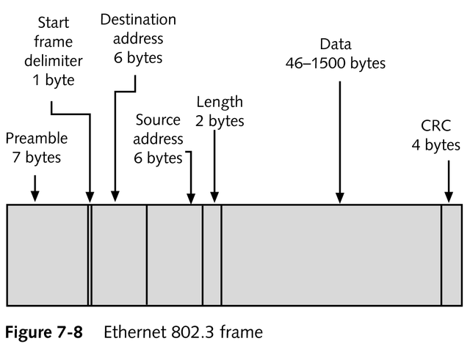
Ethernet 802.3

Slide 39
Ethernet 802.2
Used by IPX/SPX on Novell NetWare 3.12 and 4.x networks

Slide 40
Ethernet SNAP (SubNetwork Address Protocol)
Used in EtherTalk and mainframe environments
Contains enhancements to the 802.2 frame, including a protocol field type, which indicates the network protocol used in the data portion of the frame

Slide 41
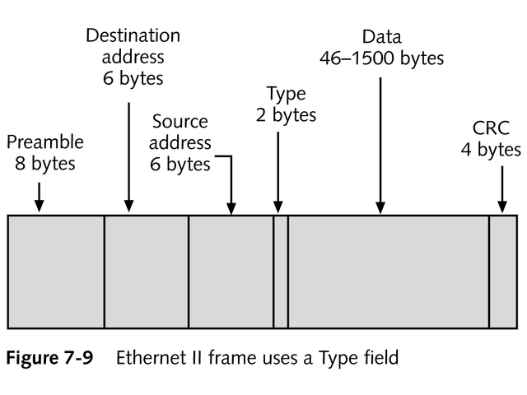
Ethernet II
Used by TCP/IP

Slide 42
Segmentation
The insertion of a bridge or router between two cable segments
Directs traffic more efficiently to its destination
Reduces traffic on each part of the network

Slide 43
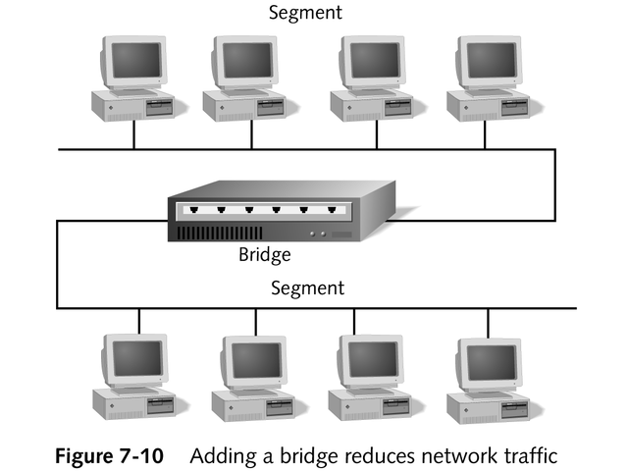
Segmentation

Slide 44
Token Ring
Developed by IBM in the early 1980s
Provides fast, reliable, efficient transport
Capable of transmitting at 4 Mbps or 16 Mbps
Physically wired as a star but uses token passing in a logical ring topology
Uses the address of the NIC to determine the address of a device

Slide 45
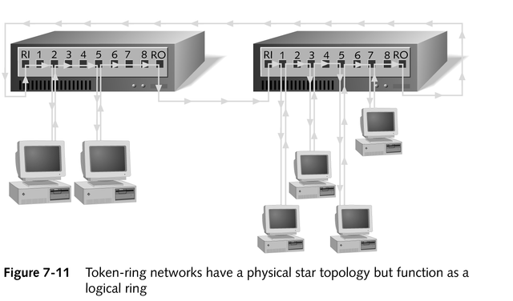
Token Ring Network

Slide 46
Token Ring Function
Computer receives the token from its Nearest Active Upstream Neighbor (NAUN)
If token is not in use, and computer has data to send, it attaches its data to the token and sends it to its Nearest Active Downstream Neighbor (NADN)
When data reaches its destination, the receiving computer sends it to upper-layer protocols for processing
continued

Slide 47
Token Ring Function
Receiving computer toggles two bits in the data packet to indicate it received the data and sends the token and data along the network to its NADN
When both token and data reach original sender, who sees the data was received, it frees the token then passes it along

Slide 48
Advantages of Token Ring
No collisions; data seldom has to be re-sent
Consistent traffic; all computers on the network have equal access to the token
Handles increases in network size and bandwidth gracefully
Suitable for transferring large blocks of data

Slide 49
Beaconing
The signal transmitted on a token ring network to inform networked computers that token passing has stopped due to an error
Isolates faults automatically

Slide 50
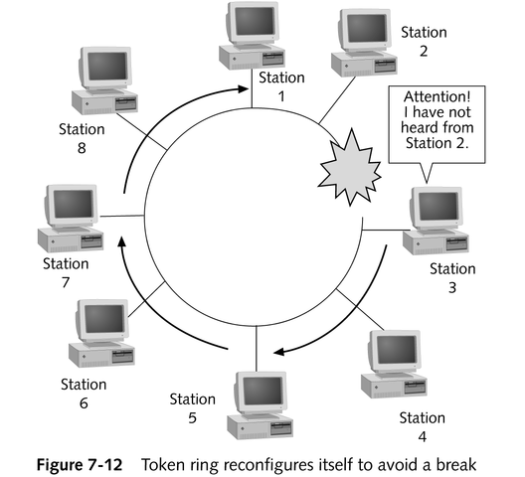
Beaconing

Slide 51
Hardware Components of a Typical IBM Token Ring Hub
Has 10 connections, eight of which can be used for connecting computers; the other two are used to connect the hubs in a ring
Allows 33 hubs to be connected via Ring Out ports and Ring In ports
Provides 260 stations per network; newer hubs allow 16 computers per hub, or 520 stations per network

Slide 52
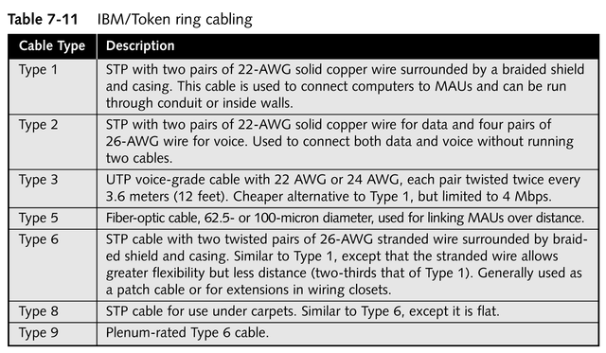
Cabling in a Token Ring Environment

Slide 53
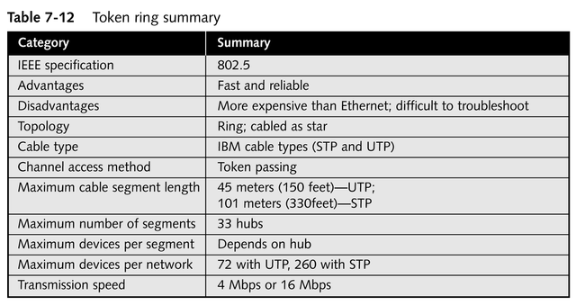
Token Ring Specifications

Slide 54
AppleTalk Environment
Introduced in 1983 by Apple Computer, Inc. for use in its Macintosh networks
Simple, easy to implement
Refers to the overall architecture of the network
Applies a dynamic scheme to determine the address of a device

Slide 55
LocalTalk
Refers to the cabling system used by Macintosh computers
Uses STP in a bus topology to allow users to share peripherals and data in a small, Macintosh-only environment
Uses the CSMA/CA channel method
Avoids collisions
Slow and cumbersome

Slide 56
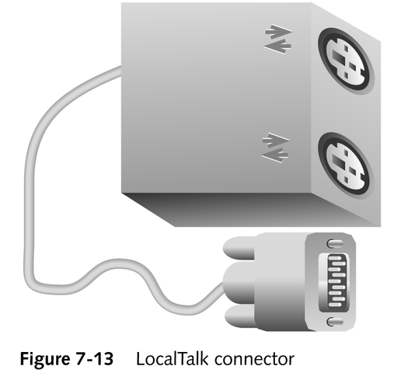
LocalTalk Connector
Consists of three connectors:
One to the computer
Two that join the devices

Slide 57
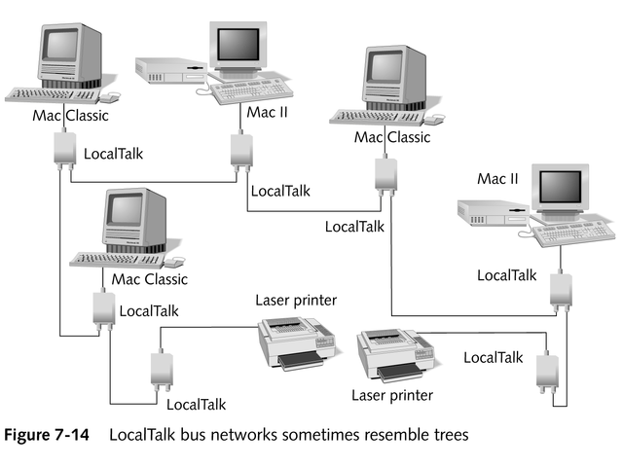
LocalTalk

Slide 58
EtherTalk and TokenTalk
Allow AppleTalk protocols to operate over Ethernet and token ring networks
Require use of a different NIC
Support AppleTalk Phase 2 and its extended addressing
With extra software, can connect Macintosh computers to a PC Ethernet or token ring environment

Slide 59
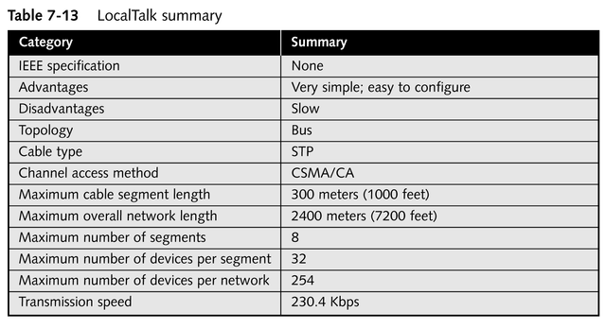
LocalTalk Specifications

Slide 60
ARCnet Environment
Introduced in 1977 by Datapoint Corporation
Used by PC-based networks
Operates in a virtual ring, but is physically wired in a bus or star topology or a combination of both

Slide 61
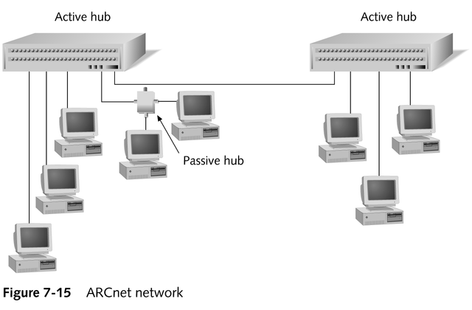
ARCnet

Slide 62
ARCnet
Provides transmission speeds up to 2.5 Mbps using the token-passing channel access method
Token passes between computers based on their station identifiers
NICs must be addressed manually; a bank of DIP switches is used to manually set the SID for each computer

Slide 63
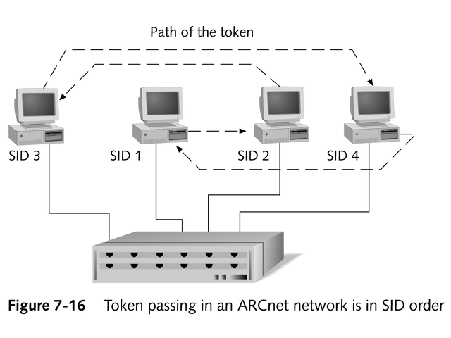
Token Passing in an ARCnet Network

Slide 64
Advantages of ARCnet
Use of token passing guarantees equal access to all computers on the network
Inexpensive
Easy to implement
Can transmit data over greater distances than other architectures and use various physical media (UTP, coaxial cable, fiber-optic cable)

Slide 65
Disadvantages of ARCnet
Manual configuration of SID numbers
Tedious administration; duplicate addresses are common
Low speed and inability to connect easily with other network architectures
Seldom used anymore, due to speed and affordability of Ethernet

Slide 66
ARCnet Hubs
Active hubs
Passive hubs

Slide 67
Active Hubs
Similar to repeaters in an Ethernet environment
Receive the signal from a port, regenerate the signal, and send it down all the other ports
Generally have eight ports
Hub-to-hub link can be no longer than 600 meters (2000 feet)

Slide 68
Passive Hubs
Generally consist of four ports
Can pass the signal only from one port to the next; cannot regenerate the signal
Have no power supply; cannot be linked
Require termination of unused ports
Can be no more than 30 meters (100 feet) from an active hub

Slide 69
ARCnet Cabling
Most common: RG-62 A/U 93-ohm coaxial cable, with a BNC connector on each end
Bus topology: BNC T-connectors connect the NIC to the cable
Star topology: BNC connector connects directly to NIC and hub, without a T-connector
UTP cable lengths up to 121 meters (400 feet)
Fiber-optic cable up to 3485 meters (11,500 feet)

Slide 70
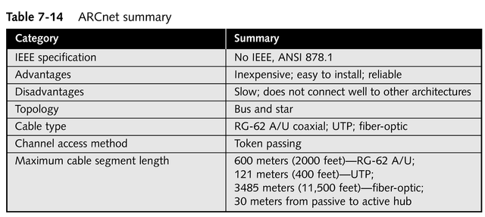
ARCnet Specifications
continued

Slide 71
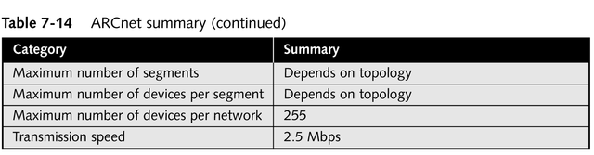
ARCnet Specifications

Slide 72
FDDI
Extremely reliable and fast
Wired as a physical ring
Utilizes dual counter-rotating rings in a token-passing environment
Dual rings enable FDDI to route traffic around problems on the network
Has no hubs; concentrators can serve as a central connection point
Expensive; usually reserved for installations where speed and security are paramount

Slide 73
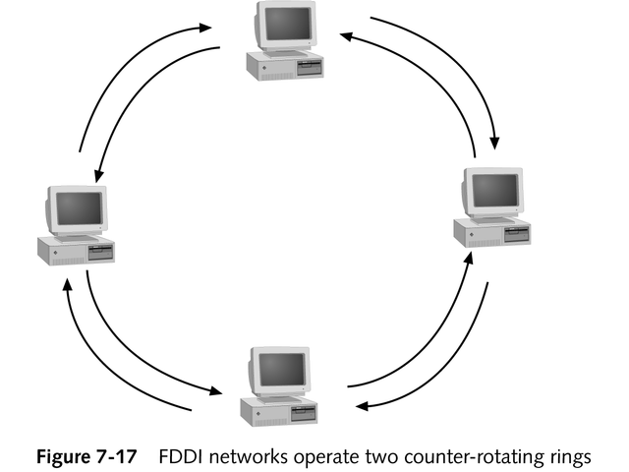
FDDI

Slide 74
FDDI
Computer possessing the token can send the next frame before the initial data frame fully circles the ring
Data doesn’t need to completely circuit the ring before the token may be passed on
Supports capability to assign a priority level to a particular station or type of data
Uses two types of NICS
Dual Attachment Stations (DAS)
Single Attachment Stations (SAS)

Slide 75
Use of Dual Rings in FDDI
All data transmission occurs along the primary ring
Secondary ring circumvents a cable break

Slide 76
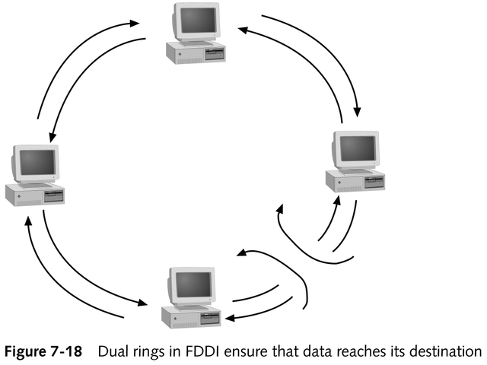
Use of Dual Rings in FDDI

Slide 77
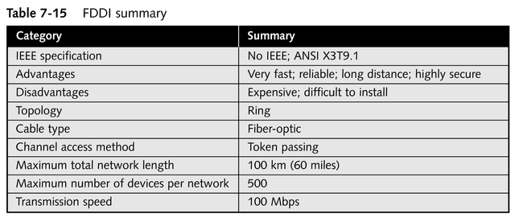
FDDI Specifications

Slide 78
Other Networking Alternatives
Broadband technologies
Broadcast technologies
Asynchronous transfer mode (ATM)

Slide 79
Broadband Technologies
A signal transmission type that uses analog techniques to encode information across a continuous range of values
Signals move across the medium in the form of continuous electromagnetic or optical waves

Slide 80
Broadband Technologies
Signals flow one way only; two channels are necessary for computers to send and receive data
Used by new networking products for extremely high-speed, reliable connectivity
Employed by cable modems to transmit across regular cable television wires

Slide 81
Broadcast Technologies
Work on the principle that most traffic a user generates is to receive files, text, and graphics
Example: Internet access by satellite television systems

Slide 82
ATM
A high-speed network technology designed for both LAN and WAN use
Uses connection-oriented switches to permit senders and receivers to communicate over a network
Requires a dedicated circuit between two end systems
Use of fixed-length cells (53 bytes) enables extremely high speeds
Works with network switches

Slide 83
ATM
Quality of service features permit certain types of network traffic to receive priority
Heavily used for the backbone and infrastructure in large communications companies
Best suited for:
LAN applications in situations where voice, data, and time-sensitive information travel on the same media
Long-haul, high-bandwidth applications

Slide 84
ATM and SONET Signaling Rates
ATM bandwidths are rated in terms of an optical carrier level that takes the form of OC-x
Rates were originally defined for the Synchronous Optical Network (SONET)
Both ATM and SONET represent the state of the art for all-digital, high-bandwidth communications designed to mix and match data, voice, and time-sensitive information through a single, high-capacity networking technology

Slide 85
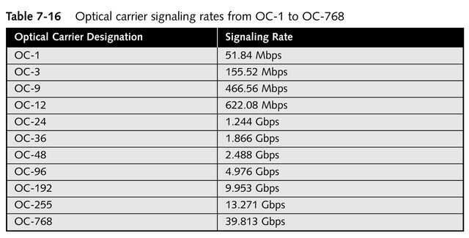
Common SONET Optical Carrier Rates

Slide 86
Chapter Summary
Explanation of network architectures
Specifics of different network architecture standards
Ethernet
Token ring
AppleTalk
ARCnet
FDDI
ATM

