Slide 1
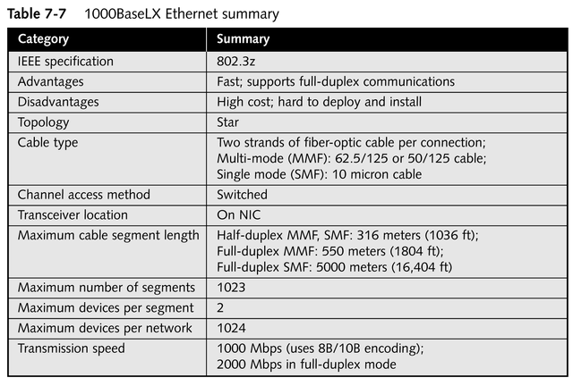
1000BaseLX Ethernet Specifications

Slide 2
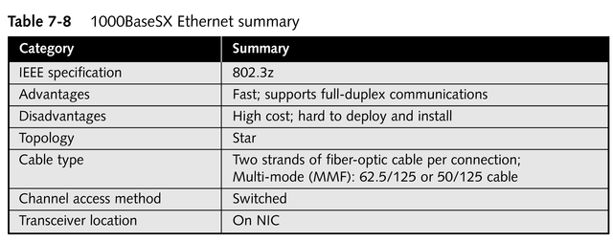
1000BaseSX Ethernet Specifications
continued

Slide 3
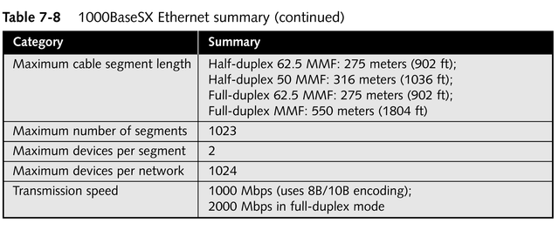
1000BaseSX Ethernet Specifications

Slide 4
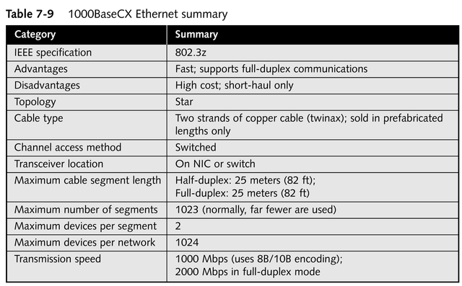
1000BaseCX Ethernet Specifications

Slide 5
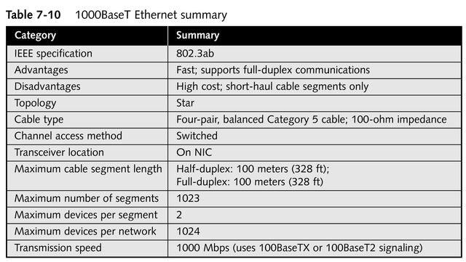
1000BaseT Ethernet Specifications

Slide 6
Ethernet Frame Types
Four frame types
  Ethernet 802.3
  Ethernet 802.2
  Ethernet SNAP
  Ethernet II
Each is unique and does not work with the others
All support a packet size between 64 and 1518 bytes
All can be used by every network architecture mentioned previously

Slide 7
Ethernet 802.3
Generally used by IPX/SPX on Novell NetWare 2.x and 3.x networks

Slide 8
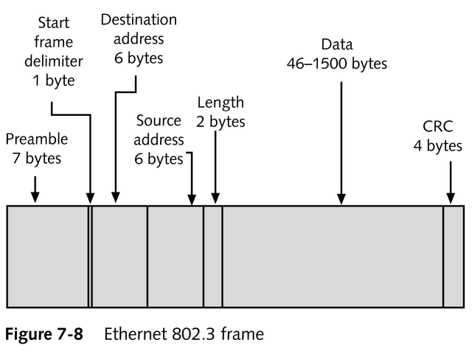
Ethernet 802.3

Slide 9
Ethernet 802.2
Used by IPX/SPX on Novell NetWare 3.12 and 4.x networks

Slide 10
Ethernet SNAP (SubNetwork Address Protocol)
Used in EtherTalk and mainframe environments
Contains enhancements to the 802.2 frame, including a protocol field type, which indicates the network protocol used in the data portion of the frame

Slide 11
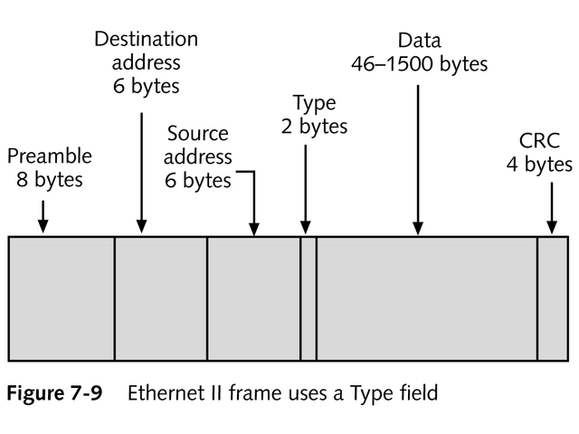
Ethernet II
Used by TCP/IP

Slide 12
Segmentation
The insertion of a bridge or router between two cable segments
Directs traffic more efficiently to its destination
Reduces traffic on each part of the network

Slide 13
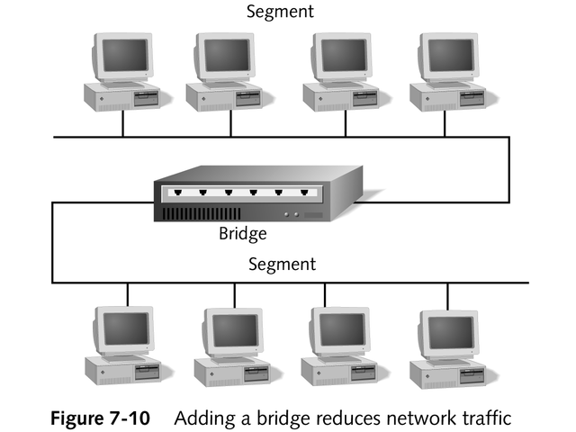
Segmentation

Slide 14
Token Ring
Developed by IBM in the early 1980s
Provides fast, reliable, efficient transport
Capable of transmitting at 4 Mbps or
16 Mbps
Physically wired as a star but uses token passing in a logical ring topology
Uses the address of the NIC to determine the address of a device

Slide 15
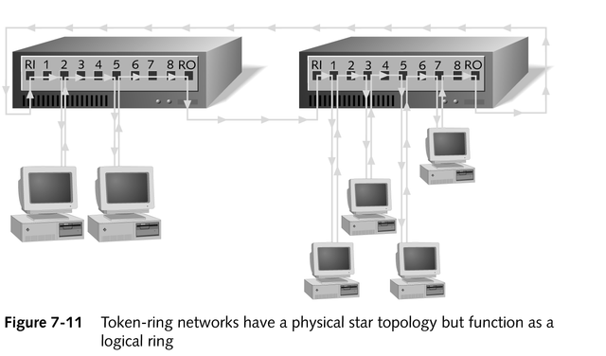
Token Ring Network

Slide 16
Token Ring Function
Computer receives the token from its Nearest Active Upstream Neighbor (NAUN)
If token is not in use, and computer has data to send, it attaches its data to the token and sends it to its Nearest Active Downstream Neighbor (NADN)
When data reaches its destination, the receiving computer sends it to upper-layer protocols for processing
continued

Slide 17
Token Ring Function
Receiving computer toggles two bits in the data packet to indicate it received the data and sends the token and data along the network to its NADN
When both token and data reach original sender, who sees the data was received, it frees the token then passes it along

Slide 18
Advantages of Token Ring
No collisions; data seldom has to be re-sent
Consistent traffic; all computers on the network have equal access to the token
Handles increases in network size and bandwidth gracefully
Suitable for transferring large blocks of data

Slide 19
Beaconing
The signal transmitted on a token ring network to inform networked computers that token passing has stopped due to an error
Isolates faults automatically

Slide 20
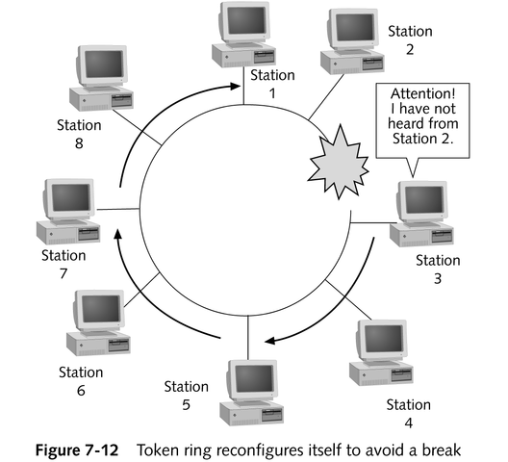
Beaconing

Slide 21
Hardware Components of a Typical IBM Token Ring Hub
Has 10 connections, eight of which can be used for connecting computers; the other two are used to connect the hubs in a ring
Allows 33 hubs to be connected via Ring Out ports and Ring In ports
Provides 260 stations per network; newer hubs allow 16 computers per hub, or 520 stations per network

Slide 22
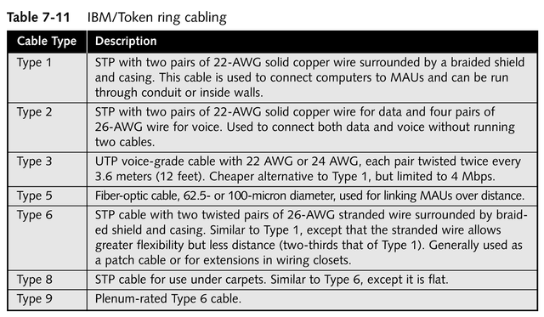
Cabling in a Token Ring Environment

Slide 23
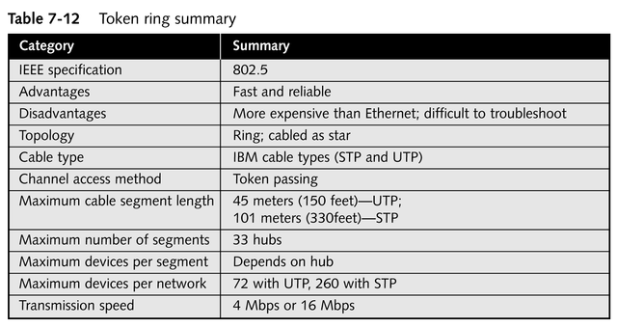
Token Ring Specifications

Slide 24
AppleTalk Environment
Introduced in 1983 by Apple Computer, Inc. for use in its Macintosh networks
Simple, easy to implement
Refers to the overall architecture of the network
Applies a dynamic scheme to determine the address of a device

Slide 25
LocalTalk
Refers to the cabling system used by Macintosh computers
Uses STP in a bus topology to allow users to share peripherals and data in a small, Macintosh-only environment
Uses the CSMA/CA channel method
  Avoids collisions
  Slow and cumbersome

Slide 26
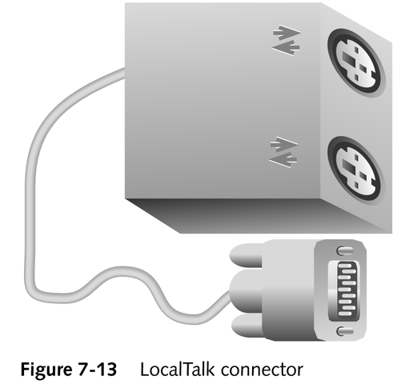
LocalTalk Connector
Consists of three connectors:
  One to the computer
  Two that join the devices

Slide 27
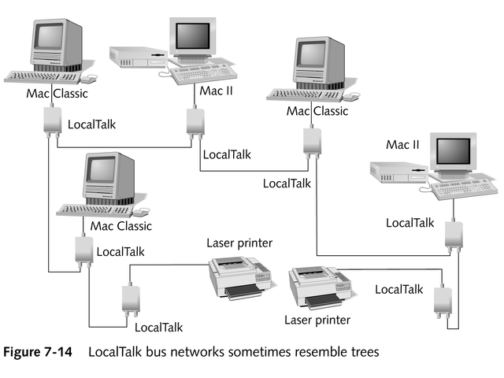
LocalTalk

Slide 28
EtherTalk and TokenTalk
Allow AppleTalk protocols to operate over Ethernet and token ring networks
Require use of a different NIC
Support AppleTalk Phase 2 and its extended addressing
With extra software, can connect Macintosh computers to a PC Ethernet or token ring environment

Slide 29
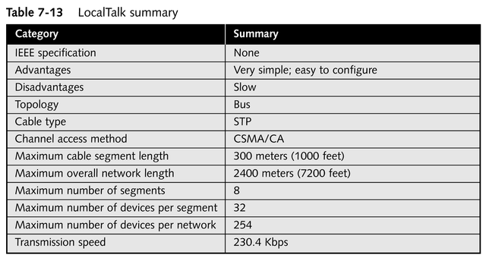
LocalTalk Specifications

