Slide 1
ARCnet Environment
Introduced in 1977 by Datapoint Corporation
Used by PC-based networks
Operates in a virtual ring, but is physically wired in a bus or star topology or a combination of both

Slide 2
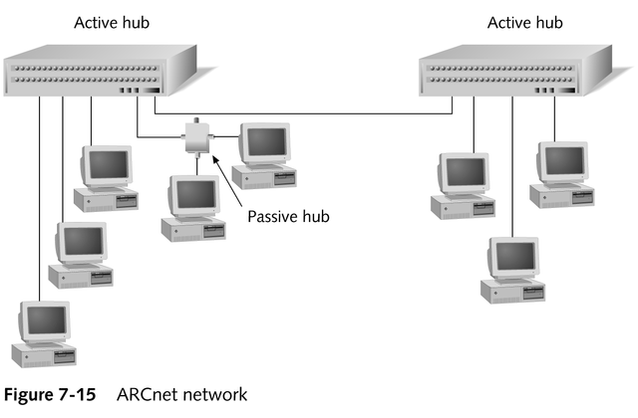
ARCnet

Slide 3
ARCnet
Provides transmission speeds up to 2.5 Mbps using the token-passing channel access method
  Token passes between computers based on their station identifiers
NICs must be addressed manually; a bank of DIP switches is used to manually set the SID for each computer

Slide 4
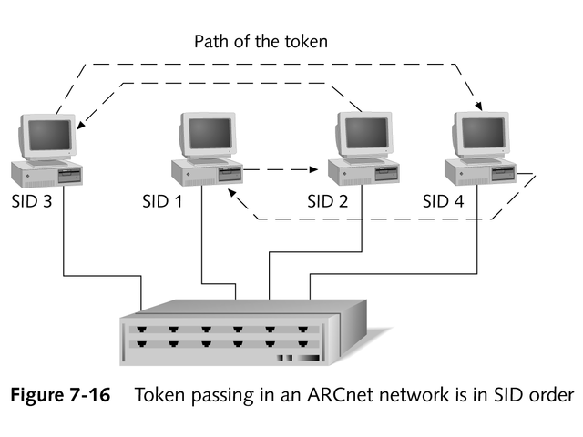
Token Passing in an ARCnet Network

Slide 5
Advantages of ARCnet
Use of token passing guarantees equal access to all computers on the network
Inexpensive
Easy to implement
Can transmit data over greater distances than other architectures and use various physical media (UTP, coaxial cable, fiber-optic cable)

Slide 6
Disadvantages of ARCnet
Manual configuration of SID numbers
Tedious administration; duplicate addresses are common
Low speed and inability to connect easily with other network architectures
  Seldom used anymore, due to speed and affordability of Ethernet

Slide 7
ARCnet Hubs
Active hubs
Passive hubs

Slide 8
Active Hubs
Similar to repeaters in an Ethernet environment
Receive the signal from a port, regenerate the signal, and send it down all the other ports
Generally have eight ports
Hub-to-hub link can be no longer than 600 meters (2000 feet)

Slide 9
Passive Hubs
Generally consist of four ports
Can pass the signal only from one port to the next; cannot regenerate the signal
Have no power supply; cannot be linked
Require termination of unused ports
Can be no more than 30 meters (100 feet) from an active hub

Slide 10
ARCnet Cabling
Most common: RG-62 A/U 93-ohm coaxial cable, with a BNC connector on each end
  Bus topology: BNC T-connectors connect the NIC to the cable
  Star topology: BNC connector connects directly to NIC and hub, without a T-connector
UTP cable lengths up to 121 meters
(400 feet)
Fiber-optic cable up to 3485 meters
(11,500 feet)

Slide 11
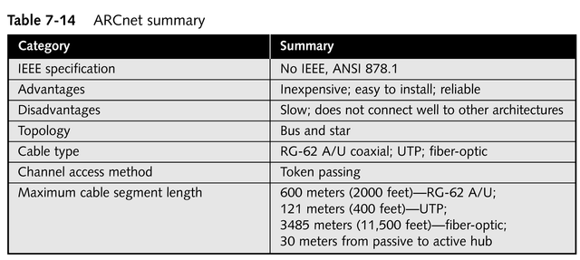
ARCnet Specifications
continued

Slide 12
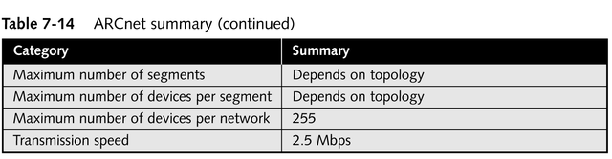
ARCnet Specifications

Slide 13
FDDI
Extremely reliable and fast
Wired as a physical ring
Utilizes dual counter-rotating rings in a token-passing environment
  Dual rings enable FDDI to route traffic around problems on the network
Has no hubs; concentrators can serve as a central connection point
Expensive; usually reserved for installations where speed and security are paramount

Slide 14
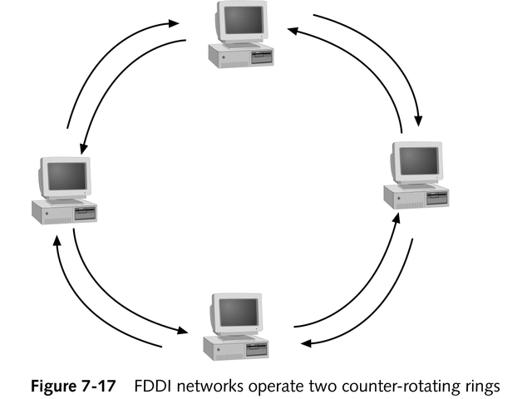
FDDI

Slide 15
FDDI
Computer possessing the token can send the next frame before the initial data frame fully circles the ring
Data doesn’t need to completely circuit the ring before the token may be passed on
Supports capability to assign a priority level to a particular station or type of data
Uses two types of NICS
  Dual Attachment Stations (DAS)
  Single Attachment Stations (SAS)

Slide 16
Use of Dual Rings in FDDI
All data transmission occurs along the primary ring
Secondary ring circumvents a cable break

Slide 17
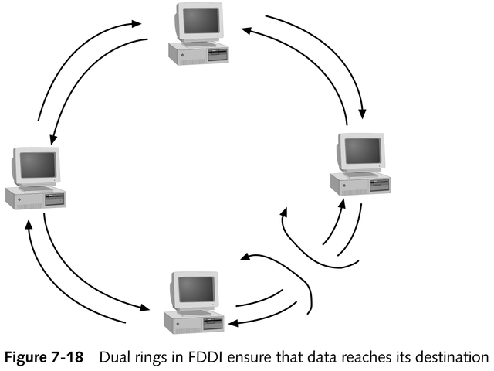
Use of Dual Rings in FDDI

Slide 18
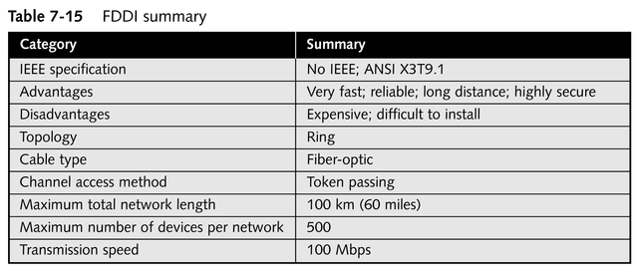
FDDI Specifications

Slide 19
Other Networking Alternatives
Broadband technologies
Broadcast technologies
Asynchronous transfer mode (ATM)

Slide 20
Broadband Technologies
A signal transmission type that uses analog techniques to encode information across a continuous range of values
Signals move across the medium in the form of continuous electromagnetic or optical waves

Slide 21
Broadband Technologies
Signals flow one way only; two channels are necessary for computers to send and receive data
Used by new networking products for extremely high-speed, reliable connectivity
Employed by cable modems to transmit across regular cable television wires

Slide 22
Broadcast Technologies
Work on the principle that most traffic a user generates is to receive files, text, and graphics
Example: Internet access by satellite television systems

Slide 23
ATM
A high-speed network technology designed for both LAN and WAN use
Uses connection-oriented switches to permit senders and receivers to communicate over a network
  Requires a dedicated circuit between two end systems
Use of fixed-length cells (53 bytes) enables extremely high speeds
Works with network switches

Slide 24
ATM
Quality of service features permit certain types of network traffic to receive priority
Heavily used for the backbone and infrastructure in large communications companies
Best suited for:
  LAN applications in situations where voice, data, and time-sensitive information travel on the same media
  Long-haul, high-bandwidth applications

Slide 25
ATM and SONET
Signaling Rates
ATM bandwidths are rated in terms of an optical carrier level that takes the form of OC-x
Rates were originally defined for the Synchronous Optical Network (SONET)
Both ATM and SONET represent the state of the art for all-digital, high-bandwidth communications designed to mix and match data, voice, and time-sensitive information through a single, high-capacity networking technology

Slide 26
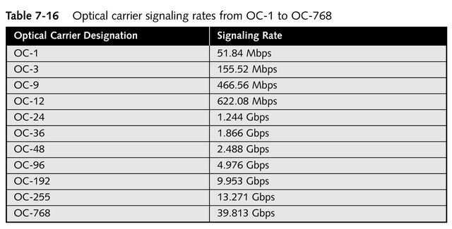
Common SONET Optical Carrier Rates

Slide 27
Chapter Summary
Explanation of network architectures
Specifics of different network architecture standards
  Ethernet
  Token ring
  AppleTalk
  ARCnet
  FDDI
  ATM

