Slide 1
Chapter 8: Simple Network Operations
LAN Design and Installation

Slide 2
Learning Objectives
Explain how network operating systems work
Understand the various networking software components
Install a network operating system
Define and implement network services
Install and configure network applications

Slide 3
Network Operating Systems Overview
Original NOSs were not true operating systems, but communication software packages or additions to standalone operating systems
Example: Microsoft’s LAN Manager
True operating systems handle standalone computer activities as well as communica-tions over the network
Examples: Netware (from Novell), Windows 2000 Server, Windows NT Server, Linux

Slide 4
Functions of an Operating System
Directs activities of a computer’s hardware components
Controls memory, CPU, storage devices, and peripherals
Coordinates the interaction between software applications and computer hardware so precisely that many applications must be written to the control parameters for a specific OS and cannot be used on different OSs

Slide 5
NOS Demands
Strong hardware computing power
Multitasking
Refers to the ability of an OS to support numerous processes at one time
Squeezes the most power out of a hardware configuration
Time slicing
Can simulate multitasking when only a single CPU is present
Occurs when the CPU’s computing cycles are divided between more than one task

Slide 6
Types of Multitasking
Preemptive multitasking
The NOS or OS retains control over the length of time each process can maintain exclusive use of the CPU
Characteristic of a true high-performance NOS
Cooperative multitasking
Each individual process controls the length of time it maintains exclusive control over the CPU

Slide 7
Other Important Features of a NOS
Connects all machines and peripherals on a network into an interactive whole
Coordinates and controls functions of machines/peripherals across the network
Supports security and privacy for the network and individual users
Controls access to resources on a user authentication basis
Advertises and manages resources from a centralized directory

Slide 8
Software Components of Networking
Naming services
Directory services
Client network software
Server network software

Slide 9
General NOS Components
Many software components are needed to provide the wide range of functions and services that a modern network operating system supports

Slide 10
Naming Services
Necessary to identify and access resources of all kinds
Translate symbolic names (such as HP4M-2nd Floor) into corresponding network addresses (such as 172.16.12.23)
Disadvantage: You must know a name before you can ask for a resource

Slide 11
More About NetBIOS Names
NetBIOS names may be no longer than 15 characters
Certain characters may not appear anywhere in a legal NetBIOS name (See Table 8-1)
Use the $ at the end of a NetBIOS name to hide computer and share names; prevents it from appearing on a browse list

Slide 12
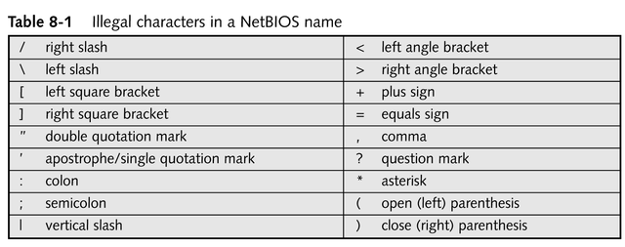
Illegal Characters in a NetBIOS Name

Slide 13
Microsoft’s Universal Naming Convention (UNC)
Standard method for naming network resources
Takes the form \\servername\sharename

Slide 14
Domain Names and DNS
Permits users to access resources and services using symbolic domain names on the Internet

Slide 15
Directory Services
Users access resources and services by browsing for them or asking for them by type
Help to centralize security information for a network
Coordinate and advertise network’s available resources and services
Some use a “tree and forest” metaphor to organize directory contents
Active Directory (Windows 2000)
Novell Directory Services (NetWare)

Slide 16
Directory Servers
Store directory information in a database that contains a list of shared resources available over the network
Store access control information about services/resources as part of the record that represents these devices to the directory; can prevent users from seeing resources/services they’re not allowed to access

Slide 17
Client Network Software
Type of software designed for workstation computers that enables the use of network resources
Components that simplify network access and hide details from users
Redirector
Designator

Slide 18
Redirector
The most important component
Operates at the Presentation layer of the OSI model
Routes resource requests to computers or directly to a peripheral device

Slide 19
Designator
Associated with drive mapping
Works in coordination with the redirector
Exchanges locally mapped drive letter with the correct network address of a directory share inside a resource request

Slide 20
Server Network Software
The NOS installed on computers that handles resources and services to be distributed to clients
Allows the sharing of resources
Access controls
Provide data privacy and protection
Help maintain a productive computing environment

Slide 21
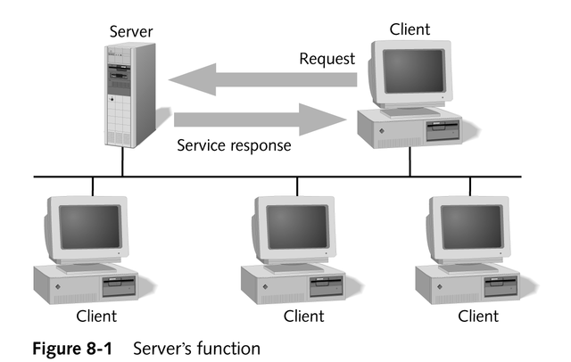
Server’s Function

Slide 22
Responsibilities of a NOS
Protection and distribution of resources
Management of users and groups
Resource advertisement and directory services
Logon authentication of individual users
Management, control, and auditing tools to administer the network
continued

Slide 23
Responsibilities of a NOS
Fault tolerance to protect integrity of the network and the data it supports
Most use redirector, designator, and UNC name support to host and offer resources to clients and to access resources from other servers elsewhere on the network

Slide 24
Client and Server
Both workstation and server versions of a NOS commonly contain client and server components
Thus, servers can access network resources and workstations can host resources

Slide 25
Installing a Network Operating System
Similar to installing any OS
Additional steps focus on configuration of the network

Slide 26
Installation Preparation Considerations
Type of network (topology)
Size of network
Job requirements of the server
File systems to be used
Identification of naming convention
Types of OSs found on servers and clients
Organization of storage devices

Slide 27
Job Requirements
Services/resources hosted by a server determine what components or add-ons are installed
Knowing job requirements before installing the NOS can simplify installation and guide configuration later by having the proper components present and active on the system
Some server-related issues
Domain controller or member server
Disk mirroring or disk duplexing

Slide 28
Naming Conventions
Predetermined processes to create names for use on a network or standalone computer
Incorporate a scheme for user accounts, computers, directories, network shares, printers, and servers
Use names that are descriptive enough to be easily deciphered

Slide 29
Common Rules of a Naming Scheme
Construct user names from the first and last name of the user, plus a code identifying their job title or department (BobSmithVP)
Construct group names from resource types, department names, location names, project names, and combinations thereof (Printer01, AustinAccounting)
Construct computer names for servers and clients from their department, location, and type (SalesTexas01)

Slide 30
Naming Convention Requirements
Consistent across all objects
Easy to use and understand
Simple to construct new names by mimicking the composition of existing names
Able to clearly identify object types

Slide 31
Storage Device Organization
How to organize the drive containing or hosting the NOS, especially regarding partitions (logical organizations of disk space, in which each partition appears as a separate logical drive)
Multiple-boot
Single-partition, single-NOS
Multiple-partition, single NOS
Which file system to use (FAT, FAT32, NTFS, etc.)

Slide 32
Network Adapter Configuration
Is usually done through a manufacturer-supplied BIOS configuration utility that is launched from a boot floppy
Process
Define and test all possible NIC settings
Set cable type and bus slot number, if appropriate
Make sure the NOS works properly before installing it on a machine

Slide 33
Protocol Selection
All computers on a network must communicate using the same protocol
Within each protocol are special designations for subnets, network addresses, frame types, and so forth
Each must either match exactly or be compatible for computers to communicate

Slide 34
TCP/IP Requirements Prior to NOS Installation
IP address
Subnet mask
Default gateway
DNS (Domain Name Server)
WINS (Windows Internet Naming Service)
DHCP (Dynamic Host Configuration Protocol)

Slide 35
Hardware Compatibility
Always double-check that your computer’s hardware components are fully compatible with the NOS being installed
Most NOS vendors publish and maintain lists of compatible hardware that they have tested with their software

Slide 36
Installing Microsoft Windows
Setup Wizard makes installation process as simple as clicking on the mouse and entering a few key data items
Major steps
Beginning the installation
Text-based portion
Graphical user interface portion
Networking portion

Slide 37
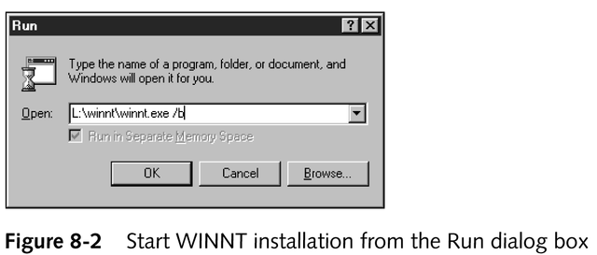
Choices for Beginning the Installation
Complete baseline installation or use existing OS?
Floppy-assisted or floppyless setup?
Network or local installation?

Slide 38
Text-based Portion
Configure hard drives
Format file systems
Confirm the license agreement
Define the name of the system directory

Slide 39
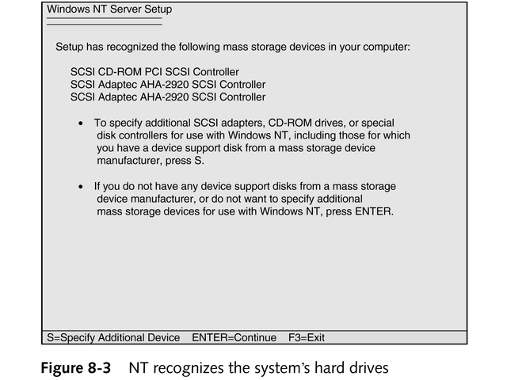
Text-based Portion

Slide 40
Graphical User Interface Portion
Controlled with mouse or keystrokes
Define computer and domain names
Enter identification key from installation CD-ROM
Select server type as a domain controller or a member server
Assign a password to Administrator account
Select environment and desktop components

Slide 41
Networking Portion
Install driver for the NIC
Select and configure the protocols
Review bindings

Slide 42
Installing Novell NetWare 5.1
Choose method
Over the network
From a CD-ROM
Start the INSTALL.NLM utility
Installation occurs within a single phase (character mode)
Assign server name
Install storage device drivers
Install NIC drivers
Define NetWare volumes
Read license agreement

Slide 43
Installing Red Hat Linux 7.0
Most easily done from the CD-ROM
Launch setup process by typing “text” after boot prompt on character-based setup screen
Create a Linux partition on the hard drive
Establish a root file system
Assign language, keyboard, and video selections
Select the type of installation
Server
Workstation

Slide 44
Network Services
Basic resources found on all networks
The foundation of network applications
Most basic shared network resources
Printers
Directory shares
Networked applications (such as groupware and e-mail) extend network capabilities

Slide 45
Installing, Removing, and Configuring Network Services
Most NOSs have an administrative tool for installation and removal of network services
Windows NT Server: Network applet
Windows 2000: Network and Dial-up Connections utility

Slide 46
Controlling Operation Parameters of a Network Service
Global services administrative tool (Windows Services applet in Control Panel)
A new administrative tool or console plug-in (added during installation) for exclusive management of the new service
Windows NT: RAS (Remote Access Service)
Windows 2000: RRAS (Routing and Remote Access Service)

Slide 47
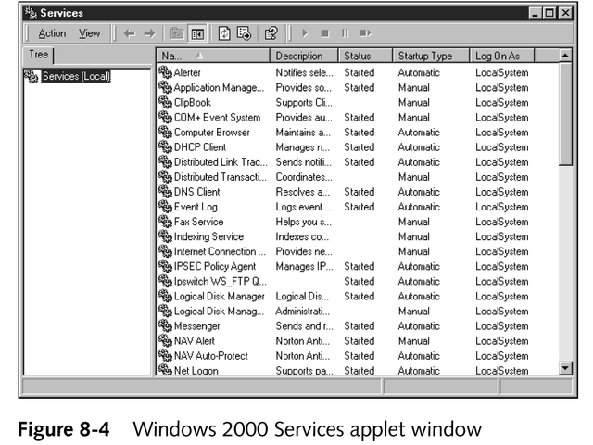
Windows Services Applet

Slide 48
Network Bindings
Link network components from various levels of the network architecture to enable communication between those components
Associate upper-layer services and protocols to lower-layer network adapter drivers
Enhance the system’s use of the network

Slide 49
Network Printing
A primary network service
Ability for a client located anywhere on the network to access and use a printer hosted by a server
Role of the redirector
Intercepts print requests
Forwards them to the proper print servers or network-connected printers

Slide 50
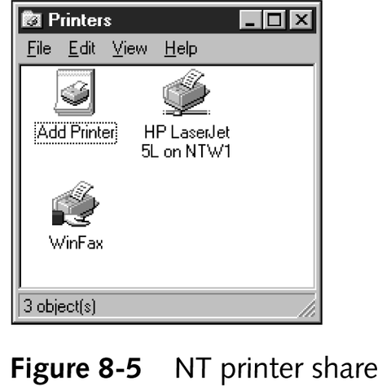
Network Printing
Logical representa-tion of the printer within the NOS can be shared

Slide 51
Printer Management
Can be accomplished from direct local access or through the network printer share
Proper level of access must be granted to the user

Slide 52
Responsibilities of Printer Management
Grant and restrict user access to printers
Monitor the print queue for proper function, including stopping, restarting, reordering, and deleting print jobs
Limit access by time frame, department, or priority
Update local and remote printer drivers
Maintain printers
Manage printers remotely

Slide 53
Sharing Fax Modems
Gives every client the ability to fax documents from the desktop
Often not found as a default component in a NOS; many third-party vendors offer add-on products

Slide 54
Network Directory Shares
A primary network service
Offers clients the ability to access and interact with storage devices located anywhere on the network
Redirector and designator play a major role

Slide 55
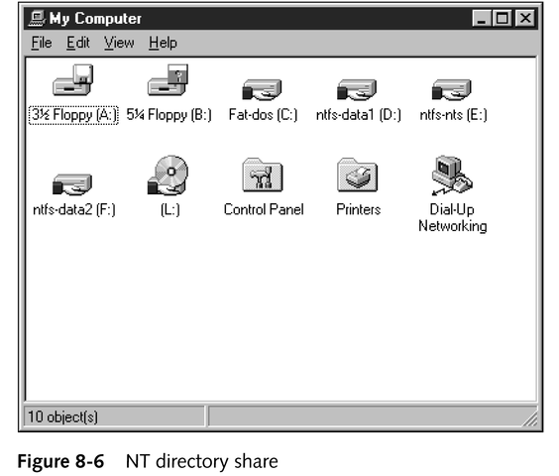
Network Directory Shares

Slide 56
Ways to Access a Shared Directory
By mapping an unused local drive letter to the directory share
By using a UNC name to reference the directory share
By selecting the directory share from a list of available shares

Slide 57
Network Applications
Enhanced software programs made possible through the communication system of a network
Most common network applications
E-mail
Scheduling
Groupware
Types of architectures
Centralized
File-system sharing
True client/server

Slide 58
Network Applications
Benefits
Improved communication
Simplified application maintenance
Lower storage requirements
Save money; multiple users per single installation
Drawbacks
Performance can be degraded by poor network performance or limited bandwidth
When the network is down, the application is often unusable

Slide 59
E-mail or Messaging
A tool that distributes messages from one person to others on the same network or across the Internet
Fast, asynchronous, and can contain more than just text
Capable of attaching files, filtering, and using distribution lists
Can communicate outside local network over the Internet (when based on SMTP, POP3, and/or IMAP)

Slide 60
Common E-mail Communication Protocols
X.400
IMAP (Internet Message Access Protocol)
MHS (Message Handling System)
POP3 (Post Office Protocol, version 3)
SMTP (Simple Mail Transfer Protocol)
X.500

Slide 61
Scheduling or Calendaring
Multiple users share a single appointment book, address book, and calendar
Provides easy coordination of meetings, appointments, and contact details

Slide 62
Groupware
Enables multiple users to interact with a single file, document, or project simultaneously
Keeps dispersed users synchronized
Coordinates distributed data and activities

Slide 63
Chapter Summary
Network operating systems
Software components of networking
Installing a network operating system
Network services
Network applications

