Slide 1
Chapter 9:
Understanding Complex Networks

Slide 2
Learning Objectives
Discuss interconnectivity issues in a multivendor environment
Define the various options to implement a multivendor network environment
Discuss the differences between centralized and client/server computing
Define the client/server networking environment
Understand remote access and remote control technologies; apply them to your networks

Slide 3
Interconnectivity in Multivendor Environments
Challenges
  Connecting systems that use different vendors’ network operating systems (NOSs)
  Implementing a single network that makes use of multiple NOSs

Slide 4
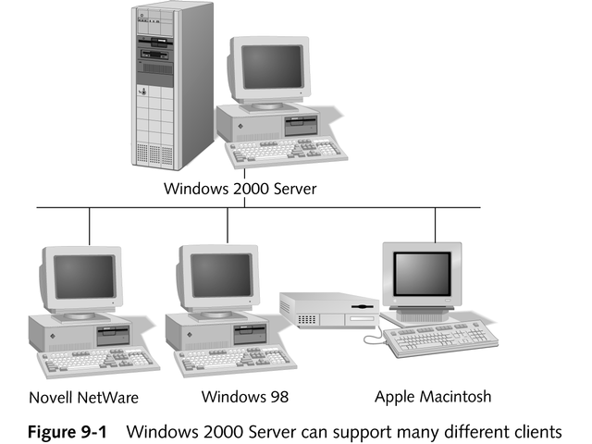
Interconnectivity in Multivendor Environments

Slide 5
Implementing Multivendor Solutions
Client-based solutions
Server-based solutions

Slide 6
Client-based Solutions
Relies on client computer’s redirectors to decide to which server to send the request

Slide 7
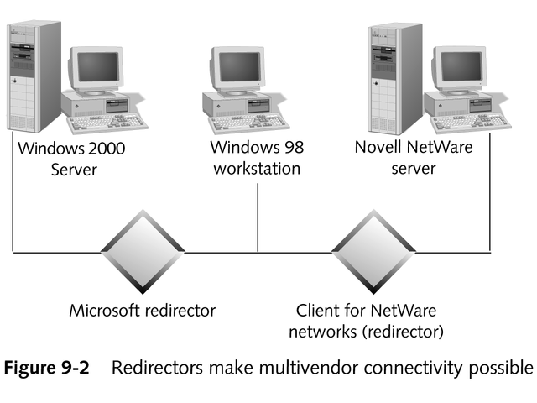
Example of a Client-based Solution

Slide 8
Server-based Solution
A server that can readily communicate with clients from multiple vendors, such as Windows 2000 Server

Slide 9
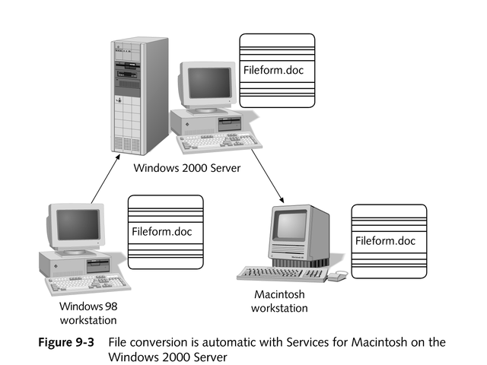
Example of a Server-based Solution

Slide 10
Vendor Options
The four major networking product vendors and organizations support connectivity to each other’s NOSs
  Microsoft
  Novell
  Linux
  Apple

Slide 11
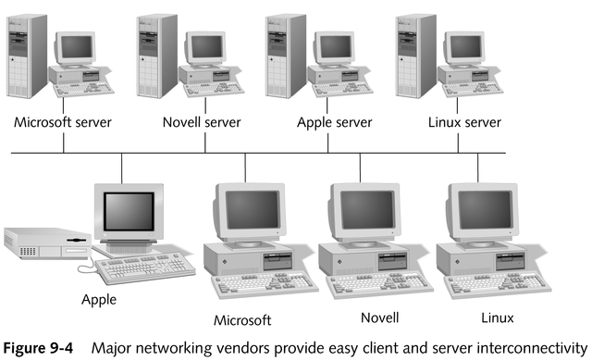
Major Networking Vendors

Slide 12
Microsoft Redirector
Included in:
  Windows 2000
  Windows NT
  Windows Millennium
  Windows 98
  Windows 95
  Windows for Workgroups

Slide 13
Microsoft in a Novell Network
Windows 2000 Professional or Windows NT Workstation
  NWLink and Client Service for NetWare (CSNW) must be loaded on the machine
Windows 2000 or Windows NT Server
  NWLink protocol, as well as Gateway Service for NetWare (GSNW) must be loaded on the machine
Windows 98 or Windows Millennium
  Can connect directly by loading IPX/SPX or NWLink and the Client for NetWare Networks

Slide 14
MS-DOS Clients
Each vendor offers utilities to allow MS-DOS clients to connect to servers of all four types – Microsoft, Novell, Linux, and Apple
Each of these utilities can coexist with the other utilities to provide MS-DOS connections to all servers

Slide 15
Novell
Provides file and print services for:
  MS-DOS-based clients
  Windows 2000 or Windows NT clients running Novell’s NetWare requester and Windows redirector

Slide 16
Linux Networks
Includes many network services, such as:
  Network File System (NFS)
  Samba
    Preferred service used to interconnect Microsoft Windows clients with UNIX or Linux hosts

Slide 17
Reasons for Using Samba
A server-based solution; software and services need be installed only on a small number of servers
An open source software product; can be downloaded and installed for free
Allows a Linux or UNIX machine to masquerade as a native Microsoft network server; Windows clients need no extra software to access its services

Slide 18
Apple Macintosh
AppleShare networking software automatically provides file sharing and includes a print server that allows computers to share printers

Slide 19
Macintosh in a Windows Network Environment
Service for Macintosh allows Macintosh computers to connect to a Windows 2000 or Windows NT server

Slide 20
Centralized vs.
Client/Server Computing
Centralized computing
  A computing environment in which all processing takes place on a mainframe or central computer
  The basis of terminal services
Client/server computing
  A computing environment in which the processing is divided between the client and the server

Slide 21
Understanding Terminal Services
A software subsystem for Windows NT and Windows 2000 Server
Permits clients to run large/complex applications on computers with minimal processing power by transferring the burden of client processing to the server

Slide 22
Uses Suited for
Terminal Services
Providing access to modern Windows applications on older PCs or thin clients that might not otherwise be able to run those applications
Providing access to centralized applications or services that would otherwise have to be installed on client machines
Permitting remote clients using narrow bandwidth connections to access modern, powerful Windows applications without bandwidth-related performance delays

Slide 23
Back to the Future:
The Mainframe Environment
Can generate large amounts of network traffic
Does not fully exploit the power available in PCs today
Not well-suited for typical user productivity applications
Still play a valid role on modern networks, especially for large-scale, transaction-oriented applications

Slide 24
Client/Server Environment
PC and server share processing and more efficiently use the resources of both machines and reduce network traffic
Most popular method of network communications (eg, World Wide Web)
Easy to implement
Scalable

Slide 25
Client/Server Model in a Database Environment
Database management system (DBMS)
  A client/server computing environment that uses SQL to retrieve data from the server
Structured Query Language (SQL)
  Standard database query language designed by IBM

Slide 26
Components of a Client/Server SQL Environment
Application (front end, or client)
Database server (back end, or server)

Slide 27
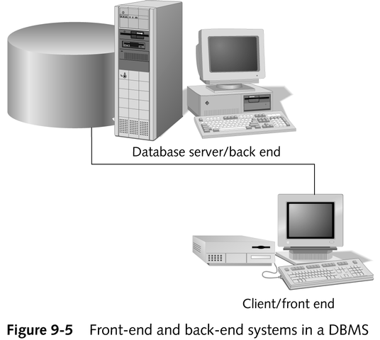
Components of a Client/Server SQL Environment

Slide 28
Process of Requesting Data from a Server in SQL
User requests the data
Client software translates that request into SQL
SQL request is sent across the network to the server
Server processes the request
Results are sent back across the network to the client software
Results are presented to the user

Slide 29
Client/Server Model in a DBMS Environment
Client
  Presents data in a usable form
  Accepts instructions from the user, formats them for the server, and sends its requests to the server
Server
  Does not contain user interface software
  Stores and manages data; most database functions occur within it
  Receives requests from clients, processes them, and returns information to the client

Slide 30
Client/Server Architecture
Methods of implementation
  Single database server
  Multiple database servers (distributed or multi-tiered database)

Slide 31
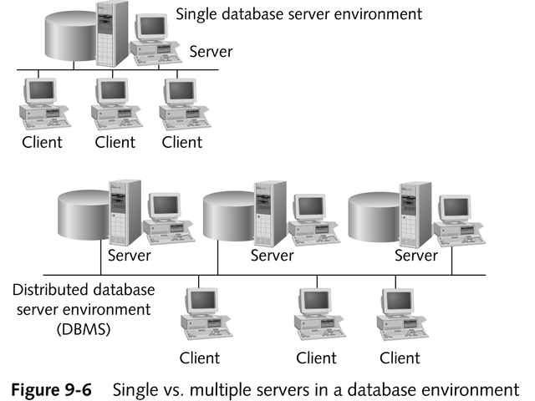
Single vs. Multiple Servers

Slide 32
Advantages of Working in a Client/Server Environment
Efficient use of computers, both front end and back end, as well as the network
Less extensive configuration
  Smaller processor and RAM
  Drive space can be reserved for local applications
Centralized location
  Servers are easy to secure and maintain
  Simplifies back-up

Slide 33
Chapter Summary
Interconnectivity in multivendor environments
Implementing multivendor solutions
Centralized vs. client/server computing
Client/server environment

