Slide 1
Chapter 10: Network Administration and Support

Slide 2
Learning Objectives
Create, disable, and delete user accounts
Configure group accounts to make them most effective
Describe all aspects of network monitoring
Create a network security plan
Protect your servers from data loss

Slide 3
Responsibilities of Network Administration
Install and troubleshoot hardware
Ensure that the network performs to specifications
Verify that users can easily access the resources they are authorized to use
Monitor network traffic
Be responsible for security issues

Slide 4
Managing Networked Accounts
Main task of network management
Make sure all users can access resources they are allowed to access but can’t access resources they don’t have permission to access
Principles of user management are similar, but the management utilities are different
Windows uses graphical user interfaces
User Manager for Domains (Windows NT)
Active Directory Users and Computers utilities (Windows 2000)
Linux allows you to open and operate directly on specially formatted files

Slide 5
User Accounts and Group Accounts
User account
Collection of information about a user
Account name
Associated password
A set of access permissions for network resources
Group account
Umbrella account to which individual accounts may be assigned to grant them a predetermined set of rights

Slide 6
Creating User Accounts
Two predefined accounts in Windows NT and Windows 2000
Administrative (for management duties)
Guest (for users who have no personal account in the local domain)
Network administration decisions relate to:
Passwords
Logon hours
Auditing

Slide 7
Passwords
Should users be able to change their passwords?
How often should they be changed?
How many letters should the password contain?
How often should users be able to reuse their passwords?
Should failed attempts to log on lead to account lockouts?

Slide 8
Logon Hours
Should users be restricted to logging on during certain hours of the day or only on certain days?

Slide 9
Auditing
Should user actions be tracked?
To what degree?

Slide 10
Setting User Rights
User rights
The actions that particular accounts have permission to perform
Most operating systems come with pre-defined default groups
General kinds of groups
Local groups
Global groups

Slide 11
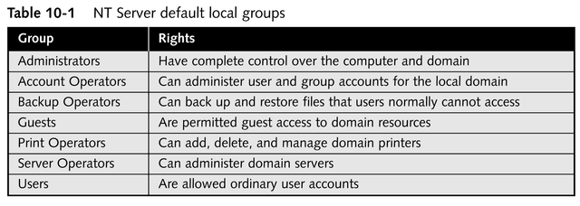
Local Groups

Slide 12
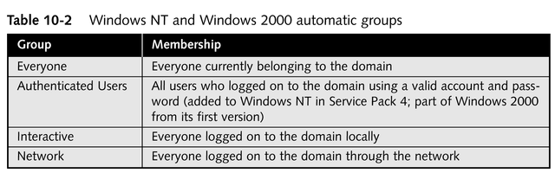
Automatic Groups

Slide 13
How Changes to User Accounts or Groups Are Reflected
Windows NT domains
Changes are written to the Registry database on the primary domain controller and recorded in the two files that make up the Registry’s security information (SECURITY and SAM [Security Accounts Manager])
Windows 2000 domains
Changes are written to a domain controller’s Active Directory database, under the control of a directory system agent

Slide 14
Managing Group Accounts
For Windows NT, adding one group to another must adhere to guidelines
Global groups can include individual users
Local groups can include individual users and global groups (for cross-domain communication)
Rules for placing groups within groups are more flexible for Windows 2000 and Linux

Slide 15
Trust Relationships
One domain permits members of another domain to access its resources
Used to manage cross-domain communications
In Windows NT
You can establish a one-way or two-way “trust” between domains, so that members of a given domain can access resources in another domain
In Windows 2000
Automatic trust relationships are all two way

Slide 16
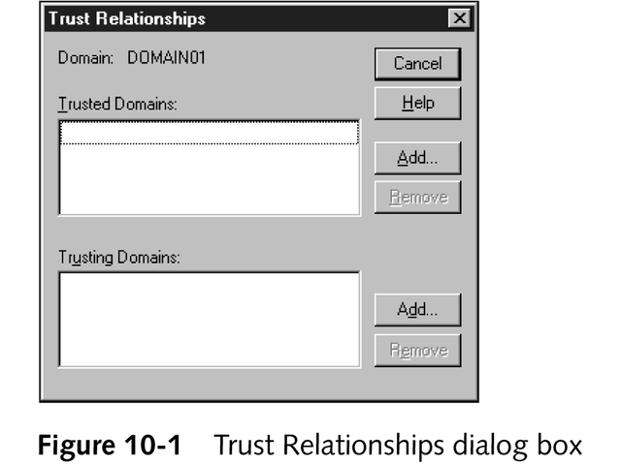
Trust Relationships

Slide 17
Disabling and Deleting User Accounts
Disabling
Temporarily makes a user account inactive
Deleting
Permanently makes a user account inactive

Slide 18
Renaming and Copying User Accounts
In Windows NT Server, use the User Manager for Domains
In Windows 2000 Server, use the Users and Passwords utility in Control Panel

Slide 19
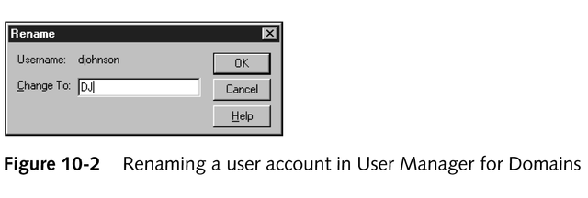
Renaming a User Account in Window NT Server

Slide 20
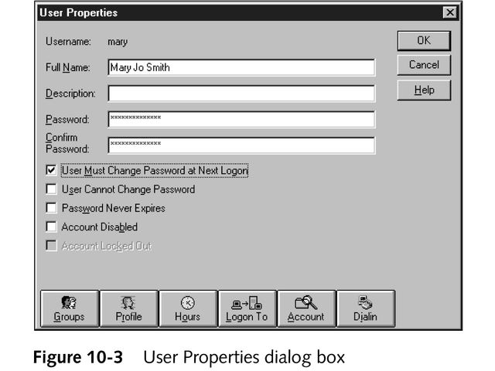
Remaining a User Account in Window NT Server

Slide 21
Managing Network Performance
Data read from and written to the server each second
Queued commands
On an Ethernet network, the number of collisions per second
Security errors (errors accessing data)
Connections currently maintained to other servers (server sessions)
Network performance

Slide 22
Data Reads and Writes
Number of bytes read from and written to a server provides a measure of the server’s activity
Server’s refusal to accept streams of raw data is a possible indication of server memory problems

Slide 23
Queued Commands
Commands awaiting execution
Should never be much more than the number of network cards in the server, or a bottleneck occurs

Slide 24
Collisions per Second
High collision rate slows down network transmission
May indicate that you need to add a repeater to the network segment

Slide 25
Security Errors
High rate of failed logons, failed access to objects, or failed changes to security settings may indicate a security risk
Use auditing to find out who is causing the errors
Find the source of errors by using a protocol analyzer (a combination of hardware and software that can capture network traffic and create reports and graphs from the data)

Slide 26
Server Sessions
Connections between a network server and another node
Broken connections may indicate that the server is overloaded and either refusing connections or unable to service them quickly
May need more RAM or to update hardware

Slide 27
Network Performance
Windows NT and Windows 2000 Server have three tools:
Event Viewer
Performance Monitor
Network Monitor
Linux has comparable open source (free) or shareware (low cost) utilities

Slide 28
Event Viewer
A Windows NT and Windows 2000 tool that records events in three logs based on the type of event

Slide 29
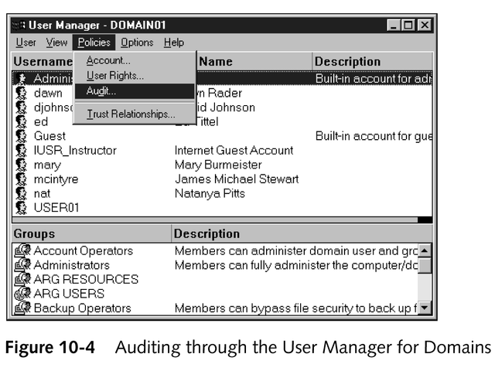
Event Viewer

Slide 30
Event Viewer Logs
Security information
Records security events based on the filters you set up in the User Manager for Domains (Windows NT) or in a policy setting (Windows 2000)
Most useful for getting more information about failed attempts to log on or access data
System information
Records events by Windows system components; provides basic information about how the network runs and whether all hardware works properly
Events generated by applications

Slide 31
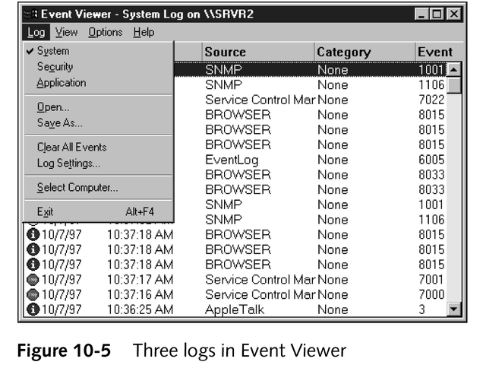
Event Viewer Logs

Slide 32
Performance Monitor
A Windows NT and Windows 2000 tool used for graphing trends, based on performance counters for system objects
Ways to view gathered information
Chart
Alert
Log
Report

Slide 33
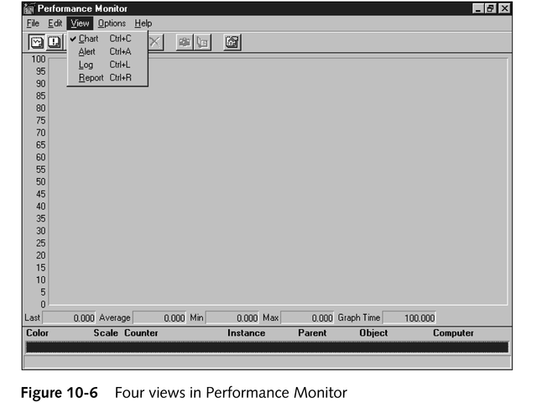
Four Views in Performance Monitor

Slide 34
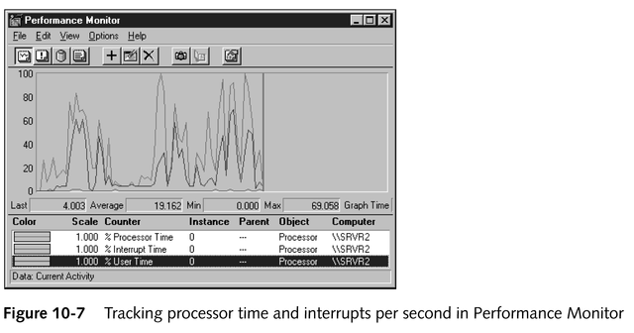
Using Performance Monitor

Slide 35
Most Important System Objects to Monitor
Logical or physical disk on the server
Network interface
Any of the protocol counters
Redirector
Server
Server work queues

Slide 36
Network Monitor
A Windows NT and Windows 2000 network service that you can use to capture network frames based on user-specific criteria, such as a protocol analyzer
Must be installed separately as a network service

Slide 37
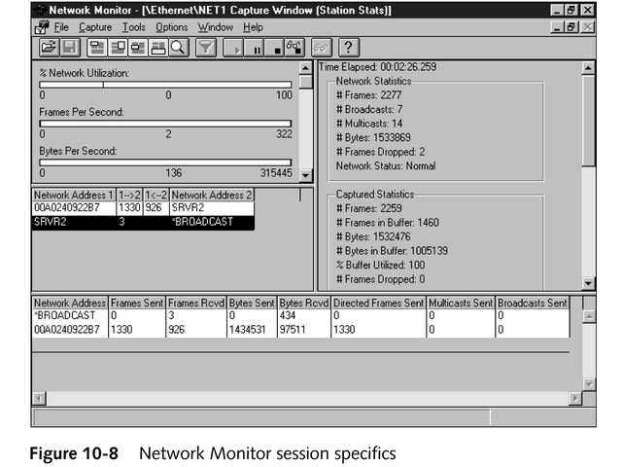
Network Monitor

Slide 38
Total System Management
Hard drive performance
Memory usage

Slide 39
Monitoring Hard Drive Performance
Disk space remaining
Speed at which requests are serviced
How often the disk is busy
Other things to notice:
Whether you’re viewing the physical disk object or the logical disk object
Not all disk-related counters add up precisely to 100%

Slide 40
Monitoring Memory Use
Soft page faults
Occur when data must be called back into a program’s working set from another location in physical memory
Take comparatively little time to solve
Hard page faults
Occur when data a program needs must be called back into memory from its storage space on the hard drive
Relatively time-consuming to resolve

Slide 41
Monitoring CPU Utilization
The %ProcessorTime counter for the Processor object provides an average utilization figure over the past second
Constant rates of 90% or over on this counter might indicate the machine is overloaded

Slide 42
Monitoring Network Statistics
Using Performance Monitor
Check statistics for the Network Interface and protocol stack objects
Using Network Monitor
Tracks the same data, but shows error rates and allows investigation of individual packets or errors

Slide 43
Maintaining a Network History
Keep long-term records of network performance and events so you can determine trends or notice when a new problem arises

Slide 44
Managing Network Data Security
Elements of data security
Ensuring that data is safe from intruders
Ensuring that you can replace destroyed data

Slide 45
Planning for Network Security
Identify the threat
What am I trying to protect?
Whom or what do I need to protect data from?
How likely is it that this threat will manifest itself?
What is the cost of breached security?
How can I protect the data in a cost-effective manner?

Slide 46
Security Models
Physical security (hardware)
Keep intruders away from cables they could tap
Physically isolate servers; keep them locked up
Generally limit physical access to your network
Data security (software)
Share-oriented security
Based on the object being shared
User-oriented security
Focuses on rights and permissions of each user

Slide 47
Implementing Security
Set up the security system and make it as foolproof as possible
Train network users about why the system is in place, how to use it, and the consequences of failing to comply with it

Slide 48
New Security Features in Windows 2000
Kerberos v5 authentication
Public Key Infrastructure (PKI)
Enhanced security policy mechanisms
Improved IP security mechanisms and protocols

Slide 49
Maintaining Security
Make sure the plan you implemented accomplishes its goals and works as intended
Modify the plan as needed

Slide 50
Avoiding Data Loss
Accomplish data protection with a three-tiered scheme that:
Reduces the chance of data loss
Makes quick recovery from data loss easy
Allows you to completely rebuild lost or corrupted data

Slide 51
Tape Backup
Offers a useful combination of respectable speed, high capacity, and cost-effectiveness
Widely supported by tape-backup software
Cannot act as a separate drive
Types of backups recognized by Microsoft
Full
Incremental
Differential
Copy
Daily

Slide 52
Aspects of a Successful Backup Plan
Combine a full weekly backup with daily differential backups
Post the backup schedule and assign one person to perform them
Ensure that you can restore the data

Slide 53
Repairing or Recovering Windows Systems
Windows NT and Windows 2000 include repair utilities built into their installation routines
They differ considerably from each other
The Windows 2000 repair facility is more powerful than that of Windows NT

Slide 54
Uninterruptible Power Supply
A device with a built-in battery, power conditioning, and surge protection
If the power goes out, the charged battery takes over long enough for you to perform an orderly shutdown

Slide 55
Fault-tolerant Systems
An arrangement of physical or logical disks such that, if one disk fails, the data remains accessible without requiring restoration from backups
Based on standard terminology for RAID (Redundant Arrays of Inexpensive Disks) arrays
Most popular
Disk mirroring (duplexing)
Disk striping with parity

Slide 56
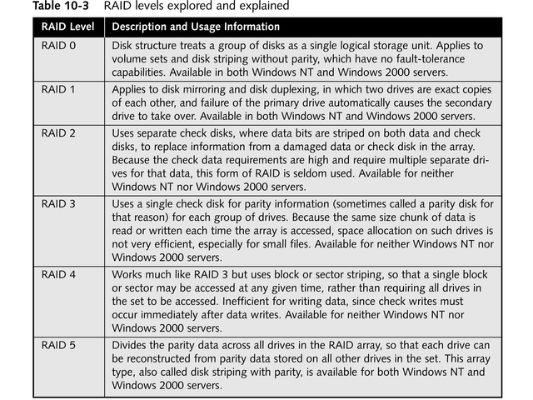

Slide 57
RAID 1: Disk Mirroring
Requires two disks, configured to work in tandem
If one disk fails, then the data remains accessible
Simple to set up and makes recovery from disk failures easy
Requires twice as much disk space

Slide 58
RAID 5: Disk Striping with Parity
Parts of several physical disks link together in an array; data and parity information is written to all disks in this array
If one disk fails, the data may be reconstructed from the parity information written on the others
Uses space efficiently
Does not recover data as quickly as disk mirroring

Slide 59
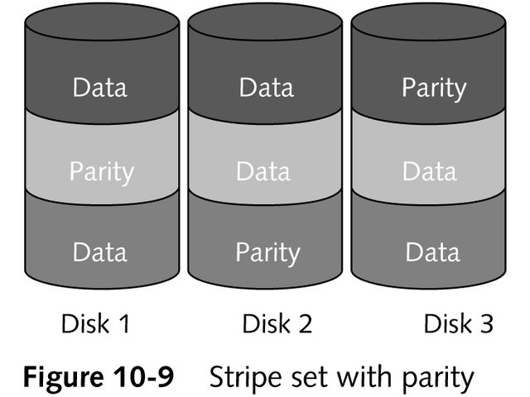
RAID 5: Disk Striping with Parity

Slide 60
Intellimirror
A Windows client/server application that creates a “smart back-up copy” of a Windows 2000 system on a Windows 2000 server
If a user wants to log onto another machine on the network, that user’s home desktop can be recreated elsewhere
Works from domain policy settings and user account permissions

Slide 61
Chapter Summary
Managing networked accounts
Managing network performance
Managing network data security
Avoiding data loss

