Slide 1
Chapter 11:
Enterprise and Distributed Networks

Slide 2
Learning Objectives
Understand how modems are used in network communications
Understand faster alternatives to modems for network communications
Survey the different types of carriers used for network communications
Explain how larger networks may be implemented using devices such as repeaters, bridges, routers, brouters, gateways, and switches

Slide 3
Modem
MOdulator/DEModulator
Used by computers to convert digital signals to analog signals for transmission over telephone lines
The receiving computer then converts the analog signals to digital signals
Available for use internally or externally
Sometimes described as Hayes-compatible

Slide 4
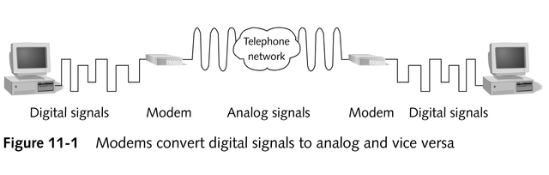
Modems in Network Communications

Slide 5
Modem Speed
Is measured in the number of bits per second (bps) that can be transmitted
V-series standards were developed by the International Telecommunications Union (ITU) to define modem speed

Slide 6
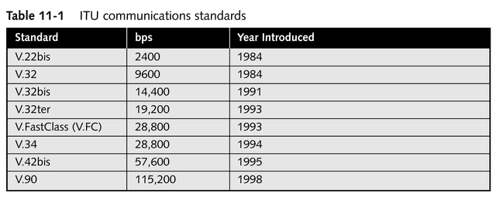
ITU Communications Standards

Slide 7
Types of Modems
Two types
  Asynchronous
  Synchronous
Which type you use depends on the type of phone lines and network requirements involved
Where continuous network connections are desirable, digital technologies (DSL or cable modems) may offer higher bandwidth and better communications capabilities

Slide 8
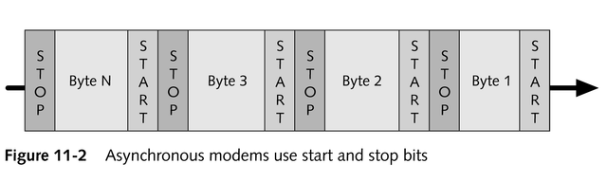
Asynchronous Modems
Depend on the start and stop bits in the data stream to determine where data begins and ends

Slide 9
Asynchronous Modems
Most popular method because it uses regular telephone lines
Flow control and data coordination account for 25% of all communication
Most incorporate data compression
  MNP Class 5
  ITUV.42bis

Slide 10
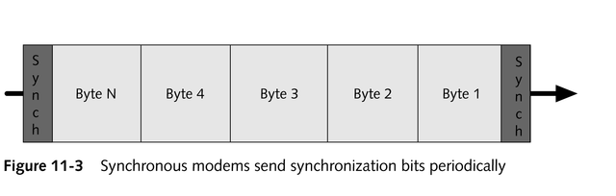
Synchronous Modems
Depend on exact timing and sync bits to maintain data synchronization

Slide 11
Synchronous Modems
Not designed for use over regular phone lines; generally found in dedicated, leased-line environments
Cost more than asynchronous solutions
Significantly faster than asynchronous modems

Slide 12
Synchronous Communication Protocols
Provide additional functions
  Format data into blocks
  Add control information
  Check information for errors
Primary protocols
  Synchronous Data Link Control (SDLC)
  High-level Data Link Control (HDLC)
  Binary Synchronous (bisync) communications protocol

Slide 13
Digital Modems
ISDN (Integrated Services Digital Network) link
Cable modem
DSL (Digital Subscriber Line)

Slide 14
ISDN
Provides a dial-up digital network connection up to 128 Kbps from a single installation
Transmit digital signals across an ISDN link
Adapters consist of a network termination (NT) device and terminal adapter (TA) equipment

Slide 15
Cable Modems
Take advantage of high bandwidth and availability of broadband CATV cables
Devices that attach to a NIC typically feature a BNC connector and an RJ-45 connector
Retain broadband’s use of multiple channels on a single cable; switches from analog to digital methods on a per-channel basis

Slide 16
Cable Modems
Typically deliver bandwidth that varies between 384 Kbps and 1.5 Mbps
Provide bandwidth to end users as a form of shared media access; more users = less bandwidth per user
Have no distance limitations
“Always on”

Slide 17
DSL
Competing digital technology offered by telecommunications carriers
Uses the same twisted-pair telephone lines to deliver digital services that deliver voice
Connections are not shared; guarantees subscriber’s bandwidth, but data rates are metered

Slide 18
DSL
Has a distance limitation between end user’s location and nearest central office
Costs less than ISDN
Typically delivers bandwidth that varies between 384 Kbps and 1.5 Mbps
“Always on”

Slide 19
Carriers
General considerations when deciding on the type of telephone line to use
  Throughput
  Distance
  Cost

Slide 20
Carrier Options Available through the PSTN
Dial-up
ISDN
DSL
Dedicated leased lines

Slide 21
Dial-up Connections
Use existing phone lines to establish a temporary connection to the network
Line quality varies; communication speed is generally limited to 28,800 bps
Cost: $18-$35 per month

Slide 22
ISDN
Provides a dial-up solution for transmitting voice and data over a digital phone line
Cost
  ISDN BRI lines: $50-$70 per month
  ISDN PRI lines: $300-$1500 per month

Slide 23
DSL Connections
Represent an all-digital service that local carriers provide as a lower-cost, medium bandwidth alternative
Offer guaranteed bandwidth (prices increase along with bandwidth)
Cost
  384-Kbps upstream/downstream connection: $30-$60 per month
  1.5-Mbps upstream/downstream connection: $300-$600 per month

Slide 24
Dedicated Leased-line Environment
Provides continuous point-to-point connectivity between sites
More expensive
Higher speed

Slide 25
Remote Access Networking
Allows up to 256 users dial-in access to the network
Windows NT offers Remote Access Service (RAS)
Windows 2000 offers Routing and Remote Access Service (RRAS)
Protocols available for remote access (RRAS, RAS, and DUN)
  Serial Line Internet Protocol (SLIP)
  Point-to-Point Protocol (PPP)

Slide 26
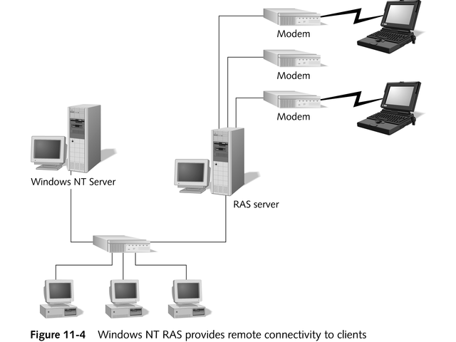
Remote Access Networking

Slide 27
Serial Line Internet Protocol (SLIP)
Dial-up protocol originally used to connect PCs directly to the Internet
Provides no error correction; relies on hardware for error checking and correction
Essentially a Physical layer protocol
Supports only connections for TCP/IP
Requires no addressing
Provides no compression unless a version called compressed SLIP (CSLIP) is used

Slide 28
Point-to-Point Protocol (PPP)
Remote access protocol that supports many protocols including TCP/IP, NetBEUI, and IPX/SPX
Provides both Physical and Data Link layer services
Inherently supports compression and error checking
Fast and reliable
Supports dynamic assignment of IP addresses

Slide 29
Creating Larger Networks
Physically expand to support additional computers
Segment to filter and manage network traffic
Extend to connect separate LANs
Connect two or more disjointed networking environments

Slide 30
Devices Used to Expand Network Capabilities
Repeaters
Bridges
Routers
Brouters
Gateways
Switches

Slide 31
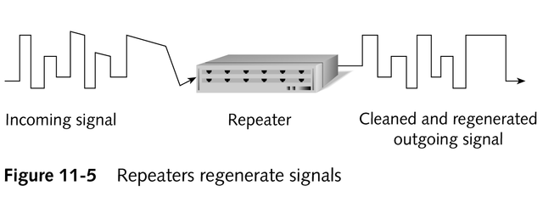
Repeaters
Accept a signal, clean it, regenerate it, and send it down the line
Increase length of the network by eliminating the effect of attenuation

Slide 32
Repeaters
Operate at Physical layer of OSI model without concern for type of data being transmitted, packet address, or protocol used
Cannot perform any filtering or translation on the data
Cannot connect different types of network architectures but can connect different physical media
Transmit data at same speed as network, but can create propagation delay

Slide 33
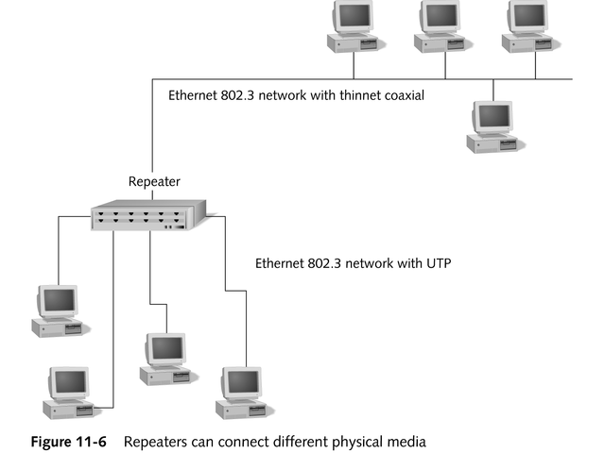
Repeaters

Slide 34
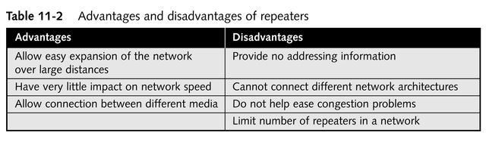
Advantages and Disadvantages of Repeaters

Slide 35
Bridges
Connect two network segments
Can connect dissimilar physical media
Can limit the traffic on each segment
Can eliminate bottlenecks
Can connect different network architectures and forward packets between them

Slide 36
Bridges
Work at the Data Link layer of the OSI model
Filter traffic according to the packet’s hardware destination address
Do not reduce network traffic caused by broadcast packets

Slide 37
Bridges
To determine on which network segment a computer exists
  Transparent bridging
    Generally used in Ethernet networks
    Builds bridging tables automatically as they receive packets
  Source-route bridging
    Used in IBM token ring networks
    Learns bridging information from information included in the packet’s structure

Slide 38
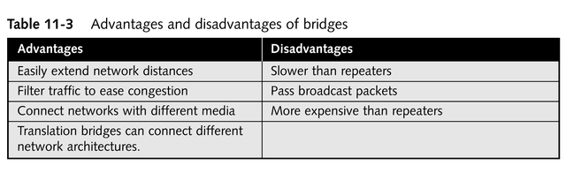
Advantages and Disadvantages of Bridges

Slide 39
Routers
Operate at Network layer of OSI model
Connect networks with different physical media
Translate between different network architectures (eg, token ring and Ethernet)
Repackage the data into different frames

Slide 40
Routers
Are able to choose the best path for a packet
  Routing Information Protocol (RIP)
    Distance-vector protocol
    Uses the number of routers (hops) along a path to determine cost
  Open Shortest Path First protocol (OSPF)
    A link-state routing protocol
    Determines a packet’s best path by taking other factors into account, such as line speed and network congestion
Discard any packets they do not understand or have a route for

Slide 41
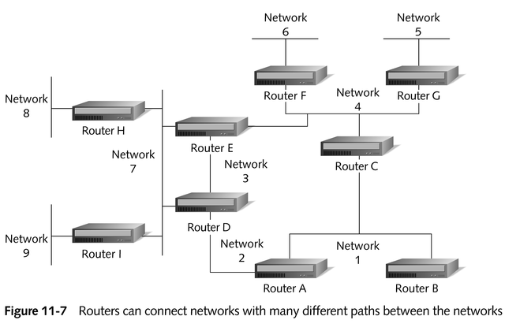
Routers

Slide 42
Routing Tables
Reference tables that include network information and the next router in line for a particular path
Ways of populating routing tables
  Static routing
  Dynamic routing

Slide 43
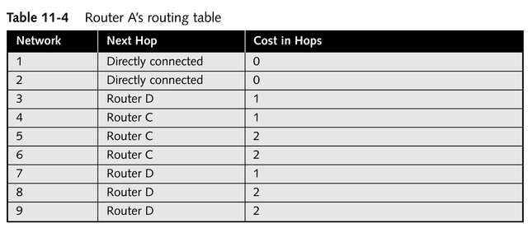
Sample Routing Table

Slide 44
Routable versus Nonroutable Protocols
Routable protocols
  Have Network layer information
Nonroutable protocols
  Have no Network layer information

Slide 45
Routable Protocols
TCP/IP
IPX/SPX
DECNet
OSI
DDP (AppleTalk)
XNS

Slide 46
Nonroutable Protocols
NetBEUI
DLC
LAT (Local Area Transport)

Slide 47
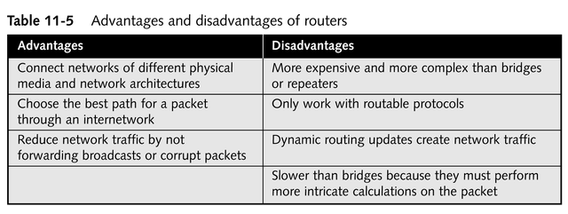
Advantages and Disadvantages of Routers

Slide 48
Brouters
Combine the best of bridges and routers
Route packets that include Network layer information and bridge all other packets
Maintain both a bridging table (hardware addresses) and a routing table (network addresses)
Especially helpful in hybrid networks using a mixture of routable and nonroutable protocols

Slide 49
Gateways
Translate information between protocols or between completely different networks, such as from TCP/IP to SNA
Change the actual format of the data
Operate at upper layers of the OSI model
Generally harder to install, slower, and more expensive

Slide 50
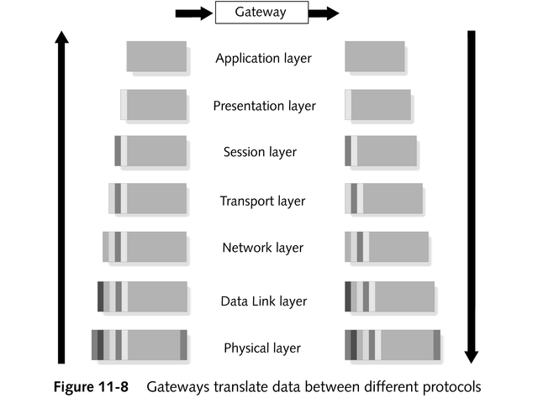
Gateways

Slide 51
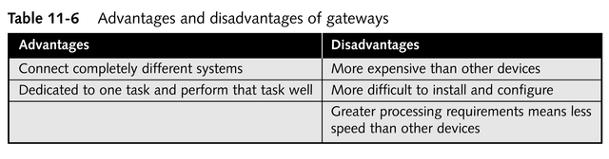
Advantages and Disadvantages of Gateways

Slide 52
Switches
High-speed, multiport bridges
Open and close electrical circuits, complete or break an electrical path, and select paths or circuits
Intelligent hubs that maintain a bridging table and keep track of which hardware addresses are located on which network segments
Can be configured to emulate multiple cable segments
Able to dedicate bandwidth to each port on the switch

Slide 53
Chapter Summary
Modems in network communications
Different types of communications lines or carriers
Remote access networking
Products that make it possible to expand networks and network segments: repeaters, bridges, routers, brouters, gateways, switches

