Slide 1
Chapter 12:
Wide Area and Large-scale Networks

Slide 2
Learning Objectives
Describe the basic concepts associated with wide area networks (WANs)
Understand the differences between analog, digital, and packet-switching WAN technologies
Identify the uses, benefits, and drawbacks of advanced WAN technologies such as ISDN, ATM, frame relay, FDDI, SONET, and SMDS

Slide 3
Wide Area Network Transmission Technologies
WAN
  A network that spans a large geographical area
Interface and access methods are same as a LAN; one distinction is the time delay
Technologies used to establish long-distance connections
  Packet-switching networks
  Fiber-optic cable
  Microwave transmitters
  Satellite links
  Cable television coax systems

Slide 4
WAN Transmission Technologies
Most organizations lease WAN links from a service provider because:
  Of the expense and complexity of purchasing, installing, and deploying their own long-distance cable or wireless connections
  A lease often includes unlimited use of the link

Slide 5
Primary Communication Technologies
Analog WAN connections
  Use conventional PSTN phone lines
  Offer little reliability or speed
Digital WAN connections
  Offer high-speed connections and much more reliable communications
Packet switching networks
  Fast, efficient, reliable

Slide 6
Analog Connectivity
Uses conventional Public Switched Telephone Network (PSTN) or POTS (plain old telephone system)

Slide 7
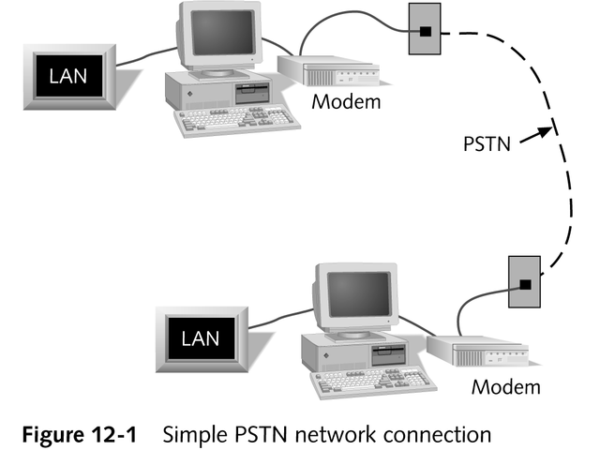
Analog Connectivity

Slide 8
Drawbacks of PSTN
Quality varies from location to location
Originally designed for voice-only; low-quality but economical choice for most WAN links
Requires modems; speed of data transmission is slow
A circuit-switched network; quality of connection is inconsistent
Can experience an error rate of up to 40%

Slide 9
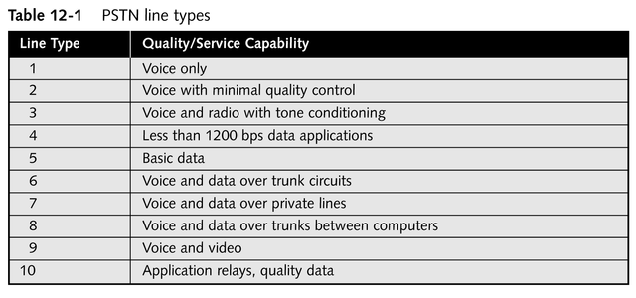
PSTN Line Types

Slide 10
How to Improve the
Quality of PSTN
Lease a dedicated line
  More expensive
  Usually guarantees reliable connection
  Offers higher-quality, more consistent data transmission
Line conditioning

Slide 11
Dial-up or Dedicated PSTN Connection?
Length of connection time required
Cost of service and usage levels
Availability of dedicated circuits, conditioning, or other quality improvements
Assessment of need for a 24-hour, seven-day connection

Slide 12
Digital Connectivity
Digital Data Service (DDS)
  A type of point-to-point synchronous communication link offering 2.4-, 4.8-, 9.6-, or 56-Kbps transmission rates
Nearly 99% error-free transmission of data
Uses special communication device called a CSU/DSU (Channel Service Unit/Data Service Unit)

Slide 13
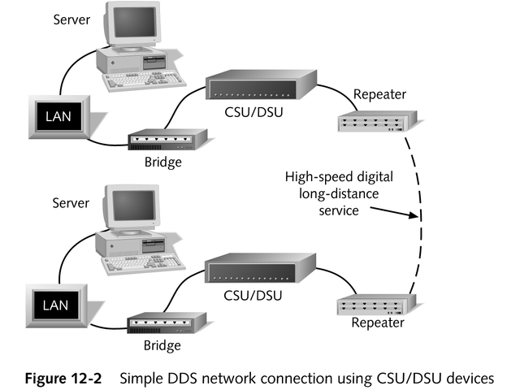
DDS

Slide 14
DDS Line Types
ISDN
T1
T3
Switched 56K

Slide 15
T1
Employs two 2-wire pairs to transmit full-duplex data signals at a maximum rate of 1.544 Mbps
Supports data, voice, and narrow-band video for moderate number of senders and receivers
Fairly expensive digital link
Consists of 24 individual channels

Slide 16
T1
Fractional T1 service
  A segmented T1 line where a customer uses or leases one to 23 channels of a T1 to achieve transmission rates in increments of 64 Kbps
Uses multiplexing to combine data transmissions from several sources and deliver them over a single cable

Slide 17
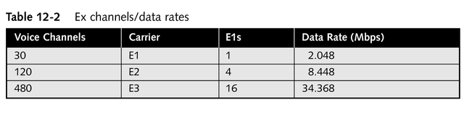
E1
Digital carrier technology used in some countries

Slide 18
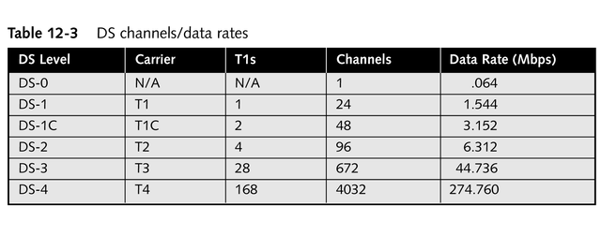
Channel Divisions
Rate of a full T1 using all 24 channels is known as DS-1

Slide 19
T3
A communications line comprised of 28 T1s or 672 channels
Supports data rates of 44.736 Mbps

Slide 20
Switched 56k
Digital point-to-point leased communication links offered by local and long-distance telcos
Lease terms are based on per-minute use charges, not on 24-hour, seven-day dedicated circuits

Slide 21
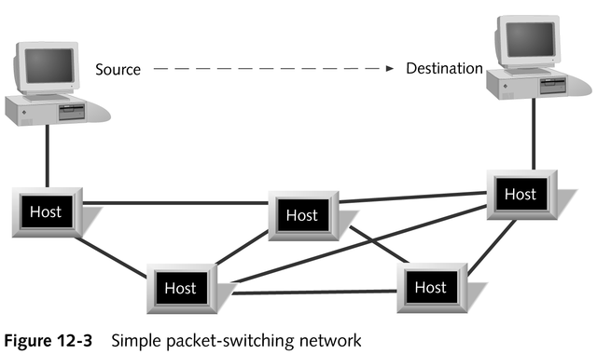
Packet-switching Networks
Often used to communicate data over both short and long distances

Slide 22
How a Packet-switching Network Handles Data
Original data is segmented into packets
Each packet is labeled with a sequence order and a destination address
Each packet is individually sent on the network toward the destination
Host receives the packet, reads its header, and either keeps it or sends it on
Destination machine uses sequence information in packets’ headers to reconstruct original data; requests retransmission of missing/damaged packets

Slide 23
Benefits of
Packet-switching Networks
Data delivery does not depend on any single pathway between the origin and the destination
Packets are small; retransmission request can be serviced with minimal time loss

Slide 24
Virtual Circuits
Consist of a logical sequence of connections with bandwidth allocated for a specific transmission pathway
Incorporate communication parameters that govern receipt acknowledgments, flow control, and error control
Two types
  Switched virtual circuits
  Permanent virtual circuits

Slide 25
Virtual Private Networks (VPNs)
Connections across a public network (such as the Internet) that act as if they were completely private
Use special encryption technology to transmit and receive data
Extend the reach of private networks across public ones, easily and transparently
VPN protocols
  Point-to-Point Tunneling Protocol (PPTP)
  Layer 2 Tunneling Protocol (L2TP)

Slide 26
Advanced WAN Technologies
X.25
ISDN (Integrated Services Digital Network)
Frame relay
ATM (Asynchronous Transfer Mode)
FDDI (Fiber Distributed Data Interface)
Synchronous Optical Network (SONET)
Switched Multi-megabit Data Service (SMDS)

Slide 27
X.25
Offers 64-Kbps network connections
Uses error checking
Used most often to connect remote terminals with centralized mainframes
Are SVC (switched virtual circuit) networks
Usually associated with PDNs (public data networks)

Slide 28
X.25
Types of data terminal equipment (DTEs) and data communications equipment (DCEs) used to connect to an X.25 network
  An X.25 network interface card (NIC) in a computer
  A PAD (packet assembler/disassembler) supports X.25 communications for low-speed character-based terminals
  A LAN/WAN X.25 gateway

Slide 29
X.25
Use is declining due to:
  Speed limitations
  Availability of other, higher-speed technologies such as frame relay and ATM

Slide 30
ISDN
Offers increments of 64-Kbps connections, most often for SOHO (small office/home office) users
Cost-effective if used as a dial-up, non-dedicated link
Available in two formats
  Basic Rate Interface (BRI)
  Primary Rate Interface (PRI)

Slide 31
Frame Relay
Offers transmission rates of 56 Kbps to 1.544 Mbps
Uses no error checking
A point-to-point PVC (permanent virtual circuit)
Uses variable-length packets or frames for data transmission at the Data Link layer of the OSI model
Allows customer to specify bandwidth needed
Fast, reliable, inexpensive

Slide 32
ATM
Uses fiber-optic media to support up to 622-Mbps transmission rates
Uses no error checking
Has a 53-byte fixed-length cell
Supports full range of data communication types
Uses hardware switching devices to transmit data at the Data Link layer of the OSI model

Slide 33
FDDI
A limited-distance linking technology that connects LANs with high-speed ring networks (not a WAN technology)
Provides 100-Mbps fault-tolerant transmission rates
More than one computer can transmit data (or a token) at a time

Slide 34
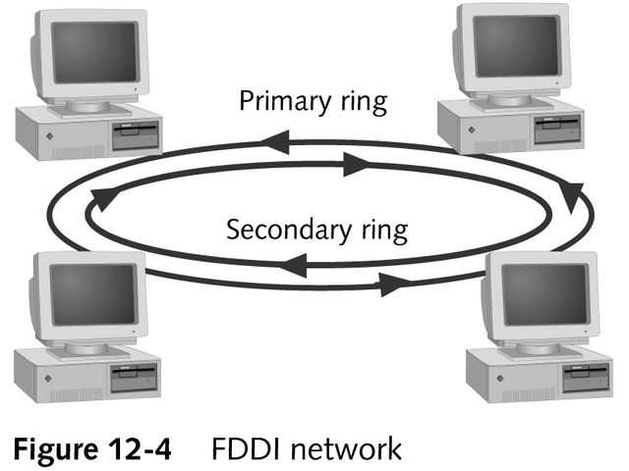
FDDI
Made up of two concentric rings
  Primary ring
  Secondary ring

Slide 35
SONET
Used to interface with dissimilar long-distance networks
Offers transmission speeds in multiples of 51.84 Mbps using fiber-optic media

Slide 36
SMDS
Similar to ATM in that it has a 53-byte fixed-length cell and no error checking
Offers transmission rates of 1.544 Mbps to 45 Mbps
Offers inexpensive, high-speed network connections

Slide 37
Chapter Summary
Basic concepts and terminology of WAN transmission, connections, and components
Features and benefits of each of the major WAN technologies

