Slide 1
Chapter 13:
Solving Network Problems

Slide 2
Learning Objectives
Discuss the benefits of network management and planning
Understand the necessity for networking standards, policies and procedures, and documentation
Troubleshoot your network following a structured approach
Discuss the types of specialized equipment and other resources available for troubleshooting

Slide 3
Preventing Problems With Network Management and Planning
Prevent problems through planning and management (pre-emptive troubleshooting or trouble avoidance)
  Form an overall network plan
  Establish network policies and procedures
Repair and control damage that already exists (troubleshooting)

Slide 4
Components of a Network Plan
Cable diagrams
Cable layouts
Network capacity information
List of all protocols and network standards in use
Documentation on computer and network device configuration, software, and important files

Slide 5
Components of Network Policies and Procedures
Back-up methods
Security
Hardware and software standards
Upgrade guidelines
Documentation

Slide 6
Backing Up Network Data
Determine what data should be backed up and how often
Develop a schedule that includes type of backup, how often, what time of day
Identify person(s) responsible
Test back-up system regularly
Maintain a back-up log listing what data was backed up, when it took place, on which tapes
Develop a plan for storing backed up data

Slide 7
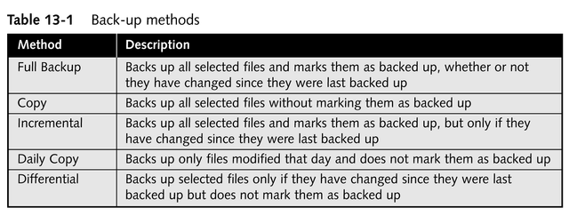
Back-up Methods

Slide 8
Setting Security Policies
Depend on value and sensitivity of the data, network size, company’s security standards
Develop standards for user security, including dial-in users, if necessary
Establish guidelines for resource access
Restrict the number of users with permission to perform network administration tasks

Slide 9
Standards for User Security
Establish minimum and maximum password lengths for user accounts
Determine how often users should change passwords
Decide whether users can reuse passwords
Be aware of character restrictions
Determine if more than one set of standards applies to user passwords
Decide how to define/document exceptions

Slide 10
Setting Hardware and
Software Standards
Establish configuration for several levels of users
Establish standards for networking devices
Define standards for server configurations
  Document current configuration
  Establish guidelines for new installations
Evaluate standards often to keep up with the pace of industry change

Slide 11
Establishing Upgrade Guidelines
Give users advance notice
Perform disruptive upgrades during off hours
Pilot new upgrades with a small group of technically astute network users
Formulate a plan to undo the installation if necessary

Slide 12
Maintaining Documentation
Address list
Cable map
Contact list
Equipment list
Network history
Network map
Networking hardware configuration
Policies and procedures
Server configuration
Software configuration
Software licensing
User administration

Slide 13
Performing Pre-emptive Troubleshooting
Saves time when problems do arise
Prevents equipment problems
Ensures data security
ISO’s categories
  Accounting management
  Configuration management
  Fault management
  Performance management
  Security management

Slide 14
Network Monitoring Utilities
Help identify conditions that may lead to problems
Prevent network failures
Troubleshoot problems when they occur
Are long-term troubleshooting tools
  Establish a baseline
  Monitor for changes

Slide 15
Network Monitoring Utilities
Gather information on:
  Events
  System usage statistics
  System performance statistics
Use this information to:
  Identify devices that create bottlenecks
  Forecast growth and plan capacity requirements
  Develop plans to improve network performance
  Monitor events that arise from software/hardware changes
  Monitor trends in network traffic and utilization

Slide 16
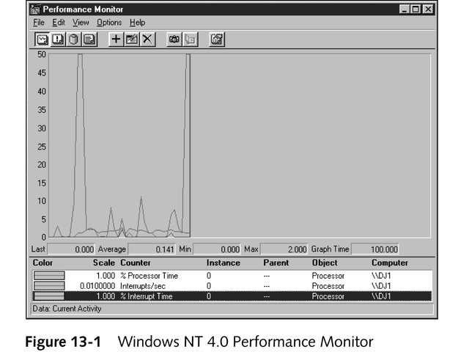
Network Monitoring Utilities

Slide 17
Creating a Network Baseline
Provides a measurement of network performance over time, against which current performance can be measured

Slide 18
Monitoring with SNMP
SNMP = Simple Network Management Protocol
A specialized TCP/IP protocol suite used for network monitoring and management
Can manage and monitor most network devices

Slide 19
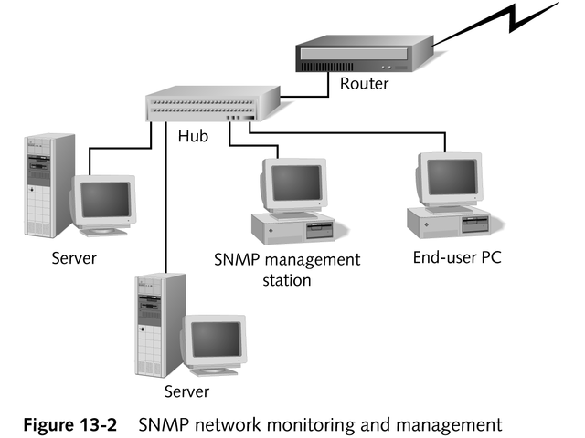
Monitoring with SNMP

Slide 20
Network Troubleshooting
Methodology: don’t panic!
Use of special tools

Slide 21
Troubleshooting Methodology
Eliminate any potential user errors
Verify that physical connections are indeed working
Verify status of any suspect NICs
Restart the computer

Slide 22
Five-step Structured Troubleshooting Approach
Set the problem’s priority
Collect information about the problem
Develop a list of possible causes
Test each hypothesis to isolate the actual cause
For each potential cause, attempt at least one solution

Slide 23
Using Special Tools
Digital voltmeter (DVM) or volt-ohm meter (VOM)
Time-domain reflectometer (TDR)
Advanced cable testers
Oscilloscopes
Network monitors
Protocol analyzers

Slide 24
Digital Voltmeter
Measures voltage, amperage, and resistance on a cable or other conductive element
Can determine if a cable break occurred

Slide 25
Time-domain Reflectometer
Can determine whether there is a break or short in the cable
Can pinpoint how far from the device the break is by sending an electrical pulse down the cable that reflects back when it encounters a break or short

Slide 26
Advanced Cable Testers
Test for cable defects
Monitor network collisions
Monitor network congestion
More expensive than DVMs or TDRs

Slide 27
Oscilloscopes
Measure the signal voltage per amount of time
Used in conjunction with a TDR to help identify shorts, sharp bends, or crimps in a cable, cable breaks, and attenuation problems

Slide 28
Network Monitors
Software that monitors network traffic and gathers information about packet types, errors, and packet traffic to and from each computer

Slide 29
Protocol Analyzers
Software, or combination of hardware and software, that can capture network traffic and create reports and graphs from the data collected
Examples
  Network Associates Sniffer
  WildPacket’s EtherPeek
  Shomiti Systems, Inc. Surveyor

Slide 30
Network Support Resources
Software products
Online services
Subscription services
Printed material

Slide 31
Microsoft TechNet (Technical Information Network)
Subscription information service for supporting all aspects of networking, with emphasis on Microsoft products
Supplied via monthly CD-ROMs; also available online

Slide 32
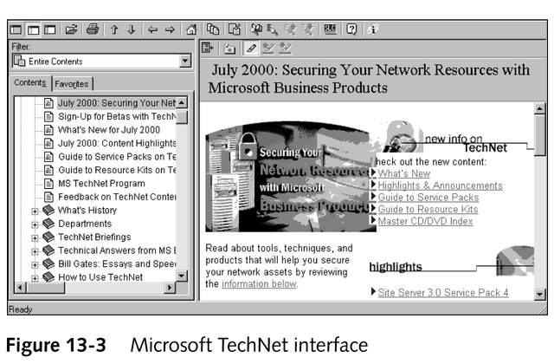
Microsoft TechNet

Slide 33
Microsoft Knowledge Base (KB)
An online reference for Microsoft and networking information
Information is gleaned from technical support staff’s interaction with customers

Slide 34
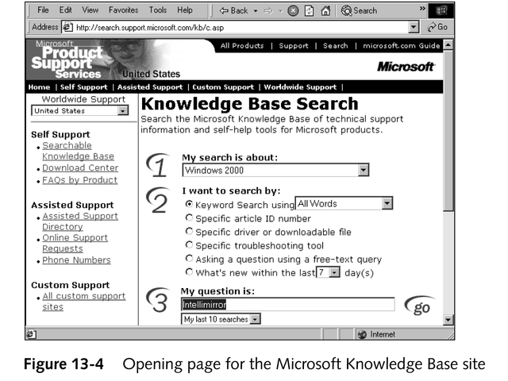
Microsoft Knowledge Base

Slide 35
Linux Information Resources
www.linux.com
Everything Linux
www.linuxcare.com

Slide 36
Online Support Services and Newsgroups
Microsoft Developer’s Network (MSDN)
  msdn.microsoft.com
Microsoft newsgroups
  microsoft.public.win2000
  microsoft.public.windowsnt
  microsoft.public.win98.networking
  microsoft.public.win98.setup
  microsoft.public.win16.programmer.networks
  microsoft.public.win32.programmer.networks
Windows Mailing list at Sunbelt software
  www.sunbelt-software.com

Slide 37
Periodicals
Networking journals
  LAN Magazine
  LAN Times
  Communications Week
  InfoWorld
  PC Week
  PC Magazine (Networking Edition)
  Network Computing

Slide 38
Periodicals
Focus on Windows
  Windows Systems
  Windows 2000 Magazine
Linux magazines
  Linux Gazette
  Linux Journal
  Linux World

Slide 39
Common Troubleshooting Situations
Cabling and related components
Power fluctuations
Upgrades
Poor network performance

Slide 40
Cabling and Related Components
Majority of networking problems occur at the Physical layer of the OSI model and include problems with
  Cables
  Connectors
  NICs

Slide 41
Power Fluctuations
Connect servers to Uninterruptible Power Supplies (UPSs)

Slide 42
Upgrades
Test any upgrade before deploying it on your production network
Tell users about upgrades

Slide 43
Poor Network Performance
Change is most common cause
  Adding new equipment or software
  Upgrading existing software or equipment
  Changes in workload or workplace behavior

Slide 44
Chapter Summary
Preventing problems with network management
  Proper planning
  Documentation
  Backing up network data
  Monitoring the network
Dealing with network management problems
  Methodology for troubleshooting networks
  Network support tools and resources
  Common troubleshooting situations

