Slide 1
Chapter 14:
Understanding and Using Internet Resources

Slide 2
Learning Objectives
Discuss the Internet and its available services
Access resources on the Internet and understand its addressing methods
Establish and use an Internet connection

Slide 3
Value of the Internet to Network Administrators
Retrieve drivers and software updates
Get technical support
Read periodicals
Discuss problems and ideas through newsgroups

Slide 4
What’s on the Internet?
Chat and instant messaging with ICQ and IRC
Electronic mail
File Transfer Protocol (FTP) for file transfer
Newsgroups
Telnet for remote access
World Wide Web (with HTTP)

Slide 5
Chat and Instant Messaging
Provide the ability to interact with others in real time
Applications range from virtual classrooms to kibitzing

Slide 6
E-mail
Becoming the preferred method of communication for individuals and organizations
Allows easy communication with anyone anywhere who is connected to the Internet
Supported by an upper-layer protocol called Simple Mail Transfer Protocol (SMTP)
  MIME (Multipurpose Internet Mail Extensions) is the corresponding standard governing attachments to e-mail

Slide 7
File Transfer Protocol Servers
FTP’s primary application is to access files or deposit files on remote servers
Popular use is to provide users with software drivers or updates

Slide 8
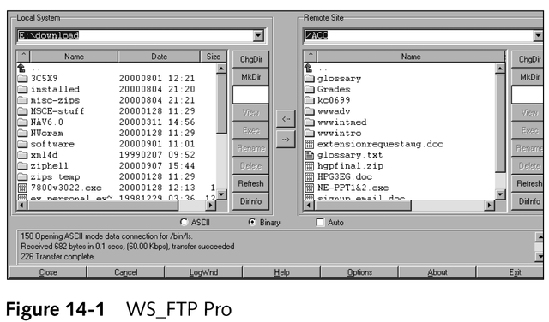
A Graphical FTP Utility

Slide 9
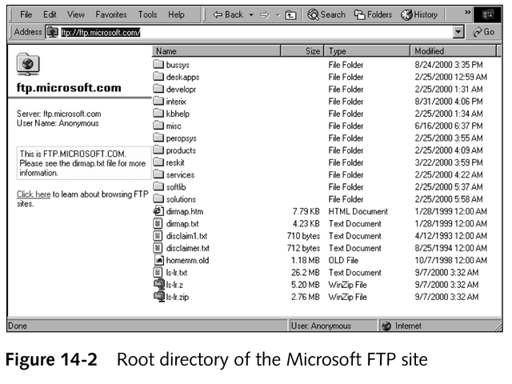
An Internet Browser Supporting a FTP File Transfer

Slide 10
Newsgroups
Discussion groups in which people share information through USENET
Organized in a hierarchical structure, alphabetically by category
See www.deja.com for a complete listing
Network News Transfer Protocol (NNTP)
  Distributes, retrieves, inquires, and posts network news articles

Slide 11
Telnet
Permits users to run programs, execute commands, and interact with remote systems elsewhere on the Internet or on any other TCP/IP-based network

Slide 12
World Wide Web
Consists of millions of documents written in the HyperText Markup Language (HTML)
HyperText Transfer Protocol (HTTP)
  Primary protocol for documents on the WWW
Search engine
  A special-purpose program that solicits strings of text from users and searches a large, indexed collection of files and documents, looking for exact/near matches for that string, in an attempt to help users find resources related to the string

Slide 13
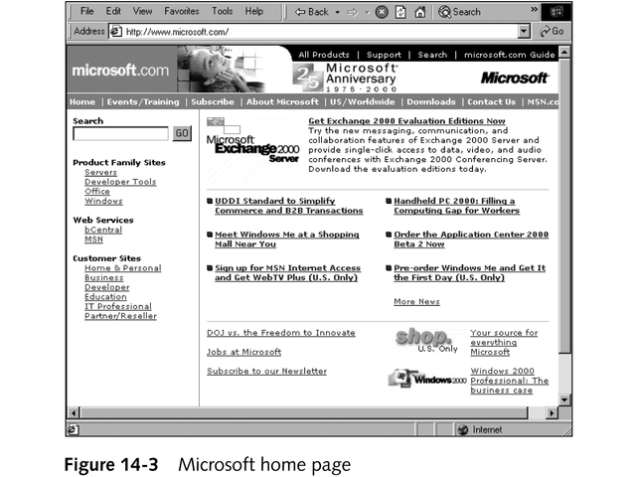
Example of a Home Page

Slide 14
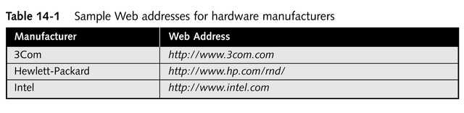
World Wide Web
Most hardware and software vendors publish Web sites

Slide 15
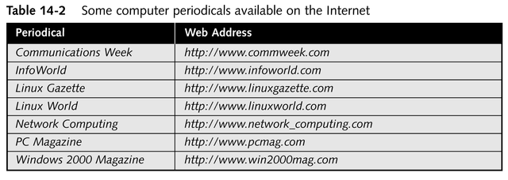
World Wide Web
Many trade periodicals publish their normal content outline or offer special Internet editions on their Web sites

Slide 16
Locating Internet Resources
Each resource must have an Internet address, generally represented as resource names, with corresponding TCP/IP numeric addresses

Slide 17
Internet Resource Names
Have an associated address called the Uniform Resource Locator (URL)
URL specifications
  Which server to access
  Which protocol to use to access its named location

Slide 18
Domain Name System (DNS)
Used on a network to resolve symbolic names to their corresponding IP addresses

Slide 19
Domain Names
Common domain types in the US
  .com
  .edu
  .gov
  .mil
  .net
  .org
Country-specific strings
  .au
  .fr
  .uk

Slide 20
Making an Internet Connection
ISPs
  Maintain dial-up and dedicated links for users
  Permit users to piggyback on their own, direct, dedicated links to the Internet, primarily as a for-a-fee service
Common ways to connect to an ISP
  Dial-up lines using modems
  Integrated Services Digital Network (ISDN), cable modem, or digital subscriber line (DSL) connections

Slide 21
Dial-up Connections
Most prevalent protocols
  Point-to-Point Protocol (PPP)
    Dial-up protocol of choice for most ISPs
    Supports compression, error checking, and dynamic IP address assignment
  Serial Line Internet Protocol (SLIP)
  Compressed SLIP (CSLIP)

Slide 22
Digital Connection Types
ISDN connections
  Provide digital lines for voice or data transmission
  Can achieve much higher speeds than with standard dial-up links, up to 128 Kbps (not including compression)
Greatest limitations of ISDN
  Cost
  Availability

Slide 23
Connection Considerations
Bandwidth requirements
  Dial-up connections
    More cost-effective and easier to implement for single-user accounts
  Digital connections
    Preferable for multiple users because they are faster and offer more bandwidth
Security requirements
  Use firewall/proxy server combinations to isolate internal networks from external Internet

Slide 24
Chapter Summary
Popular Internet services
Locating Internet resources
Making an Internet connection

