Slide 1

Team: Jahanzaib, Nurlan, Abdul Hakim

Slide 2

Objectives
Introduction
Importance of AR
Current uses of AR
Use of AR at UCA
Conclusion

Slide 3
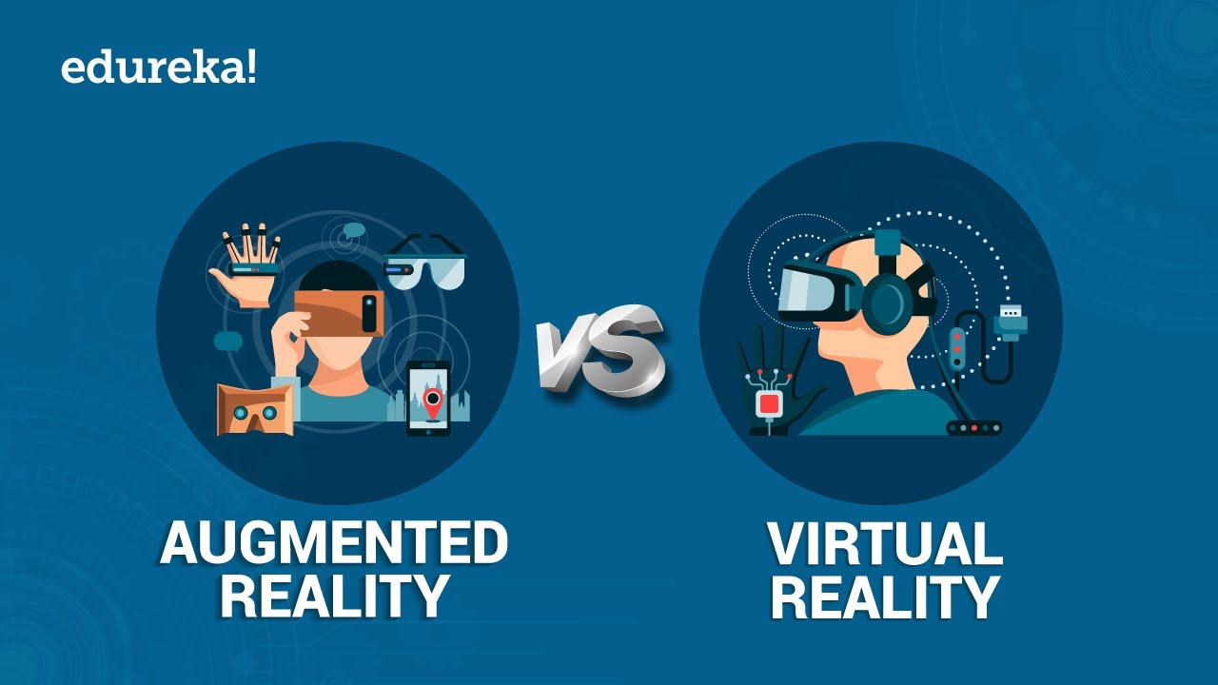
Introduction
A combination of
a real scene viewed by a user and
a virtual scene generated by a computer that augments the scene with additional information
Key point: The user must be aware that he/she is still present in the real world.
The basic idea of augmented reality is to superimpose graphics, audio and other sense enhancements over a real-world environment in real-time.
The graphics will then change to accommodate the user’s eye or head movements.
Difference of Augmented Reality from Virtual Reality.

Slide 4
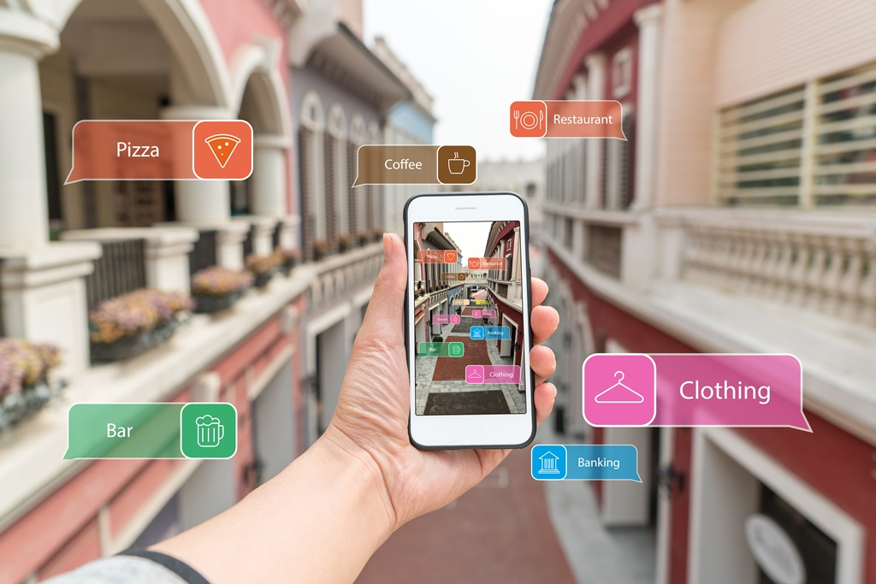
Usess of AR
Companies
Healthcare
Military
Design Modeling
Repair and Maintenance

Slide 5
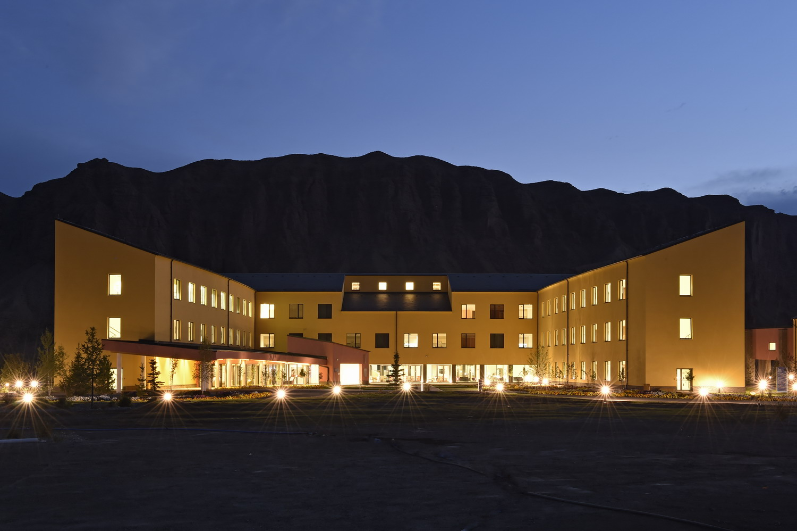
AR at UCA
Location Tracking
Classroom Teaching
Hiring/Training staff
Repairing and maintenance (Safety)
Remote Calls
Conferences

Slide 6


